Slide 1
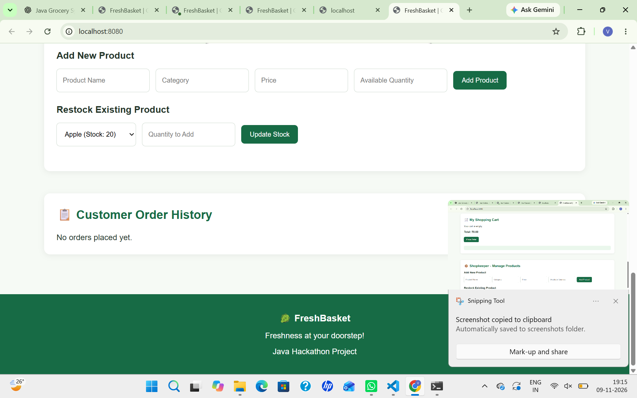
FreshBasket
Fresh groceries,
delivered simply.
A web-based grocery shopping and inventory management application.

Slide 2
01 • INTRODUCTION
Project overview
One platform for everyday grocery shopping and store operations.
CUSTOMER
SHOPKEEPER
Browse products, check prices and availability, add items to cart and place orders.
Add new products and restock existing inventory.
FreshBasket brings product discovery, cart management, order placement and stock control into a simple browser-based experience.
PRODUCT CATALOG
ORDER HISTORY
Products are displayed with category, price and available quantity.
A dedicated area shows customer order history.
Demo environment: localhost:8080
The interface is designed around a clear, green grocery-store theme.
FRESHBASKET
02

Slide 3
02 • WHY THIS PROJECT
Problem statement & proposed solution
THE CHALLENGE
THE FRESHBASKET APPROACH
• Customers need a quick way to find grocery items.
• Product price and stock availability should be easy to check.
• Store staff need a straightforward way to add products and update stock.
• Order details should be accessible after checkout.
• A searchable, filterable product catalog.
• Clear product cards showing category, price and quantity.
• A shopping cart with an order placement action.
• Shopkeeper tools for adding products and restocking inventory.
• A customer order-history section.
Goal: make grocery shopping and basic inventory tasks simpler through one application.
FRESHBASKET
03

Slide 4
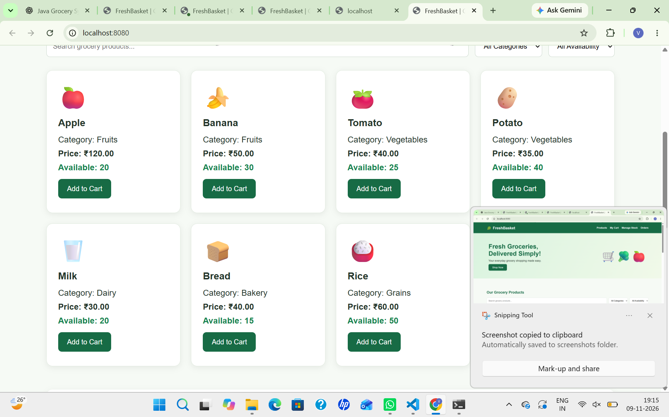
03 • PRODUCT CATALOG
Customer experience: browse products
PRODUCT DISCOVERY
Search grocery products by name.
Filter products by category.
View availability status and stock quantity.
Compare prices before adding items.
Add selected products to the cart.
FRESHBASKET
04

Slide 5
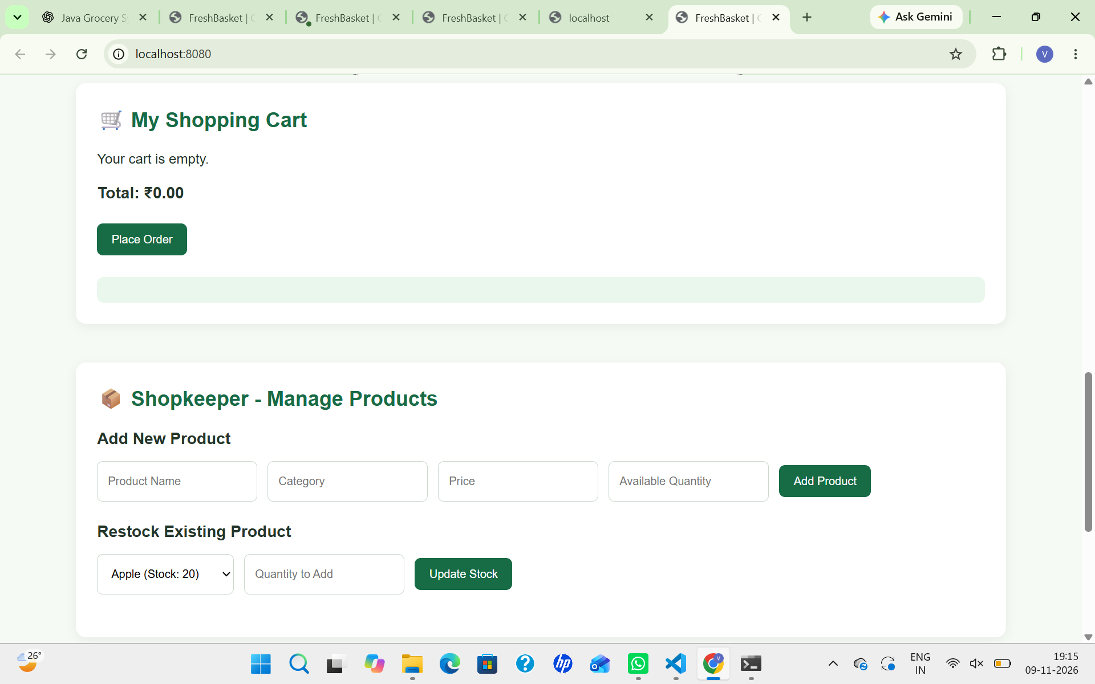
04 • CHECKOUT FLOW
Shopping cart & order placement
CUSTOMER CHECKOUT
Review items in the shopping cart.
See the total order value.
Use the Place Order action to submit the order.
Order history provides a place to review past orders.
Current screenshot shows an empty cart state.
FRESHBASKET
05

Slide 6
05 • INVENTORY MANAGEMENT
Shopkeeper: manage products & stock
STORE OPERATIONS
Add a product with name and category.
Enter the product price.
Set the available quantity.
Select an existing product to restock it.
Update stock by entering the quantity to add.
FRESHBASKET
06

Slide 7
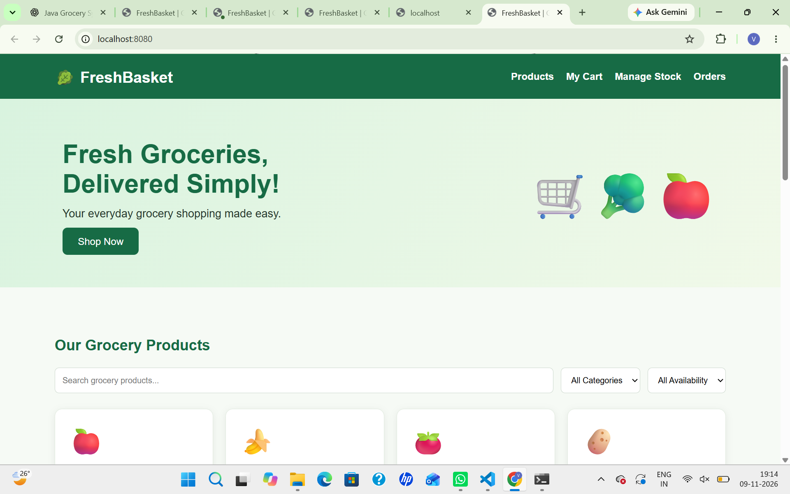
06 • ORDER TRACKING
Customer order history
A CLEAR PLACE FOR PAST ORDERS
The application includes a Customer Order History section so customers can revisit their order activity.
The supplied demo screenshot currently shows the empty state: “No orders placed yet.”
FRESHBASKET
07

Slide 8
07 • HOW IT WORKS
End-to-end application workflow
1
2
3
4
5
Browse
Discover
Add to cart
Place order
Manage stock
Customer opens the product catalog.
Search and filter products; check price and stock.
Select products for the shopping cart.
Review total and submit the order.
Shopkeeper adds products or restocks items.
Customer-facing shopping features and shopkeeper inventory tools are presented within the same FreshBasket experience.
FRESHBASKET
08

Slide 9
08 • ROADMAP
Future enhancements
PAYMENTS
DELIVERY
CUSTOMER ACCOUNTS
Integrate secure online payment options and payment confirmation.
Add delivery address, delivery slots and order status tracking.
Introduce sign-in, profiles and saved addresses.
REPORTS
RICHER CATALOG
TESTING & SECURITY
Provide sales summaries and low-stock alerts for shopkeepers.
Add product images, descriptions and sorting options.
Expand validation, automated testing and access control.
FRESHBASKET
09

Slide 10
FRESHBASKET
Thank You!
Freshness at your doorstep!
Questions & feedback

