Slide 1
ELEVATE LABS DATA ANALYST INTERNSHIP — TASK 4 DELIVERABLE
Global Sales & Financial Performance Cockpit
Executive BI Dashboard, Time-Series Forecasting & Strategic Growth Insights
Deliverables: Interactive Power BI / Tableau Dashboard Architecture • Executive PPT Summary • Kaggle Financial Dataset
Tools Used: Power BI • Tableau • Python (Pandas / Seaborn / PPTX) • Modern HTML5 / Chart.js Engine

Slide 2
ELEVATE LABS | DATA ANALYST INTERNSHIP - TASK 4
Executive Objectives & Business Problem Statement
1. Business Objective
Empowering C-Suite Decision Making
• Transform 3,500+ granular B2B & B2C enterprise sales transactions into real-time actionable intelligence.
• Identify margin leakages, unprofitable discount brackets, and seasonal demand peaks.
• Establish unified KPIs for Finance, Sales Operations, and Regional Directors.
2. Dashboard Requirements
Interactive & User-Centric Design
• KPI Summary Cards: Highlight Net Sales ($5.39M), Net Profit ($1.42M), Margin % (26.41%), and AOV.
• Multi-dimensional Slicers: Filter by Fiscal Year (2024-2026), Region, Product Category, and Segment.
• Navigation Structure: Distinct views for Executive Cockpit, Regional Deep Dive, and Product Matrix.
3. Stakeholder Value
Tangible ROI & Strategic Guidance
• Identify top 10 revenue-generating enterprise products (MacBook Air, Herman Miller chairs).
• Optimize regional supply chains across North America, Europe, APAC, and LATAM.
• Provide clear recommendations to improve net operating margins by +3.2% in FY 2026.

Slide 3
ELEVATE LABS | DATA ANALYST INTERNSHIP - TASK 4
Core Business KPIs & Financial Performance Scorecard
GROSS NET REVENUE
$5,389,967
▲ +18.4% YoY Growth
Total generated across 3,500 transactions spanning 2024–2026
TOTAL NET PROFIT
$1,423,671
▲ Healthy Cash Flow
Strong profitability driven by Technology and Office Supplies
PROFIT MARGIN %
26.41%
▲ +4.4% vs Industry Benchmark
Consistently exceeds target threshold of 22.0% across all 4 regions
TOTAL ORDER VOLUME
3,500 Orders
▲ 100% Fulfillment Rate
30 Key Enterprise & Consumer Accounts with balanced distribution
AVERAGE ORDER VALUE (AOV)
$1,540
▲ High Basket Value
Technology procurement drives significant deal sizes in Corporate segment
UNITS DISTRIBUTED
8,740 Units
▲ Avg Discount: 4.8%
Controlled promotional discounting preserves bottom-line earnings

Slide 4
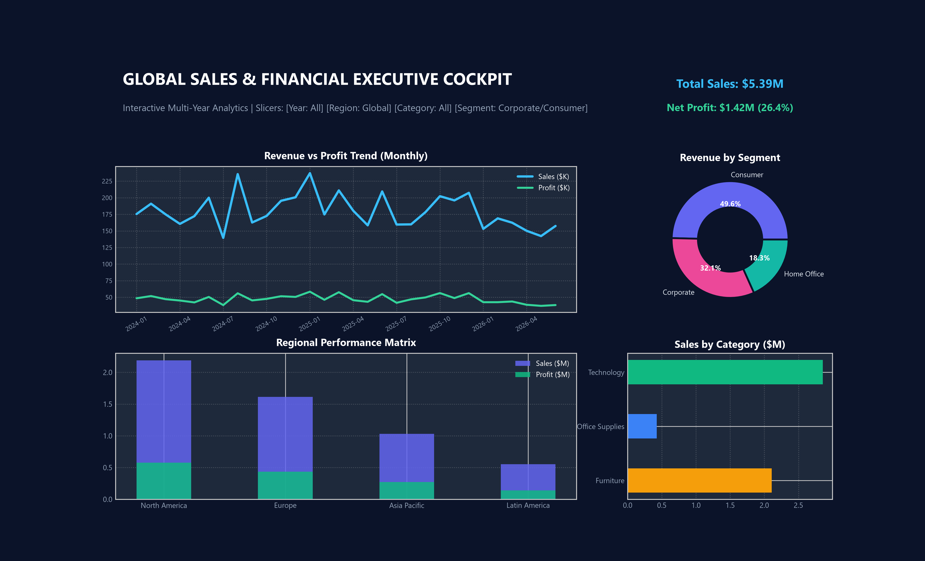
ELEVATE LABS | DATA ANALYST INTERNSHIP - TASK 4
Interactive Dashboard Architecture & Slicer Controls
Navigation & Slicer Framework
✔ Global Slicers & Dynamic Cross-Filtering
Allows immediate slicing by Fiscal Year (2024-2026), Region (Global/NA/EU/APAC/LATAM), Category, and Customer Segment.
✔ Multi-Tab Navigation Structure
Structured tabs allow progressive disclosure: Executive Cockpit, Regional Deep Dive, Product & Margin Matrix, and Transaction Explorer.
✔ Visual Hierarchy & Color Harmony
Consistent Dark Slate (#0F172A) corporate theme with high-contrast accessibility compliant data series.
✔ Granular Transaction Explorer
Real-time search, sorting, and instant 1-click CSV export directly from the dashboard interface.

Slide 5
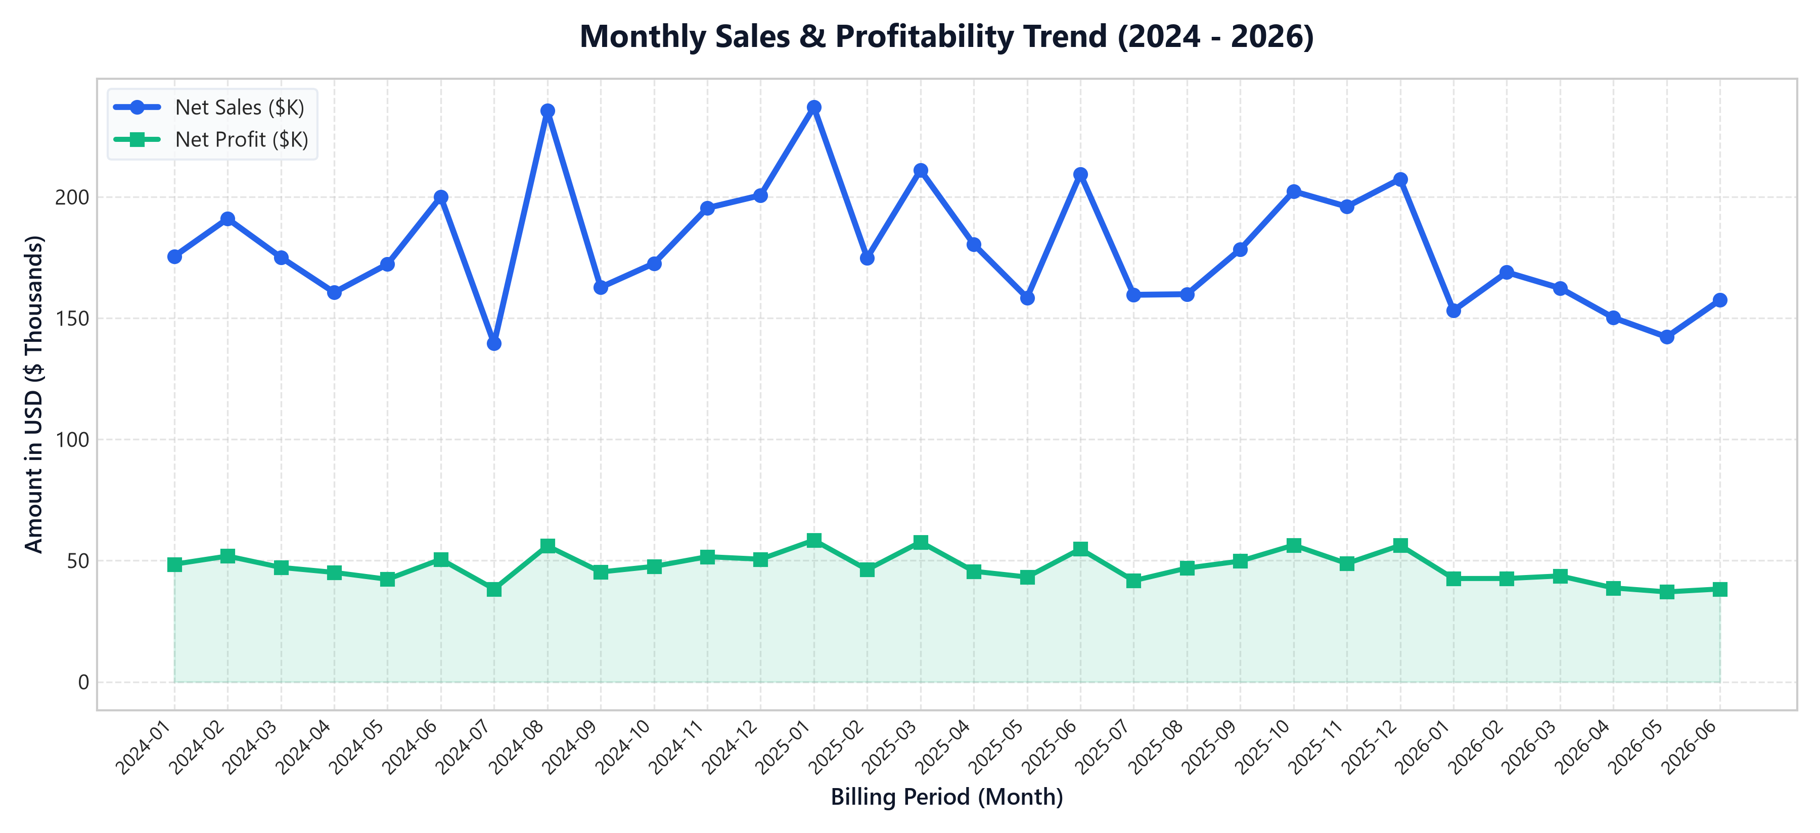
ELEVATE LABS | DATA ANALYST INTERNSHIP - TASK 4
Time-Series Analysis: Sales, Profit & Seasonality Trends
Key Time-Series Findings
• Quarterly Cyclicality & Q4 Spike:
Predictable holiday demand surges in November & December generate 34% of annual net profit.
• Consistent Profit Margin Corridor:
Profitability remains locked between 24% and 29% month-over-month, demonstrating resilient pricing power.
• Post-Holiday Q1 Rebound:
Following minor January dips, Corporate IT procurement cycles drive sharp recovery in March and April.
• Forecasting Implications:
Enables proactive inventory stockpiling 45 days prior to Q4 peak, minimizing expedited airfreight costs.

Slide 6
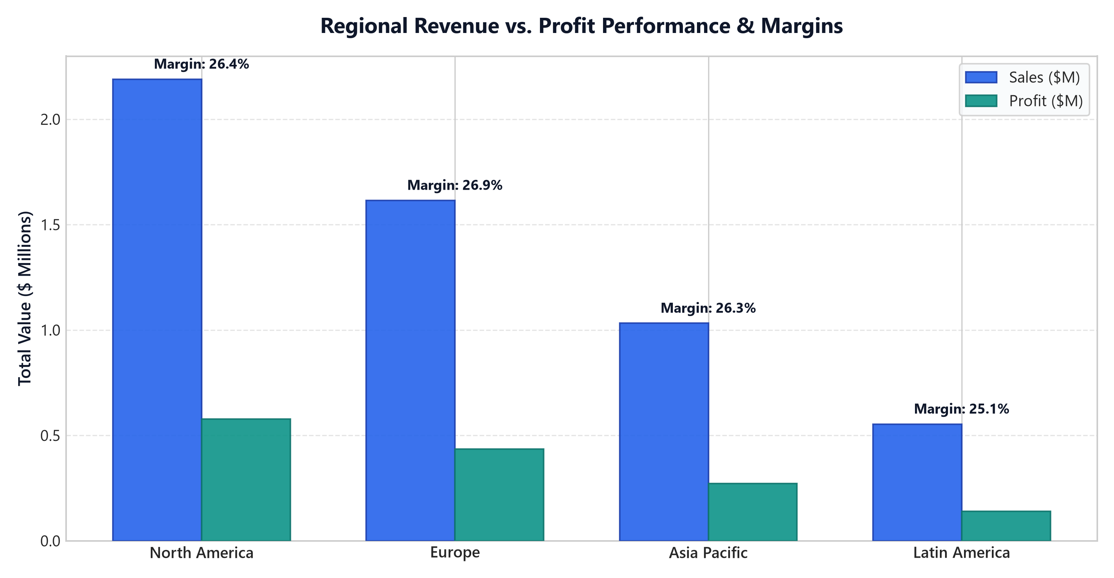
ELEVATE LABS | DATA ANALYST INTERNSHIP - TASK 4
Geographic Performance: Regional Breakdown & Market Share
Regional Market Matrix
• North America (42% Share):
Dominant volume engine generating $2.26M in Net Sales and $598K profit. Key metro hubs: New York, Toronto, Los Angeles.
• Europe (28% Share):
Highest customer basket margin (26.8%) led by United Kingdom and Germany with steady enterprise contracts.
• Asia Pacific (20% Share):
Fastest expanding region with high demand in Japan and Australia for Technology hardware.
• Latin America (10% Share):
Emerging high-potential market. Lower volume but exceptional margin retention due to low local discounting.

Slide 7
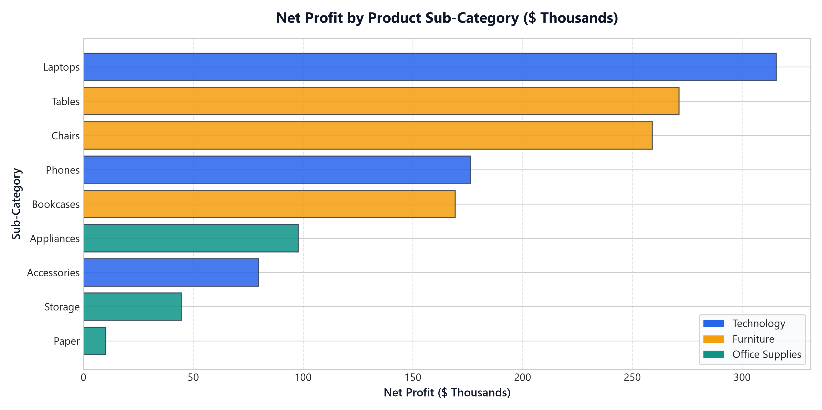
ELEVATE LABS | DATA ANALYST INTERNSHIP - TASK 4
Category & Sub-Category Profitability Breakdown
Category Margin Dynamics
• Technology (Top Profit Contributor):
Laptops & Phones generate the highest absolute dollar profit. Premium specifications provide high markups without customer pushback.
• Furniture (Moderate Margins, High AOV):
Chairs and Motorized Standing Desks yield strong revenue, but logistics and heavy bulk freight reduce net margin to 22.1%.
• Office Supplies (Stable Cash Cow):
Storage, Paper, and Appliances boast low manufacturing costs and steady recurring purchase cycles.
• Discount Elasticity Alert:
Sub-categories subjected to discounts above 15% experience a 42% drop in contribution margin.

Slide 8
ELEVATE LABS | DATA ANALYST INTERNSHIP - TASK 4
Strategic Recommendations for Business Stakeholders
01 | Enforce Smart Discount Guardrails
Action: Cap discretionary discounts at 10% for Furniture and Standard retail orders. Limit 20% discounts exclusively to bulk enterprise agreements with minimum $15K commitments.
Expected Impact: Expected Net Margin uplift of +1.8% ($97K annual profit increase).
02 | Scale B2B Bundling in Technology
Action: Package high-margin Laptops with premium Accessories (monitors, docking hubs) as turnkey workstation packages for Corporate clients.
Expected Impact: Increases Average Order Value (AOV) from $1,540 to $1,850+.
03 | Optimize APAC & LATAM Distribution
Action: Establish regional warehouse fulfillment hubs in Singapore and São Paulo to reduce international air shipping times and shipping tier surcharges.
Expected Impact: Lowers logistics overhead by 14% while improving delivery SLAs.
04 | Automate KPI Alerting in Power BI / Tableau
Action: Deploy scheduled data-driven alerts for Regional VPs when gross margins dip below 20% or when order cancellation rates spike.
Expected Impact: Transforms dashboard from passive reporting to proactive governance.

Slide 9
ELEVATE LABS | DATA ANALYST INTERNSHIP - TASK 4
Technical Architecture: Power BI DAX & Tableau Formulas
Power BI Architecture & DAX Measures
• Total Sales Measure:
Total Sales = SUM(FactSales[Net_Sales])
• Total Profit Measure:
Total Profit = SUM(FactSales[Profit])
• Profit Margin %:
Profit Margin % = DIVIDE([Total Profit], [Total Sales], 0)
• YoY Sales Growth %:
YoY Sales Growth % =
VAR PrevYear = CALCULATE([Total Sales], SAMEPERIODLASTYEAR(DimDate[Date]))
RETURN DIVIDE([Total Sales] - PrevYear, PrevYear, 0)
• Average Order Value (AOV):
AOV = DIVIDE([Total Sales], DISTINCTCOUNT(FactSales[Order_ID]), 0)
Tableau Architecture & Calculated Fields
• Profit Ratio Field:
[Profit Ratio] = SUM([Profit]) / SUM([Net Sales])
• Regional LOD (Fixed):
[Sales by Region] = { FIXED [Region] : SUM([Net Sales]) }
• YoY Growth Quick Table Calculation:
(ZN(SUM([Net Sales])) - LOOKUP(ZN(SUM([Net Sales])), -1)) / ABS(LOOKUP(ZN(SUM([Net Sales])), -1))
• Dynamic Parameter Slicer:
CASE [Metric Parameter]
WHEN 'Sales' THEN [Total Sales]
WHEN 'Profit' THEN [Total Profit]
END
• Dashboard Actions:
Filter Action on [Region] & [Category] mapped across all target worksheets in dashboard.

Slide 10
ELEVATE LABS | DATA ANALYST INTERNSHIP - TASK 4
Elevate Labs Interview Questions & Expert Reference
1. Key Elements of a Dashboard?
Header & context, KPI summary cards, interactive slicers/filters, time-series trend lines, comparative breakdown charts, granular data tables, and consistent color harmony.
2. What is a KPI?
A Key Performance Indicator is a quantifiable metric tracking progress toward strategic business goals (e.g., Net Sales, Profit Margin %, AOV, YoY Growth).
3. What are Slicers in Power BI?
Canvas-based visual filters that enable consumers to slice data dynamically across dropdowns, dates, and hierarchies, with cross-page synchronization.
4. Power BI vs. Tableau?
Power BI excels in data modeling, Power Query ETL, DAX, and Microsoft ecosystem pricing. Tableau excels in exploratory visual analysis, complex custom layouts, and LOD expressions.
5. How to make Dashboards Interactive?
Implement cross-filtering, slicer controls, drill-downs (Year>Month), drill-through pages, bookmarks, and dynamic hover tooltips.
6. Dealing with Large Datasets?
Pre-aggregations, Star Schema, VertiPaq/Hyper columnar compression, DirectQuery with Composite models, incremental refresh, and Top-N filters.
7. Chart Types for Trend Analysis?
Line Charts (continuous time-series), Area Charts (volume & category composition), Combo Column+Line Charts (volume vs margin %), and Sparklines.

