Slide 1
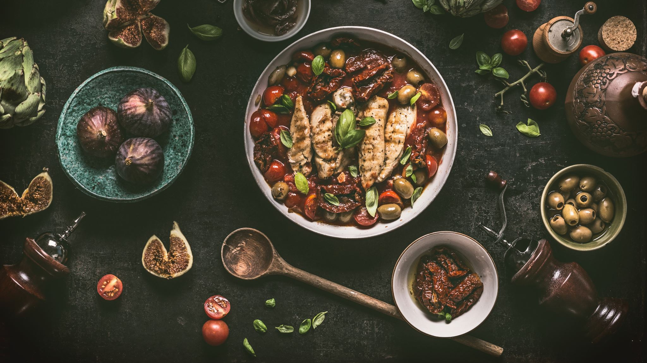
Advanced Recipe Recommendation System
Presented By,
Varshini konduru

Slide 2
Agenda
Introduction to Recipe Recommendation System
Data Sources and Methodology
Sentiment Score Distribution
Top Recipes by Rating
Recipe Sentiment Trends Over Time
Machine Learning And Deep Learning Models
Roc Curve Of LSTM Model and Model Comparison
RNN Model Architecture Design
Integration Flask API and Dashboard
Real-time Applications and Future Work
Q&A

Slide 3
Introduction to Recipe Recommendation System
A Recipe Recommendation System is a personalized system designed to suggest recipes to users based on their preferences, dietary restrictions, past interactions, and other factors such as ingredient availability or nutritional needs. These systems use algorithms to analyze user behavior, reviews, or ratings and recommend recipes more likely to match their tastes and requirements.
The chosen dataset consists of 18,182 entries across 15 attributes.
The dataset contains 150 number of recipes, 17,731 reviews, and 13,586 user profiles
Each attribute provides unique insights into recipe reviews and user interactions.
Importance:
It helps users save time by recommending recipes based on their tastes.
Increases user satisfaction and engagement.
Provides businesses insights into recipe popularity and user preferences

Slide 4
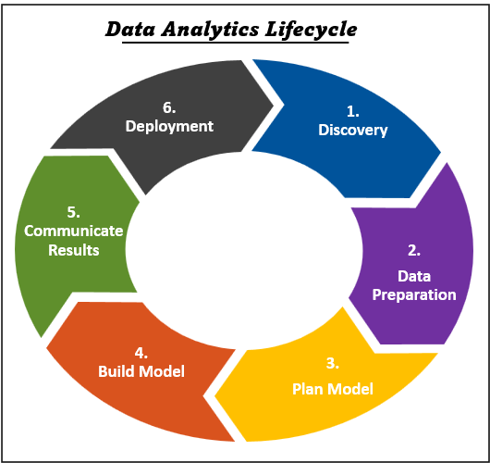
Data Sources And Methodology
Data Source: The recipe Reviews dataset used for this project was collected from the UCI Machine Learning Repository, a reliable source for machine learning research and projects, which is a well-known platform for publicly available datasets.
Methodology: This project follows the Data Analytics Lifecycle, a structured approach to solving data-related problems, involving 6 key phases.
Discovery,
Data Preparation,
Model Planning,
Model Building,
Communicating Results
Deployment

Slide 5
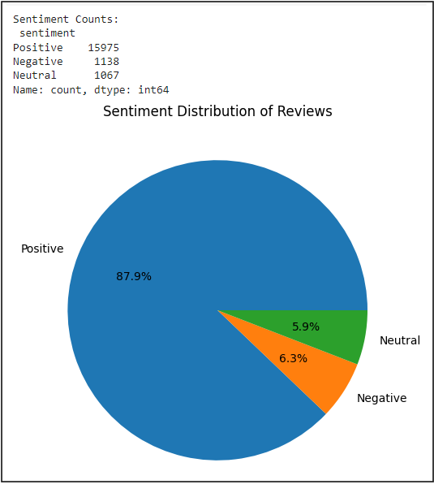
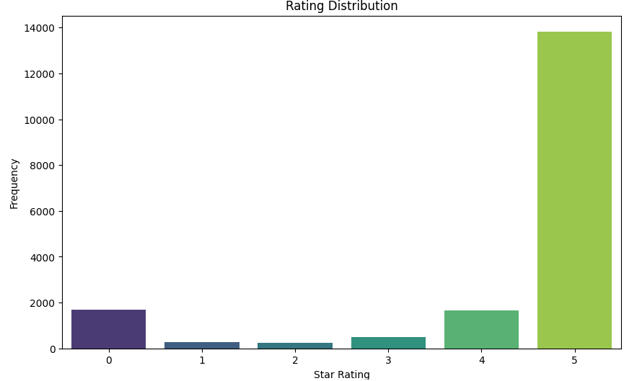
Sentiment Score and Star Rating Distribution
Sentiment Analysis using TextBlob: TextBlob is a simple Python library for processing textual data, providing an easy way to perform sentiment analysis.We utilized TextBlob to analyze user reviews by classifying sentiments into categories. Positive, Neutral, and Negative

Slide 6

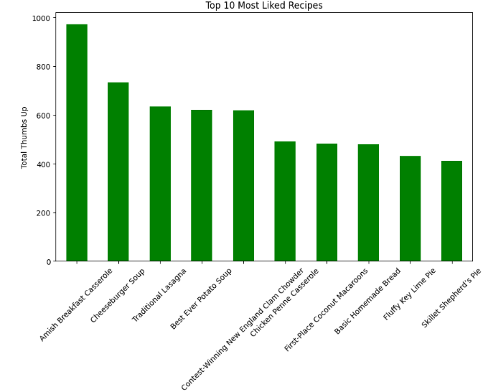
Top 10 Liked Recipes

Slide 7
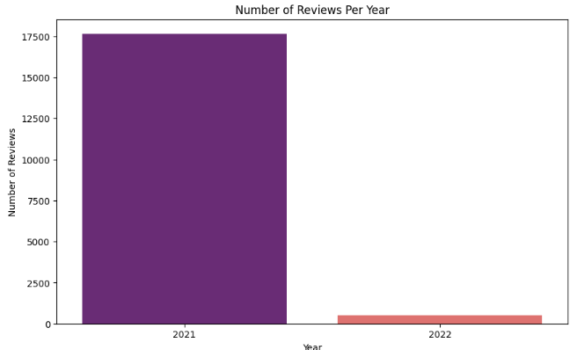
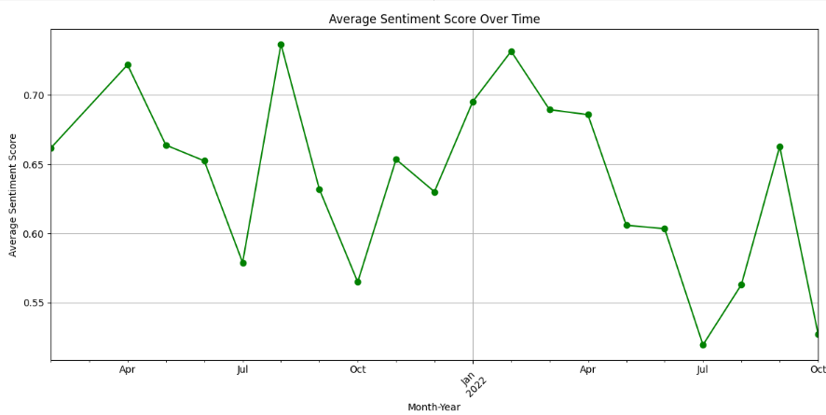
Recipe Reviews And Sentiment Trends Over Time

Slide 8
Machine Learning And Deep Learning Models
1.Recommendation System
Content-Based Filtering using Cosine Similarity
Collaborative Filtering using Singular Value Decomposition (SVD)
Hybird Recommendeion system
2.RNN Model: Traditional Models for Comparison RNN model
Logistic Regression and Multinomial Naive Bayes was used for sentiment classification.
Support Vector Regression (SVR) and Random Forest Regressor were used for star rating prediction
3.Model Integration and System Deployment with Flask API
4.PowerBI Dashboard

Slide 9
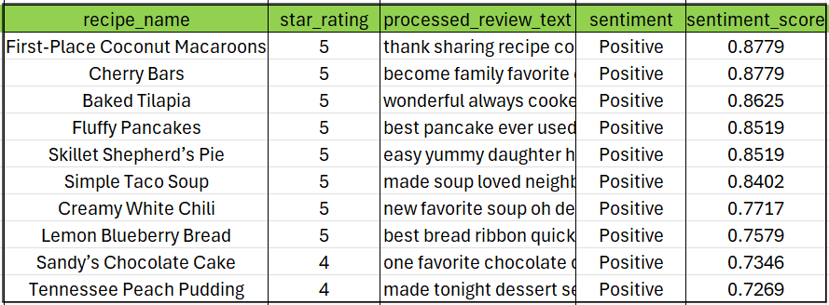
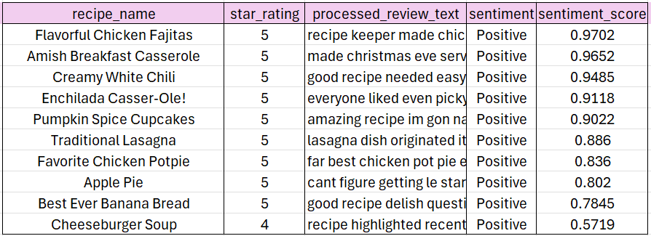
Top 10 Recommendend Recipes for Tradational Recommendation System
Content-Based Filtering using Cosine Similarity
Collaborative Filtering using SVD

Slide 10
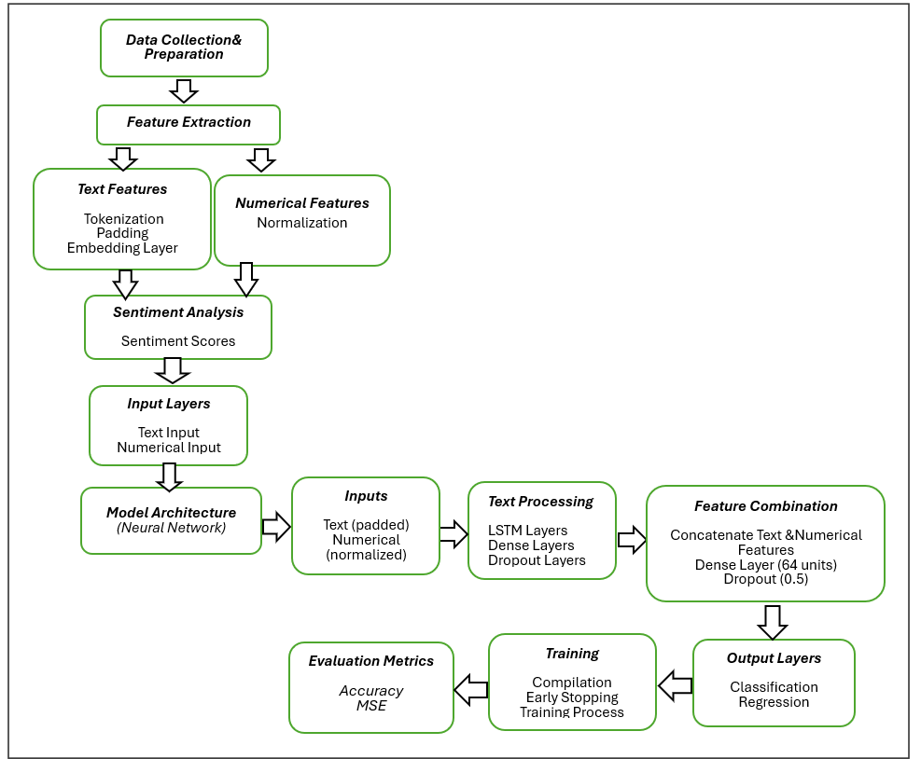
RNN Model Architecture Design:
Recurrent Neural Network model processes both text and numerical features to predict sentiment categories and star ratings. It effectively handles class imbalance, normalizes inputs, and utilizes a combined architecture to achieve both classification and regression tasks.

Slide 11
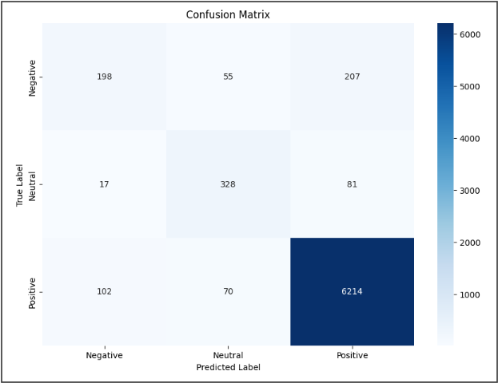
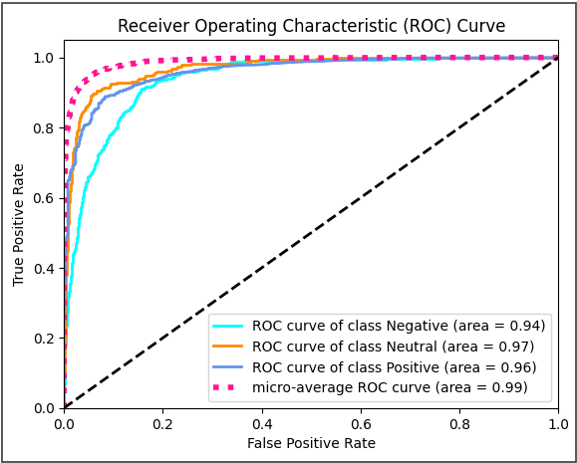
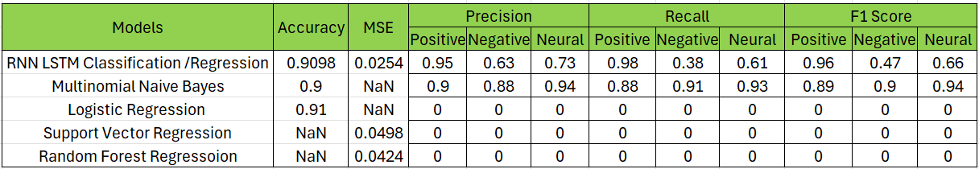
Confusion Matrix And Roc Curve Of LSTM Model and Model Comparison

Slide 12
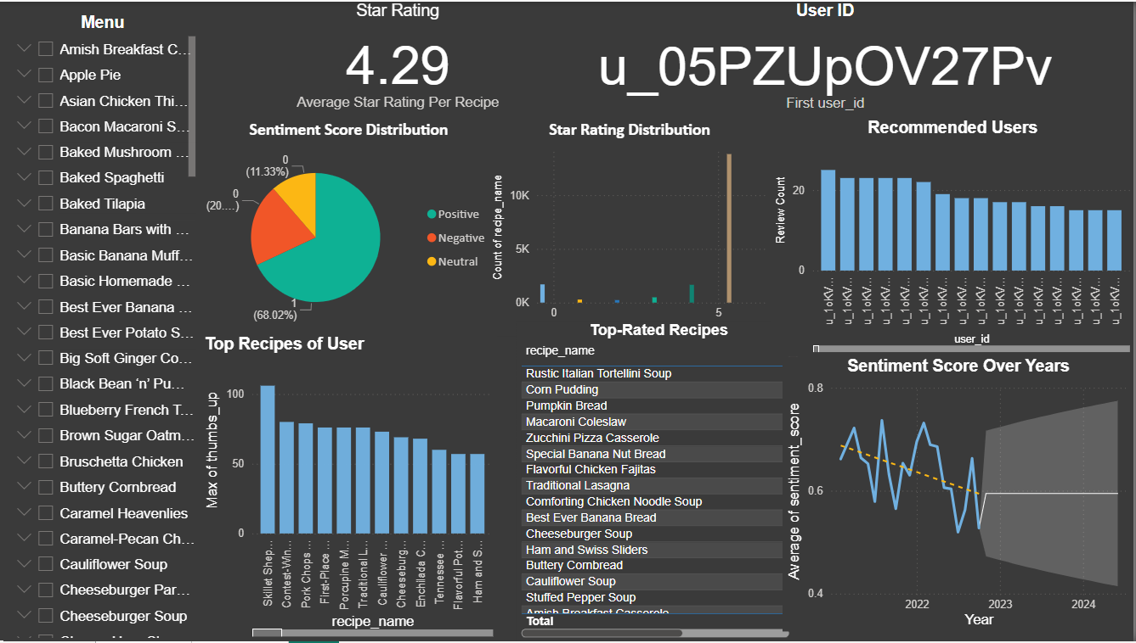
Flask API Implementation and Dashboard
To make the Recurrent Neural Network (RNN) and Hybrid model accessible for real-time predictions, a Flask API and Dasboard was implemented . Flask is a lightweight WSGI web application framework suitable for serving machine learning models http://127.0.0.1:5000.

Slide 13
Real-Time Applications and Future Works
Real-Time Applications
Food Blogs and Apps
Health and Fitness Trackers
E-Commerce Platforms
Future Works Recommendations
Development of Real-Time Adaptation Algorithms
Ethical Implications and Privacy
Time Constraints and Computational Efficiency
Integrate seasonal ingredients and current food trends for better recommendations.
Use advanced NLP models (BERT, GPT) for improved sentiment detection

Slide 14


THANK YOU

