Slide 1
SOCIAL MEDIA DATABASE
S varshini - 4Nn21cs043
Sahana M - 4Nn21cs044
Sahana s - 4Nn21cs046

Slide 2
ABSTRACT
Through this project we are creating a basic structure of social media database. Here we are managing the data of multiple users, their followers , interests and public activity on the social media platform which includes post likes ,comments , comment likes , hashtag followed ,bookmarks and many more...Through our SQL query we have shown a clear cut description of connection and inter relation between different activities on social media. Here we have tried to fetch and store the data in its true storage form into this database like (img/videos in url)With our true efforts and research we have tried to give a simple and more exact view of a basic social interconnecting site. Components Schema Database ER Diagram Sample Queries

Slide 3
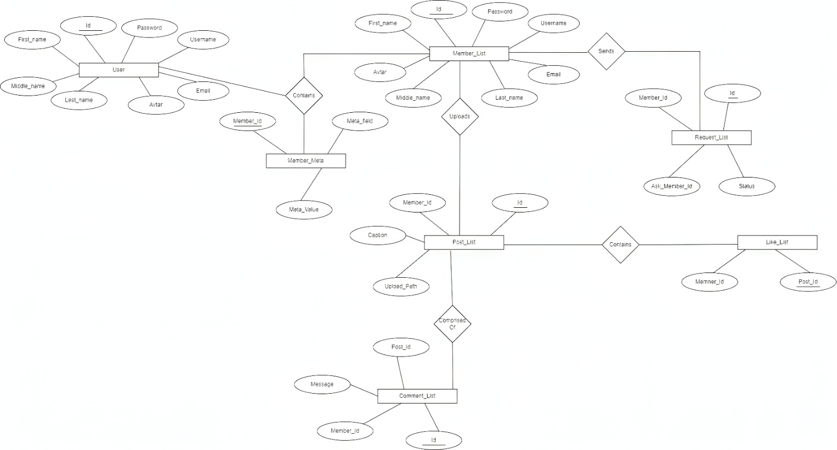
Entity Relationship Diagram

Slide 4
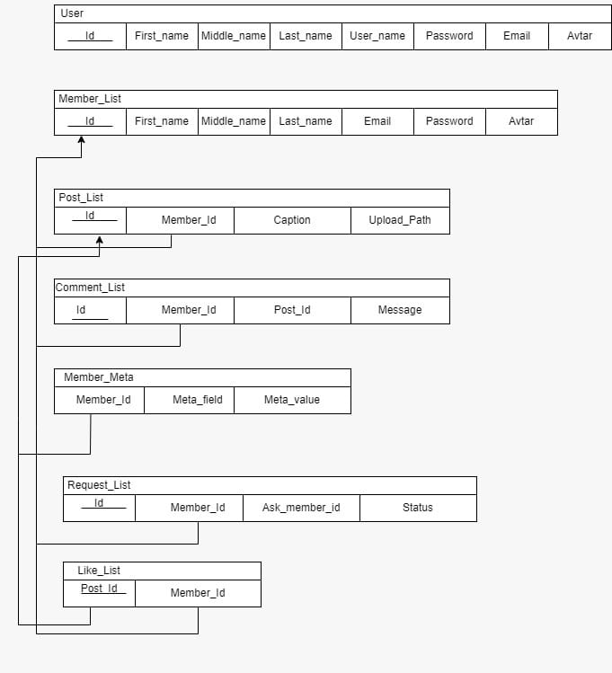
SCHEMA DIADRAM

Slide 5




TOOLS USED
My SQL
HTML
CSS
JAVASCRIPT
ANGULAR JS
NODE JS
PhpMyAdmin
GITHUB
XAMPP

Slide 6


