Slide 1
Traffic Management System
Presented by
VARSHINI-CSE
KAVYA-CSE
SIRICHANDANA-CSE

Slide 2
Abstract
The main objective of our project is to develop and implement an intelligent system utilizing AI to accurately recognize and interpret traffic signs, aiming to enhance road safety and improve driver assistance by leveraging advanced computer vision techniques and machine learning algorithms.
The project entails the utilization of AI-powered algorithms to develop a robust system capable of accurately detecting and interpreting traffic signs in real time. Through the integration of cutting-edge computer vision techniques and machine learning models, the system aims to enhance driver awareness and automate responses to signs, thereby influencing traffic signal control and facilitating speed limit enforcement.
By deploying this intelligent system, significant improvements in road safety are anticipated. The system's ability to accurately recognize and interpret traffic signs will not only enhance driver assistance but also contribute to the overall optimization of traffic management. Ultimately, the project seeks to mitigate road accidents, reduce congestion, and create a safer and more efficient driving environment.

Slide 3
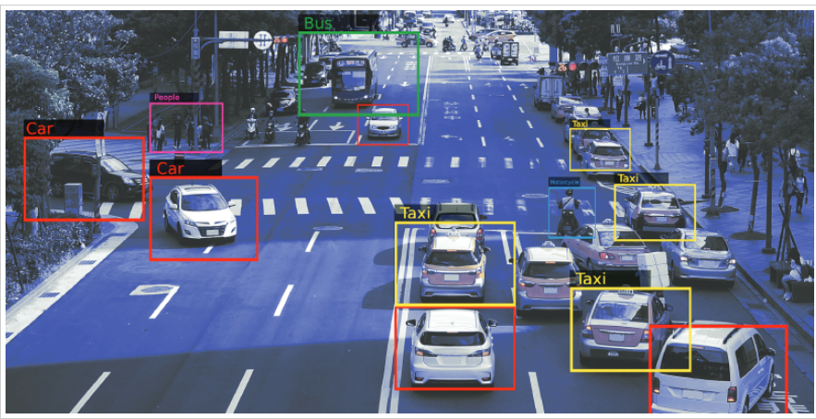
Introduction
Smart Traffic Management System uses advanced algorithms for urban traffic control and real-time data analysis.
It integrates predictive modelling, anomaly detection, and optimized traffic light control to improve traffic flow.
Trained on a diverse dataset of 42 traffic sign classes, the system enhances generalization in real-world scenarios.
Computer vision algorithms enable the system to monitor and respond to traffic events like accidents or congestion, enhancing overall traffic management.

Slide 4
Literature Survey
Published Year | Title | Author | Algorithms used
2022 | Traffic Management using Machine Learning | Ritu | YOLO algorithm
2021 | Traffic Management System using Machine Learning Algorithm | A. Ravi, R. Nandhini, K.Bhuvaneshwar, J. Divya, K. Janani | CNN, YOLO algorithm
2023 | Machine Learning-based Intelligent Traffic System | Karishama Bisen, Rohini Shahare, Karishma Wasnik, P.Jaipurka | AlexNet,YOLO algorithm

Slide 5
Existing Methodology
Here are some common methodologies for traffic management:
Traffic sign detection involves identifying and localizing traffic signs in images or video frames. Various methodologies have been developed, and deep learning techniques have shown significant success in this task. Here's an overview of existing methodologies for traffic sign detection:
Traditional Computer Vision Approaches:
Colour-Based Detection: Traffic signs often have distinct colours. Simple colour-based methods can be used to segment and detect signs based on colour thresholds.
Shape-Based Detection: Detecting signs based on predefined shapes (e.g., octagon for stop signs) using contour analysis.
Vehicle Detection Statistic method is one of the traditional methods that are used for tracking of vehicles. Blob detection and its analysis is one of the processes in detecting vehicles.

Slide 6
Proposed Methodology
Here are some proposed methodologies for traffic management:
1. Traffic Sign Detection:
This project develops a robust computer vision algorithm to detect and locate traffic signs in real time and utilize image processing techniques to preprocess input images and extract relevant features for detection.
2. Vehicle and Emergency Vehicle Detection:
We can improve this system to detect ambulances in the traffic and make the traffic clear for emergency vehicle preemption. This system can contribute significantly to traffic management systems by improving emergency vehicle response times, reducing traffic congestion, and enhancing overall road safety.

Slide 7
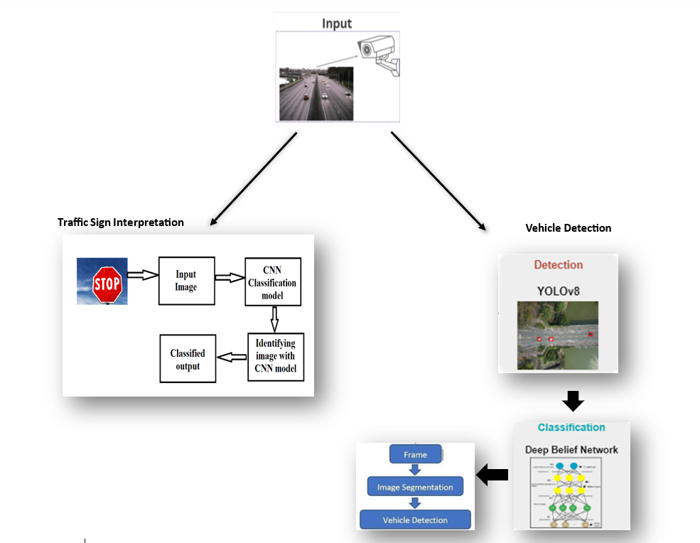
Workflow

Slide 8
1. Data Collection and Preparation:-
Gathering a dataset of images containing various types of traffic signs under different lighting conditions, weather conditions, and perspectives.
Apply preprocessing techniques such as grayscale conversion, histogram equalization, and normalization to enhance image quality and prepare the data for training.
2. Model Training and Evaluation:
Traffic Sign Recognition Model Training: Train a convolutional neural network (CNN) model using the preprocessed dataset to accurately recognize traffic signs.

Slide 9
3. Vehicle Detection Model Development:
Developed a vehicle detection model, utilizing techniques like YOLO (You Only Look Once), to detect vehicles in real-time video streams.
4. Real-time Application and Integration:
Developed a website interface to interact with the deployed traffic sign recognition system.- validate the emergency vehicles detection trained model on various video streams.

Slide 10
Tech Stack
Python: As the primary programming language for implementing machine learning algorithms, data preprocessing, and backend development.
OpenCV: For computer vision tasks such as image preprocessing, object detection, and video processing.
TensorFlow: Deep learning frameworks used for training and deploying convolutional neural networks (CNNs) for traffic sign recognition and vehicle detection.
YOLO (You Only Look Once): A popular object detection algorithm for real-time detection of vehicles in video streams.
Flask: Web frameworks for deploying the traffic sign recognition system on a website.
HTML/CSS/JavaScript: For building the frontend interface of the website, allowing users to interact with the deployed system.

Slide 11
Future Scope
Traffic Crowd Segmentation:
- Implementing traffic crowd segmentation using cluster segmentation technique in image processing.
- Cluster segmentation groups pixels or regions in an image based on similarity criteria.
- The goal is to identify meaningful structures or objects within the image.
- Image segmentation involves dividing an image into different regions or segments.

Slide 12
Conclusion
The convergence of traffic sign recognition and traffic crowd segmentation represents a significant stride towards intelligent and adaptive transportation and public space management. As these technologies continue to evolve, their widespread implementation promises to enhance safety, reduce congestion, and contribute to the development of smarter and more sustainable urban landscapes.

Slide 13




www.hexart.in
Sponsored by
THANK YOU
CSR Partner
Implementation Partner

