Slide 1
Chapter 3: Addressing Modes

Slide 2
3–1 DATA ADDRESSING MODES
MOV instruction is a common and flexible instruction.
Figure 3–1 illustrates the MOV instruction and defines the direction of data flow.
Source is to the right and destination the left, next to the opcode MOV.
  an opcode, or operation code, tells the microprocessor which operation to perform

Slide 3
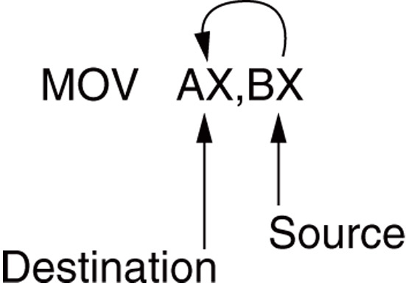
Figure 3–1 The MOV instruction showing the source, destination, and direction of data flow.

Slide 4
Figure 3–2 shows all possible variations of the data-addressing modes using MOV.
These data-addressing modes are found with all versions of the Intel microprocessor.
  except for the scaled-index-addressing mode, found only in 80386 through Core2
RIP relative addressing mode is not illustrated.
  only available on the Pentium 4 and Core2
  in the 64-bit mode

Slide 5
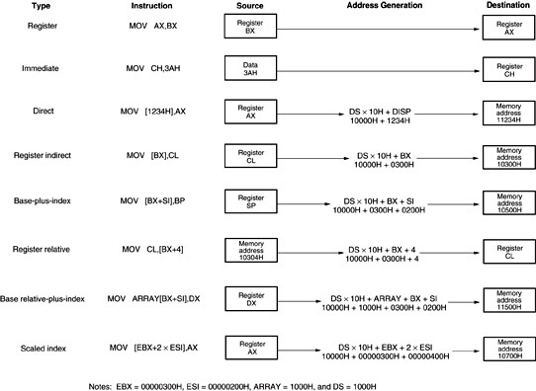
Figure 3–2 8086–Core2 data-addressing modes.

Slide 6
Register Addressing
The most common form of data addressing.
  once register names learned, easiest to apply.
The microprocessor contains these 8-bit register names used with register addressing: AH, AL, BH, BL, CH, CL, DH, and DL.
16-bit register names: AX, BX, CX, DX, SP, BP, SI, and DI.

Slide 7
In 80386 & above, extended 32-bit register names are: EAX, EBX, ECX, EDX, ESP, EBP, EDI, and ESI.
64-bit mode register names are: RAX, RBX, RCX, RDX, RSP, RBP, RDI, RSI, and R8 through R15.
Important for instructions to use registers that are the same size.
  never mix an 8-bit \with a 16-bit register, an 8- or a 16-bit register with a 32-bit register
  this is not allowed by the microprocessor and results in an error when assembled

Slide 8
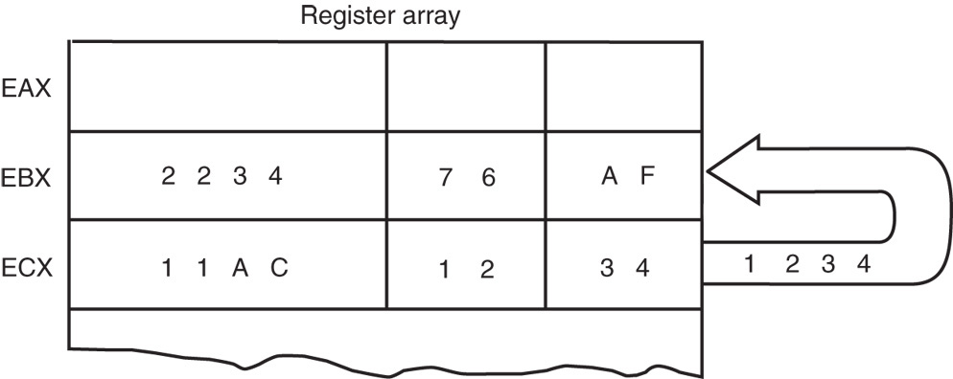
Figure 3–3 The effect of executing the MOV BX, CX instruction at the point just before the BX register changes. Note that only the rightmost 16 bits of register EBX change.

Slide 9
Figure 3–3 shows the operation of the MOV BX, CX instruction.
The source register’s contents do not change.
  the destination register’s contents do change
The contents of the destination register or destination memory location change for all instructions except the CMP and TEST instructions.
The MOV BX, CX instruction does not affect the leftmost 16 bits of register EBX.

Slide 10
Immediate Addressing
Term immediate implies that data immediately follow the hexadecimal opcode in the memory.
  immediate data are constant data
  data transferred from a register or memory location are variable data
Immediate addressing operates upon a byte or word of data.
Figure 3–4 shows the operation of a
MOV EAX,13456H instruction.

Slide 11
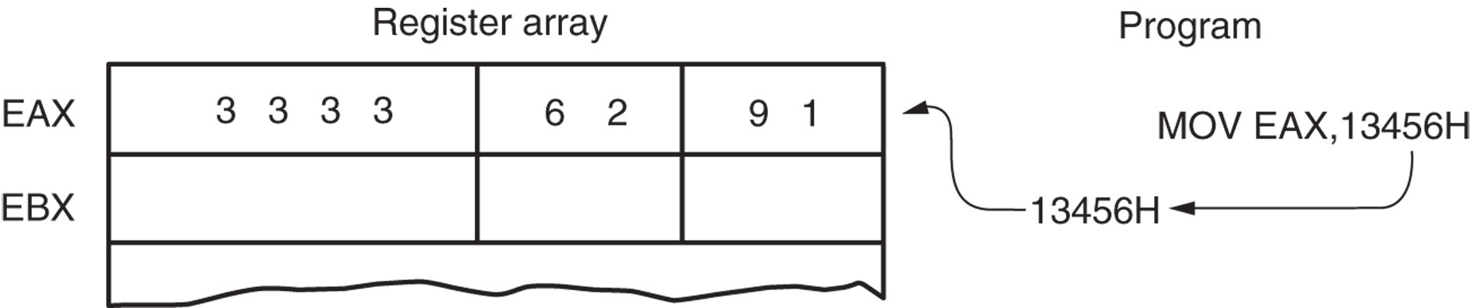
Figure 3–4 The operation of the MOV EAX,3456H instruction. This instruction copies the immediate data (13456H) into EAX.
As with the MOV instruction illustrated in Figure 3–3, the source data overwrites the destination data.

Slide 12
The symbolic assembler portrays immediate data in many ways.
The letter H appends hexadecimal data.
If hexadecimal data begin with a letter, the assembler requires the data start with a 0.
  to represent a hexadecimal F2, 0F2H is used
  in assembly language
Decimal data are represented as is and require no special codes or adjustments.
  an example is the 100 decimal in the
  MOV AL,100 instruction

Slide 13
Direct Addressing
Direct addressing with a MOV instruction transfers data between a memory location, located within the data segment, and the AL (8-bit), AX (16-bit), or EAX (32-bit) register.
  usually a 3-byte long instruction
MOV AL,DATA loads AL from the data segment memory location DATA (1234H).
  DATA is a symbolic memory location, while
  1234H is the actual hexadecimal location

Slide 14
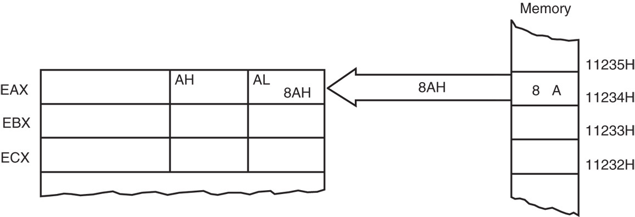
Figure 3–5 The operation of the MOV AL,[1234H] instruction when DS=1000H .
This instruction transfers a copy contents of memory location 11234H into AL.
  the effective address is formed by adding
  1234H (the offset address) and 10000H
  (the data segment address of 1000H times
  10H) in a system operating in the real mode

Slide 15
Register Indirect Addressing
Allows data to be addressed at any memory location through an offset address held in any of the following registers: BP, BX, DI, and SI.
In addition, 80386 and above allow register indirect addressing with any extended register except ESP.
In the 64-bit mode, the segment registers serve no purpose in addressing a location
in the flat model.

Slide 16
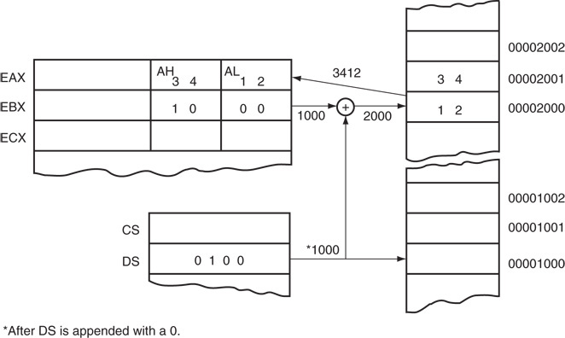
Figure 3–6 The operation of the MOV AX, [BX] instruction when BX = 1000H and DS = 0100H. Note that this instruction is shown after the contents of memory are transferred to AX.

Slide 17
The data segment is used by default with register indirect addressing or any other mode that uses BX, DI, or SI to address memory.
If the BP register addresses memory, the stack segment is used by default.
  these settings are considered the default for
  these four index and base registers
For the 80386 and above, EBP addresses memory in the stack segment by default.
EAX, EBX, ECX, EDX, EDI, and ESI address memory in the data segment by default.

Slide 18
Indirect addressing often allows a program to refer to tabular data located in memory.
Figure 3–7 shows the table and the BX register used to sequentially address each location in the table.
To accomplish this task, load the starting location of the table into the BX register
with a MOV immediate instruction.
After initializing the starting address of the table, use register indirect addressing to
store the 50 samples sequentially.

Slide 19
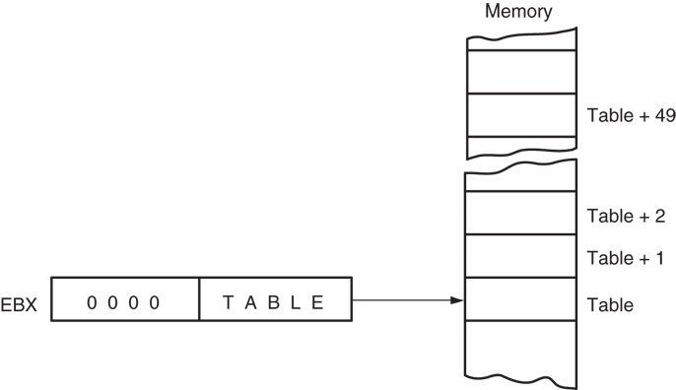
Figure 3–7 An array (TABLE) containing 50 bytes that are indirectly addressed through register BX.

Slide 20
Base-Plus-Index Addressing
Similar to indirect addressing because it indirectly addresses memory data.
The base register often holds the beginning location of a memory array.
  the index register holds the relative position
  of an element in the array
  whenever BP addresses memory data, both the stack segment register and BP generate the effective address

Slide 21
Locating Data with Base-Plus-Index Addressing
Figure 3–8 shows how data are addressed by the MOV DX, [BX + DI] instruction when the microprocessor operates in the real mode.
The Intel assembler requires this addressing mode appear as [BX][DI] instead of [BX + DI].
The MOV DX, [BX + DI] instruction is MOV DX,[BX][DI] for a program written for the Intel ASM assembler.

Slide 22
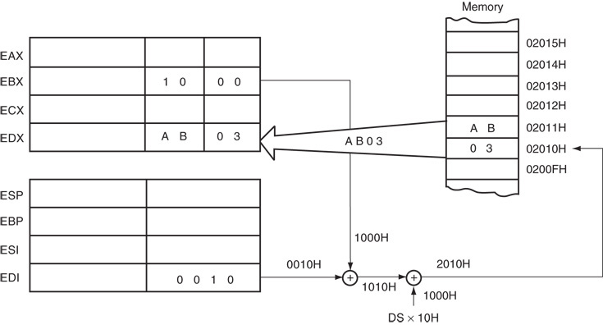
Figure 3–8 An example showing how the base-plus-index addressing mode functions for the MOV DX, [BX + DI] instruction. Notice that memory address 02010H is accessed because DS=0100H, BX=100H and DI=0010H.

Slide 23
Locating Array Data Using Base-Plus-Index Addressing
A major use is to address elements in a memory array.
To accomplish this, load the BX register (base) with the beginning address of the array and the DI register (index) with the element number to be accessed.
Figure 3–9 shows the use of BX and DI to access an element in an array of data.

Slide 24
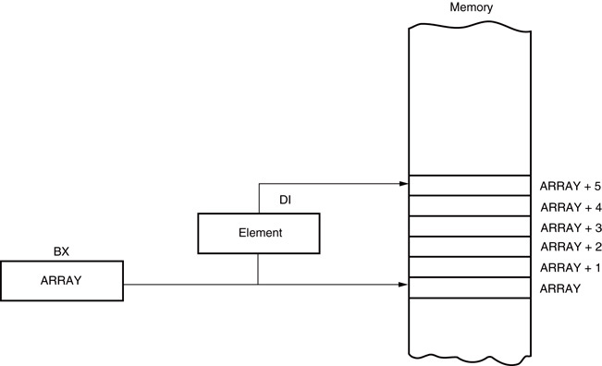
Figure 3–9 An example of the base-plus-index addressing mode. Here an element (DI) of an ARRAY (BX) is addressed.

Slide 25
Register Relative Addressing
Similar to base-plus-index addressing and displacement addressing.
  data in a segment of memory are addressed by adding the displacement to the contents of a base or an index register (BP, BX, DI, or SI)
Figure 3–10 shows the operation of the MOV AX,[BX+1000H] instruction.
A real mode segment is 64K bytes long.

Slide 26
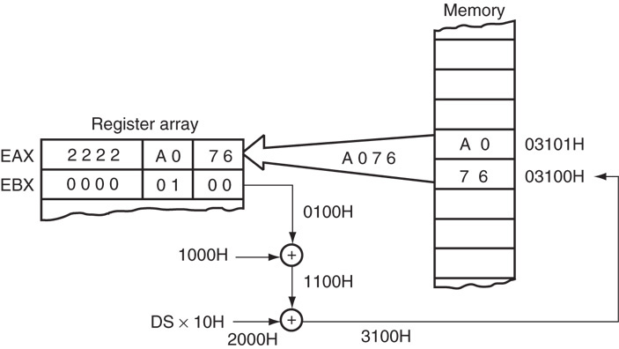
Figure 3–10 The operation of the MOV AX, [BX+1000H] instruction, when BX=1000H and DS=0200H .

Slide 27
Addressing Array Data with Register Relative
It is possible to address array data with register relative addressing.
  such as with base-plus-index addressing
In Figure 3–11, register relative addressing is illustrated with the same example as for base-plus-index addressing.
  this shows how the displacement ARRAY adds
  to index register DI to generate a reference to
  an array element

Slide 28
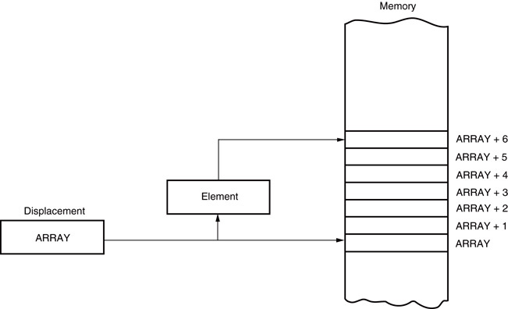
Figure 3–11 Register relative addressing used to address an element of ARRAY. The displacement addresses the start of ARRAY, and DI accesses an element.

Slide 29
Base Relative-Plus-Index Addressing
Similar to base-plus-index addressing.
  adds a displacement
  uses a base register and an index register to
  form the memory address
This type of addressing mode often addresses a two-dimensional array of memory data.

Slide 30
Addressing Data with Base Relative-Plus-Index
Least-used addressing mode.
Figure 3–12 shows how data are referenced if the instruction executed by the microprocessor is MOV AX, [BX + SI + 100H].
  displacement of 100H adds to BX and SI to form the offset address within the data segment
This addressing mode is too complex for frequent use in programming.

Slide 31
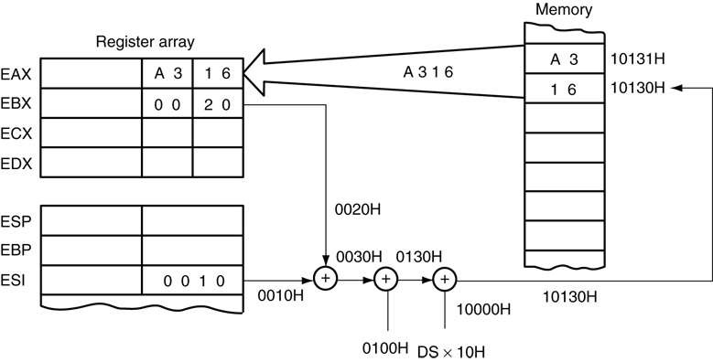
Figure 3–12 An example of base relative-plus-index addressing using a MOV AX,[BX+SI=1000H] instruction. Note: DS=1000H

Slide 32
Addressing Arrays with Base Relative-Plus-Index
Suppose a file of many records exists in memory, each record with many elements.
  displacement addresses the file, base register addresses a record, the index register addresses an element of a record
Figure 3–13 illustrates this very complex form of addressing.

Slide 33
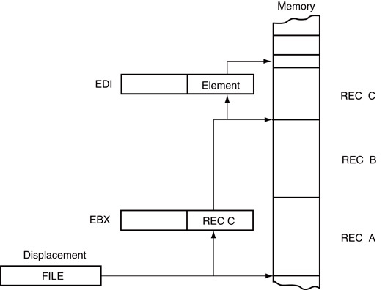
Figure 3–13 Base relative-plus-index addressing used to access a FILE that contains multiple records (REC).

Slide 34
Scaled-Index Addressing
Unique to 80386 - Core2 microprocessors.
  uses two 32-bit registers (a base register and
  an index register) to access the memory
The second register (index) is multiplied by a scaling factor.
  the scaling factor can be 1x, 2x, 4x, 8x
A scaling factor of is implied and need not be included in the assembly language instruction (MOV AL, [EBX + ECX]).

