Slide 1
Chapter 5: Arithmetic and Logic Instructions

Slide 2
Introduction
We examine the arithmetic and logic instructions. The arithmetic instructions include addition, subtraction, multiplication, division, comparison, negation, increment, and decrement.
The logic instructions include AND, OR, Exclusive-OR, NOT, shifts, rotates, and the logical compare (TEST).

Slide 3
Chapter Objectives
Upon completion of this chapter, you will be able to:
Use arithmetic and logic instructions to accomplish simple binary, BCD, and ASCII arithmetic.
Use AND, OR, and Exclusive-OR to accomplish binary bit manipulation.
Use the shift and rotate instructions.

Slide 4
Chapter Objectives
(cont.)
Upon completion of this chapter, you will be able to:
Explain the operation of the 80386 through
the Core2 exchange and add, compare and exchange, double-precision shift, bit test,
and bit scan instructions.
Check the contents of a table for a match with the string instructions.

Slide 5
5-1 ADDITION, SUBTRACTION AND COMPARISON
The bulk of the arithmetic instructions found in any microprocessor include addition, subtraction, and comparison.
Addition, subtraction, and comparison instructions are illustrated.
Also shown are their uses in manipulating register and memory data.

Slide 6
Addition
Addition (ADD) appears in many forms in the microprocessor.
A second form of addition, called add-with-carry, is introduced with the ADC instruction.
The only types of addition not allowed are memory-to-memory and segment register.
  segment registers can only be moved, pushed,
  or popped
Increment instruction (INC) is a special type of addition that adds 1 to a number.

Slide 7
Register Addition
When arithmetic and logic instructions execute, contents of the flag register change.
  interrupt, trap, and other flags do not change
Any ADD instruction modifies the contents of the sign, zero, carry, auxiliary carry, parity, and overflow flags.
Immediate Addition
Immediate addition is employed whenever constant or known data are added.

Slide 8
Memory-to-Register Addition
Moves memory data to be added to the AL (and other) register.
Array Addition
Memory arrays are sequential lists of data.

Slide 9
Array Addition
Sequential lists of data.
A sequence of instructions written 80386 shows scaled-index form addressing to add elements 3, 5, and 7 of an area of memory called ARRAY.
EBX is loaded with the address ARRAY, and ECX holds the array element number.
The scaling factor is used to multiply the contents of the ECX register by 2 to address words of data.

Slide 10
Increment Addition
The INC instruction adds 1 to any register or memory location, except a segment register.
The size of the data must be described by using the BYTE PTR, WORD PTR, DWORD PTR, or QWORD PTR directives.
The assembler program cannot determine if the INC [DI] instruction is a byte-, word-, or doubleword-sized increment.

Slide 11
Addition-with-Carry
ADC) adds the bit in the carry flag (C) to the operand data.
  mainly appears in software that adds numbers
  wider than 16 or 32 bits in the 80386–Core2
  like ADD, ADC affects the flags after the addition
Figure 5–1 illustrates this so placement and function of the carry flag can be understood.
  cannot be easily performed without adding the carry flag bit because the 8086–80286 only
  adds 8- or 16-bit numbers

Slide 12
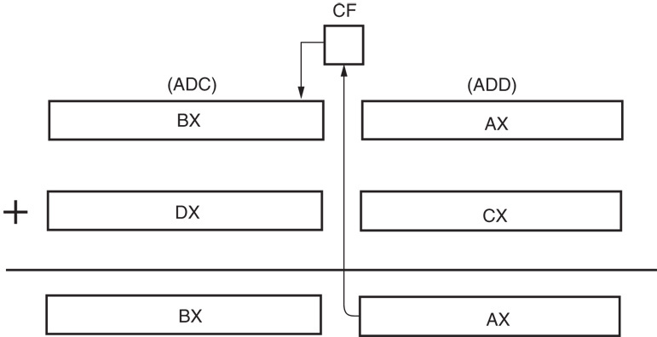
Figure 5–1 Addition-with-carry showing how the carry flag (C) links the two 16-bit additions into one 32-bit addition.

Slide 13
Exchange and Add for the 80486–Core2 Processors
Exchange and add (XADD) appears in 80486 and continues through the Core2.
XADD instruction adds the source to the destination and stores the sum in the destination, as with any addition.
  after the addition takes place, the original value of the destination is copied into the source operand
One of the few instructions that change the source.

Slide 14
Subtraction
Many forms of subtraction (SUB) appear in the instruction set.
  these use any addressing mode with 8-, 16-, or 32-bit data
  a special form of subtraction (decrement, or DEC) subtracts 1 from any register or memory location
Numbers that are wider than 16 bits or 32 bits must occasionally be subtracted.
  the subtract-with-borrow instruction (SBB) performs this type of subtraction

Slide 15
Register Subtraction
After each subtraction, the microprocessor modifies the contents of the flag register.
  flags change for most arithmetic/logic operations
Immediate Subtraction
The microprocessor also allows immediate operands for the subtraction of constant data.
Decrement Subtraction
Subtracts 1 from a register/memory location.

Slide 16
Subtraction-with-Borrow
A subtraction-with-borrow (SBB) instruction functions as a regular subtraction, except that the carry flag (C), which holds the borrow, also subtracts from the difference.
  most common use is subtractions wider than 16 bits in the 8086–80286 microprocessors or wider than 32 bits in the 80386–Core2.
  wide subtractions require borrows to propagate through the subtraction, just as wide additions propagate the carry

Slide 17
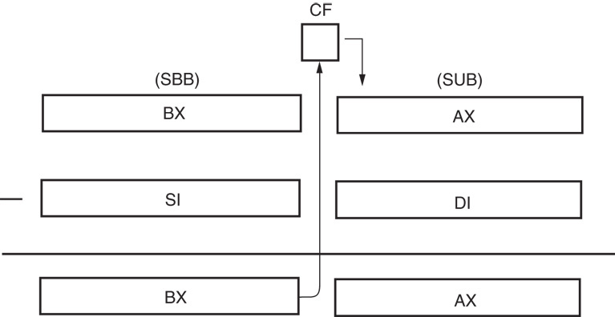
Figure 5–2 Subtraction-with-borrow showing how the carry flag (C) propagates the borrow.

Slide 18
Comparison
The comparison instruction (CMP) is a subtraction that changes only the flag bits.
  destination operand never changes
Useful for checking the contents of a register or a memory location against another value.
A CMP is normally followed by a conditional jump instruction, which tests the condition of the flag bits.

Slide 19
Compare and Exchange (80486–Core2 Processors Only)
Compare and exchange instruction (CMPXCHG) compares the destination operand with the accumulator.
  found only in 80486 - Core2 instruction sets
If they are equal, the source operand is copied to the destination; if not equal, the destination operand is copied into the accumulator.
  instruction functions with 8-, 16-, or 32-bit data

Slide 20
CMPXCHG CX,DX instruction is an example of the compare and exchange instruction.
  this compares the contents of CX with AX
  if CX equals AX, DX is copied into AX; if CX
  is not equal to AX, CX is copied into AX
  also compares AL with 8-bit data and EAX with 32-bit data if the operands are either 8- or 32-bit
This instruction has a bug that will cause the operating system to crash.
  more information about this flaw can be obtained at www.intel.com

Slide 21
5-2 MULTIPLICATION AND DIVISION
Earlier 8-bit microprocessors could not multiply or divide without the use of a program that multiplied or divided by using a series of shifts and additions or subtractions.
  manufacturers were aware of this inadequacy, they incorporated multiplication and division into the instruction sets of newer microprocessors.
Pentium–Core2 contains special circuitry to do multiplication in as few as one clocking period.
  over 40 clocking periods in earlier processors

Slide 22
8-Bit Multiplication
With 8-bit multiplication, the multiplicand is always in the AL register, signed or unsigned.
  multiplier can be any 8-bit register or memory location
Immediate multiplication is not allowed unless the special signed immediate multiplication instruction appears in a program.
The multiplication instruction contains one operand because it always multiplies the operand times the contents of register AL.

Slide 23
Multiplication
Performed on bytes, words, or doublewords,
  can be signed (IMUL) or unsigned integer (MUL)
Product after a multiplication always a double-width product.
  two 8-bit numbers multiplied generate a 16-bit product; two 16-bit numbers generate a 32-bit;
  two 32-bit numbers generate a 64-bit product
  in 64-bit mode of Pentium 4, two 64-bit numbers are multiplied to generate a 128-bit product

Slide 24
16-Bit Multiplication
Word multiplication is very similar to byte multiplication.
AX contains the multiplicand instead of AL.
  32-bit product appears in DX–AX instead of AX
The DX register always contains the most significant 16 bits of the product; AX contains the least significant 16 bits.
As with 8-bit multiplication, the choice of the multiplier is up to the programmer.

Slide 25
A Special Immediate 16-Bit Multiplication
80186 - Core2 processors can use a special version of the multiply instruction.
  immediate multiplication must be signed;
  instruction format is different because it contains three operands
First operand is 16-bit destination register; the second a register/memory location with16-bit multiplicand; the third 8- or 16-bit immediate data used as the multiplier.

Slide 26
32-Bit Multiplication
In 80386 and above, 32-bit multiplication is allowed because these microprocessors contain 32-bit registers.
  can be signed or unsigned by using IMUL and MUL instructions
Contents of EAX are multiplied by the operand specified with the instruction.
The 64 bit product is found in EDX–EAX, where EAX contains the least significant 32 bits of the product.

Slide 27
64-Bit Multiplication
The result of a 64-bit multiplication in the Pentium 4 appears in the RDX:RAX register pair as a 128-bit product.
Although multiplication of this size is relatively rare, the Pentium 4 and Core2 can perform it on both signed and unsigned numbers.

Slide 28
Division
Occurs on 8- or 16-bit and 32-bit numbers depending on microprocessor.
  signed (IDIV) or unsigned (DIV) integers
Dividend is always a double-width dividend, divided by the operand.
There is no immediate division instruction available to any microprocessor.
In 64-bit mode Pentium 4 & Core2, divide a 128-bit number by a 64-bit number.

Slide 29
A division can result in two types of errors:
  attempt to divide by zero
  other is a divide overflow, which occurs when a small number divides into a large number
In either case, the microprocessor generates an interrupt if a divide error occurs.
In most systems, a divide error interrupt displays an error message on the video screen.

Slide 30
8-Bit Division
Uses AX to store the dividend divided by the contents of any 8-bit register or memory location.
Quotient moves into AL after the division with AH containing a whole number remainder.
  quotient is positive or negative; remainder always assumes sign of the dividend; always an integer

Slide 31
Numbers usually 8 bits wide in 8-bit division .
  the dividend must be converted to a 16-bit wide number in AX ; accomplished differently for signed and unsigned numbers
CBW (convert byte to word) instruction performs this conversion.
In 80386 through Core2, MOVSX sign-extends a number.

Slide 32
16-Bit Division
Sixteen-bit division is similar to 8-bit division
  instead of dividing into AX, the 16-bit number is divided into DX–AX, a 32-bit dividend
As with 8-bit division, numbers must often be converted to the proper form for the dividend.
  if a 16-bit unsigned number is placed in AX, DX must be cleared to zero
In the 80386 and above, the number is zero-extended by using the MOVZX instruction.

Slide 33
32-Bit Division
80386 - Pentium 4 perform 32-bit division on signed or unsigned numbers.
  64-bit contents of EDX–EAX are divided by the operand specified by the instruction
    leaving a 32-bit quotient in EAX
    and a 32-bit remainder in EDX
Other than the size of the registers, this instruction functions in the same manner as the 8- and 16-bit divisions.

Slide 34
64-Bit Division
Pentium 4 operated in 64-bit mode performs 64-bit division on signed or unsigned numbers.
The 64-bit division uses the RDX:RAX
register pair to hold the dividend.
The quotient is found in RAX and the remainder is in RDX after the division.

Slide 35
The Remainder
Could be used to round the quotient or dropped to truncate the quotient.
If division is unsigned, rounding requires the remainder be compared with half the divisor
to decide whether to round up the quotient
The remainder could also be converted to a fractional remainder.

Slide 36
5-3 BCD and ASCII Arithmetic
The microprocessor allows arithmetic manipulation of both BCD (binary-coded decimal) and ASCII (American Standard Code for Information Interchange) data.
BCD operations occur in systems such as point-of-sales terminals (e.g., cash registers) and others that seldom require complex arithmetic.

Slide 37
BCD Arithmetic
Two arithmetic techniques operate with BCD data: addition and subtraction.
DAA (decimal adjust after addition) instruction follows BCD addition,
DAS (decimal adjust after subtraction) follows BCD subtraction.
  both correct the result of addition or subtraction
  so it is a BCD number

Slide 38
DAA Instruction
DAA follows the ADD or ADC instruction to adjust the result into a BCD result.
After adding the BL and DL registers, the result is adjusted with a DAA instruction before being stored in CL.
DAS Instruction
Functions as does DAA instruction, except it follows a subtraction instead of an addition.

Slide 39
ASCII Arithmetic
ASCII arithmetic instructions function with coded numbers, value 30H to 39H for 0–9.
Four instructions in ASCII arithmetic operations:
  AAA (ASCII adjust after addition)
  AAD (ASCII adjust before division)
  AAM (ASCII adjust after multiplication)
  AAS (ASCII adjust after subtraction)
These instructions use register AX as the source and as the destination.

Slide 40
AAA Instruction
Addition of two one-digit ASCII-coded numbers will not result in any useful data.
AAD Instruction
Appears before a division.
The AAD instruction requires the AX register contain a two-digit unpacked BCD number (not ASCII) before executing.

Slide 41
AAM Instruction
Follows multiplication instruction after multiplying two one-digit unpacked BCD numbers.
AAM converts from binary to unpacked BCD.
If a binary number between 0000H and 0063H appears in AX, AAM converts it to BCD.
AAS Instruction
AAS adjusts the AX register after an ASCII subtraction.

Slide 42
5-4 BASIC LOGIC INSTRUCTIONS
Include AND, OR, Exclusive-OR, and NOT.
  also TEST, a special form of the AND instruction
  NEG, similar to the NOT instruction
Logic operations provide binary bit control in low-level software.
  allow bits to be set, cleared, or complemented
Low-level software appears in machine language or assembly language form and often controls the I/O devices in a system.

Slide 43
All logic instructions affect the flag bits.
Logic operations always clear the carry and overflow flags
  other flags change to reflect the result
When binary data are manipulated in a register or a memory location, the rightmost bit position is always numbered bit 0.
  position numbers increase from bit 0 to the left, to bit 7 for a byte, and to bit 15 for a word
  a doubleword (32 bits) uses bit position 31 as its leftmost bit and a quadword (64-bits) position 63

Slide 44
AND
Performs logical multiplication, illustrated by a truth table.
AND can replace discrete AND gates if the speed required is not too grea
  normally reserved for embedded control applications
In 8086, the AND instruction often executes
in about a microsecond.
  with newer versions, the execution speed is greatly increased

Slide 45
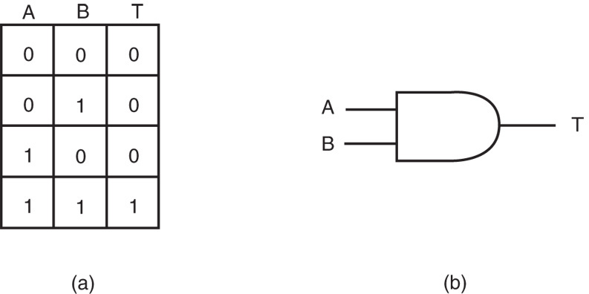
Figure 5–3 (a) The truth table for the AND operation and (b) the logic symbol of an AND gate.

Slide 46
AND clears bits of a binary number.
  called masking
AND uses any mode except memory-to-memory and segment register addressing.
An ASCIInumber can be converted to BCD by using AND to mask off the leftmost four binary bit positions.

Slide 47
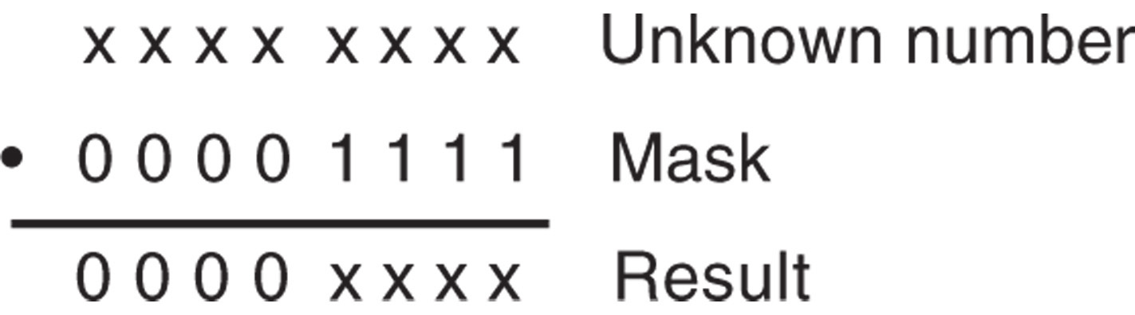
Figure 5–4 The operation of the AND function showing how bits of a number are cleared to zero.

Slide 48
OR
Performs logical addition
  often called the Inclusive-OR function
The OR function generates a logic 1 output if any inputs are 1.
  a 0 appears at output only when all inputs are 0
Figure 5–6 shows how the OR gate sets (1) any bit of a binary number.
The OR instruction uses any addressing mode except segment register addressing.

Slide 49
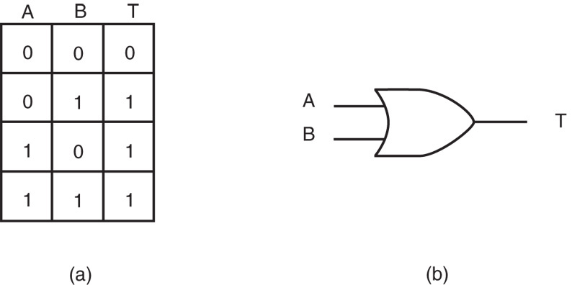
Figure 5–5 (a) The truth table for the OR operation and (b) the logic symbol of an OR gate.

Slide 50
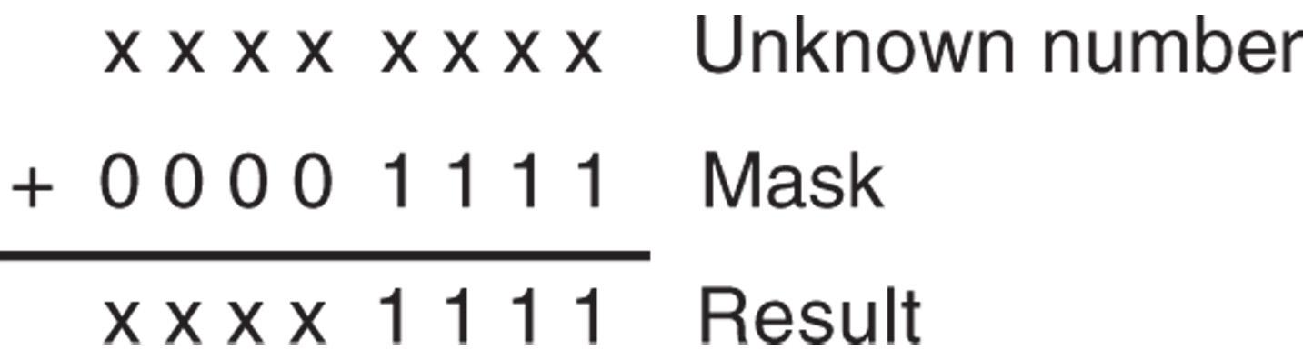
Figure 5–6 The operation of the OR function showing how bits of a number are set to one.

Slide 51
Exclusive-OR
Differs from Inclusive-OR (OR) in that the 1,1 condition of Exclusive-OR produces a 0.
  a 1,1 condition of the OR function produces a 1
The Exclusive-OR operation excludes this condition; the Inclusive-OR includes it.
If inputs of the Exclusive-OR function are both 0 or both 1, the output is 0; if the inputs are different, the output is 1.
Exclusive-OR is sometimes called a comparator.

Slide 52
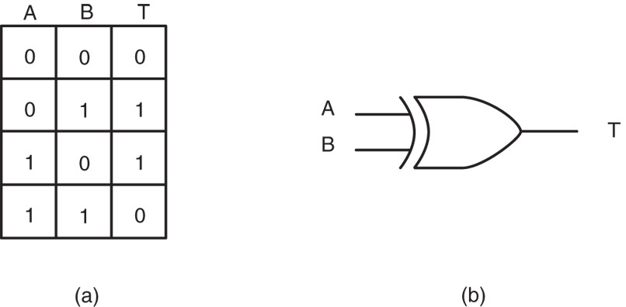
Figure 5–7 (a) The truth table for the Exclusive-OR operation and (b) the logic symbol of an Exclusive-OR gate.

Slide 53
XOR uses any addressing mode except segment register addressing.
Exclusive-OR is useful if some bits of a register or memory location must be inverted.
Figure 5–8 shows how just part of an unknown quantity can be inverted by XOR.
  when a 1 Exclusive-ORs with X, the result is X
  if a 0 Exclusive-ORs with X, the result is X
A common use for the Exclusive-OR instruction is to clear a register to zero

Slide 54
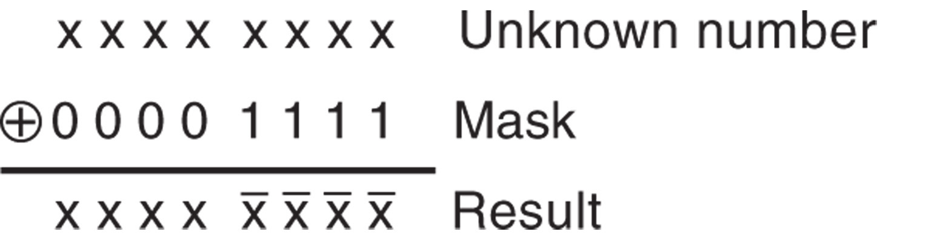
Figure 5–8 The operation of the Exclusive-OR function showing how bits of a number are inverted.

Slide 55
Test and Bit Test Instructions
TEST performs the AND operation.
  only affects the condition of the flag register,
  which indicates the result of the test
  functions the same manner as a CMP
Usually the followed by either the JZ (jump if zero) or JNZ (jump if not zero) instruction.
The destination operand is normally tested against immediate data.

Slide 56
80386 - Pentium 4 contain additional test instructions that test single bit positions.
  four different bit test instructions available
All forms test the bit position in the destination operand selected by the source operand.

Slide 57
NOT and NEG
NOT and NEG can use any addressing
mode except segment register addressing.
The NOT instruction inverts all bits of a byte, word, or doubleword.
NEG two’s complements a number.
  the arithmetic sign of a signed number changes from positive to negative or negative to positive
The NOT function is considered logical, NEG function is considered an arithmetic operation.

Slide 58
Shift and Rotate
Shift and rotate instructions manipulate binary numbers at the binary bit level.
  as did AND, OR, Exclusive-OR, and NOT
Common applications in low-level software used to control I/O devices.
The microprocessor contains a complete complement of shift and rotate instructions that are used to shift or rotate any memory data or register.

Slide 59
Shift
Position or move numbers to the left or right within a register or memory location.
  also perform simple arithmetic as multiplication by powers of 2^{+n} (left shift) and division by powers of 2^{-n} (right shift).
The microprocessor’s instruction set contains four different shift instructions:
  two are logical; two are arithmetic shifts
All four shift operations appear in Figure 5–9.

Slide 60
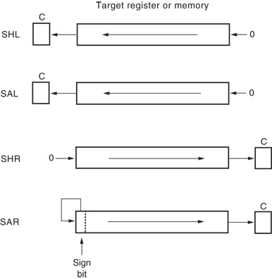
Figure 5–9 The shift instructions showing the operation and direction of the shift.
  logical shifts move 0 in the rightmost bit for a logical left shift;
  0 to the leftmost bit position for a logical right shift
  arithmetic right shift copies the sign-bit through the number
  logical right shift copies a 0 through the number.

Slide 61
Logical shifts multiply or divide unsigned data; arithmetic shifts multiply or divide signed data.
  a shift left always multiplies by 2 for each bit position shifted
  a shift right always divides by 2 for each position
  shifting a two places, multiplies or divides by 4

Slide 62
Double-Precision Shifts (80386–Core2 Only)
80386 and above contain two double precision shifts: SHLD (shift left) and SHRD (shift right).
Each instruction contains three operands.
Both function with two 16-or 32-bit registers,
  or with one 16- or 32-bit memory location and
  a register

Slide 63
Rotate
Positions binary data by rotating information in a register or memory location, either from one end to another or through the carry flag.
  used to shift/position numbers wider than 16 bits
With either type of instruction, the programmer can select either a left or a right rotate.
Addressing modes used with rotate are the same as those used with shifts.
Rotate instructions appear in Figure 5–10.

Slide 64
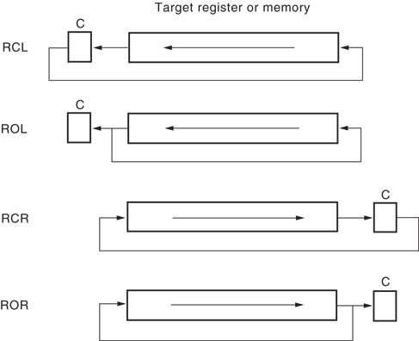
Figure 5–10 The rotate instructions showing the direction and operation of each rotate.

Slide 65
A rotate count can be immediate or located in register CL.
  if CL is used for a rotate count, it does not change
Rotate instructions are often used to shift wide numbers to the left or right.

Slide 66
Bit Scan Instructions
Scan through a number searching for a 1-bit.
  accomplished by shifting the number
  available in 80386–Pentium 4
BSF scans the number from the leftmost bit toward the right; BSR scans the number from the rightmost bit toward the left.
  if a 1-bit is encountered, the zero flag is set and the bit position number of the 1-bit is placed into the destination operand
  if no 1-bit is encountered the zero flag is cleared

Slide 67
5-6 STRING COMPARISONS
String instructions are powerful because they allow the programmer to manipulate large blocks of data with relative ease.
Block data manipulation occurs with MOVS, LODS, STOS, INS, and OUTS.
Additional string instructions allow a section of memory to be tested against a constant or against another section of memory.
  SCAS (string scan); CMPS (string compare)

Slide 68
SCAS
Compares the AL register with a byte block of memory, AX with a word block, or EAX with a doubleword block of memory.
Opcode used for byte comparison is SCASB; for word comparison SCASW; doubleword comparison is SCASD
SCAS uses direction flag (D) to select auto-increment or auto-decrement operation for DI.
  also repeat if prefixed by conditional repeat prefix

Slide 69
CMPS
Always compares two sections of memory data as bytes (CMPSB), words (CMPSW), or doublewords (CMPSD).
  contents of the data segment memory location addressed by SI are compared with contents of extra segment memory addressed by DI
  CMPS instruction increments/decrements SI & DI
Normally used with REPE or REPNE prefix.
  alternates are REPZ (repeat while zero) and REPNZ (repeat while not zero)

Slide 70
SUMMARY
Addition (ADD) can be 8, 16, 32, or 64 bits.
The ADD instruction allows any addressing mode except segment register addressing.
Most flags (C, A, S, Z, P, and O) change when the ADD instruction executes.
A different type of addition, add-with-carry (ADC), adds two operands and the contents of the carry flag (C).

Slide 71
SUMMARY
(cont.)
The 80486 through the Core2 processors have an additional instruction (XADD) that combines an addition with an exchange.
The increment instruction (INC) adds 1 to the byte, word, or doubleword con-tents of a register or memory location.
The INC instruction affects the same flag bits as ADD except the carry flag.

Slide 72
SUMMARY
(cont.)
BYTE PTR, WORD PTR, DWORD PTR, or QWORD PTR directives appear with the INC instruction when contents of a memory location are addressed by a pointer.
Subtraction (SUB) is a byte, word, doubleword, or quadword and is performed on a register or a memory location.
The only form of addressing not allowed by the SUB instruction is segment register addressing.

Slide 73
SUMMARY
(cont.)
The subtract instruction affects the same flags as ADD and subtracts carry if the SBB form is used.
The decrement (DEC) instruction subtracts 1 from the contents of a register or a memory location.
The only addressing modes not allowed with DEC are immediate or segment register addressing.

Slide 74
SUMMARY
(cont.)
The DEC instruction does not affect the carry flag and is often used with BYTE PTR, WORD PTR, DWORD PTR, or QWORD PTR.
The comparison (CMP) instruction is a special form of subtraction that does not store the difference; instead, the flags change to reflect the difference.

Slide 75
SUMMARY
(cont.)
Comparison is used to compare an entire byte or word located in any register (ex-cept segment) or memory location.
An additional comparison instruction (CMPXCHG), which is a combination of comparison and exchange instructions, is found in the 80486-Core2 processors.
In the Pentium-Core2 processors, the CMPXCHG8B instruction compares and exchanges quadword data.

Slide 76
SUMMARY
(cont.)
Multiplication is byte, word, or doubleword; can be signed (IMUL) or un-signed (MUL).
The 8-bit multiplication always multiplies register AL by an oper-and with the product found in AX.
The 16-bit multiplication always multiplies register AX by an operand with the product found in DX-AX.

Slide 77
SUMMARY
(cont.)
The 32-bit multiply always multiplies register EAX by an operand with the product found in EDX-EAX.
A special IMUL immediate instruction exists on the 80186-Core2 proces-sors that contains three operands.
In the Pentium 4 and Core2 with 64-bit mode enabled, multiplication is 64 bits.

Slide 78
SUMMARY
(cont.)
Division is byte, word, or doubleword, and it can be signed (IDIV) or unsigned (DIV).
For an 8-bit division, the AX register divides by the operand, after which the quotient appears in AL and the remainder appears in AH.
In the 16-bit division, the DX-AX register divides by the operand, after which the AX register contains the quotient and DX contains the remainder.

Slide 79
SUMMARY
(cont.)
In the 32-bit division, the EDX-EAX register is divided by the operand, after which the EAX register con-tains the quotient and the EDX register contains the remainder.
The remainder after a signed division always assumes the sign of the dividend.
BCD data add or subtract in packed form by adjusting the result of the addition with DAA or the subtraction with DAS.

Slide 80
SUMMARY
(cont.)
ASCII data are added, subtracted, multi-plied, or divided when the operations are adjusted with AAA, AAS, AAM, and AAD.
These instructions do not function in the 64-bit mode.
The AAM instruction has an interesting added feature that allows it to convert a binary number into unpacked BCD.

Slide 81
SUMMARY
(cont.)
This instruction converts a binary number between 00H-63H into unpacked BCD in AX.
The AAM instruction divides AX by 10, and leaves the remainder in AL and quotient in AH.
These instructions do not function in the 64-bit mode.

Slide 82
SUMMARY
(cont.)
The AND, OR, and Exclusive-OR instructions perform logic functions on a byte, word, or doubleword stored in a register or memory location.
All flags change with these instructions, with carry (C) and overflow (O) cleared.
The TEST instruction performs the AND operation, but the logical product is lost.
This instruction changes the flag bits to indicate the outcome of the test.

Slide 83
SUMMARY
(cont.)
The NOT and NEG instructions perform logical inversion and arithmetic inver-sion.
The NOT instruction one's complements an operand, and the NEG in-struction two's complements an operand.

Slide 84
SUMMARY
(cont.)
There are eight different shift and rotate instructions.
Each of these instructions shifts or rotates a byte, word, or doubleword register or memory data.
These instructions have two operands: The first is the location of the data shifted or ro-tated, and the second is an immediate shift or rotate count or CL.

Slide 85
SUMMARY
(cont.)
If the second operand is CL, the CL register holds the shift or rotate count.
In the 80386 through the Core2 processors, two additional double-precision shifts (SHRD and SHLD) exist.
The scan string (SCAS) instruction compares AL, AX, or EAX with the contents of the extra segment memory location addressed by DI.

Slide 86
SUMMARY
(cont.)
The string compare (CMPS) instruction compares the byte, word, or doubleword contents of two sections of memory.
One section is addressed by DI in the extra segment, and the other is addressed by SI in the data segment.

Slide 87
SUMMARY
The SCAS and CMPS instructions repeat with the REPE or REPNE prefixes.
The REPE prefix repeats the string instruction while an equal condition exists, and the REPNE repeats the string instruction while a not-equal condition exists.

