Slide 1
Chapter 4
Data Movement Instructions

Slide 2


Instruction
Data movement instructions :
  MOV, MOVSX, MOVZX, PUSH, POP, BSWAP, XCHG, XLAT, IN, OUT, LEA, LDS, LES, LFS, LGS, LSS, LAHF, SAHF
  String instruction : MOVS, LODS, STOS, INS, OUTS
  CMOV(pentium pro, pentiumII)
Describe the assembler language syntax and directive
Ch.4 Data Movement Instructions

Slide 3
4-1 MOV Revisited
Machine code : is introduced
  Occasionally be necessary to interpret machine language programs generated by an assembler
  Debugging or modification at machine language level
Machine language : native binary code
  In length from one to as many as 13 bytes
16-bit mode instructions of 8086~80286 : Fig. 4-1(a)
  80386~ real mode (prefixed) : Fig. 4-1(b)
32-bit mode instruction : Fig. 4-1(b)
Protected mode : D-bit of descriptor selects 16, 32
Ch.4 Data Movement Instructions

Slide 4
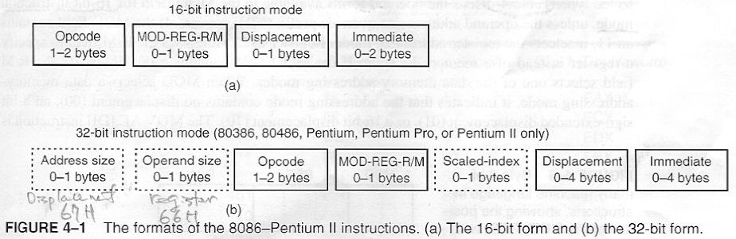
Fig. 4-1 Instruction Format
16-bit
Ch.4 Data Movement Instructions

Slide 5
Machine Language
Override prefix :
  Address size prefix(67H) : modifies address size
  Register size prefix(66H) : modifies register size
Prefixes : toggle size of register and operand address from 16-bit to 32-bit or from 32-bit to 16-bit for prefixed instruction
16-bit instruction : 8, 16-bit registers and address
32-bit instruction : 8, 32-bit registers and address
Mode of operation : selected to conform with the application
Ch.4 Data Movement Instructions

Slide 6
The Opcode
Opcode : selects operation that is performed by µ
  1~2 byte long
Fig. 4-2 : general form of 1st opcode byte of many, but not all
1st 6 bits : binary opcode
D(direction) bit : data flow
  D = 1: to register REG field from R/M field in 2nd byte
  D = 0: to R/M field from REG field in 2nd byte
W : data size
  W = 1 : word or doubleword(386~)
  W = 0 : always byte
Ch.4 Data Movement Instructions

Slide 7
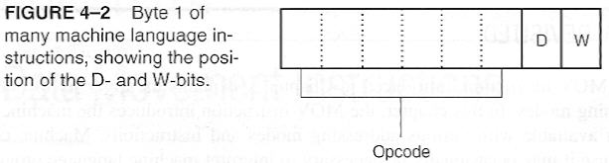
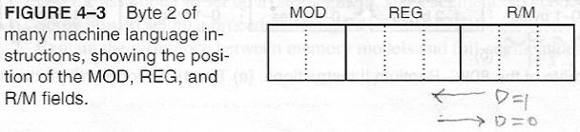
The Opcode
Opcode :
Ch.4 Data Movement Instructions

Slide 8
MOD Field
Fig. 4-3 : for binary bit pattern of 2nd opcode byte
MOD field : specifies addressing mode
Table 4-1: lists operand forms available for 16-bit
MOD=11 : selects register addressing mode
  Use to R/M field to specify a register
MOD=00,01,10 : R/M field selects one of data memory-addressing modes contains
  no displacement(00),
  8-bit sign-extended displacement(01),
  16-bit displacement(10)
Ch.4 Data Movement Instructions

Slide 9
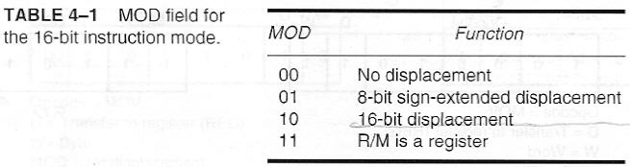
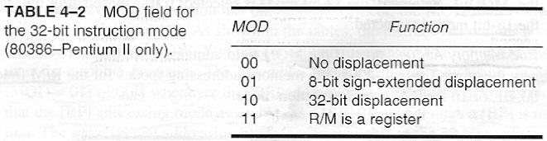
MOD Field
Table 4-1
Ch.4 Data Movement Instructions

Slide 10
MOD field
8-bit displacement : sign-extended into 16-bit displacement when µ executes the instruction
  sign-bit copied to next higher-order byte
  00H~7FH : 0000~007FH, 80~FFH : FF80H~FFFFH
MOD field (80386~) : table 4-2
00 : no displacement
01 : 8-bit sign-extended displacement to 32-bit
10 : 32-bit displacement
Ch.4 Data Movement Instructions

Slide 11
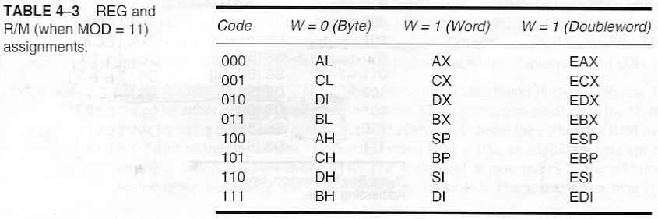
Register Assignments
Table 4-3 : register assignment for REG field and R/M field(MOD=11)
  W=1(doubleword) : 80386~
Ch.4 Data Movement Instructions

Slide 12
Register Assignments
Ex. 2 byte instruction(8BECH) : Fig. 4-4
  Assume µ is operated in 16-bit instruction mode
  MOV BP,SP
Ex. 668BE8H in 80386~(operated 16-bit mode)
  66H : register size override prefix → 32-bit reg.
  MOV EBP,EAX
  MOV BP,AX(80386~, operated 32-bit mode)
.386 switch before .MODEL : 32-bit mode
.386 switch after .MODEL : 16-bit mode
Ch.4 Data Movement Instructions

Slide 13
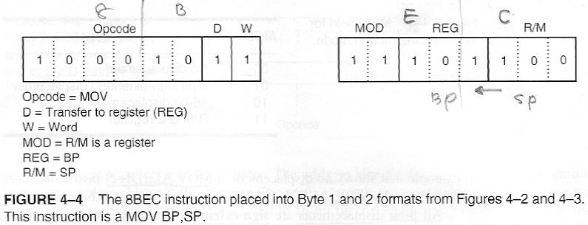
Register Assignments
P894 : MOV reg.,reg. mem.,reg. reg.,mem.
Fig. 4-4
Ch.4 Data Movement Instructions

Slide 14
R/M Memory addressing
Table 4-4 : lists memory addressing modes for R/M field when MOD is 00,01,10 for 16-bit mode
R/M=000,001,010,011 :
  MOD=00 : base-plus-index
  MOD=01,10 : base relative plus index
R/M=100,101,110,111 :
  MOD=00 : register indirect
  MOD=01,10 : register relative
Ch.4 Data Movement Instructions

Slide 15
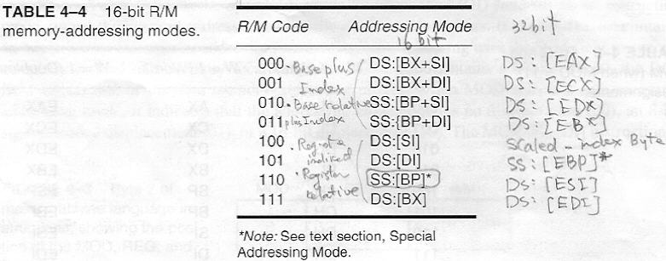
R/M Memory addressing
Table 4-4 :
Ch.4 Data Movement Instructions

Slide 16
R/M Memory addressing
R/M = 101 → DS:[DI]
  MOD = 00 : [DI], MOD=01,10 : [DI+33H]
Fig. 4-5 : 16-bit instruction(8A15H) MOV DL,[DI]
  If MOV DL,[DI+1] : 8A 55 01H
  If MOV DL,[DI+1000H] : 8A 95 00 10H
Ch.4 Data Movement Instructions

Slide 17
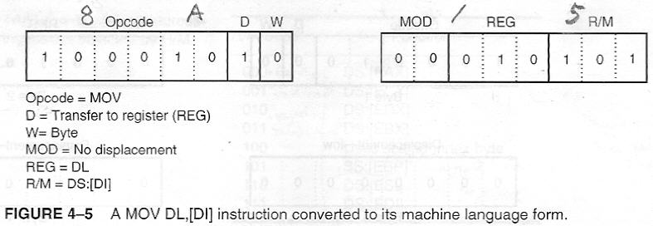
R/M Memory Addressing
MOV DL,[DI] : 8A15H
MOV DL,[DI+1] : 8A5501H
MOV DL,[DI+1000H] : 8A950010H
Ch.4 Data Movement Instructions

Slide 18
Special Addressing Mode
Direct addressing : data are referenced by only displacement for 16-bit instruction
Ex. : MOV [1000H],DL or MOV NUMB,DL
  MOD=00, R/M=110 : [BP] ← Table 4-4
[BP] → [BP+0] 8-bit disp. : MOD=01, R/M=110
Same special addressing mode : 32-bit mode
Ch.4 Data Movement Instructions

Slide 19
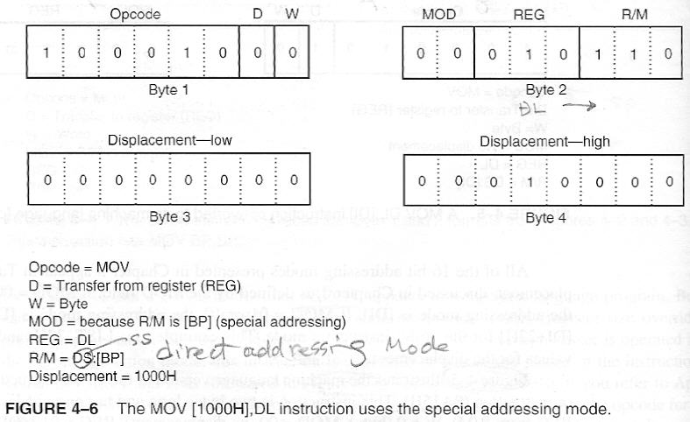
Fig. 4-6
Fig. 4-6 : MOV [1000H],DL
Ch.4 Data Movement Instructions

Slide 20
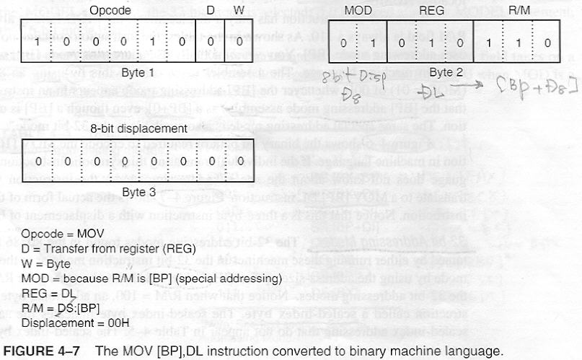
Fig. 4-7
Fig. 4-7 : MOV [BP],DL
Ch.4 Data Movement Instructions

Slide 21
32-bit Addressing Modes
32-bit addressing in 80386~ : are obtained by
  either running these machines in the 32-bit mode
  or in the 16-bit mode by using address-size prefix 67H
Table 4-5 : coding for R/M used to specify the 32-
R/M=100 : scaled-index addressing mode(p.850)
  7-bits in the opcode(no D-bit) + scaled-index byte
Fig. 4-8 : format of the scaled-index byte
MOV EAX,[EBX+4*ECX] : 8B 04 8BH
  80386~ µ are operated in 16-bit mode : 67668B048BH
MOV AL,[2*ECX]
Ch.4 Data Movement Instructions

Slide 22
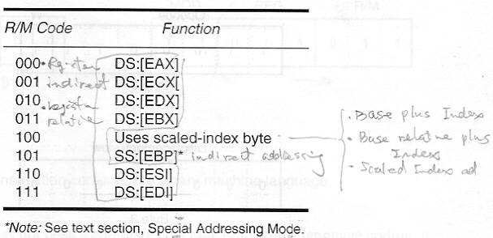
Table 4-5
Table 4-5 : 32-bit addressing modes selected by R/M
Ch.4 Data Movement Instructions

Slide 23
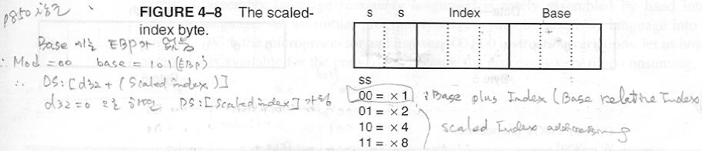
Fig. 4-8
Fig. 4-8
Ch.4 Data Movement Instructions

Slide 24
An Immediate Instruction
MOV WORD PTR [BX+1000H],1234H : 16-bit instruction(fig. 4-9, p.895)
6 byte instruction: 2 byte(opcode), 2(disp), 2(data)
MOV [BX],AL : byte operation
MOV [BX],1 : not exact
specify BYTE PTR, WORD PTR, DWORD PTR
If not, assembler flags it as an error because it cannot determine the intent of this instruction
Ch.4 Data Movement Instructions

Slide 25
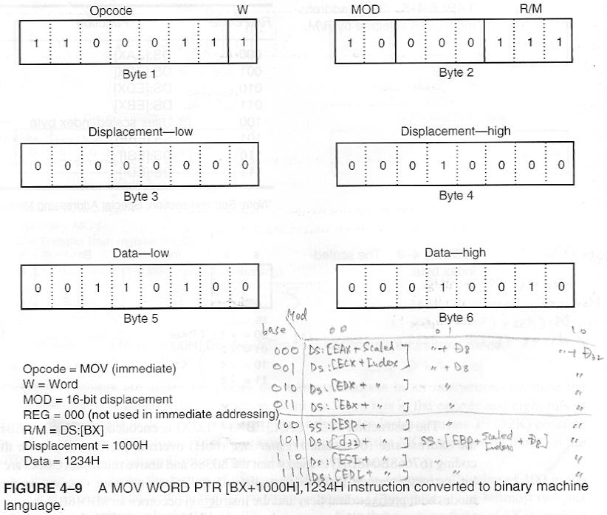
Fig. 4-9
Fig. 4-9

Slide 26
Segment MOV Instruction
Contents of a segment reg. are moved by MOV, PUSH, POP : REG field selects segment reg. (Table 4-6)
Fig. 4-10 : MOV BX,CS
Segment reg. can be moved between any 16-bit reg. or 16-bit memory location : MOV [DI], DS
Immediate segment reg. MOV : is not available
Ch.4 Data Movement Instructions

Slide 27
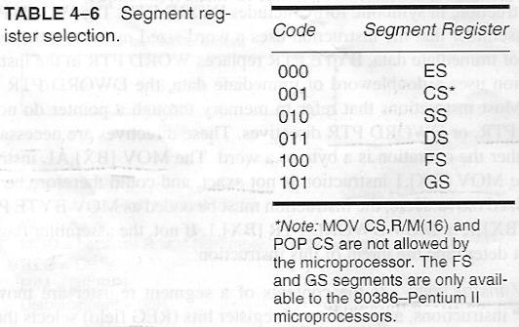
Table 4-6
Table 4-6
Ch.4 Data Movement Instructions

Slide 28
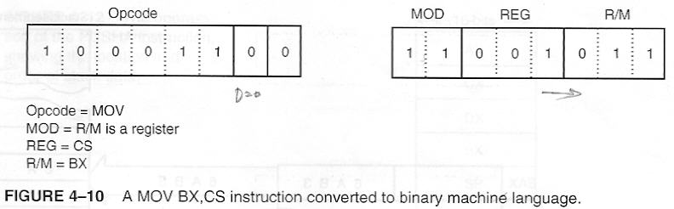
Fig. 4-10
Fig. 4-10 : p896
Ch.4 Data Movement Instructions

Slide 29
4-2 PUSH/POP
PUSH, POP : store and retrieve data from LIFO stack memory
Six form : register, memory, immediate, segment register, flags, all registers
PUSH immediate, PUSHA, POPA : 80286~
Any 16-bit register(80386~ : 32-bit register)
16-bit memory location (80386~ : 32-bit)
Only PUSH immediate data : not popped off stack
Any segment reg. to be pushed or popped from stack : Data from stack never be popped into CS
Ch.4 Data Movement Instructions

Slide 30
PUSH
8086~286 : always transfer 2 bytes of data to stack
80386~ : 2 or 4 bytes
Source of data : any internal 16- or 32-bit reg., immediate data, any segment reg., or any 2 or 4 bytes of memory data
PUSHA(push all) :
order : AX, CX, DX, BX, SP, BP, SI, DI
value for SP pushed onto stack: before PUSHA
PUSHF(push flags) : push the contents of flag reg.
PUSHAD : push the contents of 32-bit register set
Ch.4 Data Movement Instructions

Slide 31
PUSH
Fig. 4-11 : PUSH AX
  SS:[SP-1] ← AH, 1st(most significant) byte
  SS:[SP-2] ← AL, 2nd(least significant)byte
  after PUSH operation, SP ← SP - 2
PUSHA : fig. 4-12
PUSH immediate : two different opcodes
  immediate data are 00H~FFH : opcode is 6AH
  data 0100H~FFFFH : opcode is 68H
  Ex. PUSH 8 : 6A08H(pushes 0008H onto stack)
  PUSH 1000H : 680010H
  PUSH `A` : pushes 0041H onto stack
Ch.4 Data Movement Instructions

Slide 32
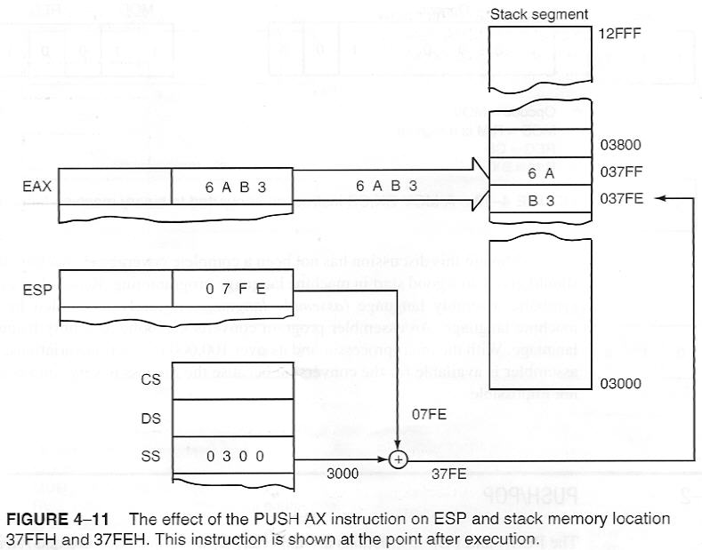
Fig. 4-11
Fig. 4-11
Ch.4 Data Movement Instructions

Slide 33
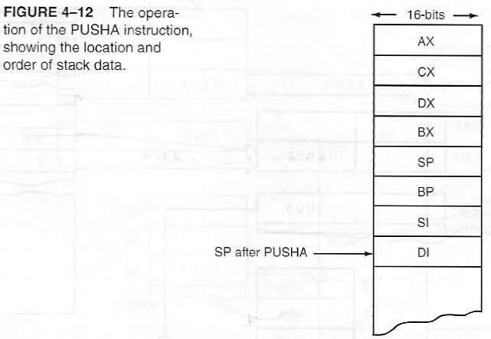
Fig. 4-12
Fig. 4-12
Ch.4 Data Movement Instructions

Slide 34
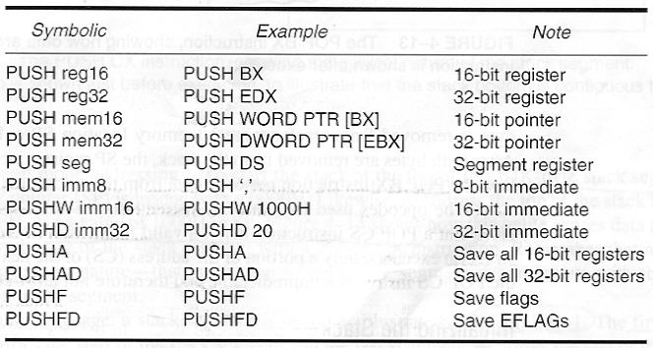
Table 4-7
Table 4-7 : The PUSH instructions
Ch.4 Data Movement Instructions

Slide 35
POP
POP : performs the inverse operation of PUSH
POP : removes data from stack and place it into target 16- or 32-bit reg., segment reg., or a 16- or 32-bit memory location
POP : is not available as an immediate POP
POP CS : is not a valid instruction
POPA : DI, SI, BP, SP, BX, DX, CX, AX
POP BX : Fig 4-13
  BL ← SS:[SP], BH ← SS:[SP+1]
  after POP operation, SP← SP+2
Ch.4 Data Movement Instructions

Slide 36
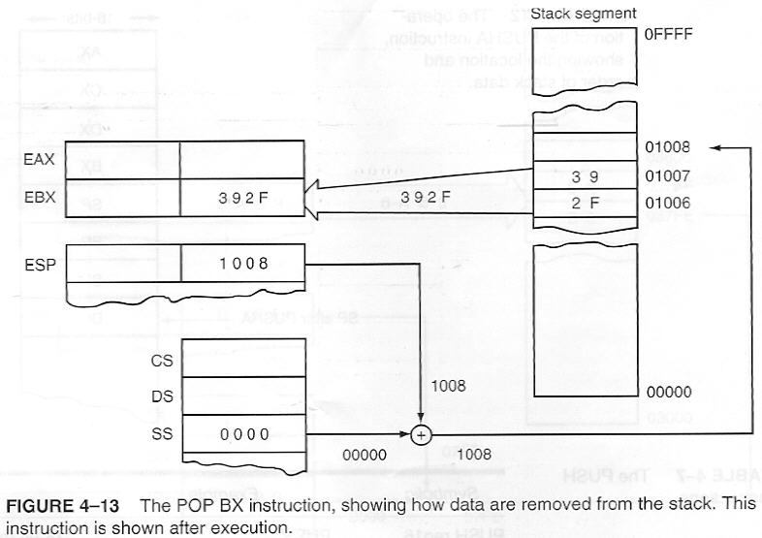
Fig. 4-13
Fig. 4-13
Ch.4 Data Movement Instructions

Slide 37
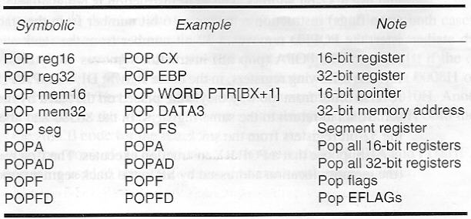
Table 4-8
Table 4-8 : The POP instructions
Ch.4 Data Movement Instructions

Slide 38
Initializing the Stack
When the stack area is initialized : load both SS reg. and SP reg.
Ex. Stack segment : 10000H ~ 1FFFFH
  load SS with a 1000H : fig. 4-14
  to start stack at the top of 64K-byte : SP ← 0000H
  to address the top of stack at 10FFFH : SP ← 1000H
Fig. 4-14 : all segment are cyclic in nature
  that is, top location of a segment is contiguous with bottom location of the segment
Stack segment set up: EX.4-1(full segment definition)
  EX.4-2(memory model method) : only MASM
Ch.4 Data Movement Instructions

Slide 39
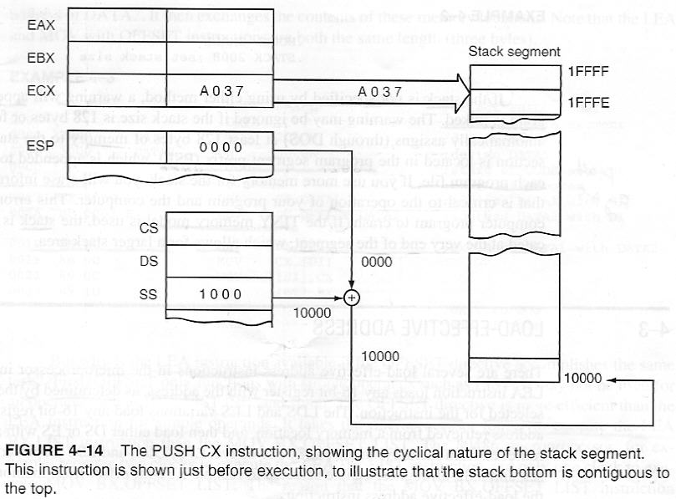
Fig. 4-14
Fig. 4-14
Ch.4 Data Movement Instructions

Slide 40
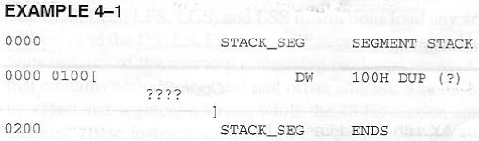

EX. 4-1, EX. 4-2
EX. 4-1, EX. 4-2
Ch.4 Data Movement Instructions

Slide 41
Assembler, linker : place the correct stack segment address in SS and length of the segment(top of stack) into SP
no need to load SS,SP unless wish to change stack
If the stack is not specified: warning(when linked)
may be ignored : if stack size is 128 bytes or fewer
  system automatically assign(through DOS) at least 128 bytes that is located in program segment prefix(PSP) : will erase information in PSP
if TINY model is used : stack is automatically located at the very end of the segment, which allows for a lager stack area
Ch.4 Data Movement Instructions

Slide 42
4-3 Load-Effective Address
LEA : loads a 16- or 32-bit reg. with the offset address of the data specified by the operand
Table 4-9
  1st ex. : AX ← operand offset address MUMB
LEA BX,[DI] : loads offset address specified by [DI] (contents of DI) into BX
MOV BX,[DI] : loads the data stored at the memory location addressed by [DI] into BX
OFFSET directive : performs the same function as an LEA instruction if operand is a displacement
  MOV BX, OFFSET LIST = LEA BX, LIST
Ch.4 Data Movement Instructions

Slide 43
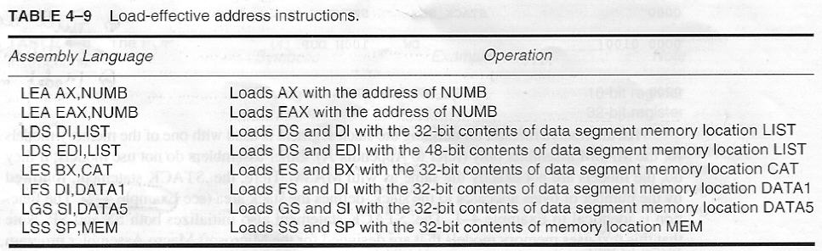
Table 4-9
Table 4-9
Ch.4 Data Movement Instructions

Slide 44
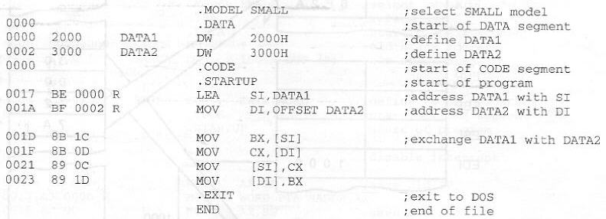
EX. 4-3 : loads SI with address of DATA1 and DI with address of DATA2, exchanges the contents of these memory location
Ch.4 Data Movement Instructions

Slide 45
LEA
LEA and MOV with OFFSET : 3 bytes instruction
why is LEA available if OFFSET accomplishes the same task ?
1. OFFSET only functions with simple operands such as LIST(not used [DI], LIST[DI], and so on)
2. OFFSET is more efficient for simple operands
  longer to execute LEA BX, LIST(2 clocks) than MOV BX, OFFSET LIST(1 clock, 80486)
  because assembler calculates offset address of LIST, while µ calculates the LEA instruction
Ch.4 Data Movement Instructions

Slide 46
LEA
MOV BX, DI performs in less time and is often preferred to LEA BX, [DI]
3. LEA SI,[BX+DI] : modulo-64K sum
  drops any carry out of the 16-bit result
  Ex. BX = 1000H, DI = FF00H : SI = 0F00H
Ch.4 Data Movement Instructions

Slide 47
LDS, LES, LFS, LGS, LSS
load any 16-bit or 32-bit register with an offset address, and the DS, ES, FS, GS, or SS segment register with a segment address
use any of memory-addressing modes to access a 32-bit(16-bit offset, segment address) or 48-bit(32-bit offset, 16-bit segment address) section of memory that contains both the segment and offset address
may not use the register addressing(MOD=11)
LFS, LGS, LSS : 80386~
Ch.4 Data Movement Instructions

Slide 48
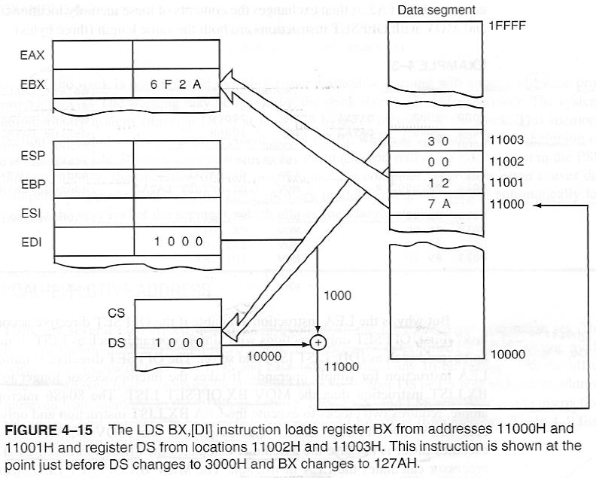
Fig. 4-15
Fig. 4-15 : LDS BX,[DI]
Ch.4 Data Movement Instructions

Slide 49
LDS, LES, LFS, LGS, LSS
obtain a new far address from memory
far address(offset, segment address) can be stored in memory by the assembler
ADDR DD FAR PTR FROG : stores far address of FROG in 32-bits of memory at location ADDR
LDS EBX,[DI] in 80386~ : loads EBX from 4-byte section of memory addressed by DI in the data segment, and following this 4-byte offset is a word that is loaded to DS
EX. 4-4 : creates a new stack area after saving the address of the old stack area
Ch.4 Data Movement Instructions

Slide 50
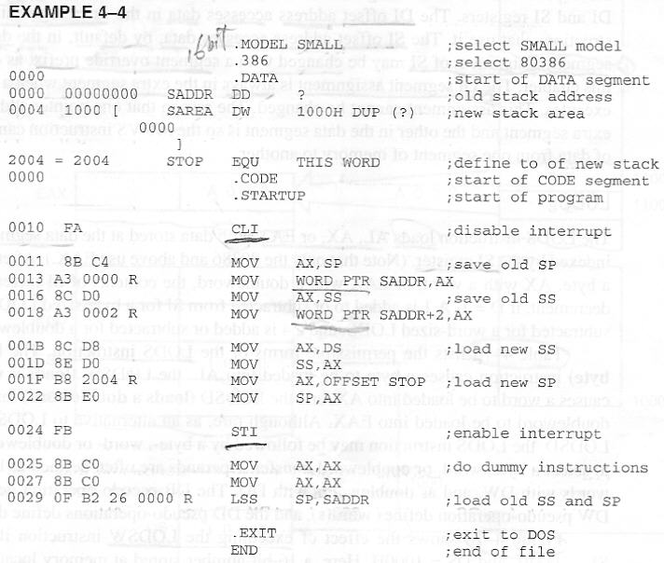
EX. 4-4
EX. 4-4

Slide 51
4-4 String Data Transfers
LODS, STOS, MOVS, INS, OUTS
data transfers that either a single byte, word, or doubleword(or if repeated, a block of bytes, words, doublewords)
before string instruction, the operation of D flag-bit(direction), DI, and SI must be understood
D flag selects auto-increment(D = 0) or auto-decrement(D = 1) operation for DI, SI registers during string instruction.
  CLD : clears D flag(D = 0)
  STD : sets D flag(D = 1)
Ch.4 Data Movement Instructions

Slide 52
4-4 String Data Transfers
whenever a string instruction transfers a byte, word, doubleword : DI/SI ← DI/SI ± 1, ± 2, ± 4
  Only actual registers used by string instruction increment or decrement
DI offset address : accesses data in extra segment for all string instructions that use it
SI offset address : accesses data, by default, in data segment
SI Segment assignment : may be changed with a segment override prefix
DI Segment assignment : is always extra segment
Ch.4 Data Movement Instructions

Slide 53
4-4 String Data Transfers
LODS AL ← DS:[SI]
STOS ES:[DI] ← AL
MOVS ES:[DI] ← DS:[SI]
SCAS AL – ES:[DI]
CMPS DS:[SI] – ES:[DI]
INS ES:[DI] ← [DX]
OUTS [DX] ← DS:[SI]
Ch.4 Data Movement Instructions

Slide 54
LODS
LODS : AL, AX, EAX ← DS:[SI]
loads AL, AX, EAX with data stored at the data segment offset address indexed by SI
AL, AX, EAX : SI ← SI ± 1, ± 2, ± 4
D = 0 : auto-increment, D = 1 auto-decrement
Table 4-10 : LODSB, LODSW, LODSD
operands : are often defined as bytes with DB, as words with DW, as doublewords with DD
Fig. 4-16 : LODSW
  D = 0, SI = 1000H, DS = 1000H
Ch.4 Data Movement Instructions

Slide 55
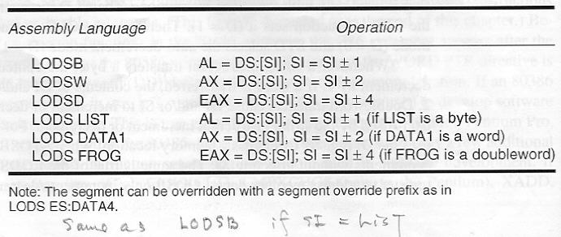
Table 4-10
Table 4-10 : Forms of the LODS instruction
Ch.4 Data Movement Instructions

Slide 56
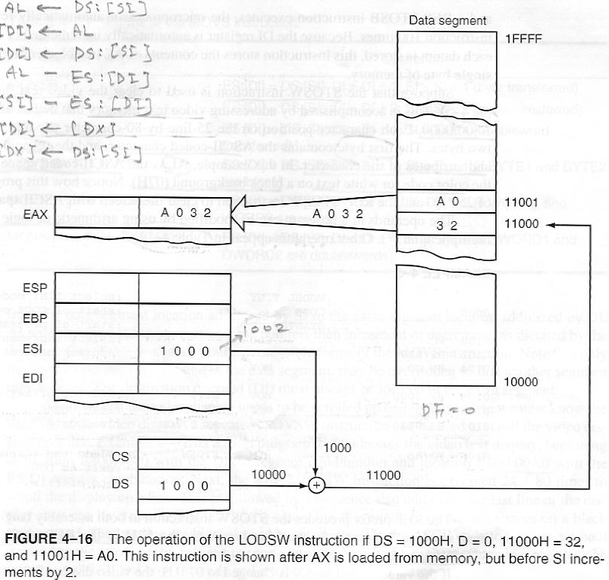
Fig. 4-16
Fig. 4-16 : LODSW
Ch.4 Data Movement Instructions

Slide 57
STOS
STOS : ES:[DI] ← AL, AX, EAX
stores AL, AX, EAX at the extra segment memory location addressed by DI
AL, AX, EAX : DI ← DI ± 1, ± 2, ± 4
D = 0 : auto-increment, D = 1 auto-decrement
Table 4-11 : STOSB, STOSW, STOSD
operands : are often defined as bytes with DB, as words with DW, as doublewords with DD
Ch.4 Data Movement Instructions

Slide 58
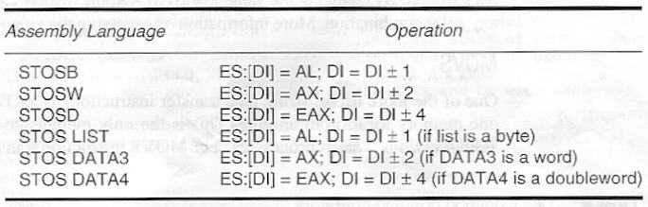
Table 4-11
Table 4-11 : Forms of STOS instruction
Ch.4 Data Movement Instructions

Slide 59
STOS with a REP
repeat prefix(REP) : is added to any string data transfer instruction, except the LODS
REP : causes CX to decrement by 1 each time string instruction executes
  after CX decrements, if CX ≠ 0, string instruction repeats.
  if CX = 0, instruction terminates and continues with next sequential instruction
EX. 4-5 : to clear the video text display
  video text memory : B800:0000(25 line × 80 character)
  each character position : 2 bytes(ASCII, color attributes)
  AL= 20H(space), AH= 07H(white text, black background)
Ch.4 Data Movement Instructions

Slide 60
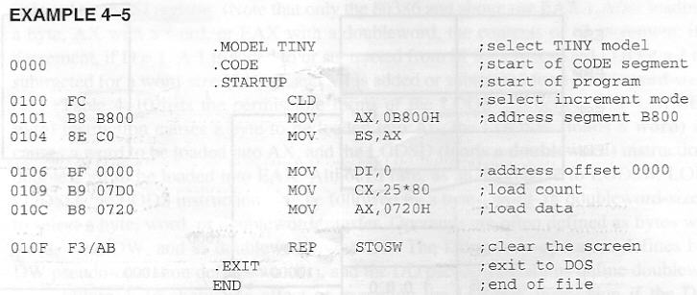
EX. 4-5
EX. 4-5
Ch.4 Data Movement Instructions

Slide 61
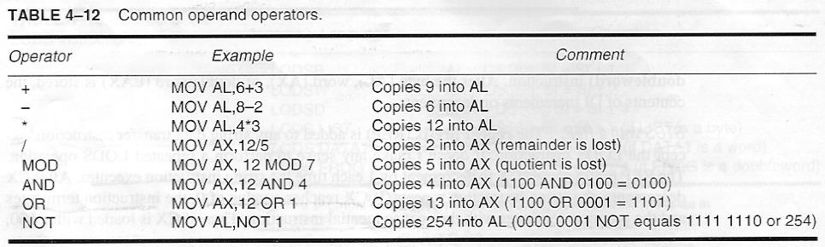
Table 4-12
Table 4-12:arithmetic, logic operator in a program
Ch.4 Data Movement Instructions

Slide 62
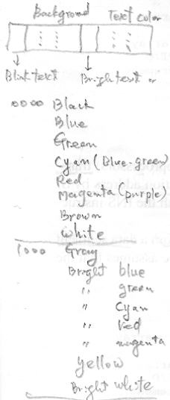
Color code and Attributes
Attribute byte

Slide 63
MOVS
MOVS : ES:[DI] ← DS:[SI]
  transfer byte, word, doubleword
  from data segment location addressed by SI
  to extra segment location addressed by DI
  SI : may be changed with a segment override prefix
  destination operand DI : is always extra segment
  byte,word,doubleword : SI/DI←SI/DI±1, ±2, ±4
  D = 0 : auto-increment, D = 1 auto-decrement
Table 4-13 : MOVSB, MOVSW, MOVSD
  operands is often defined as DB, DW, DD
Ch.4 Data Movement Instructions

Slide 64
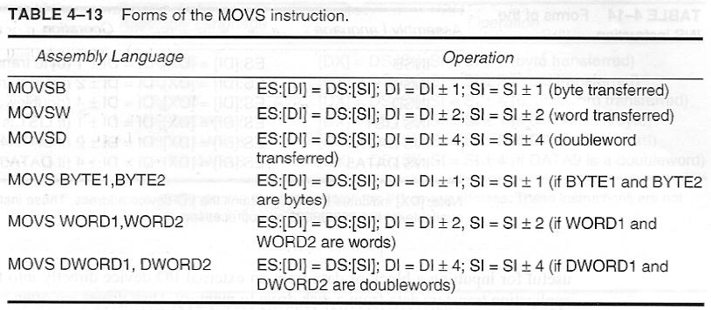
Table 4-13
Table 4-13
Ch.4 Data Movement Instructions

Slide 65
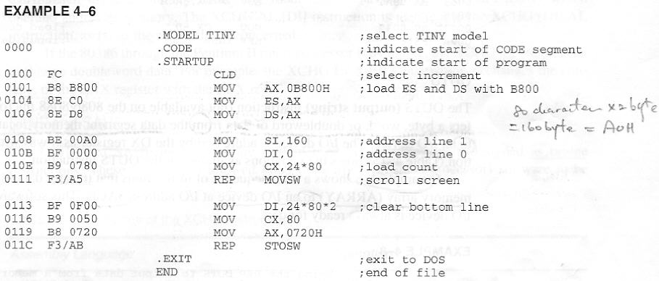
EX. 4-6 : to be scrolled up one line
1 line = 160(A0H) byte = 2 byte × 80 character
Ch.4 Data Movement Instructions

Slide 66
INS
INS : ES:[DI] ← [DX]
  transfer byte, word, doubleword
  from I/O device addressed by DX
  to extra segment location addressed by DI
  byte, word, doubleword : DI←DI ± 1, ± 2, ± 4
  D = 0 : auto-increment, D = 1 auto-decrement
useful for inputting a block of data from external I/O
  transfers data from disk drive to memory
Table 4-14 : INSB, INSW, INSD
  operands is often defined as DB, DW, DD
Ch.4 Data Movement Instructions

Slide 67
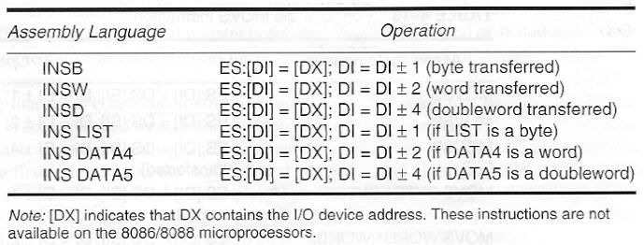
Table 4-14
Table 4-14 : forms of the INS instruction
Ch.4 Data Movement Instructions

Slide 68
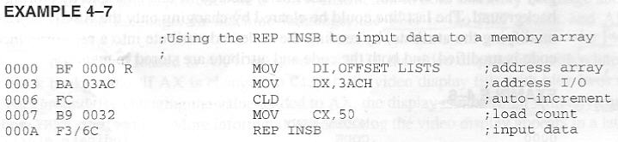
EX. 4-7
EX. 4-7 : to input 50 bytes of data from an I/O device whose address is 03ACH and stores in extra segment memory array LISTS
Ch.4 Data Movement Instructions

Slide 69
OUTS
OUTS : [DX] ← DS:[SI]
  transfer byte, word, doubleword
  from data segment location addressed by SI
  to I/O device addressed by DX
  byte, word, doubleword : SI←SI ± 1, ± 2, ± 4
  D = 0 : auto-increment, D = 1 auto-decrement
useful for outputting a block of data to external I/O
  transfers data from memory to disk drive
Table 4-15 : OUTSB, OUTSW, OUTSD
  operands is often defined as DB, DW, DD
Ch.4 Data Movement Instructions

Slide 70
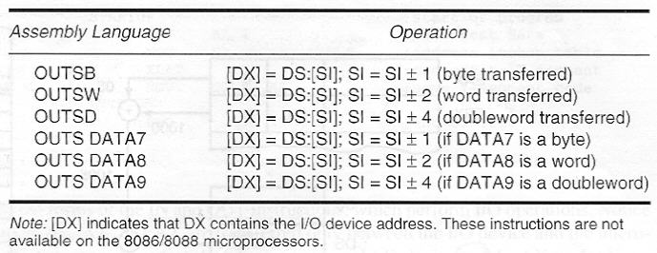
Table 4-15
Table 4-15 : forms of the OUTS instruction
Ch.4 Data Movement Instructions

Slide 71
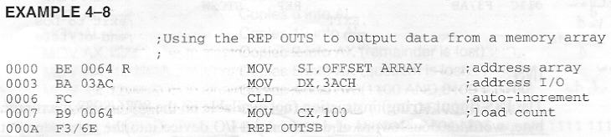
EX. 4-8
EX. 4-8 : transfer data from data segment memory array(ARRAY) to an I/O device whose address is 03ACH(assumes that I/O device is always ready for data)
Ch.4 Data Movement Instructions

Slide 72
4-5 Miscellaneous Data Transfer Instructions
XCHG(exchange) :
  exchanges contents of register with contents of any other register or memory location
  cannot exchange segment registers, or memory-to-memory data
  use any addressing mode except immediate
  16-bit AX with other 16-bit reg. : most efficient exchange(1 byte instruction, p 933)
  other XCHG : two or more bytes
  XCHG AL,[DI] = XCHG [DI], AL : assembler is concerned
Table 4-16
Ch.4 Data Movement Instructions

Slide 73
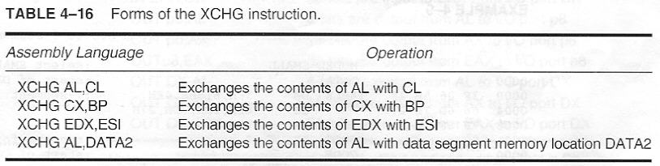
Table 4-16
Table 4-16
Ch.4 Data Movement Instructions

Slide 74
LAHF and SAHF
LAHF, SAHF : seldom used, as bridge instruction
  these instruction allowed 8085 software to be translated into 8086 software by translation program
  LAHF : AH ← FLAG(lower 8-bit)
  SAHF : FLAG(lower 8-bit) ← AH
XLAT(translate) : AL ← DS:[BX + AL]
  direct table lookup technique
EX. 4-9 : from a BCD code to a 7-segment code
  7-segment LED(p251) display lookup table : TABLE
Fig. 4-17 : AL = 6DH ← AL = 05H(a 5 BCD)
Ch.4 Data Movement Instructions

Slide 75
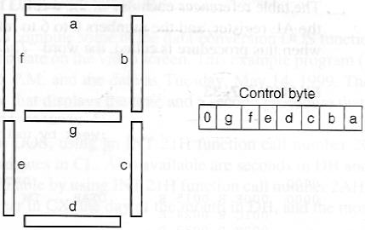
Fig. 7-1 Seven segment LED
EX. 4-9
Ch.4 Data Movement Instructions

Slide 76
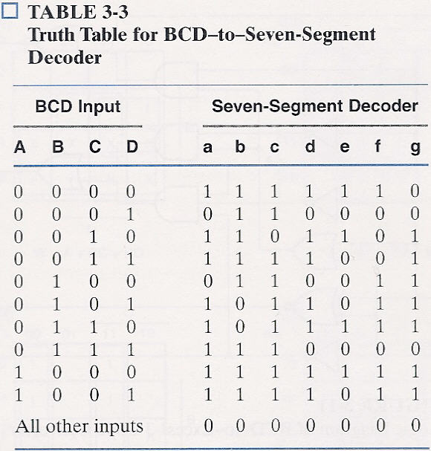
Fig. 7-1 Seven segment LED
EX. 4-9
Ch.4 Data Movement Instructions

Slide 77
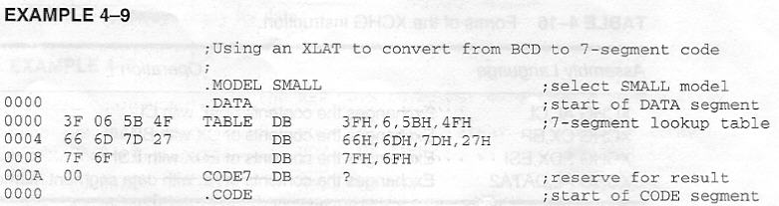
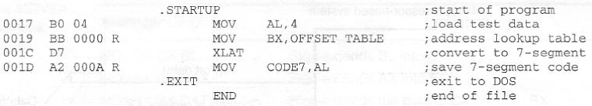
EX. 4-9
EX. 4-9
Ch.4 Data Movement Instructions

Slide 78
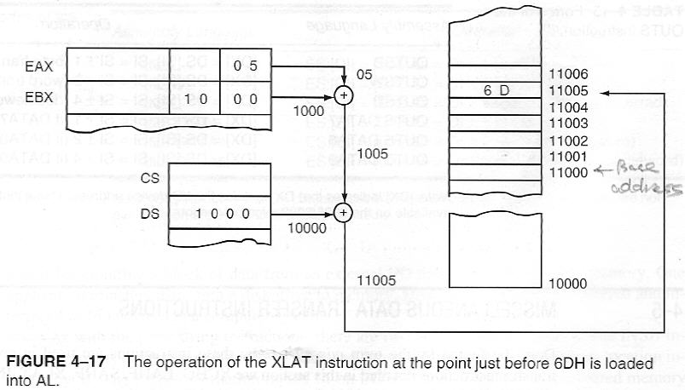
Fig. 4-17
Fig. 4-17 : XLAT
Ch.4 Data Movement Instructions

Slide 79
IN and OUT
IN :
  transfers data from external I/O device to AL, AX, EAX
OUT :
  from AL,AX,EAX to external I/O device
I/O device(port) addressing : two form
1. fixed-port addressing : using an 8-bit I/O port address → zero-extended into 16-bit address
  IN AL,6AH:16-bit address 006AH on pins A0-A15
2. variable-port addressing : I/O port address is stored in DX, which can be changed(varied)
Table 4-17
Ch.4 Data Movement Instructions

Slide 80
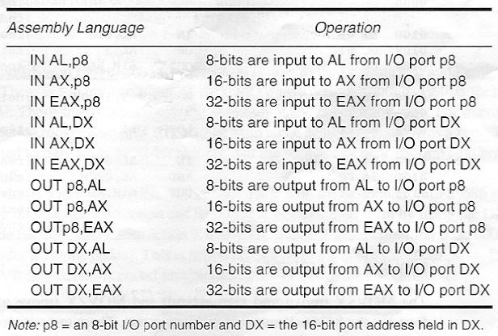
Table 4-17
Table 4-17 : IN and OUT instruction
Ch.4 Data Movement Instructions

Slide 81
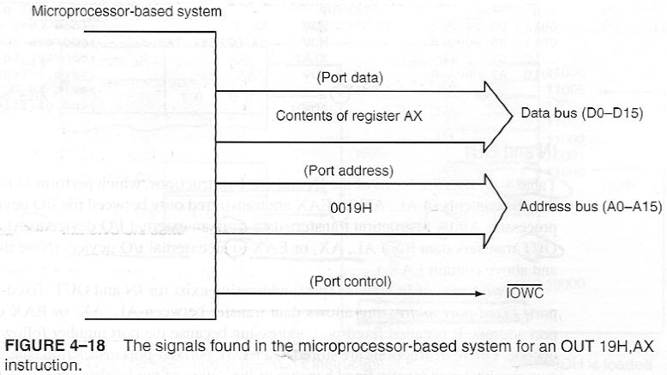
Fig. 4-18
Fig. 4-18 : OUT 19H,AX
Ch.4 Data Movement Instructions

Slide 82
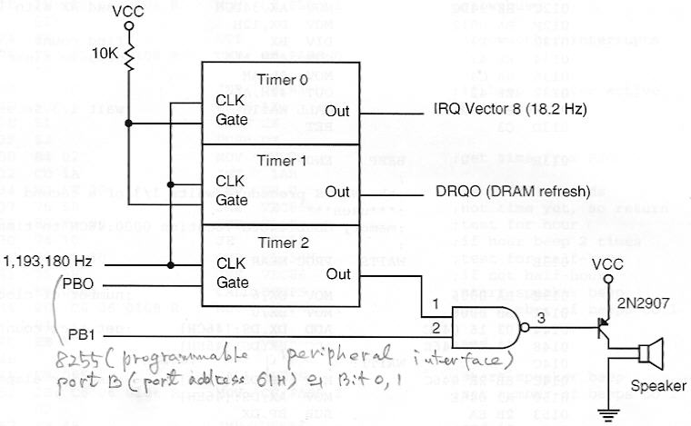
clicks speaker(controlled by accessing I/O port 61H) in PC.
  rightmost 2 bits of this port: set(11) and then cleared(00)
Ch.4 Data Movement Instructions

Slide 83
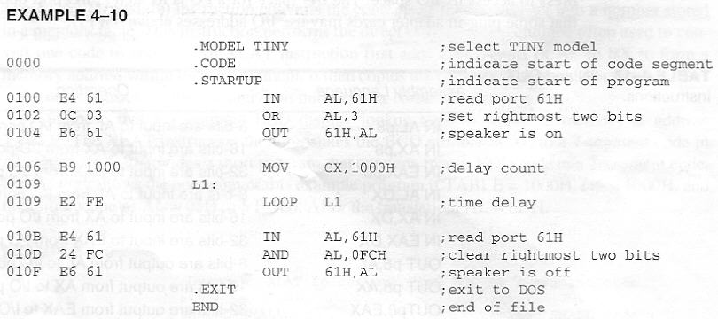
clicks speaker(controlled by accessing I/O port 61H) in PC.
  rightmost 2 bits of this port : set(11) and then cleared(00)
Ch.4 Data Movement Instructions

Slide 84
MOVSX and MOVZX
MOVSX(move and sign-extend), MOVZX(move and zero-extend) : 80386~
Table 4-18
zero-extended : most-significant part fills with 0
  8-bit 34H : is zero-extended into 16-bit 0034H
  convert unsigned 8-,16-bit no. into unsigned 16-,32-bit
sign-extended : sign bit is copied into most-significant part
  8-bit 84H : is sign-extended into 16-bit FF84H
  convert signed 8-,16-bit no. into signed 16-,32-bit no.
Ch.4 Data Movement Instructions

Slide 85
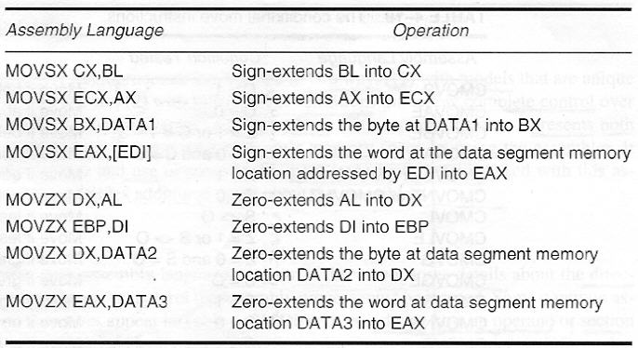
Table 4-18
Table 4-18 : The MOVSX and MOVZX instructions
Ch.4 Data Movement Instructions

Slide 86
BSWAP
BSWAP(byte swap, 80486~) :
  takes contents of any 32-bit register and swaps 1st byte with 4th and 2nd with 3rd
  BSWAP EAX : if EAX=00112233H, 33221100H
CMOV(conditional move, pentium pro~): table 4-19
  move data only if condition is true
CMOVZ :
  move data only if result from some prior instruction was a zero
  destination : is limited to only a 16-, 32-bit register
  source : can be a 16-, 32-bit reg. or memory location
Ch.4 Data Movement Instructions

Slide 87

Table 4-19
Table 4-19
Ch.4 Data Movement Instructions

Slide 88
CMOV
opcode for CMOV : 0F4XH
  where X is condition code 0000 ~ 1111(Appendix B, p.869)
  this is followed by a mod-reg-r/m byte
EX. 4-11 :
  how CMOVB is coded into hexadecimal by using DB directive(0F 42 C3: ~ 0010 11 000 011)
  if below reg AX BX
Ch.4 Data Movement Instructions

Slide 89

CMOV
opcode for CMOV : 0F4XH, where X is condition code 0000 ~ 1111(Appendix B, p.869)
Ch.4 Data Movement Instructions

Slide 90
4-6 Segment Override Prefix
segment override prefix :
  additional byte that appends the front of an instruction to select an alternate segment register
  only JMP, CALL : cannot be prefixed
  MOV AX,[DI], MOV AX,ES[DI]
Table 4-20
segment override prefix :
  one byte long, add to the instruction’s execution time
default segment :
  shorter and more efficient software
Ch.4 Data Movement Instructions

Slide 91

Table 4-20
Table 4-20: instructions that include segment override prefixes
Ch.4 Data Movement Instructions

Slide 92
4-7 Assembler Detail
assembler(microsoft MACRO assembler MASM ver.6X) for µ : can be used in two ways :
1. with memory models that are unique to a particular assembler, and
2. with full segment definitions that allow complete control over the assembly process and are universal to all assemblers
presents both methods, and explains how to organize a program’s memory space by using assembler
also explains the purpose and use of some of more important directives
Ch.4 Data Movement Instructions

Slide 93
Directives
directive(pseudo-operations) : controls assembly process (indicate how an operand or section of a program is to be processed by the assembler)
Table 4-21: some common directives
appendix A : provides additional detail about assembler
some directives :
  generate and store information in the memory(DB), while others do not(BYTE PTR)
.386 : tell assembler to use 386 real mode instruction
.386P : tell assembler to use 386 protected mode instruction set
Ch.4 Data Movement Instructions

Slide 94

Table 4-21
Table 4-21
Ch.4 Data Movement Instructions

Slide 95

Table 4-21
Table 4-21
Ch.4 Data Movement Instructions

Slide 96
Storing Data in a Memory Segment
DB, DW, DD, DQ(define quadword), DT(define ten byte)
EX. 4-12 : SEGMENT ~ ENDS(name LIST_SEG)
memory : is reserved for use in future by using a ?
  assembler does not initialize to any specific value
  actually, assembler usually stores a zero
DUP(duplicate) : creates an array
10 DUP (?) : reserves 10 location, stores no value
ALIGN 2,4,8 : makes sure that memory arrays are stored on word, dword, qword boundary
Ch.4 Data Movement Instructions

Slide 97



EX. 4-12
EX. 4-12
Ch.4 Data Movement Instructions

Slide 98
ASSUME, EQU, ORG
EQU(equate) : equates a numeric, ASCII, or label to another label
equates : make a program clearer and simplify debugging
EX. 4-13
THIS BYTE, THIS WORD, THIS DWORD
data : must be referred to as both a byte, a word
assembler can only assign either a byte, word address to a label
EX. 4-14
Ch.4 Data Movement Instructions

Slide 99

EX. 4-13
EX. 4-13
Ch.4 Data Movement Instructions

Slide 100


EX. 4-14
EX. 4-14
Ch.4 Data Movement Instructions

Slide 101
ASSUME, EQU, ORG
ORG(origin) : assigns absolute offset address of data, code
ASSUME : tell assembler what names have been chosen for code, data, extra, stack segments
  only used with full segment definitions
PROC, ENDP : start, end of a procedure(subroutine)
  require a label to indicate name of procedure
  PROC must be followed with NEAR, FAR
NEAR(local) : resides in same code segment
FAR(global) : resides any location in memory, can be used by any program
Ch.4 Data Movement Instructions

Slide 102

EX. 4-15
EX. 4-15 : a procedure that adds BX, CX, DX and stores the sum in AX
Ch.4 Data Movement Instructions

Slide 103
PROC and ENDP
USES(MASM ver.6X) :
  indicates which registers are used by procedure,
  so that assembler can automatically save them before procedure begins and restores them before procedure ends with RET instruction
ADDS PROC USES AX BX CX : automatically
  pushes AX,BX,CX before procedure begins and
  pops them before RET instruction executes
EX. 4-16 : assembled with .LISTALL
asterisk(*) : are inserted by assembler
Ch.4 Data Movement Instructions

Slide 104

EX. 4-16
EX. 4-16 :
Ch.4 Data Movement Instructions

Slide 105
Memory Organization
memory models : unique to MASM
full segment definitions : common to most assembler
models : used with assembly language procedures that are used by high-level languages such as C/C++
many models available : tiny to huge(Appendix A)
  TINY model : all software, data fit into one 64K byte memory segment
  SMALL model : only one data segment, one code segment → total 128K bytes of memory
EX. 4-17 : .MODEL
  copy 100-bytes block of LISTA into 2nd block of LISTB
Ch.4 Data Movement Instructions

Slide 106

EX. 4-17
EX. 4-17 : .MODEL
  copies 100-bytes block of LISTA into 2nd lock of LISTB
Ch.4 Data Movement Instructions

Slide 107
Models
.EXIT 0 : return to DOS with error code 0(no error)
.EXIT : still return to DOS, error is code not defined
@DATA : used to identify various segments
.STARTUP :
  MOV AX,@DATA and MOV DS,AX statements can be eliminated
  also eliminates the need to store the starting address next to the END directive
models are important with C/C++ development system if assembly language is included with C/C++ programs
Ch.4 Data Movement Instructions

Slide 108
Full segment Definitions
EX. 4-18 : using full segment definition
  longer and more structured than model method(EX. 4-17) of setting up a program
full segment definition : are also used with C/C++ environments for procedures developed in assembly language
name SEGMENT ~ name ENDS : define segment
STACK appears next to SEGMENT : assembler, linker automatically load both register SS, SP
group name ‘DATA’: CodeView can be effectively used to symbolically debug this software
Ch.4 Data Movement Instructions

Slide 109

EX. 4-18
EX. 4-18 :
Ch.4 Data Movement Instructions

Slide 110

EX. 4-18
EX. 4-18 :

Slide 111

DOS Function Call : 4CH
4CH :

Slide 112
Full Segment Definitions
CODE_SEG : far procedure because most software is procedure-oriented
loader : does not automatically initialize DS, ES
DS, ES must be loaded with desired segment address in the program
END MAIN : indicates end of program, and location of 1st instruction executed
USE 16, USE 32(80386~) : 16- or 32-bit instruction mode
EX. 4-19(386~) : same software listed in EX. 4-18
Ch.4 Data Movement Instructions

Slide 113

EX. 4-19
EX. 4-19 :
Ch.4 Data Movement Instructions

Slide 114
A Sample Program
EX. 4-20 : using full segment definition, that reads a character from keyboard and display it on CRT screen. If an @ symbol typed, program ends.
use a few DOS function calls
06H function : reads keyboard if Dl=0FFH, or displays ASCII contents of DL if DL is not 0FFH
4CH function : return to DOS prompt(C>)
EX. 4-21 : using model method
Ch.4 Data Movement Instructions

Slide 115

DOS Function Call : 06H
06H :
Ch.4 Data Movement Instructions

Slide 116


EX. 4-20
EX. 4-20 :
Ch.4 Data Movement Instructions

Slide 117

EX. 4-21
EX. 4-21 :
Ch.4 Data Movement Instructions

