Slide 1

Data Denoising with FFT
BL.EN. U4AIE21126 Suryamritha M
BL.EN. U4AIE21128 TVNL Harshitha
BL.EN. U4AIE21139 Varshini Balaji

Slide 2
FFT
A fast Fourier transform (FFT) is an algorithm that computes the discrete Fourier transform (DFT) of a sequence, or its inverse (IDFT).
Fourier analysis converts a signal from its original domain (often time or space) to a representation in the frequency domain and vice versa.
The FFT algorithm revolutionized the computation of the DFT by reducing its complexity from O(n^2) to O(n log n), where n is the number of samples in the input sequence.
The FFT algorithm has numerous applications in various fields, including signal processing, image processing, audio analysis, communications, and scientific computing.

Slide 3
Data Denoising
Data denoising refers to the process of removing or reducing unwanted noise or disturbances from data.
The goal is to extract the underlying signal or information from the noisy data while minimizing the impact of noise.
Noise can arise from various sources, such as sensor limitations, environmental factors, transmission errors, or interference during data acquisition.
Denoising techniques aim to enhance the quality of the data by removing or reducing the effects of noise, allowing for better analysis and interpretation of the underlying signal or information.

Slide 4
Data Denoising with FFT
Acquire the Noisy Data
Preprocess the data
Apply FFT
Analyze the Frequency Spectrum
Data Reconstruction
Inverse FFT
Thresholding

Slide 5
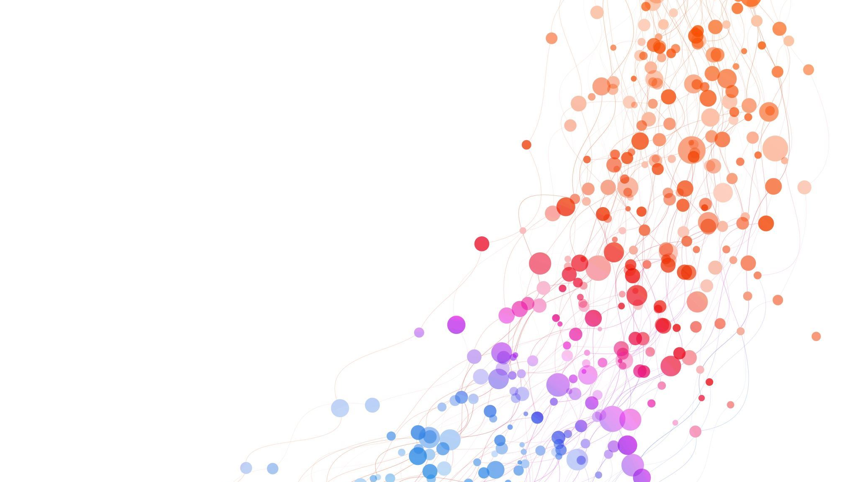
ADMM

Slide 6
ADMM stands for Alternating Direction Method of Multipliers.
It is an algorithm that attempts to solve a convex optimization problem by breaking it into smaller pieces, each of which will be easier to handle.
ADMM

Slide 7
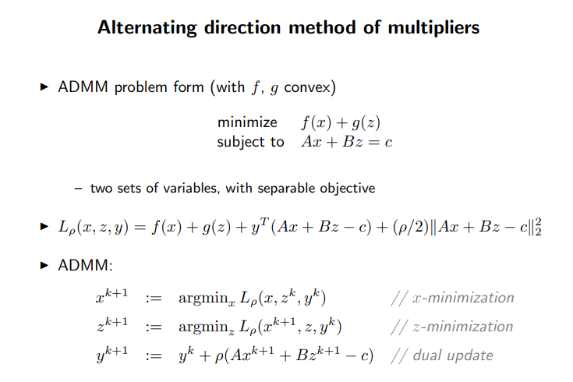

Slide 8
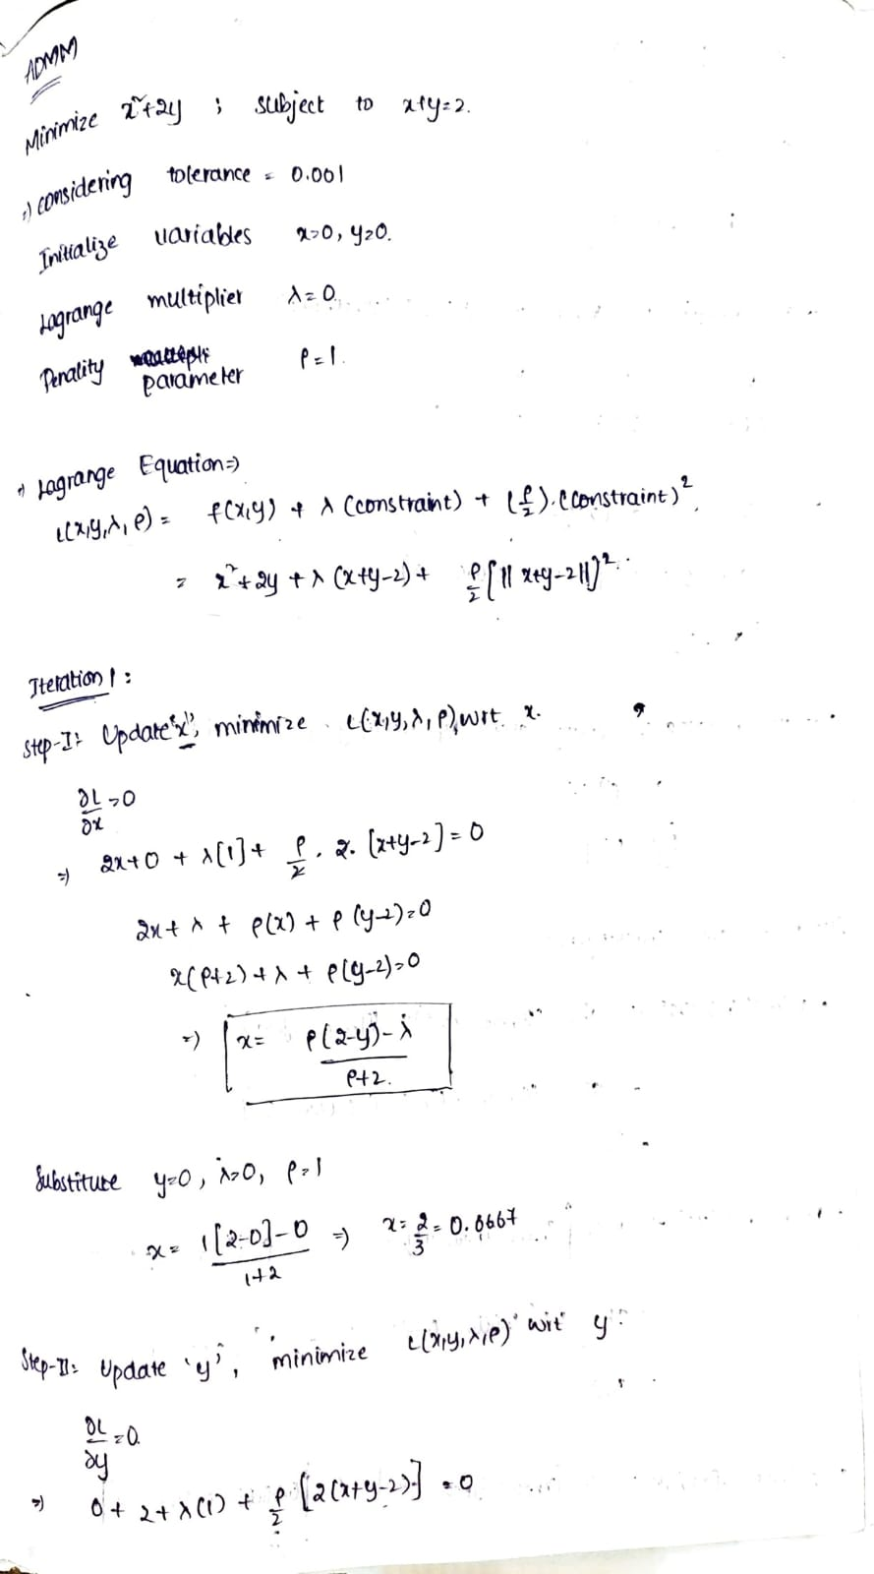
Minimize x^2 + 2y ;
Subject to x + y = 2
Tolerance is a parameter that determines the convergence criterion for stopping the ADMM algorithm
Lagrange Multiplier are introduced to handle the constraints in the augmented Lagrangian formulation. They provide information about the sensitivity of the constraints and can be used to assess the optimality of the solution.
Penalty parameter determines the trade-off between minimizing the objective function and satisfying the constraints.
It affects the convergence behavior and solution quality of the ADMM algorithm.

Slide 9
By converting the original problem into the augmented Lagrangian form and introducing Lagrange multipliers,
we can
simplify the problem structure
enable efficient optimization techniques
These benefits make the use of Lagrange multipliers and the augmented Lagrangian formulation a popular choice in handling constrained optimization problems with ADMM.

Slide 11
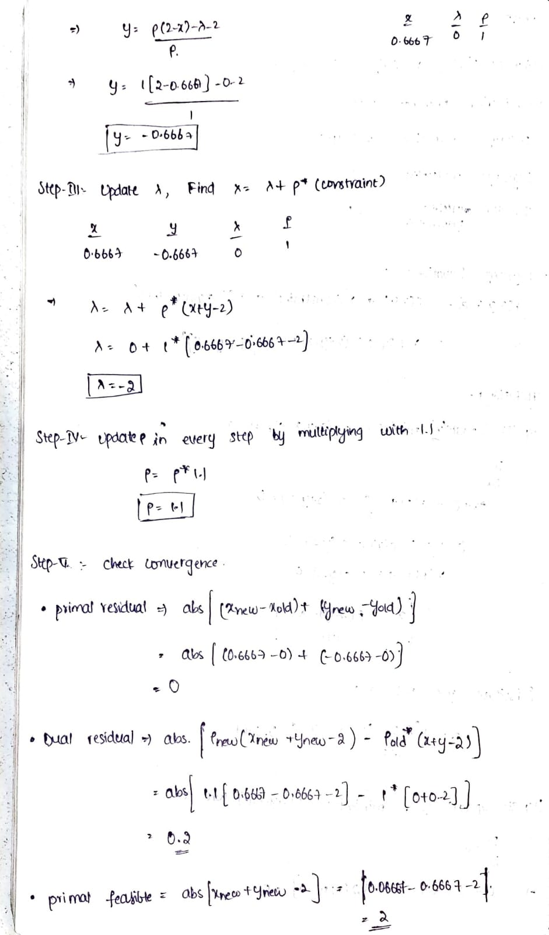

Slide 12
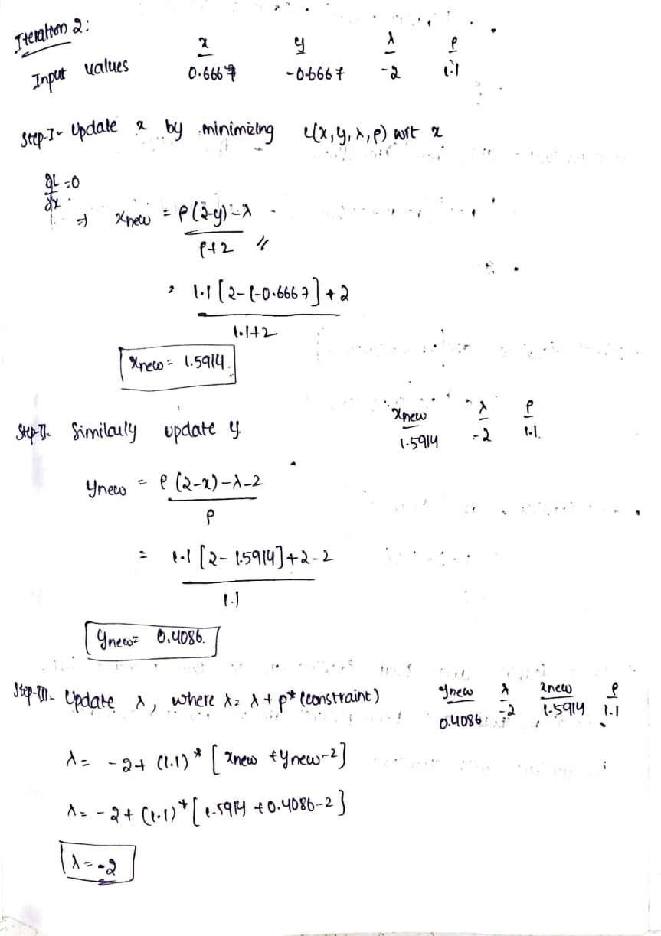
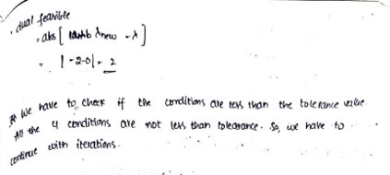

Slide 13
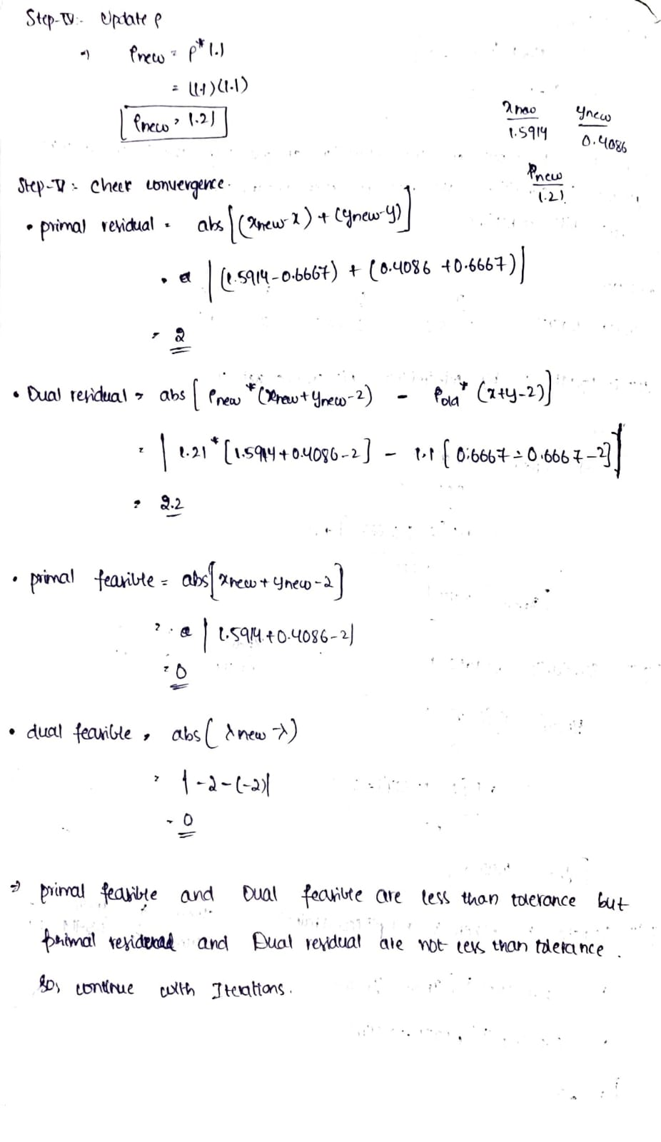

Slide 14
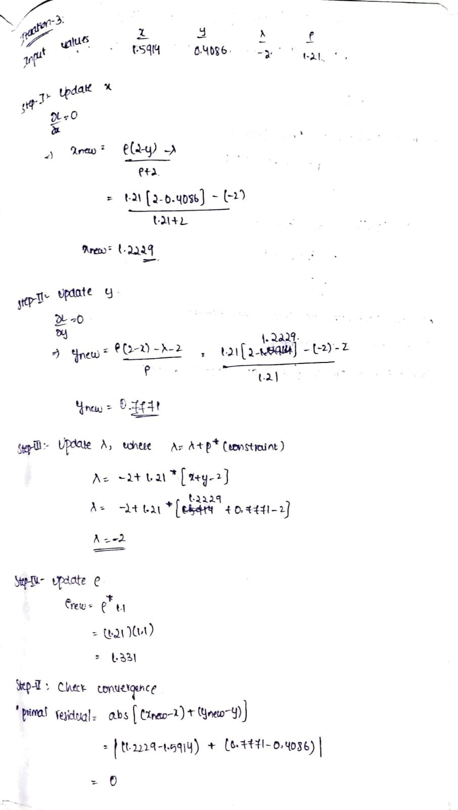

Slide 15
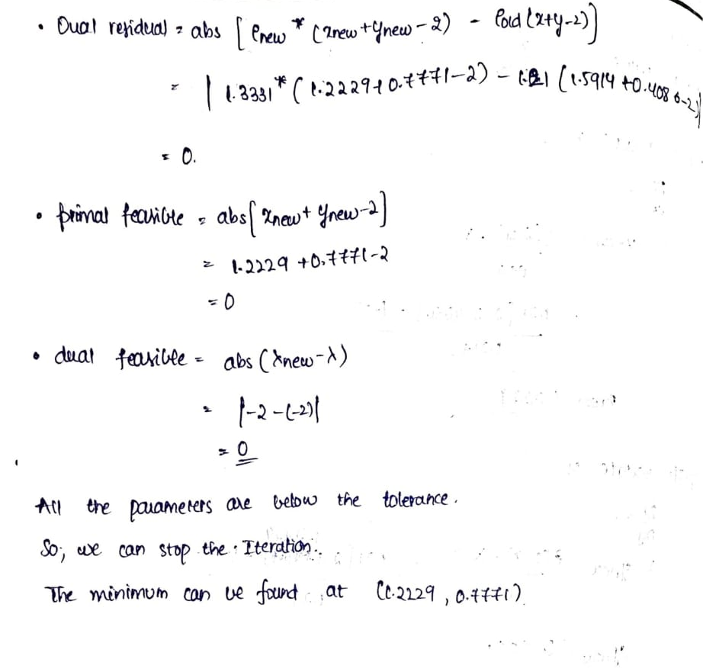

Slide 16
THANK YOU

