Slide 1

Final Project Presentation
on
Multi-class Text Classification ​
(using PySpark ML)​
Team Members
Suryamritha M BL.EN.U4AIE21126
TVNL Harshitha BL.EN.U4AIE21128)
Varshini Balaji BL.EN.U4AIE21139
Date: 23-06-2023
Course :Big Data Analytics 21AIE214
AI 4th sem –E Sec

Slide 2
Introduction
Text classification is a key component of natural language processing.
Some of the usages of text classification are
spam detection
sentiment analysis
Topic labeling
Intent detection
Priority detection in customer support
Toxic comment detection.
In our Model we are using Multi Class Text Classification.
Multi-class text classification is a text classification task with more than two classes/categories. Each data sample can be classified into one of the classes. However, a data sample cannot belong to more than one class simultaneously.

Slide 3
Problem Statement
To implement a machine learning model using PySpark that analyses a restaurant's review and categorizes it based on cuisine such as Indian, Chinese, Korean, Mexican, Italian etc. It helps food delivery websites such as Swiggy and Zomato to automatically label their restaurants and display them in their respective sections.

Slide 4
Dataset
We created our own dataset on restaurant reviews
The dataset contains :
Type of cuisine
Name of restaurants in each cuisine
Review of each restaurant
Rank of each restaurant

Slide 5
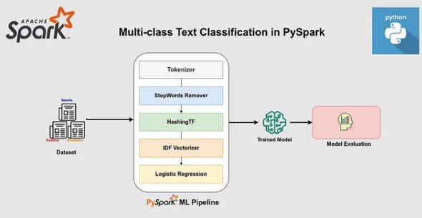
Proposed Framework

Slide 6
Proposed Framework
Tokenizer : To convert the sentences to a list of words also known as tokens.
Stop Word Removal - to remove stop words or meaningless words from the tokens (is, this, that, etc..)
Hashing TF- Calculating the Term Frequency of the words in the corpus
TF-IDF Vectorizer is a measure of originality of a word by comparing the number of times a word appears in document with the number of documents the word appears in.
The standard formulation is used:
IDF = log((m + 1) / (d(t) + 1)),
where m is the total number of documents and d(t) is the number of documents that contain the term t.
Train Test Split: keep 75% data as the train set and 25% data as a test set.
Logistic Regression- It is a supervised ML algorithm. It is more preferable for Multi-class text classification

Slide 7
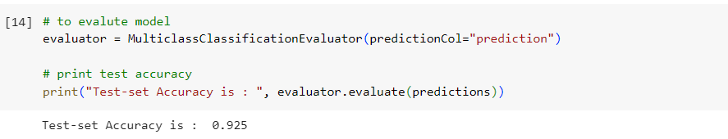
Evaluation Metrics
Accuracy of model

Slide 8
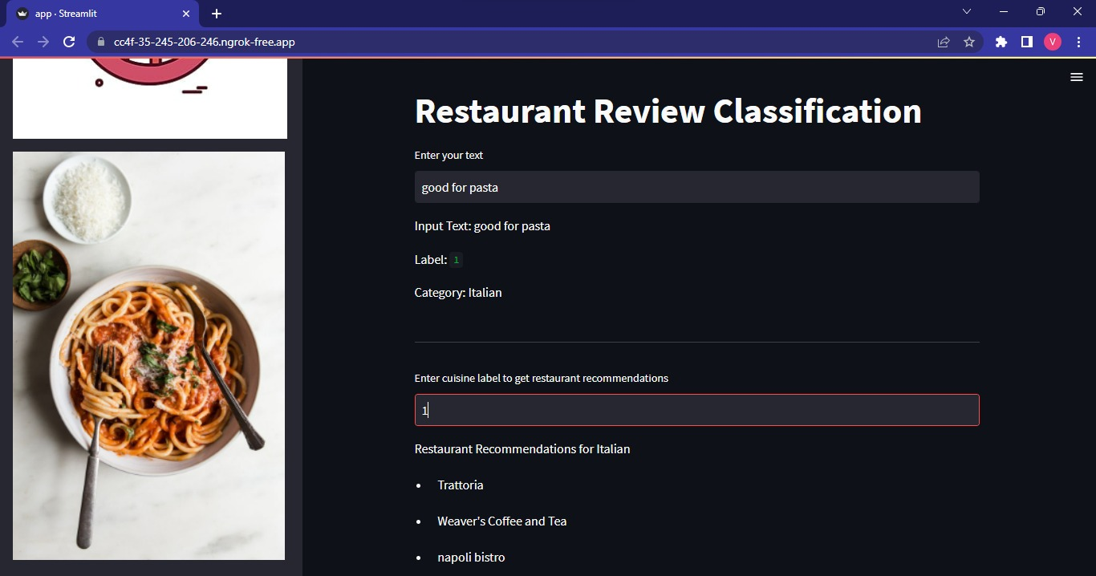
Results Web app

Slide 9
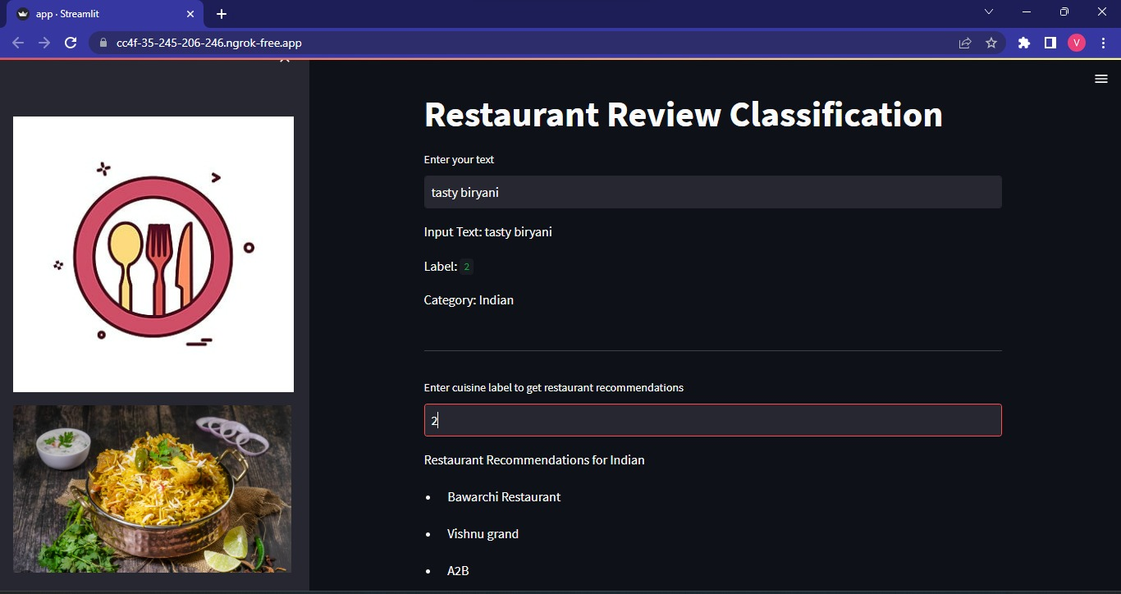
Results

Slide 10
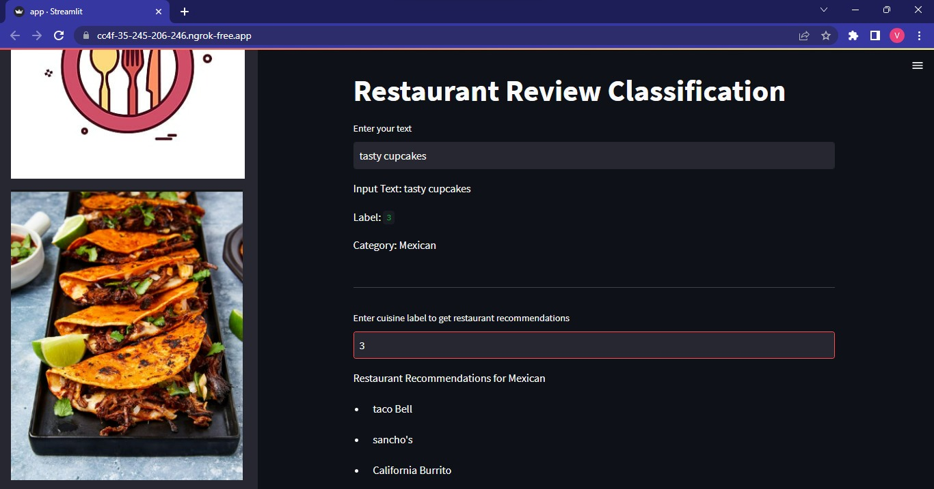
Results

Slide 11
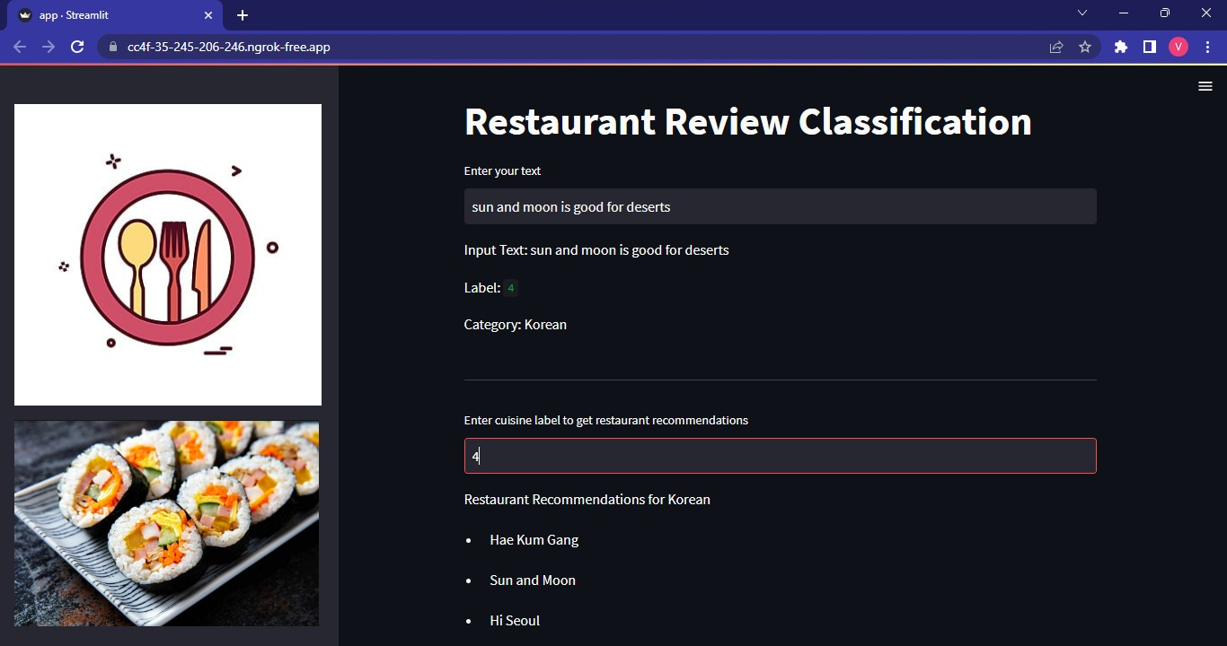
Results

Slide 12
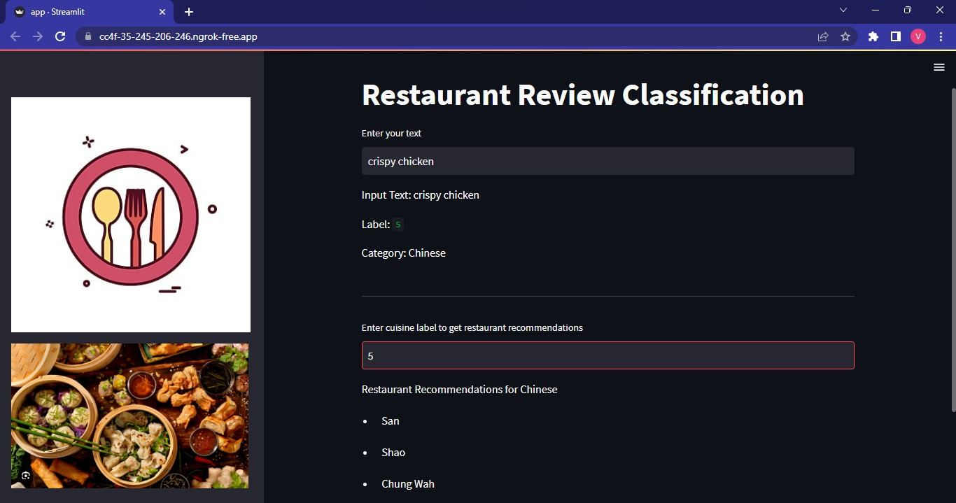
Results

Slide 13
Conclusion and Scope for Improvements
We developed a text classification model on a news dataset using the Pyspark library. We have used pyspark transformers to vectorize our text. We trained a Logistic Regression model and got 90% of test accuracy and plot confusion matrix. In the end, we put all the preprocessing and modeling steps in a pipeline to run our predictions easily.
Future scope:
1. Model Optimization:
2. Advanced Feature Engineering3. Deep Learning Approaches
4. Handling Imbalanced Classes
5. Domain Adaptation

Slide 14
References
[1] Multi-Class Text Classification: Model Comparison and Selection, Proc. of the 3rd International Conference on Electrical, Communication and Computer Engineering (ICECCE)
[2] Multi-Class Text Classification Using Machine Learning Models for Online Drug Reviews, 2021 IEEE World AI IoT Congress.

Slide 15
Thank You

