Slide 1
FINANCE IN AI SOCIETE GENERAL DATASET
DONE BY | B.VARSHINI
DATE | 15-01-2018
MEETING NO | 3

Slide 2
PROCESS
Visualization of the data.
Extracting the insights.
Identifying the relations among the features.
Pointing out the important features.

Slide 3
MISSING DATA
Average / most frequent
Replace with random values
Remove rows with missing values

Slide 4
CURRENCY
CHF | SWISS FRANCE
EUR | EURO
JPY | JAPNESE YEN
GBP | BRITISH POUND
USD | US DOLLAR

Slide 5
COUNTRY_CODE
M | ?
N | ?
T | ?
U | ?
Z | ?

Slide 6
RELATION BETWEEN COUNTRY_CODE AND CURRENCY
M | CHF
N | GBP
T | USD
U | JPY
Z | EUR

Slide 7
PORTFOLIO_ID
Under financial services portfolio defined as, a grouping of financial assets such as stocks, bonds and cash equivalents, as well as their funds counterparts, including mutual, exchange-traded and closed funds. Portfolios are held directly by investors and/or managed by financial professionals.
No missing data.
All data are unique.
Total data : 9366.

Slide 8
DESK_ID:
Desk_id is an id given to the finance manager who handles the respective portfolio.
Presence of missing data.
Presence of repeated data.
Total missing data : 3665.
Total data present : 5701.
Filled missing data with ‘no_desk_id’.
Number of times data repeated: 10,9,8,7,6,5,4,3,2.

Slide 9
DESK_ID
Maximum Repeated data : [TOP 3]
DESK_ID | NO OF TIMES REPEATED
DSK00005869 DSK00006011 DSK00005951 DSK00005895 DSK00005724 DSK00005718 DSK00005754 DSK00006030 DSK00005905 DSK00005789 DSK00005727 | 10 10 9 9 9 9 9 8 8 8 8

Slide 10
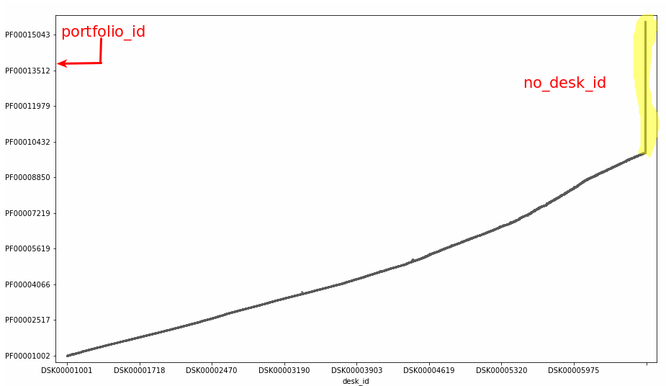
PORTFOLIO_ID AND DESK_ID

Slide 11
OFFICE_ID:
Office_id is an id which denotes the location of the office. [where the office is located]
No missing data
Presence of repeated data.
Only two office id : OFF00001001, OFF00001002.

Slide 12
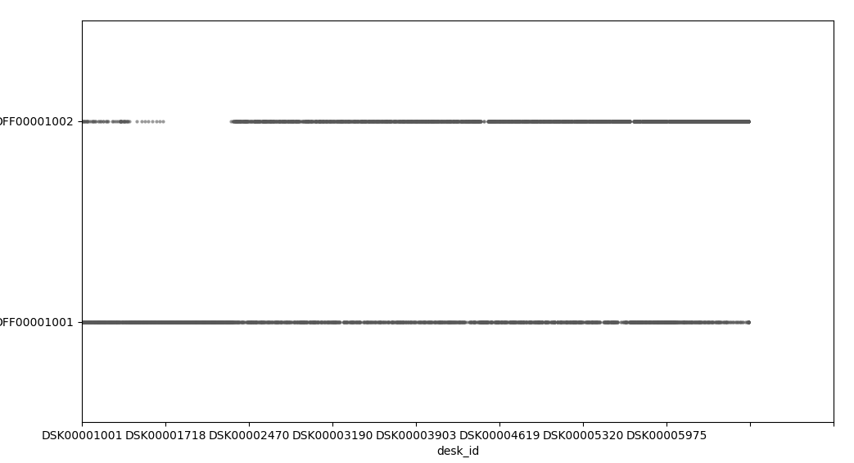
OFFICE_ID AND DESK_ID

Slide 13
OFFICE_ID AND DESK_ID
Mostly OFF00001001 covers overall deskID.
Most of the desk ID which lies on both the office ID.
Only the desk_ID from DSK00001500 – DSK00002500[Approx] which lies only on OFF00001001.
The Portfolio_id which contains empty desk Id also lies on both the office ID.

Slide 14
PF_CATEGORY
PF_category which denotes, on which type of financial service does the portfolio ID related to.
No missing data.
Presence of repeated data.
Total pf_category : 5 → A,B,C,D,E.

Slide 15
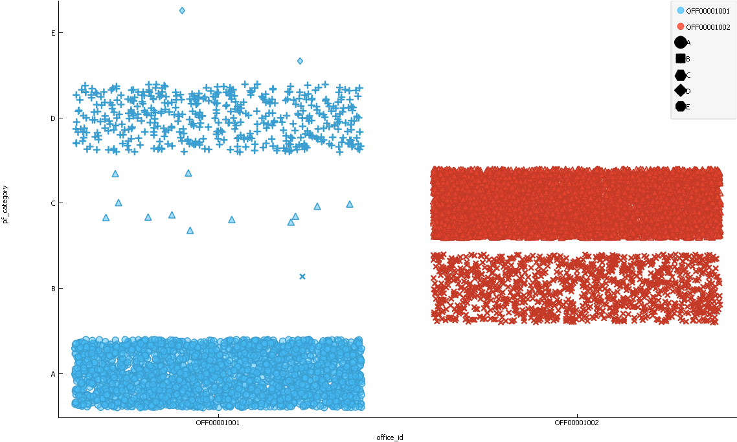
PF_CATEGORY AND OFFICE_ID

Slide 16
PF_CATEGORY AND OFFICE_ID
Office_id1 → A,D,E
Office_id2 → B,C
B → PF00009568 → DSK00006395 → OF1
E → PF00005076 → DSK00004479 → OF1
E → PF00005075 → DSK00004478 → OF1

Slide 17
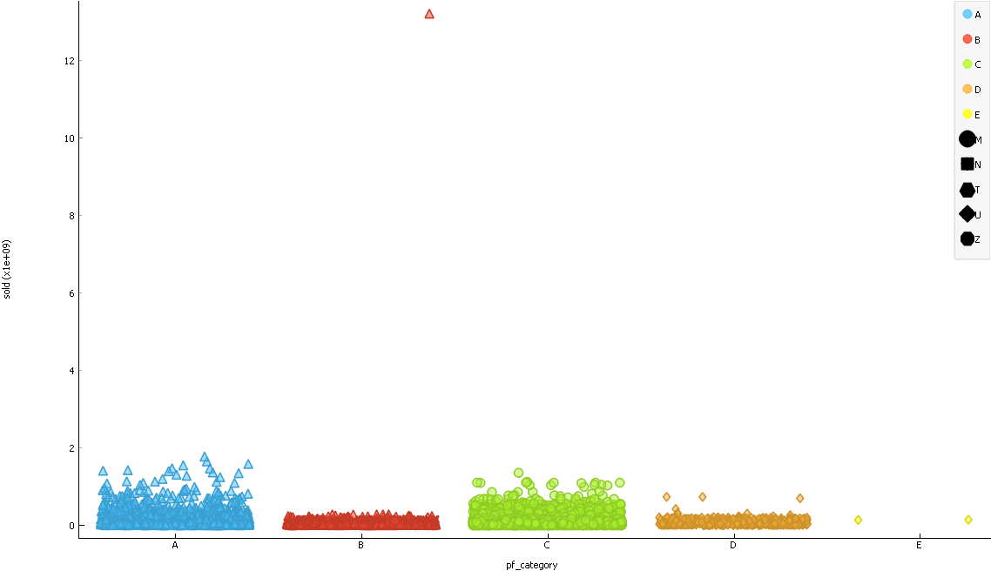
PF_CATEGORY AND SOLD

Slide 18
PF_CATEGORY AND SOLD
B → PF00013397 → No Desk ID → OFF00001002 → N → GBP →ER(-) →LR(+)

Slide 19
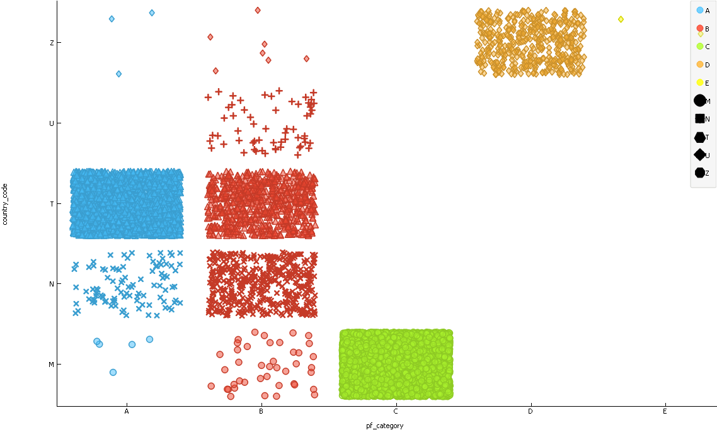
PF_CATEGORY AND COUNTRY_CODE

Slide 20
PF_CATEGORY AND COUNTRY_CODE
M → A,B,C
N → A,B
T → A,B
U → B
Z → A,B,D,E
More than one country which comes under a single country code.

Slide 21
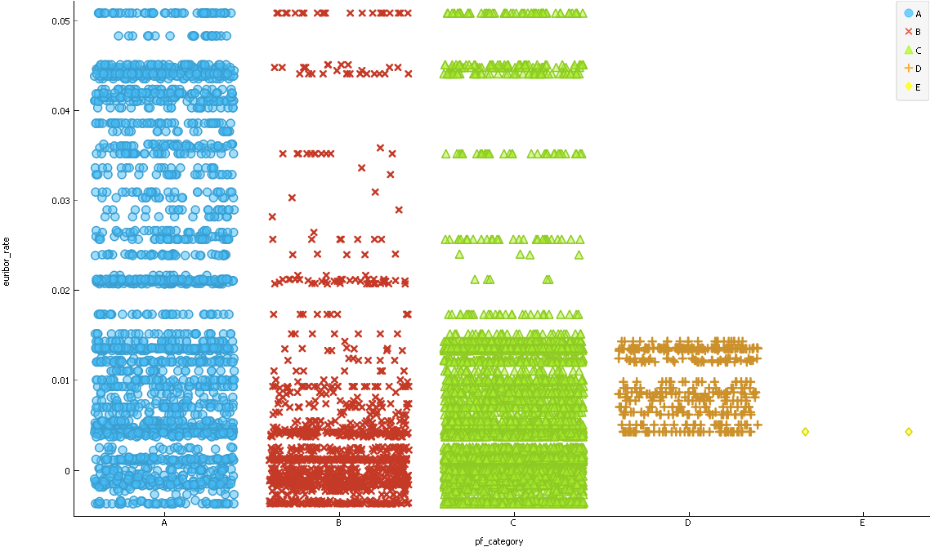
PF_CATEGORY AND EURIBOR RATE

Slide 22
PF_CATEGORY AND EURIBOR RATE
Euribor_rate for the Pf_category D,E is low.

Slide 23
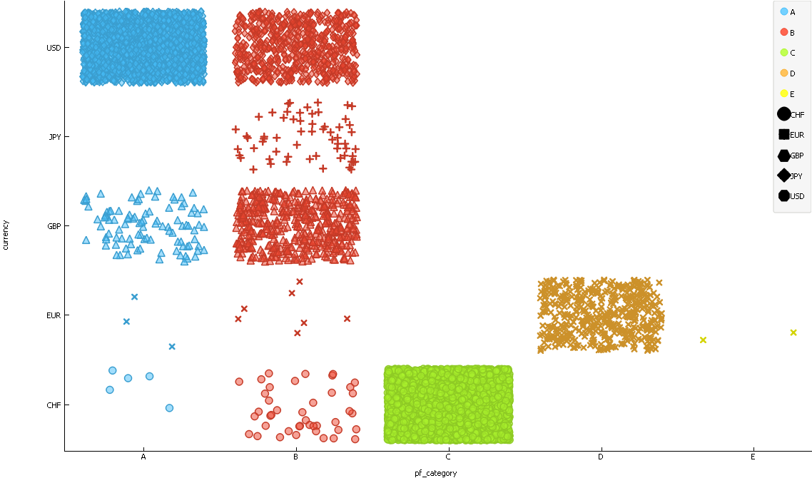
PF_CATEGORY AND CURRENCY

Slide 24
PF_CATEGORY AND CURRENCY
A → No JPY
B → All Currency
C → CHF
D → EUR
E → EUR

Slide 25
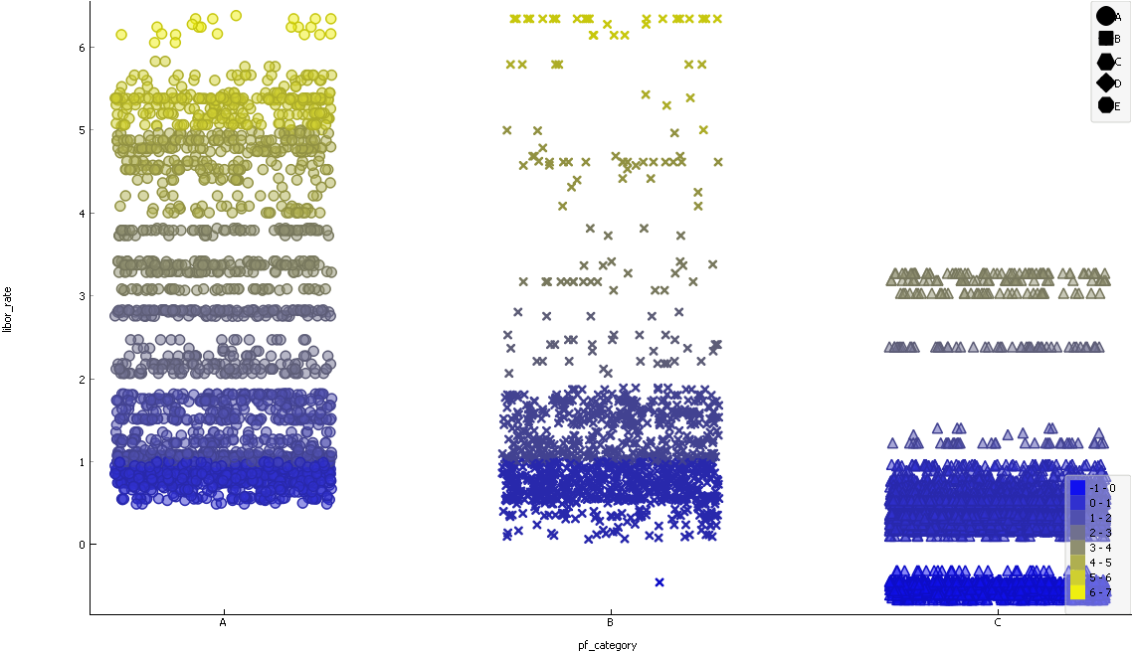
PF_CATEGORY AND LIBOR_RATE

Slide 26
PF_CATEGORY AND LIBOR_RATE
A,B,C has Libor_rate
D,E → empty [EUR]
EUR in A,B,C are not empty and with positive values.

Slide 27
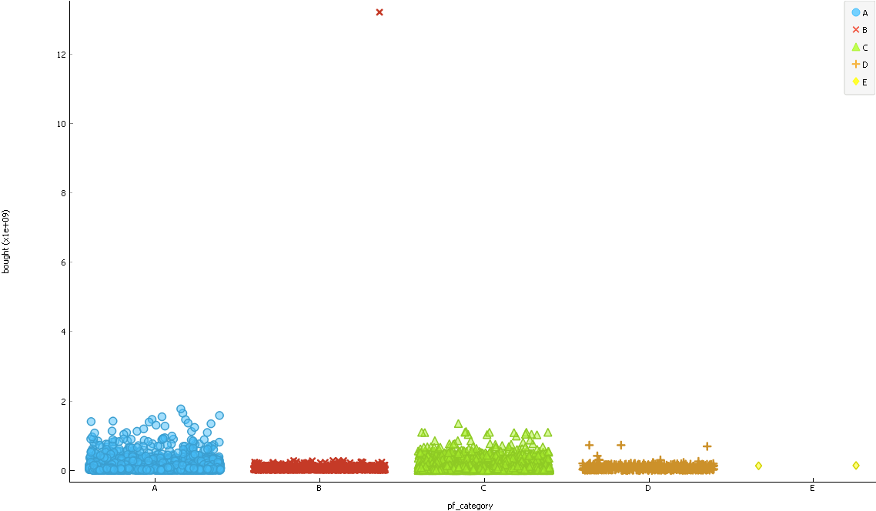
PF_CATEGORY and BOUGHT

Slide 28
PF_CATEGORY and BOUGHT
B → PF00013397

Slide 29
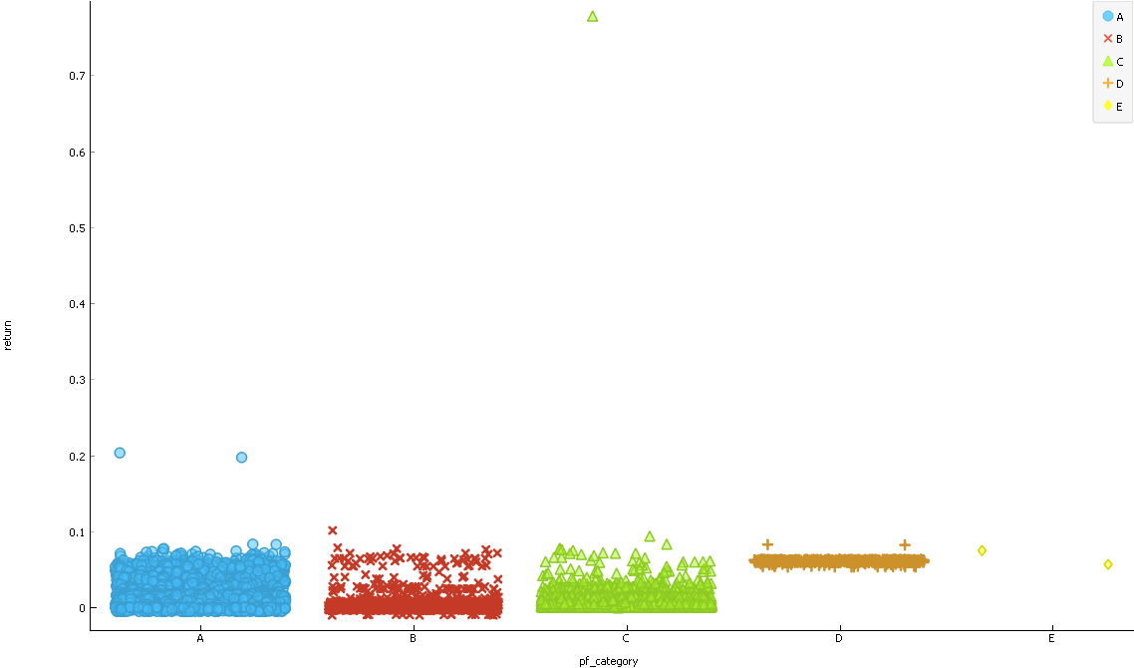
PF_CATEGORY AND RETURN

Slide 30
PF_CATEGORY AND RETURN
C → High.
PF00003547 → OF2 → ER(+) → M → CHF → LR(+)
Sold : 59594739
Bought : 59487353

Slide 31
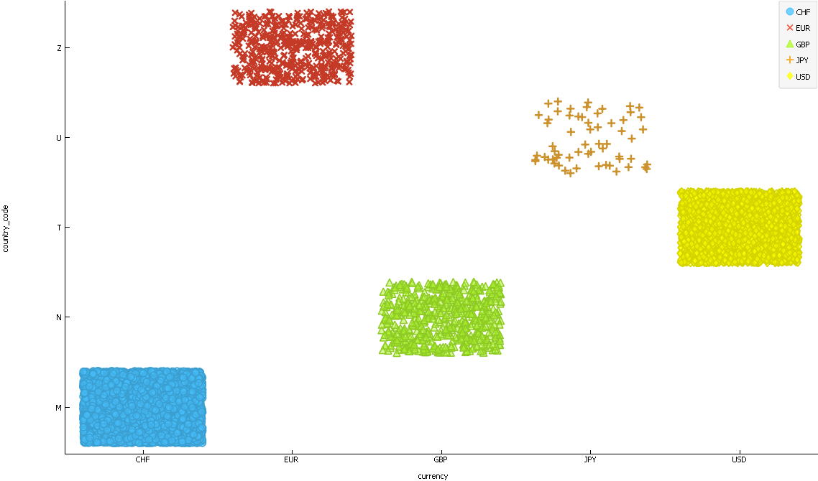
CURRENCY AND COUNTRY_CODE

Slide 32
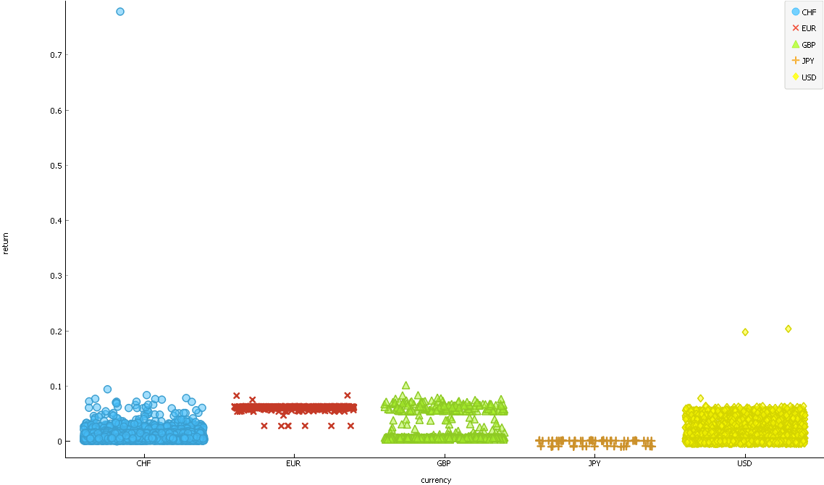
CURRENCY AND RETURN

Slide 33
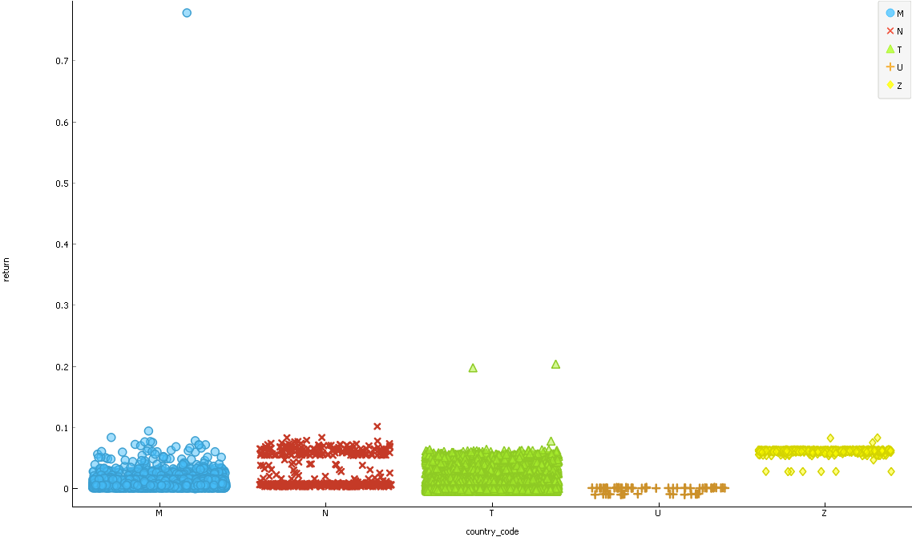
COUNTRY_CODE AND RETURN

Slide 34
PF_CATEGORY AND RETURN

Slide 35
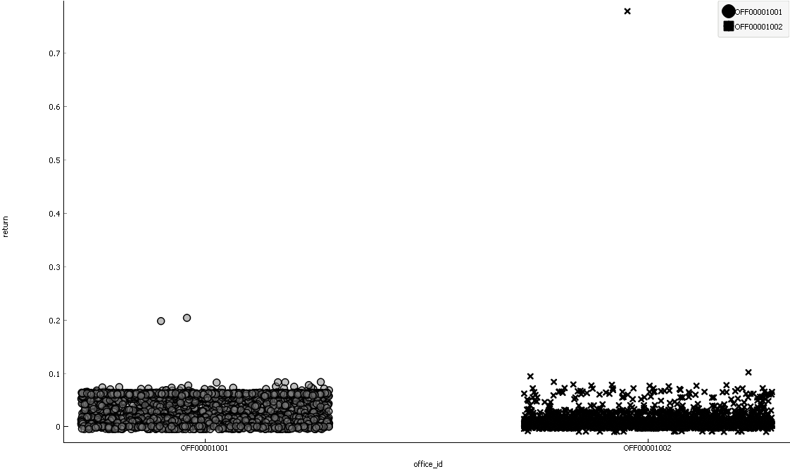
RETURN AND OFFICE_ID

