Slide 1
FINANCE IN AI SOCIETE GENERAL DATASET
DONE BY | B.VARSHINI
DATE | 31-01-2018
MEETING NO | 6

Slide 2
LIST OF TASK --> MEET 5
Delete E pf-Category in training set, because their is no E pf-Category in test set.
Decision tree for all features with unique value.
Find the better way to show currency and returns.
Analyse the reson for the difference between the calculated return and the actual return rate.

Slide 3
Basic decision tree of Societe General Dataset

Slide 4
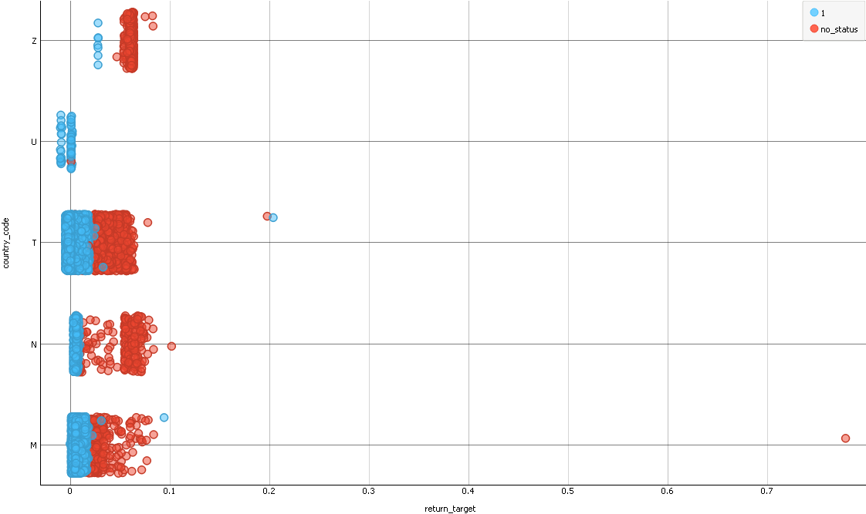
RETURN_COUNTRY-CODE_STATUS

Slide 5
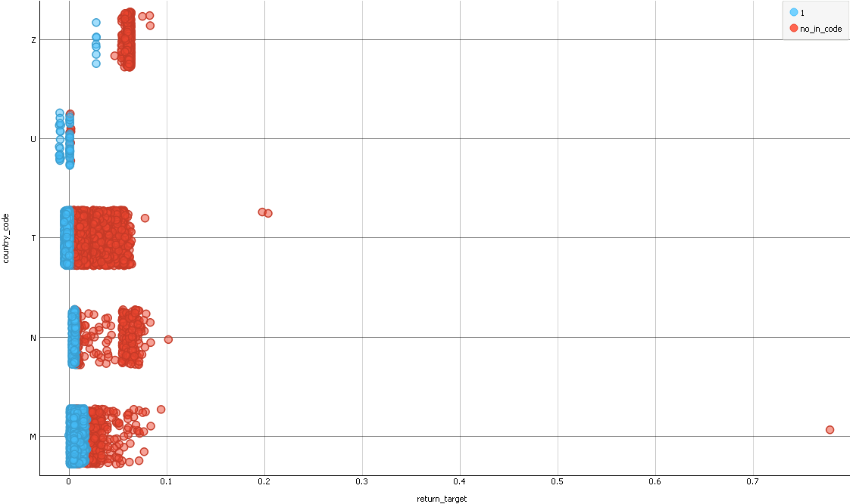
RETURN_COUNTRY-CODE_INDICATOR-CODE

Slide 6
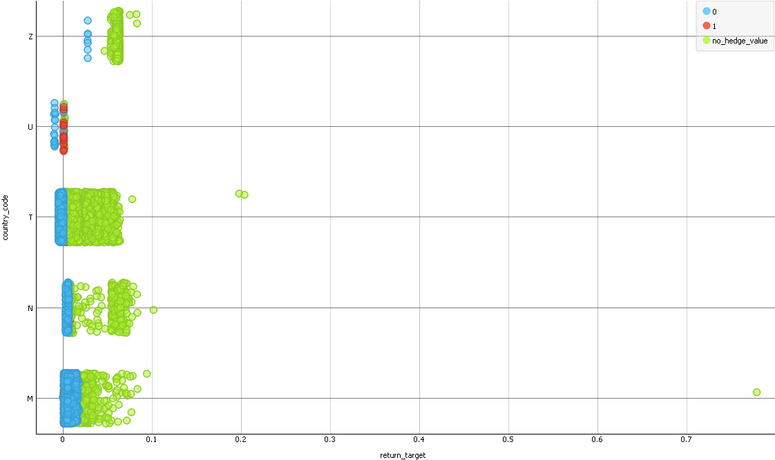
RETURN_COUNTRY-CODE_HEDGE-VALUE

Slide 7
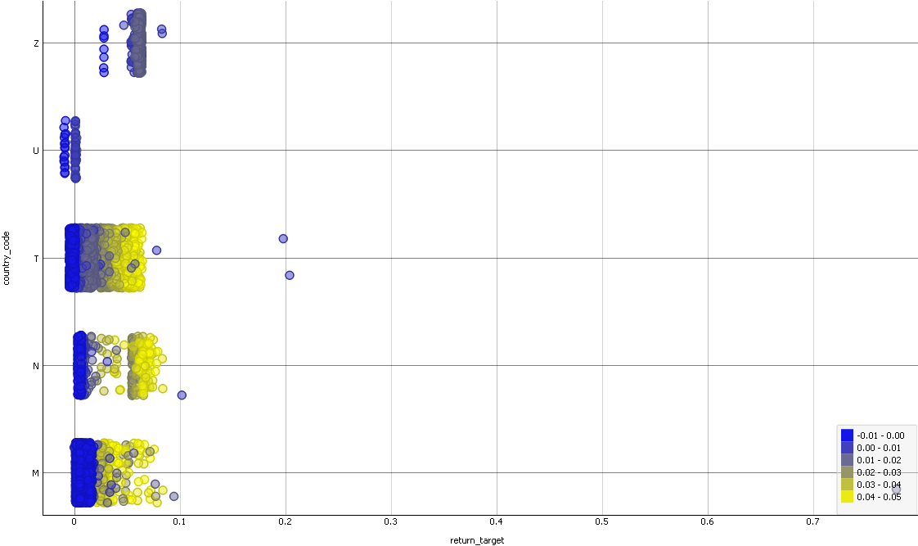
RETURN_COUNTRY-CODE_EURIBOR-RATE

Slide 8
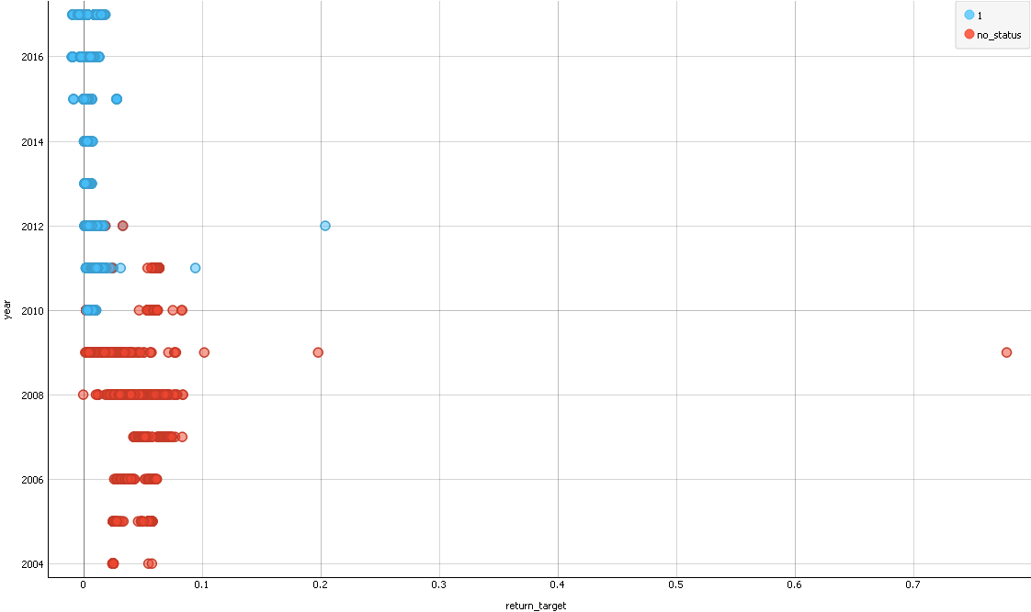
RETURN_YEAR_STATUS

Slide 9
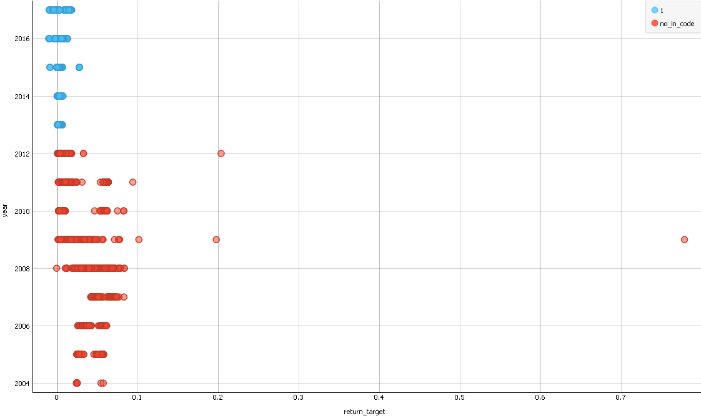
RETURN_YEAR_INDICATOR-CODE

Slide 10
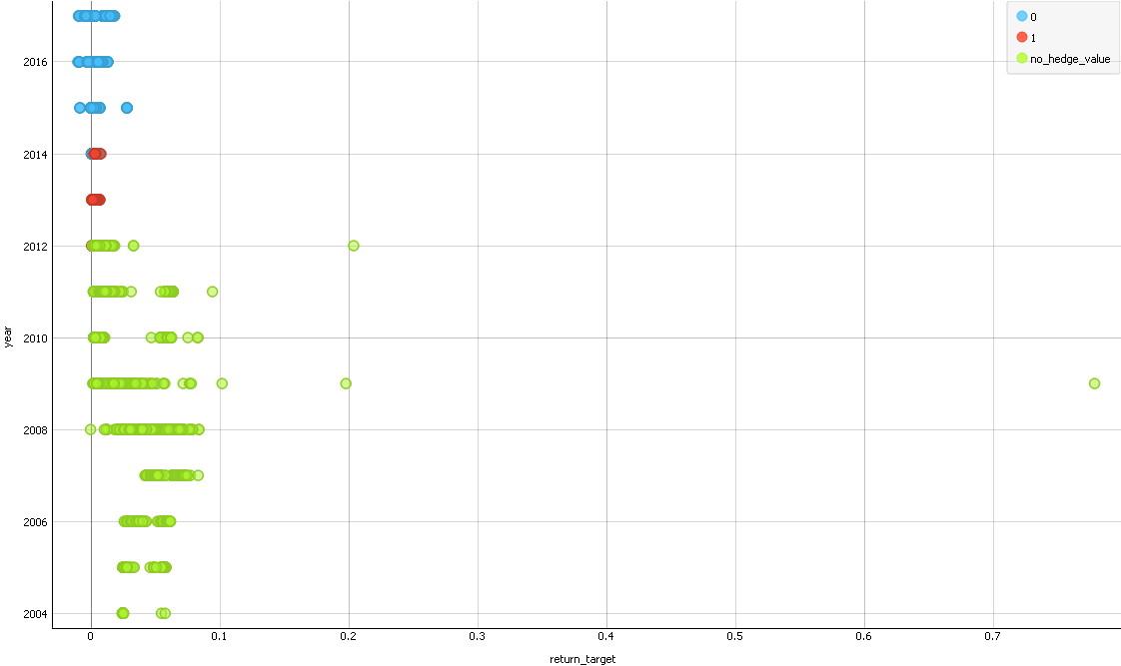
RETURN_YEAR_HEDGE-VALUE

Slide 11
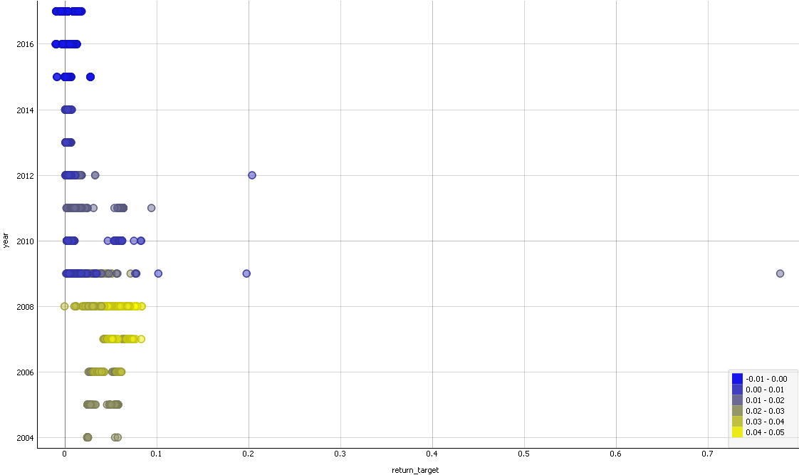
RETURN_YEAR_EURIBOR-RATE

Slide 12
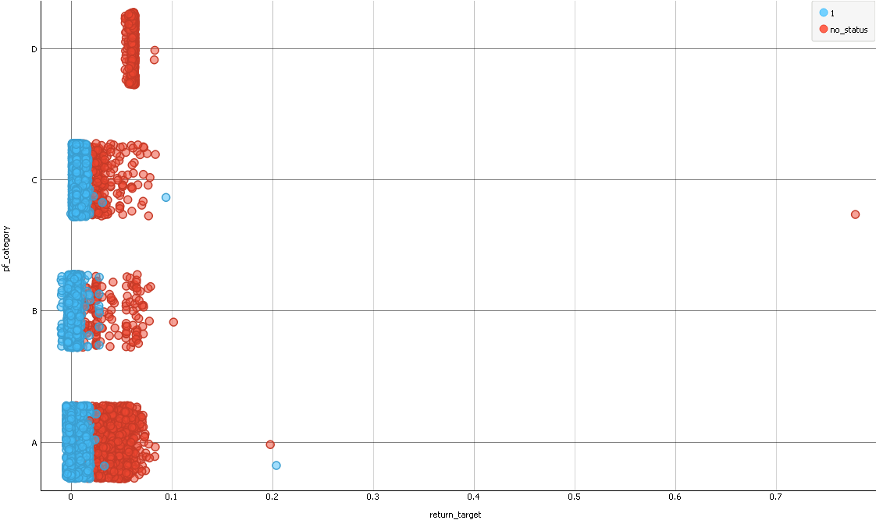
RETURN_PF-CATEGORY_STATUS

Slide 13
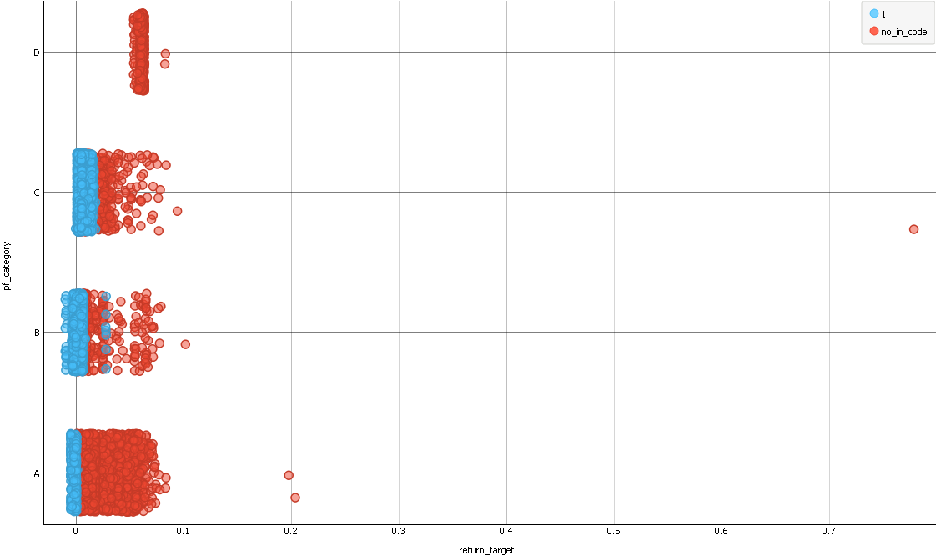
RETURN_PF-CATEGORY_INDICATOR-CODE

Slide 14
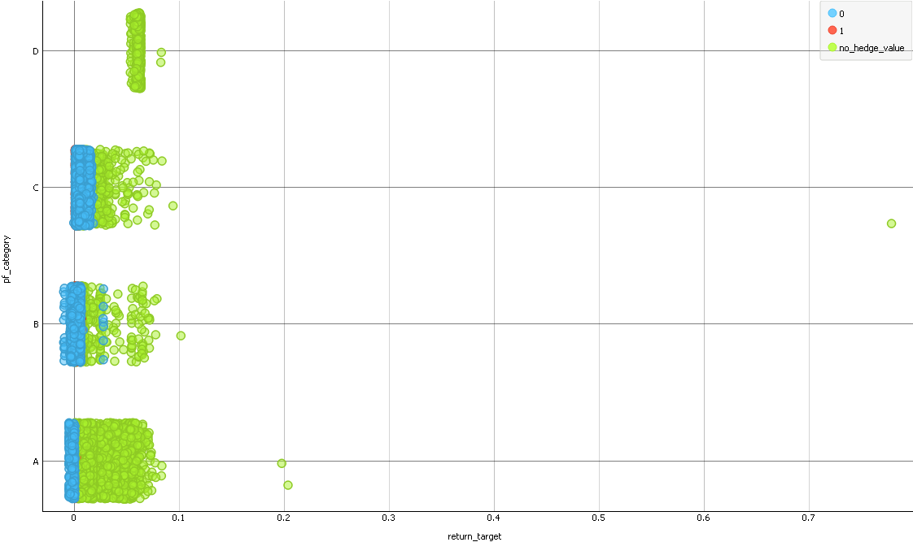
RETURN_PF-CATEGORY_HEDGE-VALUE

Slide 15
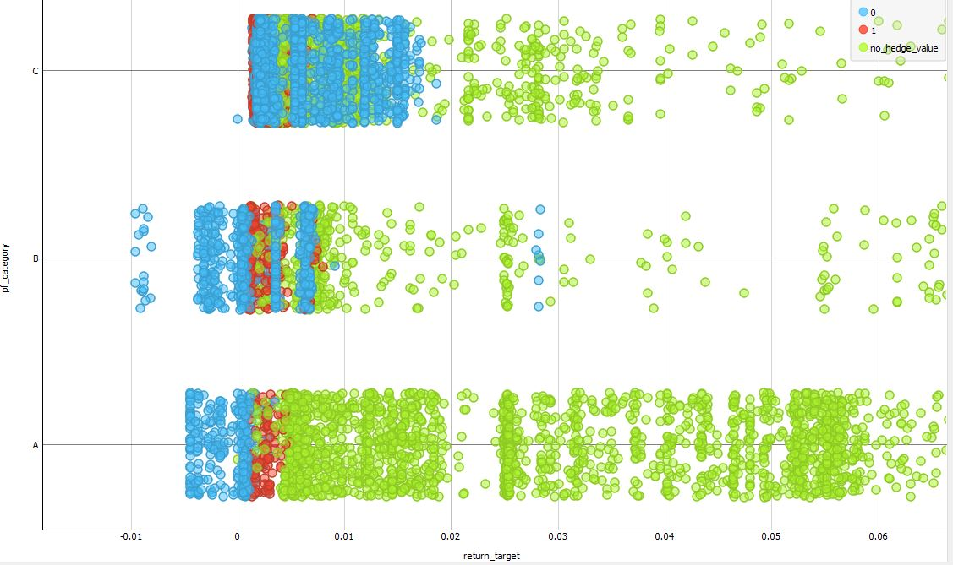
RETURN_PF-CATEGORY_HEDGE-VALUE (ZOOM)

Slide 16
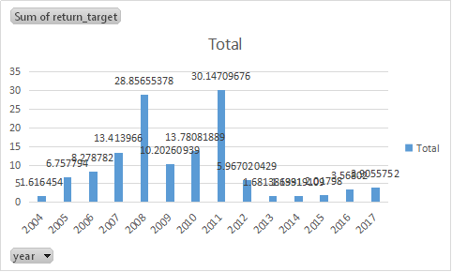
RETURN_YEAR

Slide 17
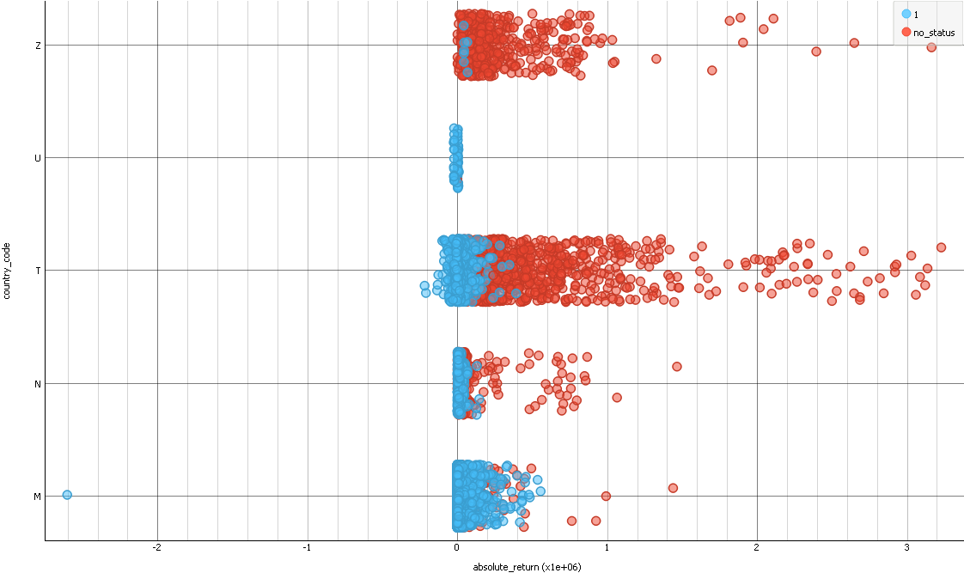
ABSOLUTE_RETURN-COUNTRY_CODE-STATUS

Slide 18

ABSOLUTE_RETURN-COUNTRY_CODE-INDICATOR_CODE

Slide 19
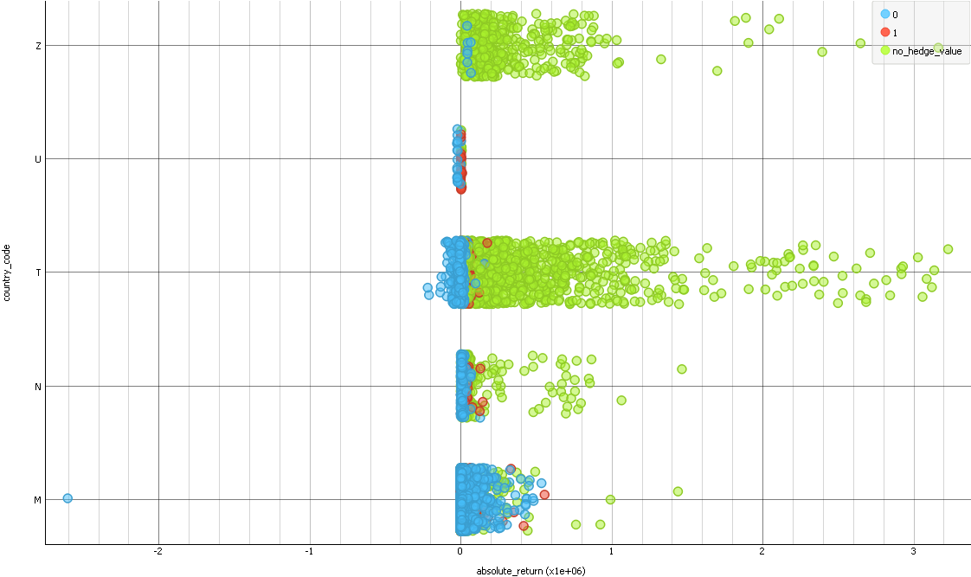
ABSOLUTE_RETURN-COUNTRY_CODE-HEDGE_VALUE

Slide 20
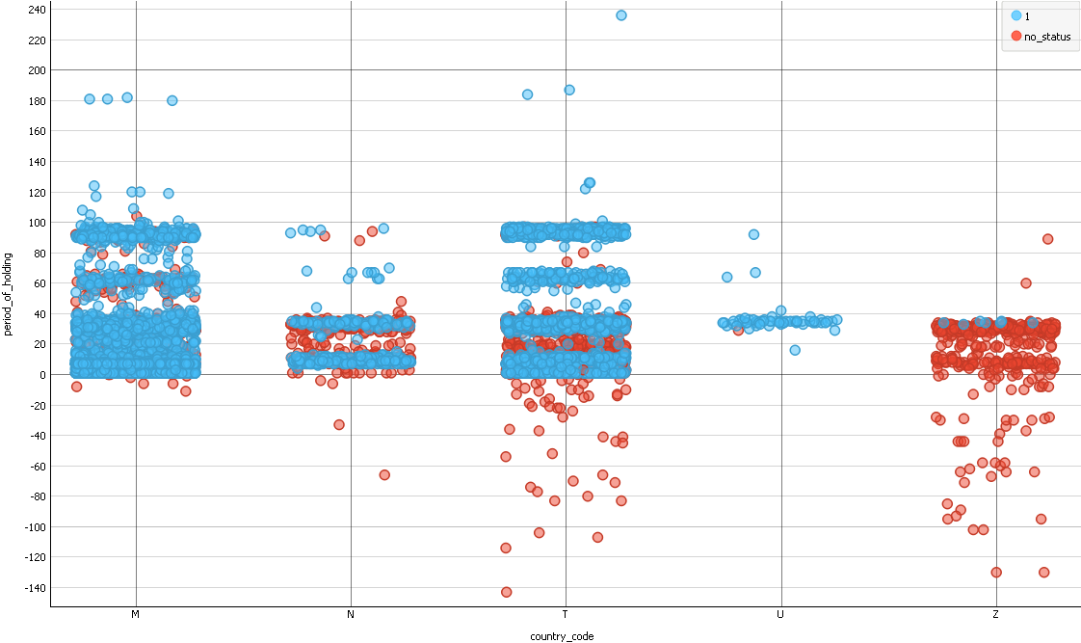
COUNTRY_CODE-PERIOD_OF_HOLDING

Slide 21
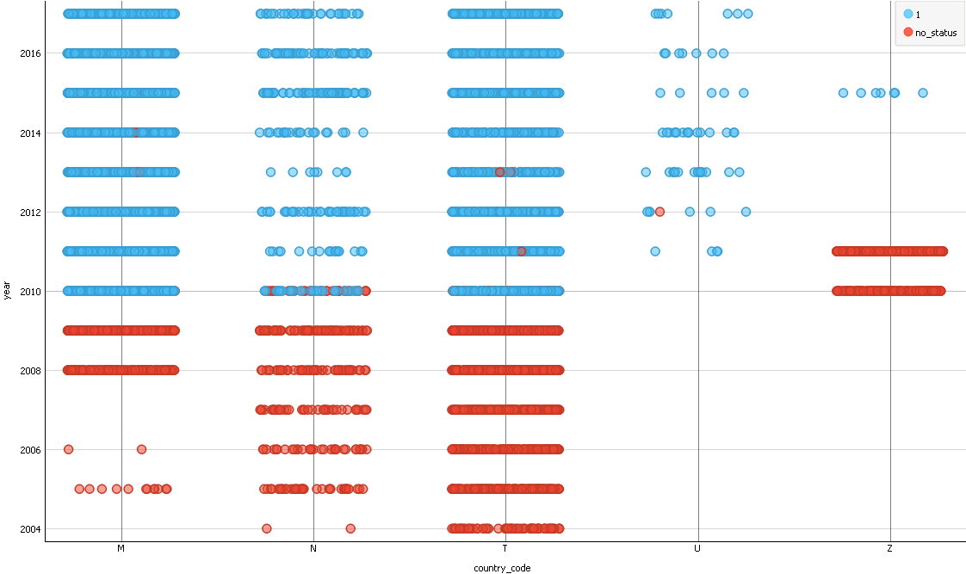
COUNTRY_CODE-YEAR

Slide 22
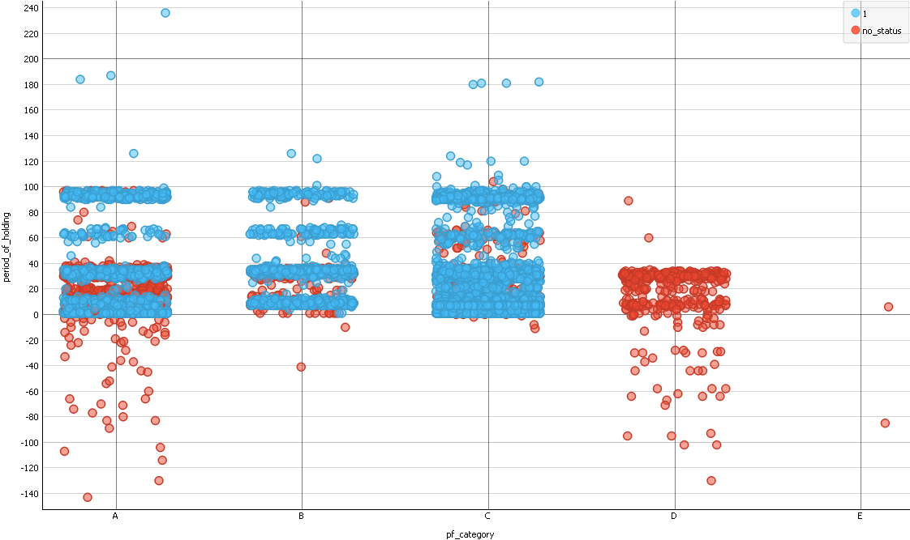
PF_CATEGORY - PERIOD_OF_HOLDING

Slide 23
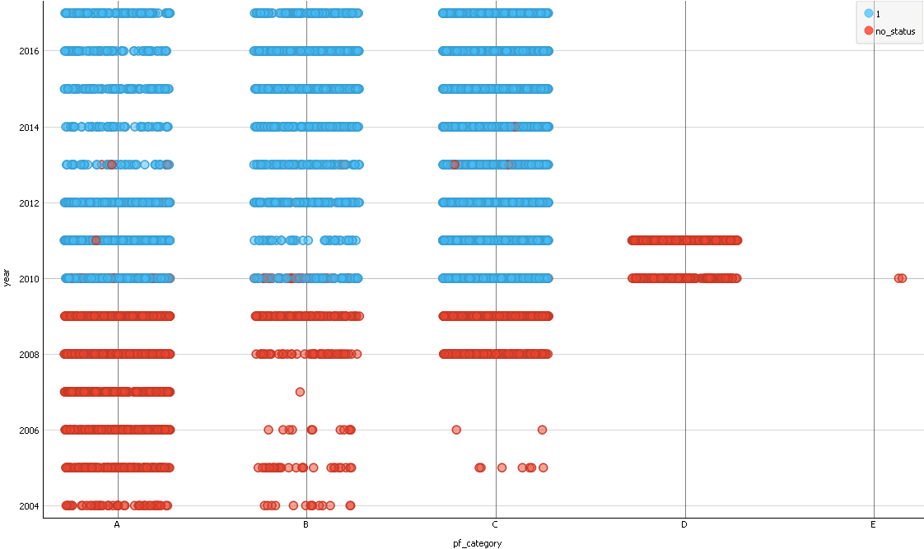
PF_CATEGORY - YEAR

Slide 24
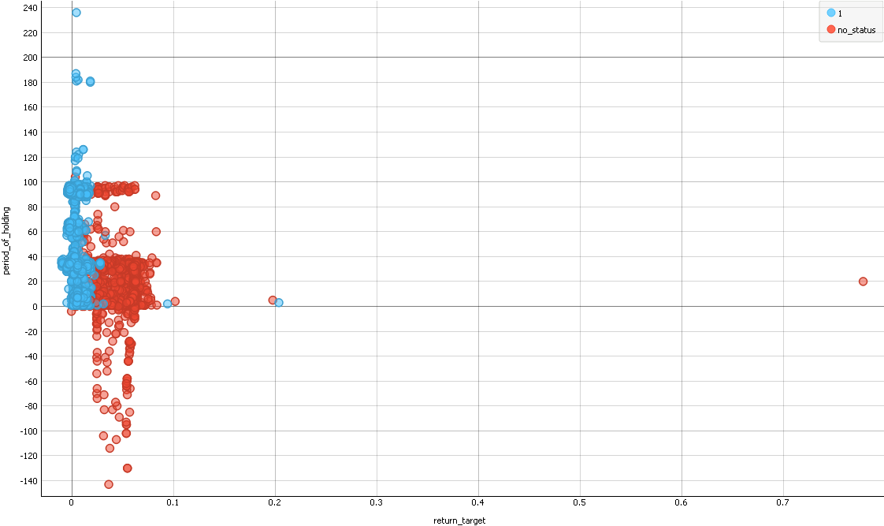
RETURN - PERIOD_OF_HOLDING

Slide 25
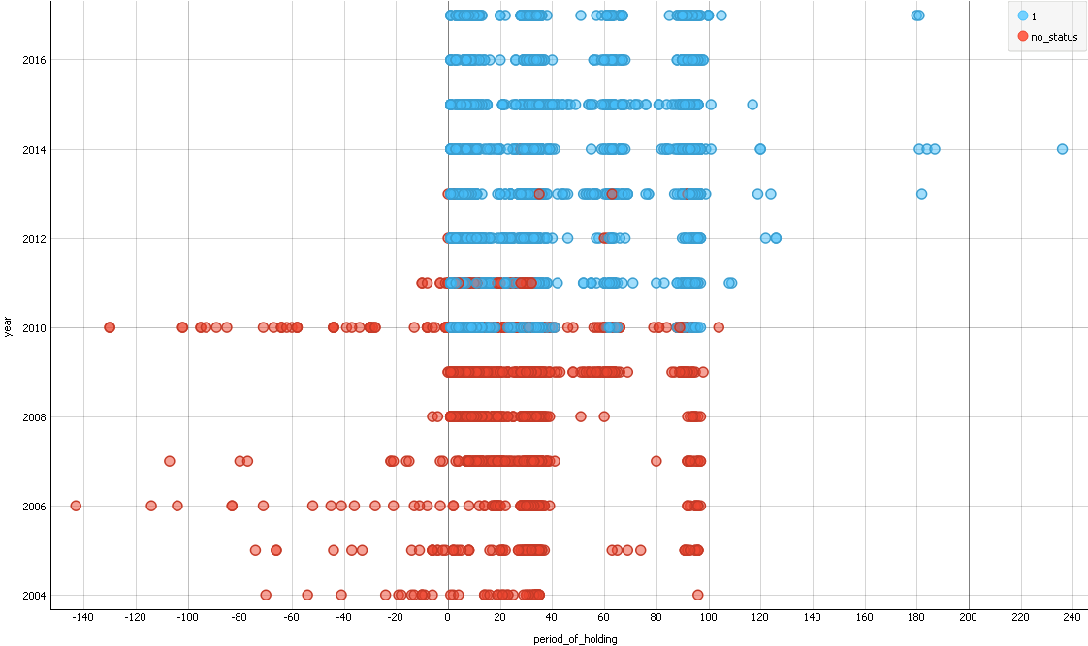
YEAR - PERIOD_OF_HOLDING

Slide 26
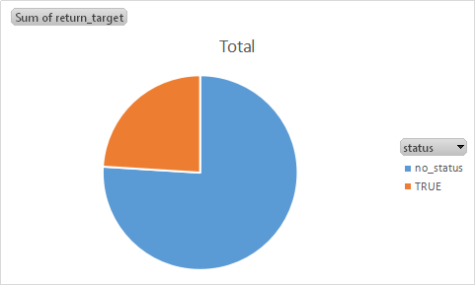
RETURN_STATUS

Slide 27
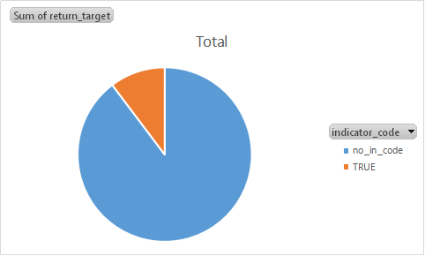
RETURN - INDICATOR_CODE

Slide 28
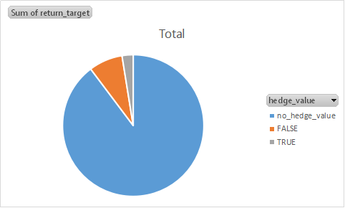
RETURN - HEDGE_VALUE

