Slide 1
SOCIETE GENERALE START DATE YEAR ANALYSIS
DONE BY | B.VARSHINI
DATE | 09-02-2018
MEETING NO | 8

Slide 2
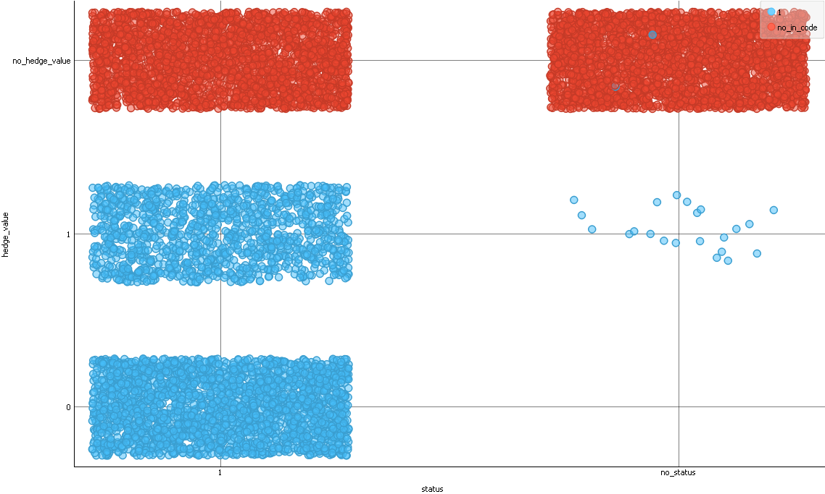
STATUS AND INDICATOR CODE

Slide 3
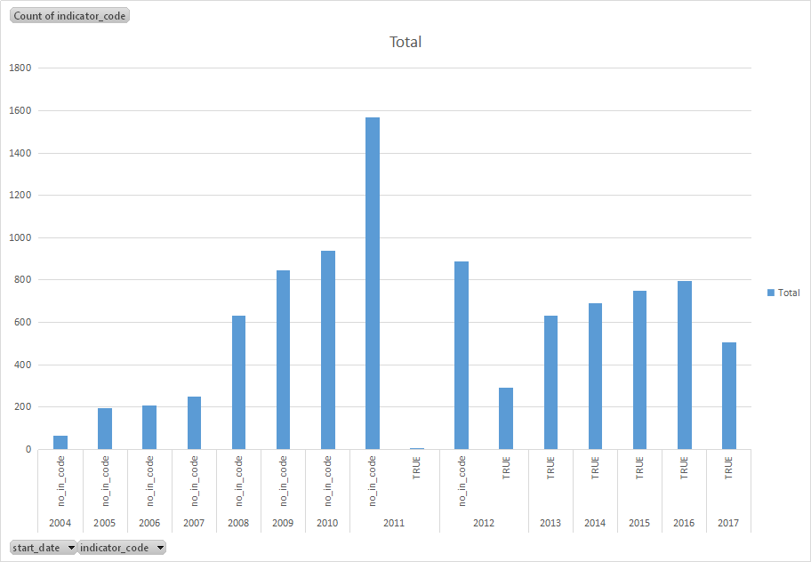
START_DATE_YEAR WITH INCODE

Slide 4
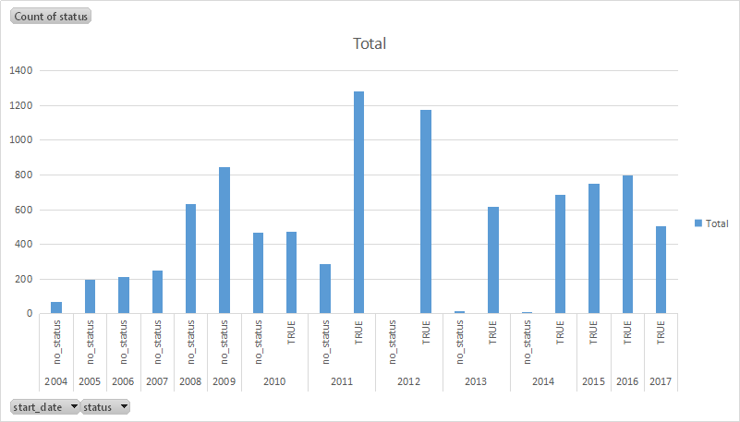
START_DATE_YEAR WITH STATUS

Slide 5
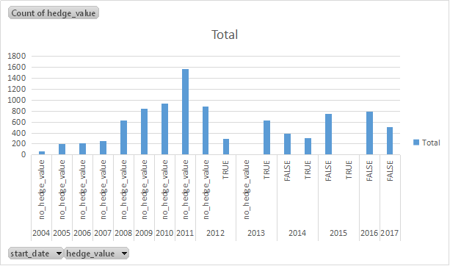
START_DATE_YAER WITH HEDGE_VALUE

Slide 6
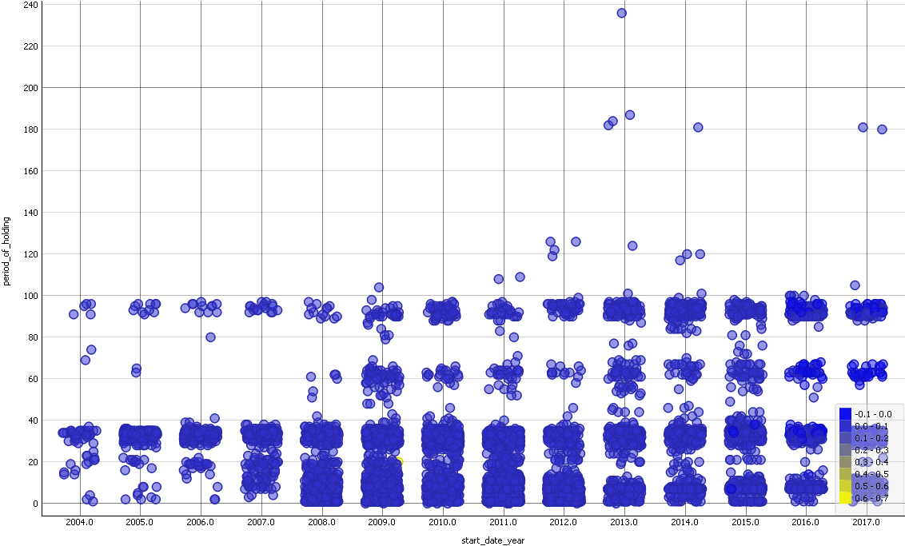
START_DATE_YEAR WITH PERIOD OF HANDLING

Slide 7
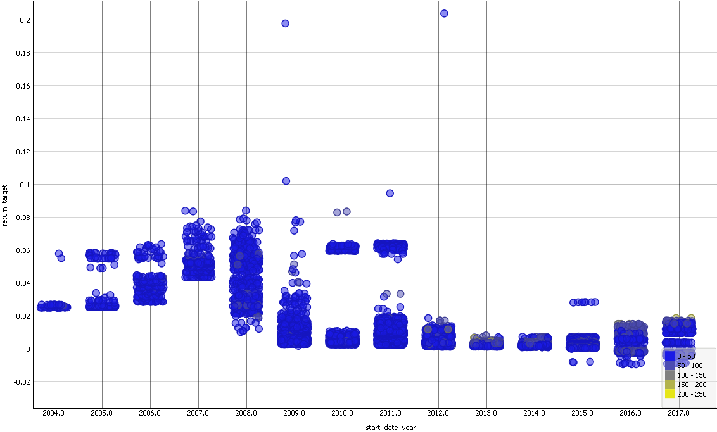
START_DATE_YEAR WITH RETURN

