Slide 1
Machine Intelligence
Project Title : Hate speech detection

Slide 2
Abstract and Scope
Hate speech, defined as an "abusive speech targeting specific group characteristics, regarding ethnicity, religion, gender or social issue", is a critical problem plaguing websites that makes social media a thriving platform for negativity and misinformation.Consequently, the community is affected as a whole, deteriorating the society on a behavioural and economical front.
In order to address this issue, in this project, we aim to develop a model that will be able to classify a given text as hate speech or not using state-of-the-art transformer models through deep learning techniques.

Slide 3
Design Approach
Data Collection: Tweets is initially taken as input to the model.
Data Pre-processing: The initially collected data is cleaned to remove NULL, redundant and inconsistent data. Further punctuation cleaning is performed using regular expression. Stop words are removed in order to get a concise representation of data appropriate for further analysis and modelling.
Word Embeddings generation: Word embeddings play a crucial role in correctly classifying hate speech tweets as they convey contextualised meaning of the words to the model.
Modelling: Training the model on the train dataset
Hyperparameter Fine Tuning: Validating and improving accuracy of the model.

Slide 4
Design Constraints, Assumptions & Dependencies
Assumptions:
The tweet text is in English only.
Constraints:
The model is constrained to work primarily on tweet texts in English
Dependencies:
GPU

Slide 5
Proposed Methodology / Approach
Training data has been extracted from Huggingface which is a labelled dataset indicating whether a given tweet represents hate speech or not. The dataset has been cleaned and pre-processed to remove redundant and inconsistent data. It has been split into training and testing sets. The data is mapped to word embeddings using linguistic models. Deep learning models have been trained on this data and the results are validated. Testing set is used to obtain test results through classification metrics and confusion matrix.

Slide 6
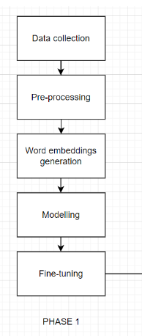
Architecture - Control Flow

Slide 7
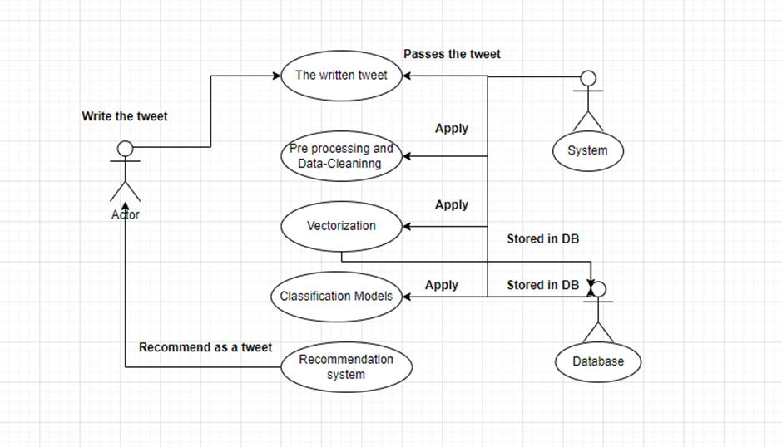
Design Description - Use Case Diagram

Slide 8
Technologies Used
Pandas
Numpy
Keras
Tensorflow
NLTK
Scikit-learn

Slide 9
Models used - Machine Learning
Naive Bayes Classifier
Logistic Regression
Random Forests
Passive Aggressive Classifier
Adaboost
Linear SVM
K- Nearest Neighbours
XGBoost
Decision trees

Slide 10
Embeddings used - Deep Learning
FastText
GloVe
RoBerta
These word embeddings have been passed to a neural networks with three Bi-directional LSTM layers or to BERT architecture.

Slide 11
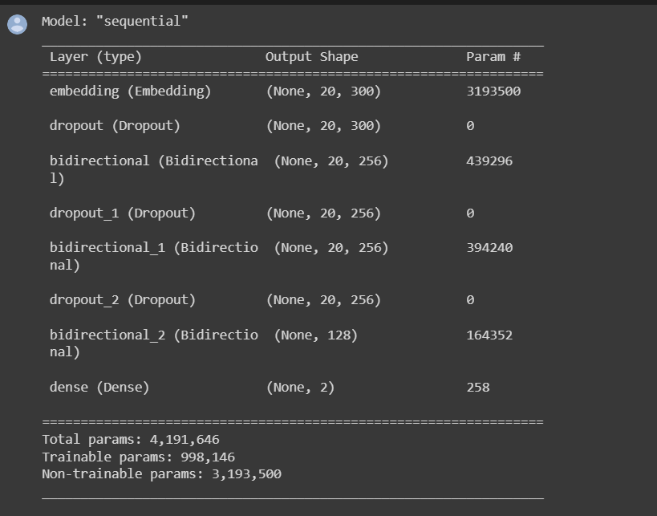
Neural network architecture for BiLSTM

Slide 12
Metrics used
Confusion matrix
Classification report

Slide 13
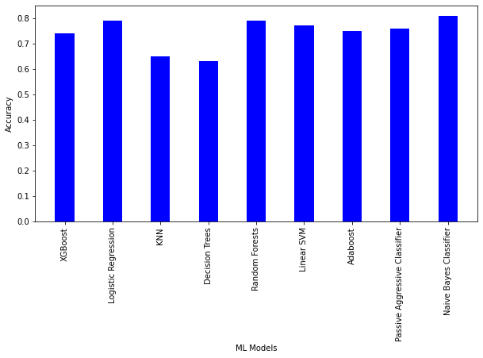
Results

Slide 14
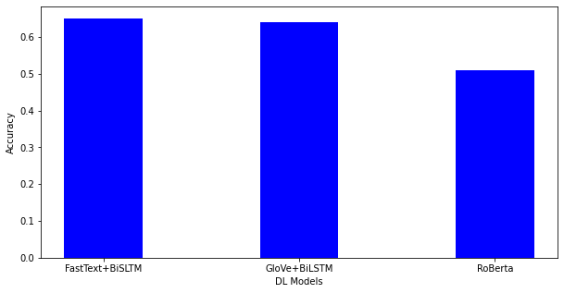

Slide 15
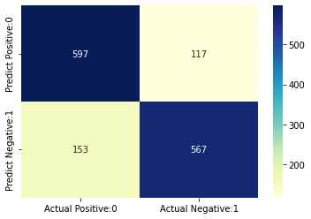
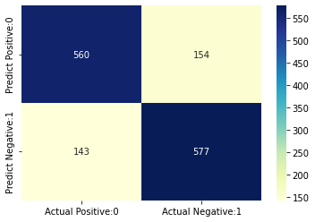
Confusion matrix for top 2 models
Naive Bayes Classifier Logistic Regression

Slide 16
References
https://arxiv.org/pdf/2010.12472v2.pdf
https://openaccess.thecvf.com/content_WACV_2020/papers/Gomez_Exploring_Hate_Speech_Detection_in_Multimodal_Publications_WACV_2020_paper.pdf
https://peerj.com/articles/cs-598/
https://www.researchgate.net/profile/Fabio-Del-Vigna/publication/316971988_Hate_me_hate_me_not_Hate_speech_detection_on_Facebook/links/591af15d0f7e9beed7f5ff61/Hate-me-hate-me-not-Hate-speech-detection-on-Facebook.pdf
https://ieeexplore.ieee.org/abstract/document/4722931
https://arxiv.org/abs/1712.07525
https://ieeexplore.ieee.org/abstract/document/9658978

Slide 17
Thank You

