Slide 1
PARICHAY · by SiteSureLabs
INTRODUCTION
BACKGROUND
Worker ID passes were manual, paper-based, and slow
Site offices tracked contractor workers on paper registers and outsourced ID printing — no central records, no photos on file, no way to verify who's actually on site.
Objective
Solution
Current Status
• Digitize worker onboarding & ID issuance
• Capture photo + verified details on site
• Give every site a live, searchable worker record
• Parichay: browser-based operator + admin app
• 3-step flow: Personal, Employment, Photo — to a printable pass
• Centralized admin dashboard across all sites
• Live at Udyan, Vyoma, Nishada, Vipina, TTPL
• Role-based logins: Site Operator (CSO) & Admin
• Batch printing, Excel/CSV export, analytics dashboard
• Configurable data retention policy
1

Slide 2
PARICHAY · by SiteSureLabs
HOW IT WORKS
WORKFLOW
Login → Details → Photo → Generate → Print
One continuous flow at the site gate — from operator login to a printed, verified worker ID.
01
02
03
04
05
◉
→
◉
→
◉
→
◉
→
◉
Operator Login
Personal & Work Details
Photo Capture
Generate Pass
Print / Batch
CSO logs in per site; session is scoped to that site only.
Name, Aadhar, DOB, address, contractor, designation, validity.
Live webcam capture, natural or studio-white background.
Duplicate check by Aadhar, then pass is rendered to canvas.
Download, print single, or queue & print a full A4 batch.
2

Slide 3
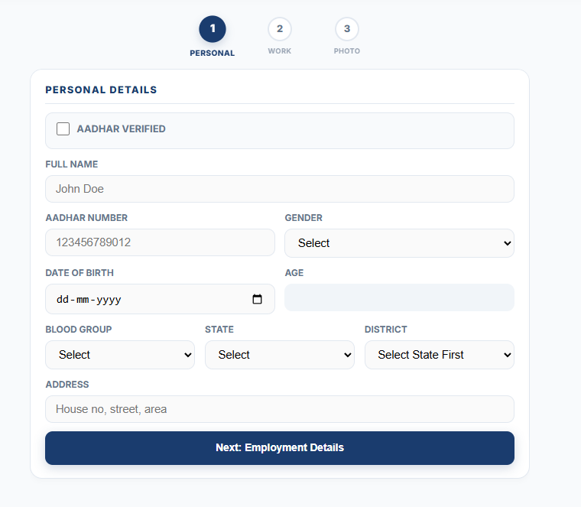
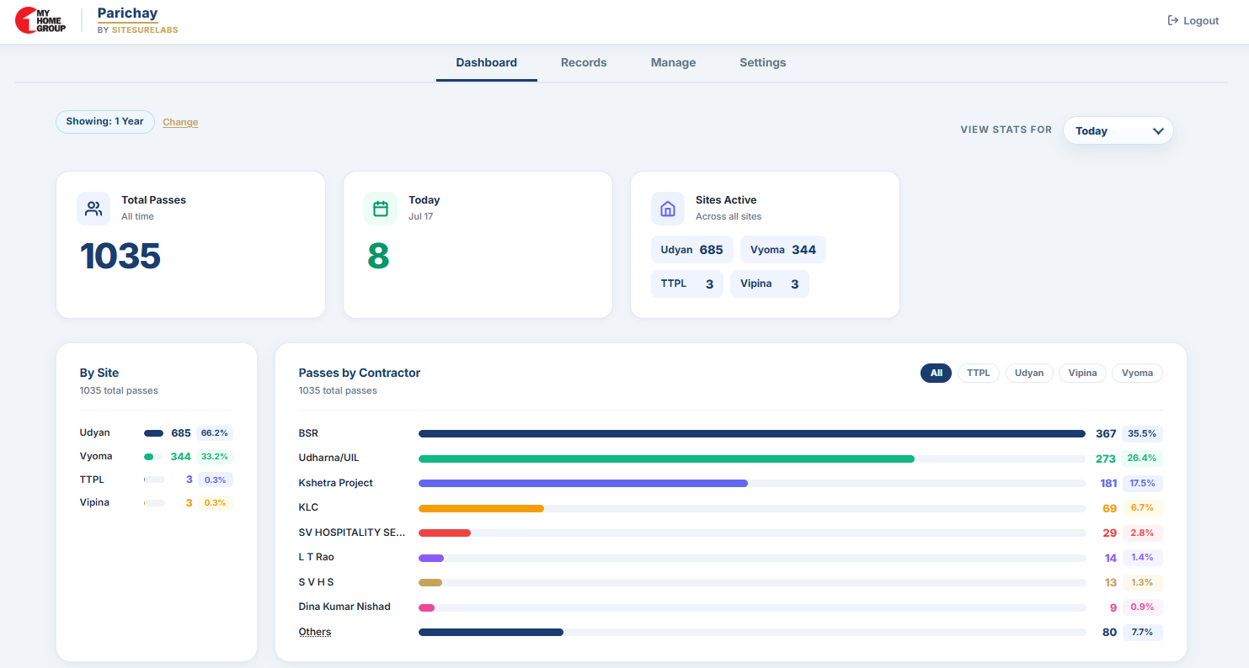
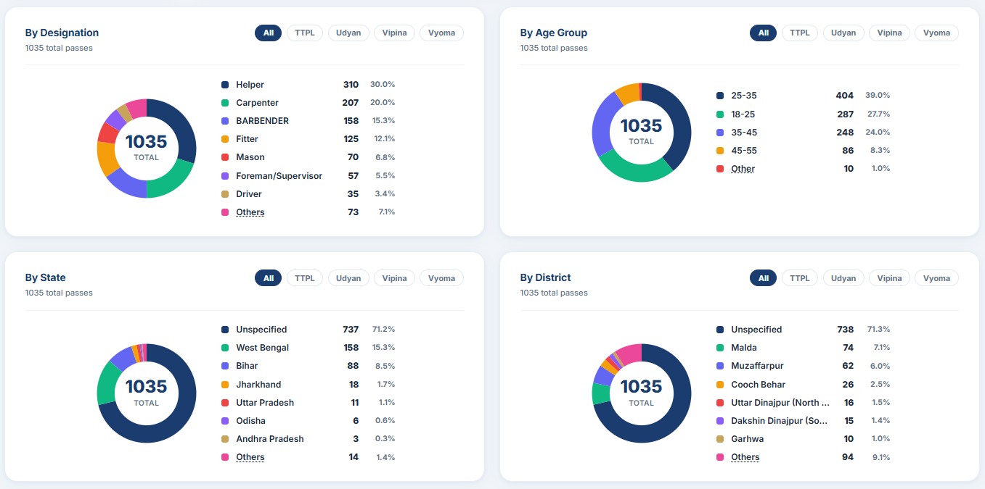
PARICHAY · by SiteSureLabs
CURRENT EXPERIENCE
SCREENS
What it looks like today
Operator App
[ screenshot placeholder ]
Records Table
[ screenshot placeholder ]
Analytics
[ screenshot placeholder ]
Pass Generation
Site Records
Admin Dashboard
ACCESS: https://icg-owg0.onrender.com/
3

