Slide 1
SITEVISION · by SiteSureLabs
INTRODUCTION
BACKGROUND
We rely on Constra & Sitepace for 360° tours. Why?
Two external vendors handle our virtual walkthroughs today — recurring cost, no control over the workflow, and data locked outside our systems.
Objective
Solution
Current Status
• Bring 360° tours fully in-house
• Drop dependency on Constra & Sitepace
• Own the workflow, data, and cost
• SiteVision replaces both vendors end-to-end
• Built around our own floor plans, pins & roles
• Publish once — browse from any device
• Core workflow live end-to-end
• Role-based access: Engineer/Manager/Admin
• AI progress reports (PDF) added
• Refining panorama stitch quality

Slide 2
SITEVISION · by SiteSureLabs
HOW IT WORKS
WORKFLOW
Plan → Pin → Capture → Publish → View
One continuous pipeline, from a blank floor plan to a walkthrough anyone can open in a browser.
01
02
03
04
05
▦
→
◎
→
◐
→
▩
→
▶
Upload Floor Plan
Place Pins
Capture Photos
Auto-Stitch
Publish & Browse
Engineer uploads the plan for a tower & floor.
Mark capture points — sets the walkthrough order.
360°/fisheye shots at each pin — mobile or upload.
Backend blends fisheye frames into one panorama.
Tour goes live — Pin 1 → Pin 2 → … in 360°.

Slide 3
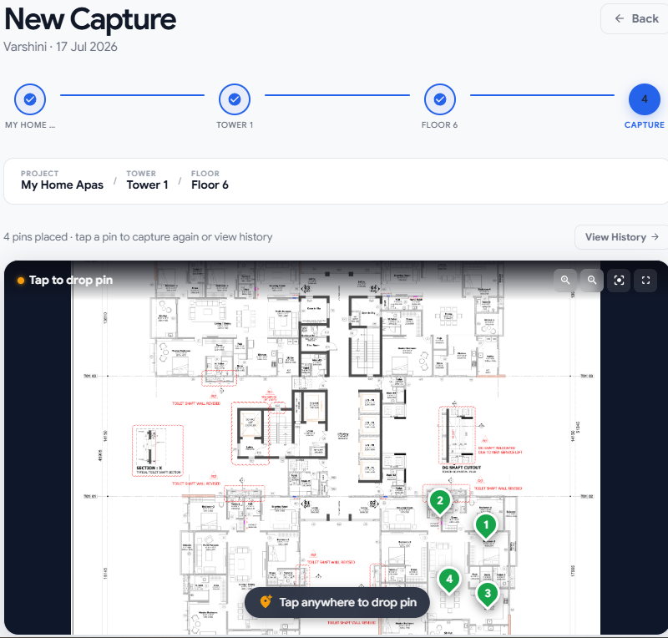
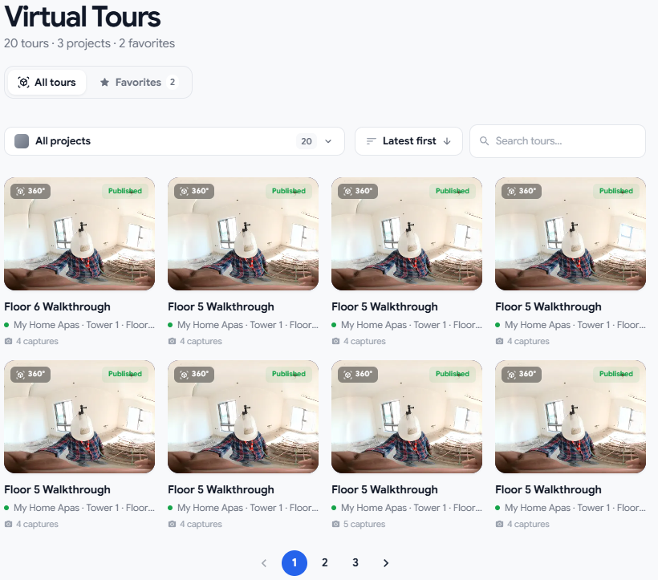
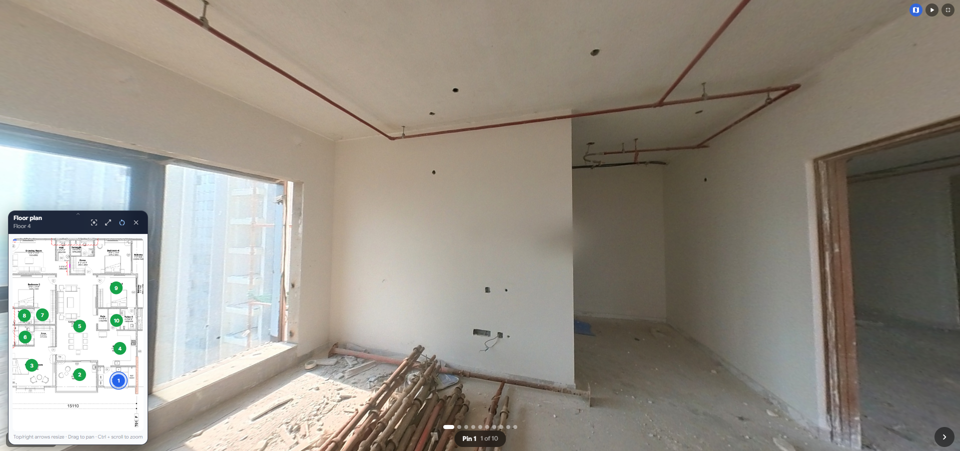
SITEVISION · by SiteSureLabs
CURRENT EXPERIENCE
SCREENS
What it looks like today
▦
Floor plan + pins
drop in screenshot
◐
360° panorama viewer
drop in screenshot
▤
Virtual Tours listing
drop in screenshot
Capture Workflow
Virtual Tours
360⁰ Virtual Tours Viewer
ACCESS http://172.20.7.22:5174/

