Slide 1
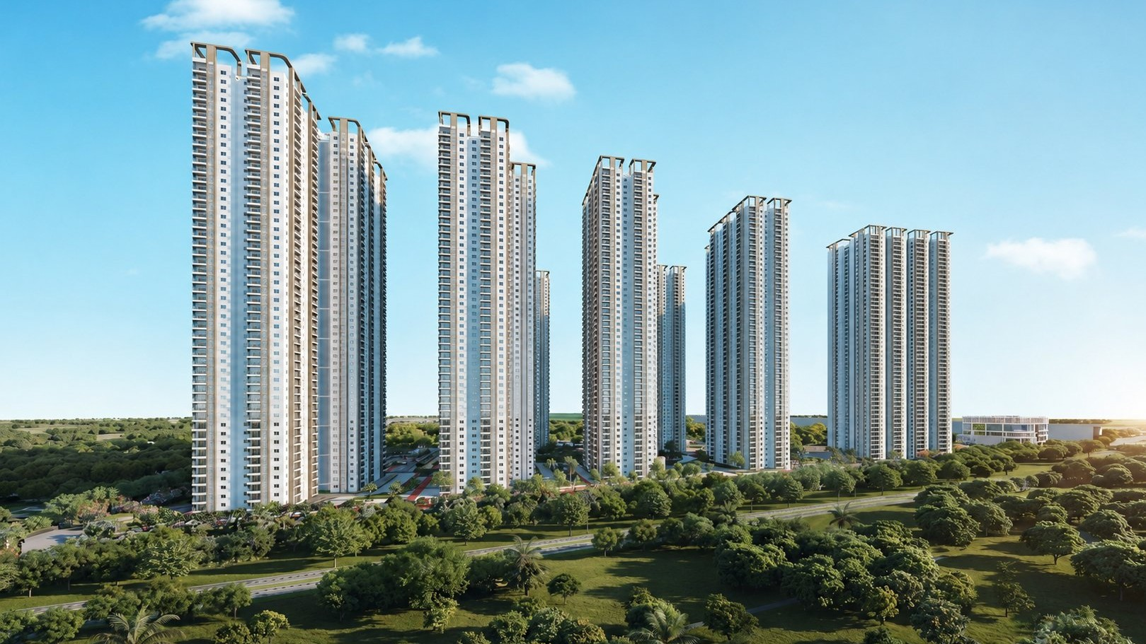



QUALITY OBSERVATION REPORT
MH Udyan
Construction Quality Review
My Home Constructions
REPORTING PERIOD
PREPARED BY
27-05-2026
Quality Assurance Cell
This report has been generated using AI; human review is required.

