Slide 1
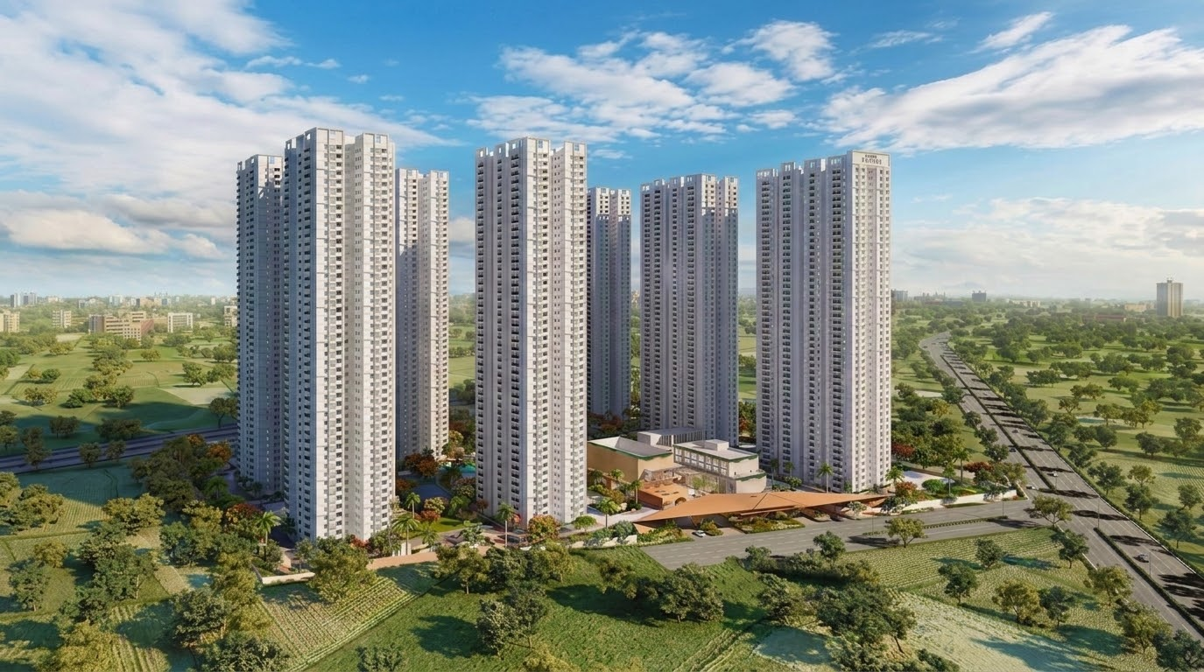

Quality Observation Report - MH Vipina
Report Dated XX-XX-XX To XX-XX-XX
My Home Constructions

