Slide 1
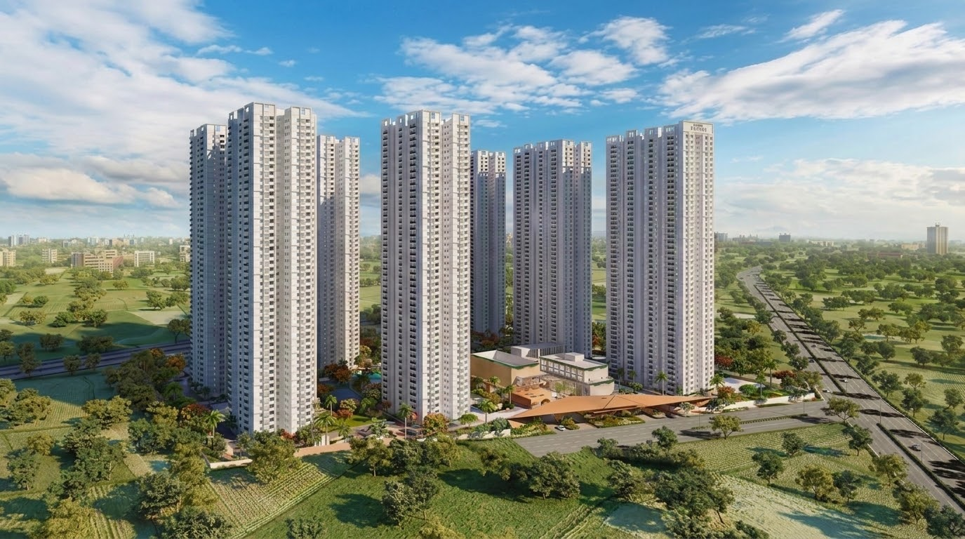



QUALITY OBSERVATION REPORT
MH Vipina
Construction Quality Review · My Home Constructions
REPORTING PERIOD
PREPARED BY
Period start — Period end
Quality Assurance Cell

