Slide 1
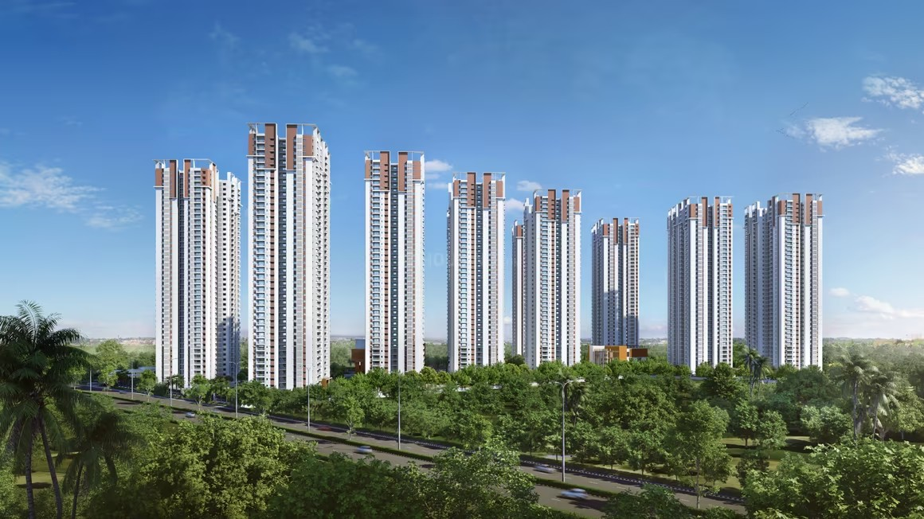



QUALITY OBSERVATION REPORT
MH Akrida
Construction Quality Review
My Home Constructions
REPORTING PERIOD
PREPARED BY
05-05-2026 — 20-05-2026
Quality Assurance Cell
This report has been generated using AI; human review is required.

Slide 2
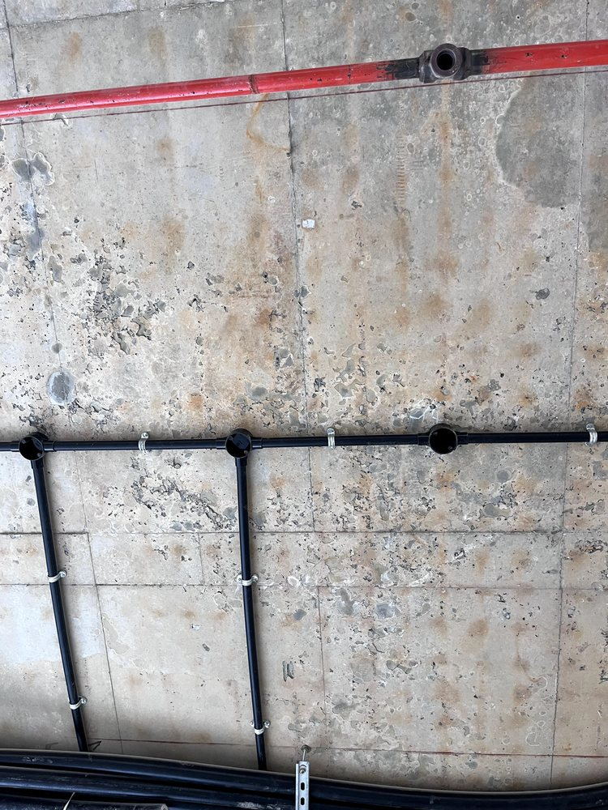
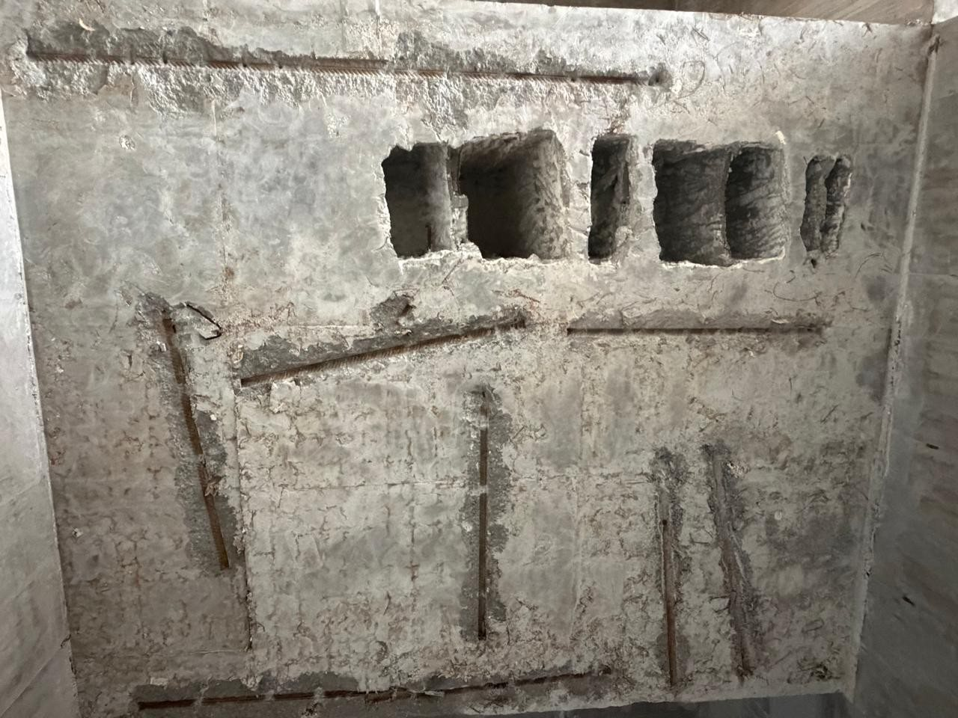
Quality Walkthrough - My Home Akrida
1
2
Location | To be confirmed
Category | Structural
Reporting date | 20-May-2026
Severity | HIGH
Defect | Crack
Observation | x
Recommendation | y
Location | To be confirmed
Category | Structural
Reporting date | 5-May-2026
Severity | HIGH
Defect | Crack
Observation | x
Recommendation | y
SiteSureLabs

