Slide 1
PHOTO SKETCH GENERATOR
CONVERT AN IMAGE INTO PENCIL SKETCH
Presented by:
Amirishetti Varshini
23B81A7358
AIM

Slide 2
Introduction
A Photo Sketch Generator converts a normal photo into a pencil sketch using image processing techniques.
It involves multiple steps like Grayscale conversion, Inversion, Gaussian Blur, and Image Blending.
The process is inspired by how pencil strokes create shading in real sketches.

Slide 3
Image Processing Basics
Digital image processing allows us to manipulate and enhance images using mathematical operations.
An image is made up of pixels, each containing color intensity values for Red, Green, and Blue channels.
In this project, we modify pixel intensity values to create a pencil sketch effect.

Slide 4
Step 1: Grayscale Conversion
Purpose: Simplifies the image by removing color information, leaving only brightness levels.
A grayscale image has shades of gray ranging from black (0) to white (255).
Formula used in OpenCV: Gray = 0.299*R + 0.587*G + 0.114*B
OpenCV function: cv2.cvtColor(image, cv2.COLOR_BGR2GRAY)

Slide 5
Step 2: Image Inversion
Purpose: Creates a negative of the grayscale image.
Each pixel intensity is subtracted from 255 (max intensity).
This helps highlight the bright regions that will appear as sketch strokes after blending.
Formula: Inverted = 255 - Gray
OpenCV uses direct subtraction for inversion.

Slide 6
Step 3: Gaussian Blur
Purpose: To smooth out details and noise in the inverted image.
Gaussian Blur applies a weighted average using a Gaussian function around each pixel.
It creates a soft blur that mimics shading in pencil sketches.
The parameter (21,21) defines the kernel size, controlling the amount of blur.
OpenCV function: cv2.GaussianBlur(image, (21,21), sigmaX=0, sigmaY=0)

Slide 7
Step 4: Image Blending (Color Dodge)
Purpose: To combine the grayscale and blurred images to produce a sketch effect.
The Color Dodge technique lightens the base image depending on the brightness of the top layer.
Formula: Result = Gray / (255 - Blur) * 256
This makes dark regions more prominent, simulating pencil lines.
OpenCV function: cv2.divide(gray, 255 - blur, scale=256)

Slide 8
Python Implementation
import numpy as np
import matplotlib.pyplot as plt
import cv2
img=r"pic.jpg"
i_bgr=cv2.imread(img)
plt.figure(figsize=(10,10))
plt.subplot(5,4,1)
plt.title("original image")
plt.imshow(i_bgr)
i_rgb=i_bgr[:,:,::-1]/255.0
r=i_rgb[:,:,0]
g=i_rgb[:,:,1]
b=i_rgb[:,:,2]
plt.subplot(5,4,2)
plt.title("rbg image")
plt.imshow(i_rgb)
grayscale=(r+g+b)/3
plt.subplot(5,4,3)
plt.title("gray scale image")
plt.imshow(grayscale, cmap='gray') # Added cmap='gray' for better visualization

Slide 9
def gaussian(size,sigma=1):
k=size//2
kernel=np.zeros((size,size),np.float64)
for x in range(-k,k+1):
for y in range(-k,k+1):
kernel[x+k,y+k]=np.exp(-(x**2+y**2)/(2*sigma**2)) # Corrected formula for Gaussian
kernel/=np.sum(kernel)
return kernel
def gaussian_filter(img, kernel_size, sigma=1):
kernel = gaussian(kernel_size, sigma)
pad = kernel_size // 2
img_pad = np.pad(img, pad, mode='edge')
output = np.zeros_like(img)
for i in range(output.shape[0]):
for j in range(output.shape[1]):
region = img_pad[i:i+kernel_size, j:j+kernel_size]
output[i, j] = np.sum(kernel * region)
return output

Slide 10
m,n=grayscale.shape
m1,n1=3,3
# Pass kernel size (m1 or n1) to gaussian_filter
g=gaussian_filter(grayscale, m1, 1) # Using m1 as kernel size
plt.subplot(5,4,4)
plt.title("gaussian filter image")
plt.imshow(g, cmap='gray') # Added cmap='gray' for better visualization
inverted = 1 - g
plt.subplot(5,4,5)
plt.title("inverted image")
plt.imshow(inverted, cmap='gray')
blur_inverted = gaussian_filter(inverted, m1, 1)
plt.subplot(5,4,6)
plt.title("blurred inverted image")
plt.imshow(blur_inverted, cmap='gray')
pencil_sketch = grayscale / (1 - blur_inverted)
pencil_sketch = np.clip(pencil_sketch, 0, 1)
plt.subplot(5,4,7)
plt.title("pencil sketch image")
plt.imshow(pencil_sketch, cmap='gray')

Slide 11
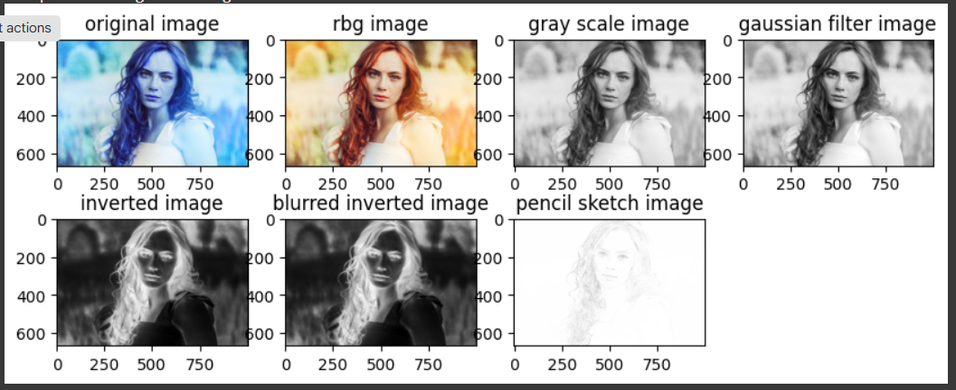

Slide 12
Output
The final result is a pencil-like sketch image.
Bright areas of the original image appear as light strokes.
Dark regions become darker pencil lines, creating a realistic sketch effect.
Example: Original Photo → Grayscale → Inverted → Blurred → Blended Sketch.

Slide 13
Applications
Fun photo editing and filters.
Artistic and creative image generation.
Pre-processing step in image stylization pipelines.
Used in apps for cartoon, portrait, or pencil sketch filters.

Slide 14
Conclusion
This project demonstrates how simple image processing techniques can create artistic results.
Combining Grayscale, Inversion, Gaussian Blur, and Color Dodge blending produces a natural pencil sketch effect.

