Slide 1


P.E.S. College of Engineering, Mandya-571401
(An Autonomous Institute under Visvesvaraya Technological University, Belagavi)
Department of Information Science and Engineering
Phase 3:Implementation & Validation Review On:
“ Kannada Speech Emotion Recognition Using Data Science Tool”
Team Members:
Parikshith S – 4PS22IS039
Pavana S – 4PS22IS040
Sahana S Gudennavar – 4PS22IS045
Varshini M R – 4PS22IS056
Under the Guidance of:
Sushmitha S. R Assistant Professor
Dept. Of IS&E

Slide 2
Table of Contents
Sl. No. | Content Title
1 | Introduction
2 | Abstract & Problem Statement
3 | Objectives
4 | Objective 1 – Methodology
5 | Objective 1 - Results
6 | Objective 2 – Methodology
7 | Objective 2 – Results
8 | Tools and Technologies
9 | Conclusion
10 | References

Slide 3
Introduction
Speech Emotion Recognition (SER) enables computers to identify human emotions from voice.
Our project focuses on Kannada-language emotion recognition, addressing limited research in regional languages.
The system is built using Data Science tools such as the Python language
Aims to enhance emotion-aware communication systems in healthcare, education, and daily interactions.
SDG Contribution:
SDG 9: Industry, Innovation, and Infrastructure
→ Our project promotes innovation by developing an intelligent system that recognizes emotions from Kannada speech using data science tools.
SDG 3: Good Health and Well-being
→ It supports mental health by helping detect emotional states through speech, which can aid in stress or mood monitoring systems.

Slide 4
Abstract:
Speech Emotion Recognition (SER) is an emerging research area in the field of artificial intelligence and human–computer interaction that focuses on identifying human emotions from speech signals.
The goal of this project is to develop a system that can automatically recognize emotions from Kannada speech audio using machine learning techniques.
Emotions such as happiness, anger, sadness, fear, surprise, and neutral are identified based on acoustic characteristics present in speech.
Problem Statement:
Existing Speech Emotion Recognition systems perform poorly on Kannada speech due to limited regional data . Hence, a Kannada SER model using data science tools is needed to accurately classify basic emotions.

Slide 5
OBJECTIVES
1. Feature Extraction from Speech Signals
To extract important acoustic features such as MFCC, pitch, energy, and intensity from Kannada speech audio using Python-based audio processing techniques. These features help in identifying emotional patterns in speech.
2. Emotion Classification using Kannada Dataset
To train and evaluate a machine learning model using a labeled Kannada speech dataset in order to accurately classify human emotions such as happiness, anger, sadness, fear, neutral, and surprise.
3. Development of a User Interface and Accuracy Improvement
To build a frontend interface that allows users to input audio and view the predicted emotion, while also improving the model accuracy through dataset enhancement and model optimization.

Slide 6
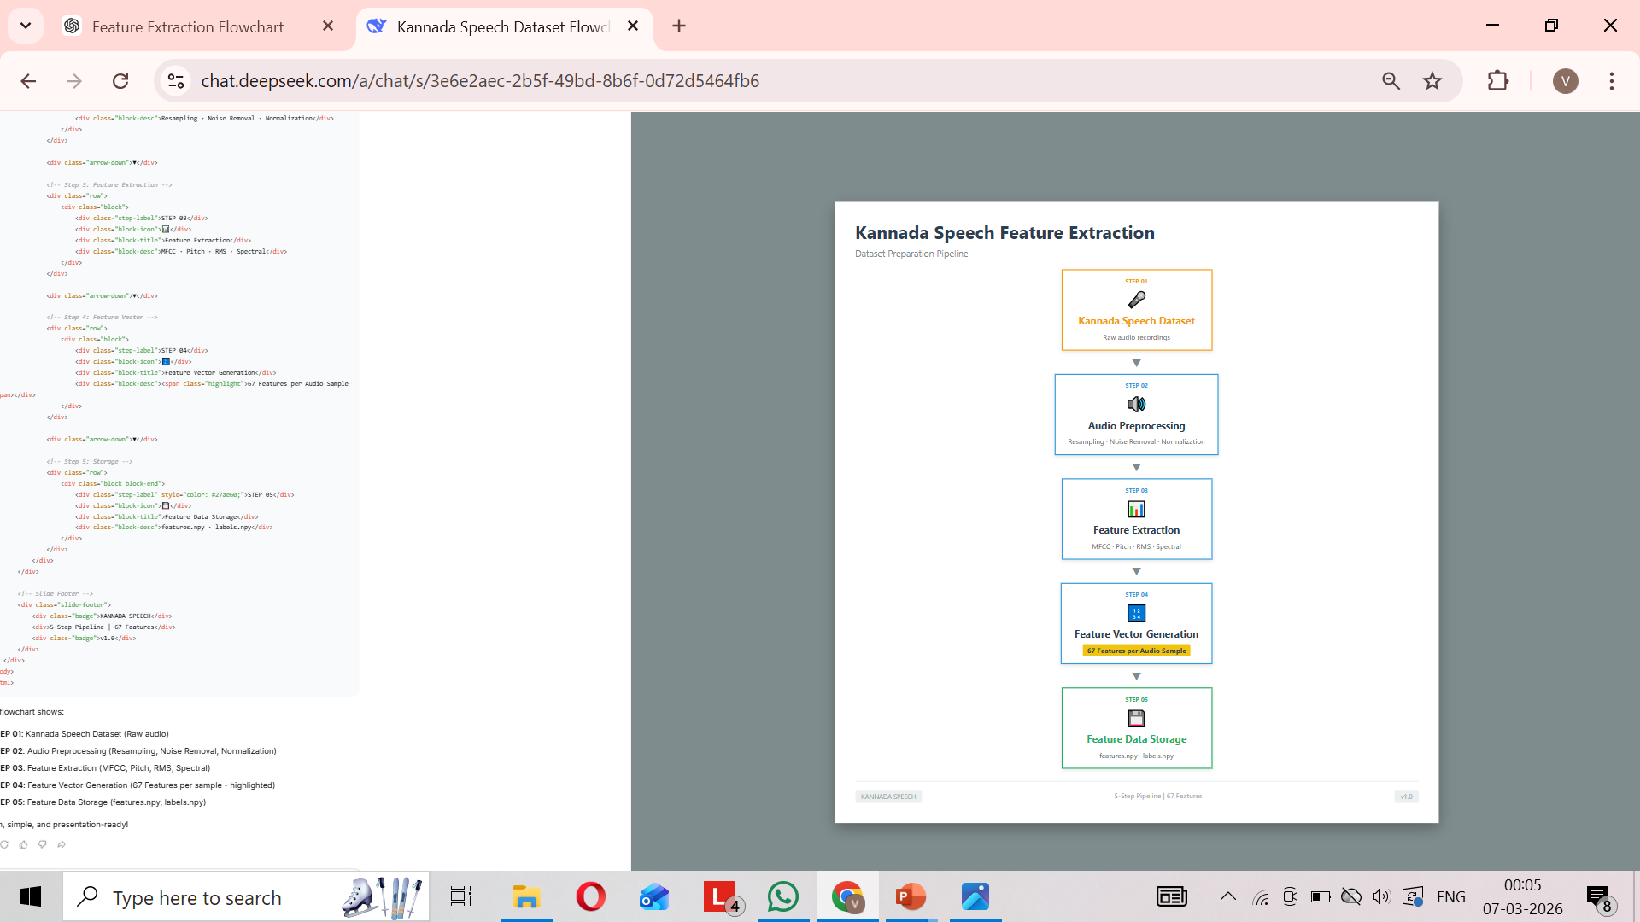
Objective 1 Methodology

Slide 7
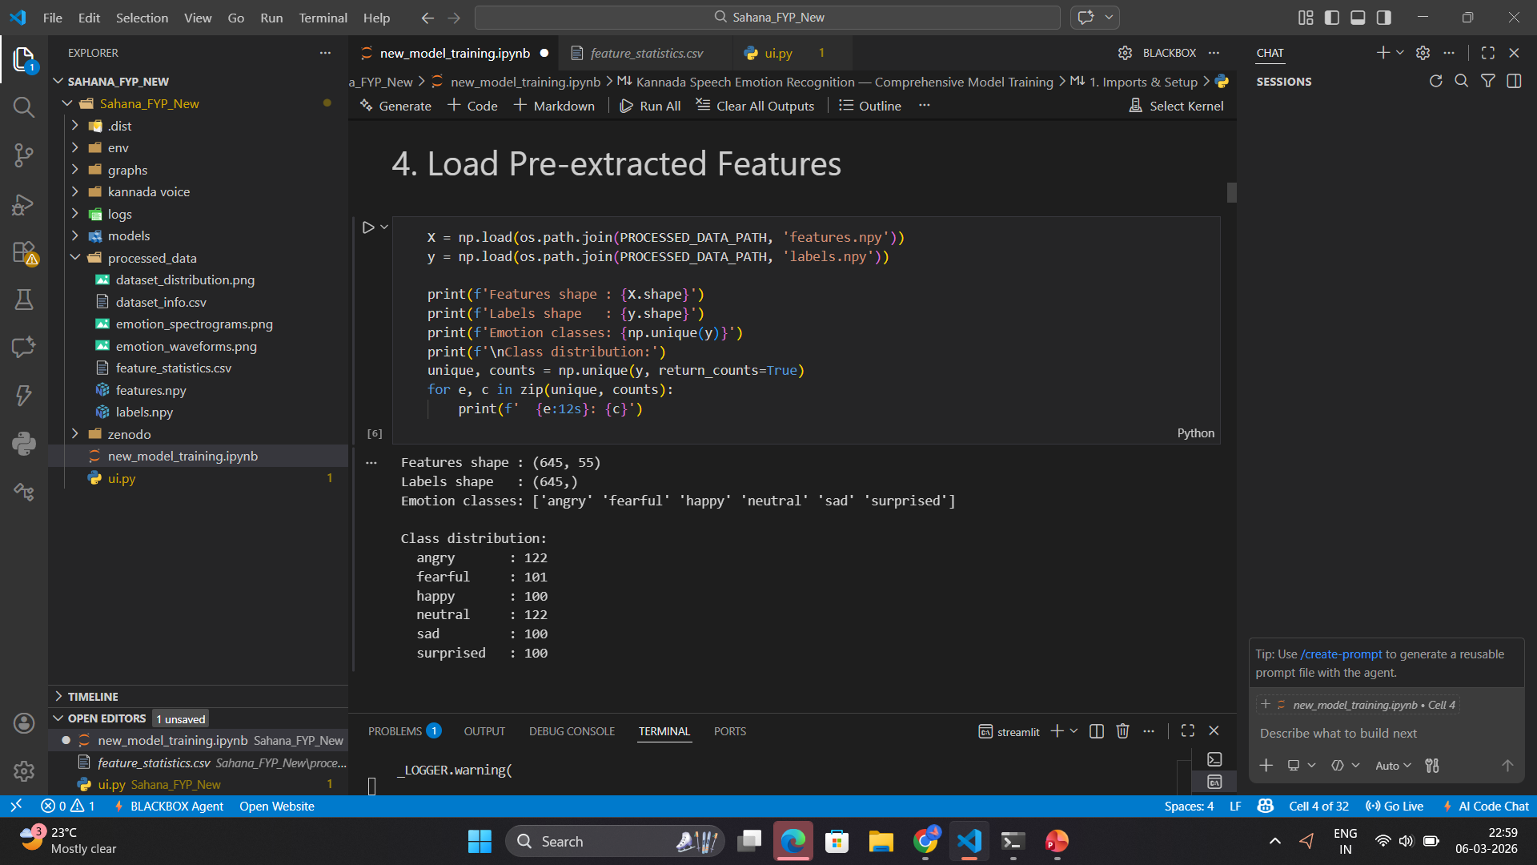
OBJECTIVE -1: RESULT

Slide 8
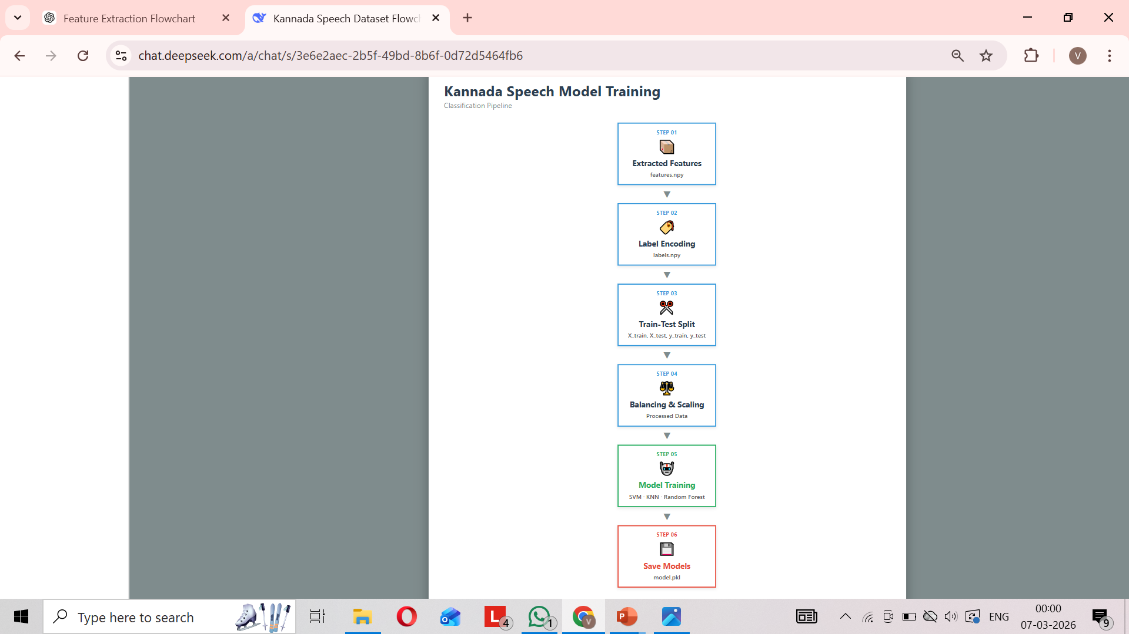
Objective 2 Methodology

Slide 9
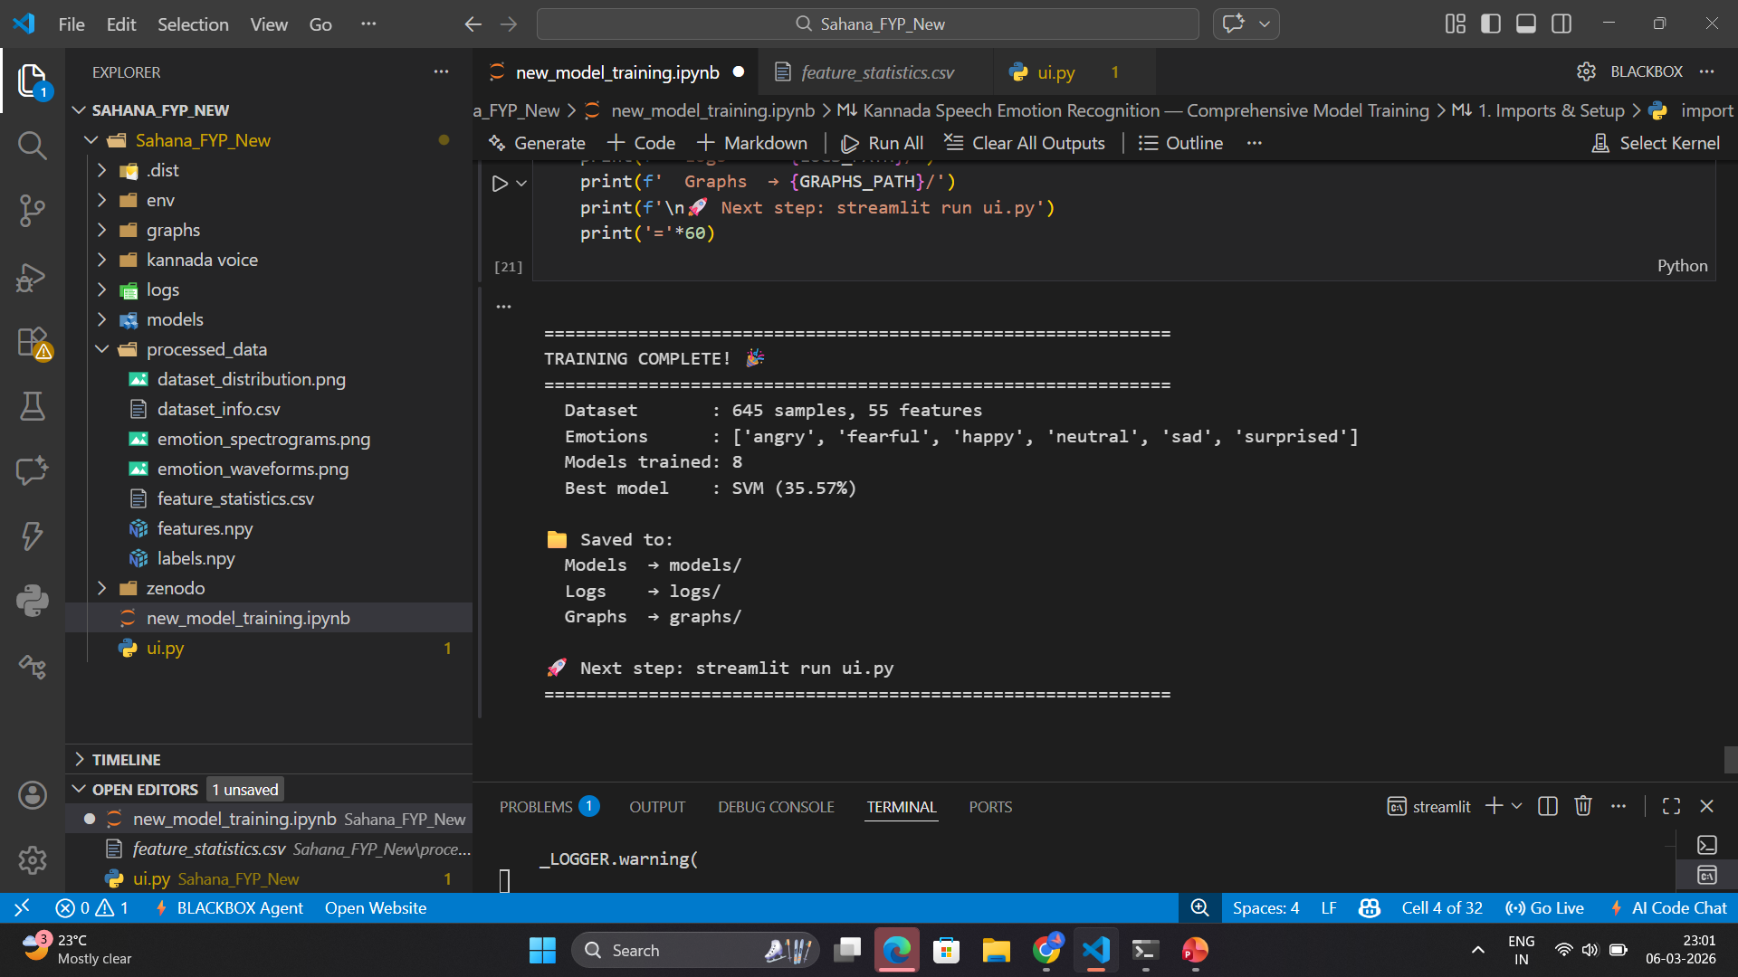
OBJECTIVE-2:RESULT

Slide 10
TOOLS AND TECHNOLOGIES
Category
Programming Language
Libraries / Packages
Audio Processing
ML Models
Dataset
Platforms
Hardware
Tools / Frameworks
Python
NumPy, Pandas, Librosa, Matplotlib, Plotly, Scikit-learn.
Librosa , Audacity
SVM,KNN,Random Forest.
Kannada Emotional Speech Dataset (Zenodo, 2022)
VS Code
PC/Laptop with Microphone

Slide 11
CONCLUSION
The Kannada Speech Emotion Recognition system was developed to identify human emotions from speech signals using machine learning techniques. Important acoustic features such as MFCC, pitch, energy, and intensity were extracted from Kannada speech audio for emotion analysis. The trained model successfully classified emotions like happiness, anger, sadness, fear, surprise, and neutral. A user interface was also designed to allow users to input speech and view the predicted emotion.

Slide 12
REFERENCES
[1].IEEE Authors (Multiple) (2021). Speech Emotion Recognition using CNN.
[2].Bhattacharya T. et al. (IEEE) (2024). Deep Learning Approaches for Speech Emotion Recognition.
[3].Li X. et al. (Elsevier) (2024). Transformer Models for Multilingual Emotion Recognition.
[4].Kumar R., Singh A. (Springer) (2022). Emotion Recognition in RAVDESS Dataset using SVM.
[5[ Han K., Yu D. (Elsevier) (2023). Speech Emotion Analysis using R.
[6]Harshith B U. et al. (IERT) (2019). Speaker Dependent Emotion Recognition from Speech for
Kannada Language.
[7]Pallavi J., Geethashree A., D J Ravi (2014). Emotional Analysis and Evaluation of Kannada Speech Database.
[8].Smrithi Baliga et al. (2023). Kannada Speech Emotion Recognition Using Ensembling Techniques.

Slide 13
[9].B. Sreekantha et al. (2023). LSTM Based Kannada Speech Emotion Recognition.
[10].Vivek et al. (2023). Lightweight SER for Regional Languages (Kannada Case Study).
[11].Kawade & Jagtap (RIA) (2024). Indian Cross-Corpus SER using Spectral-Temporal-Voice Features and Deep CNN.
[12].Bhat et. al. (IJCA) (2024). Acoustic Feature Mapping for Kannada Emotion Recognition.
[13].Hande et al. (arXiv) (2021). Hope Speech Detection in Under-resourced Kannada Language.
[14] Zenodo Dataset Authors (2022). Kannada Emotional Speech Dataset (Open Database).
[15] Deepa et al. (IEEE) (2023). Transformer-based Hybrid Model for Multilingual SER.

Slide 14
THANK YOU

