Slide 1

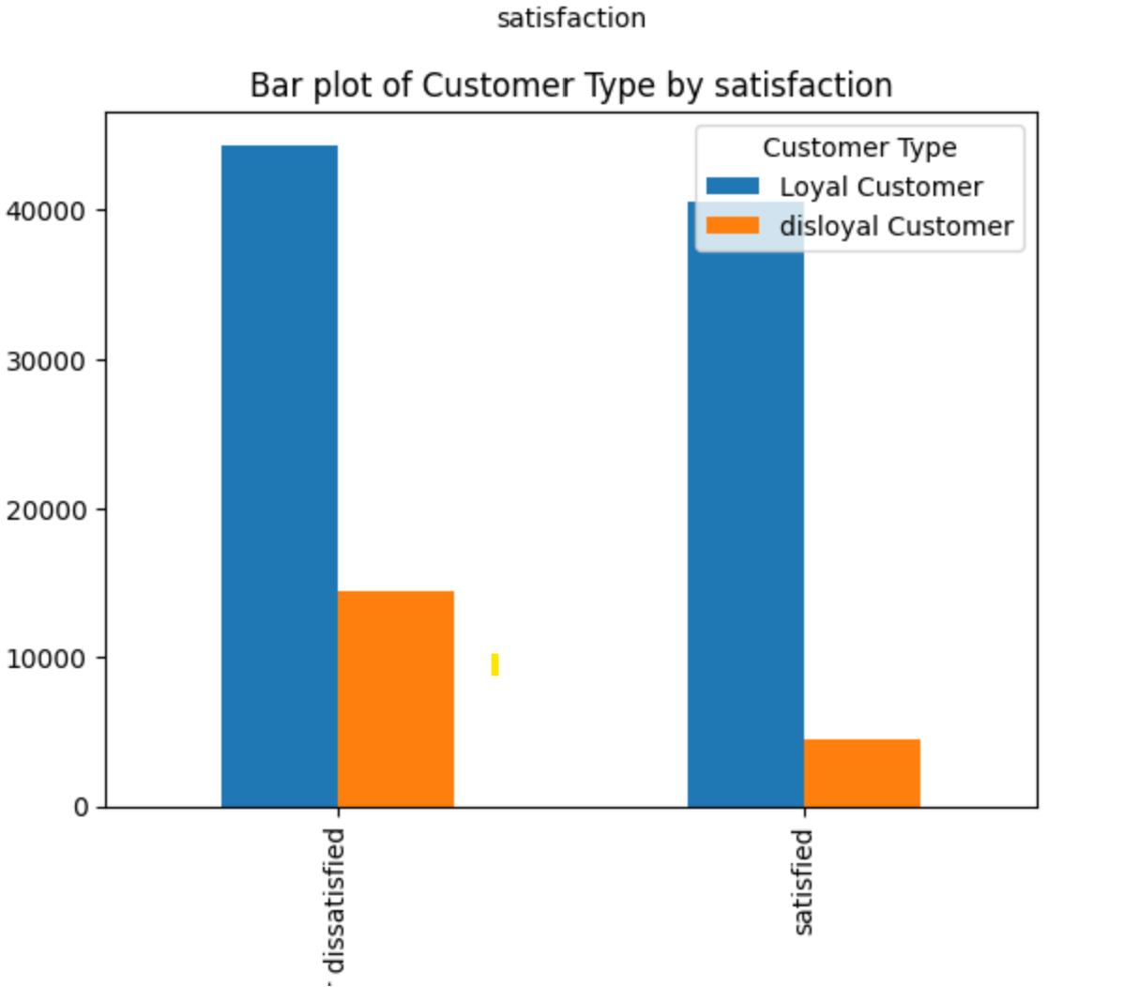
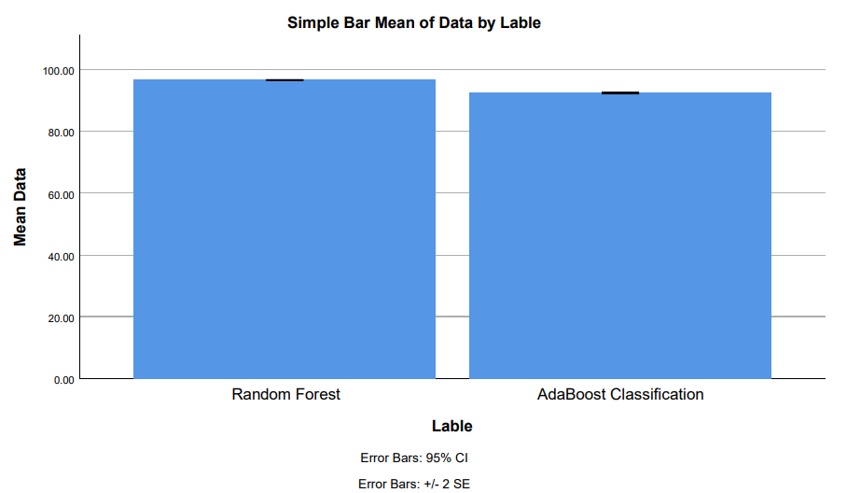
Ms. Poorani.S
Guided by Dr. Mary Valantina. G
Students Name K. Varshini
Registration number:19211556
Guided By-Dr.K.Sashi Rekha
Improved Accuracy for Automated Aero Assist Recommendation using Random Forest and Compared with AdaBoost Classification with Improved Accuracy
INTRODUCTION
The research project focuses on enhancing the accuracy of automated airline recommendations using machine learning algorithms, specifically Random Forest and Adaboost classifiers.
The primary objective is to improve the precision of automated recommendations for airline selection, considering factors like price, schedule, airline reputation, and passenger preferences.
Random Forest is an ensemble learning method that constructs multiple decision trees during training, while Adaboost combines multiple weak classifiers to form a strong one.
The study aims to fill the gap in automated airline recommendations by employing advanced machine learning techniques, addressing issues of precision and personalization in methods.
By comparing the performance of Random Forest and Adaboost classifiers and demonstrating improved accuracy, the research aims to contribute to advancements in travel systems.
Fig 1: Customer satisfaction for Automated Aero Assist Recommendation
MATERIALS AND METHODS
Based on the flight services it provided the airlines.
Providing best airlines based on satisfaction.
Passenger Request for Reservation
Flight Information
Details
Recommendations
Airline reservation System
Seats Reserved
IBM SPSS is used for statical analysis of mean square error
Input
No.of Seats
Conclusion
Fig 2. Automated Aero Assist Recommendation using machine learning algorithms
RESULTS
Table 1.Mean table for Random forest and AdaBoost Classification
Algorithms.
Table 2. The accuracy of Random Forest and
AdaBoost Classification.
Group statistics of accuracy for the Novel Random Forest and AdaBoost Classification Algorithms . The above Novel Random Forest has 96.57% accuracy the AdaBoost Classification has 96.42%.
S.NO | Random Forest | AdaBoost Classification
1 | 96.16 | 92.96
2 | 96.61 | 92.38
3 | 96.02 | 92.39
4 | 96.99 | 92.92
5 | 96.34 | 92.36
6 | 96.76 | 92.29
7 | 96.93 | 92.59
8 | 96.97 | 92.65
9 | 96.83 | 92.86
10 | 96.66 | 92.83
Accuracy | 96.57 | 92.37
 | Algorithm | N | Mean | Std.Deviation | Std . Error Mean
Accuracy | Novel Random Forest | 10 | 96.57 | 0.145 | 0.046
 | AdaBoost Classification | 10 | 92.37 | 0.034 | 0.096
Fig 2.Comparison of Random forest and Adaboost classification Algorithm.
DISCUSSION AND CONCLUSION
By independent sample test, there is a significant difference in accuracy attained by the algorithm is 0.0016(p<0.05).
The research with the help of machine learning methods revealed that the Random Forest algorithm perform 96.57% better that the AdaBoost Classification , Which had an accuracy of 92.37%.
Advancements in hardware and algorithmic optimizations can mitigate computational resource demands
Random Forest and AdaBoost may have reduced interpretability compared to simpler models, and training them on large datasets or in real-time may demand significant computational resources.
The high accuracy of Random Forest is attributed to its insight into feature importance, aiding in understanding the underlying factors driving recommendations for Aeroassist, compared to other machine learning algorithms.
BIBLIOGRAPHY
International Association for Food Protection. 2016. Procedures to Investigate Waterborne Illness. Springer.
International Civil Aviation Organization. 2004. Manual on the Regulation of International Air Transport.
Jayakumari, J., George K. Karagiannidis, Maode Ma, and Syed Akhter Hossain. 2020. Advances in Communication Systems and Networks: Select Proceedings of ComNet 2019. Springer Nature.
Joseph Pine, B., Joseph Pine, and James H. Gilmore. 1999. The Experience Economy: Work Is Theatre & Every Business a Stage. Harvard Business Press.
Kasabov, E., and A. Warlow. 2012. The Compliance Business and Its Customers: Gaining Competitive Advantage by Controlling Your Customers. Springer.
Krajangta, Jurairat, Mahāwitthayālai Mahidon, and Mahāwitthayālai Mahidon Khana Witthayāsāt. 1997. Self Service Airline Reservation System VIA Internet.
Marwedel, Peter. 2021. Embedded System Design: Embedded Systems Foundations of Cyber-Physical Systems, and the Internet of Things. Springer Nature.

