Slide 1


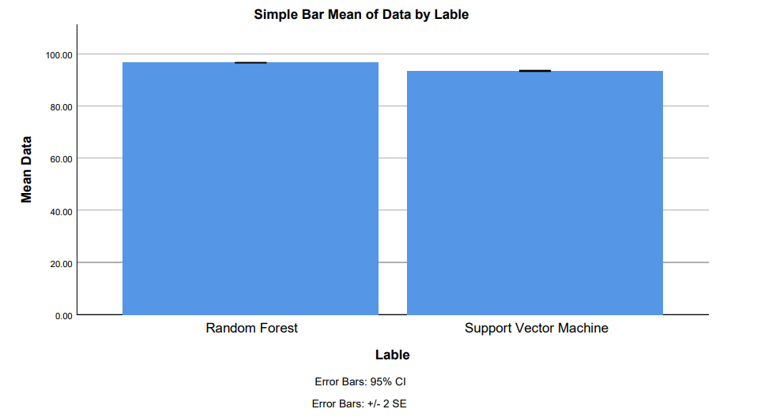
Ms. Poorani.S
Guided by Dr. Mary Valantina. G
Students Name K. Varshini
Registration number:19211556
Guided By-Dr.K.Sashi Rekha
Enhanced Accuracy For Automated Aero Assist Recommendation Using Random Forest And Compared With Support Vector Machine With Improved Accuracy
INTRODUCTION
The research paper aims to enhance the accuracy of automated Aero Assist recommendation systems using machine learning algorithms.
The application domain likely involves aerospace engineering or related areas where automated assistance for aerodynamic processes is needed, such as aircraft design control
The study compares Random Forest and Support Vector Machine (SVM) algorithms in terms of their accuracy for recommending aero assist strategies.
A potential research gap is identified as the lack of studies comparing the accuracy of Random Forest and SVM specifically in the context of aero assist recommendation.
The paper seeks to address this gap by providing insights into which algorithm performs better for recommending aero assist strategies in aerospace engineering or related fields.
Fig 1: Customer satisfaction for Automated Aero Assist Recommendation
MATERIALS AND METHODS
Based on the flight services it provided the airlines.
Providing best airlines based on satisfaction.
Customer Information
Flight
Search Scenario
Scene Judgement
Recommendations
Personalized Recommendation
Model
IBM SPSS is used for statical analysis of mean square error
Input
Flight Information
Conclusion
RESULTS
Fig 2. Automated Aero Assist Recommendation using machine learning algorithms
In, Automated AreoAssist .Random Forest is compared with logistic regression and it depicts that the RF got highest accuracy than the SVM.
Group statistics of accuracy for the Novel Random Forest and Support Vector Machine Algorithms . The above Novel Random Forest has 96.57% accuracy the Support Vector Machine has 93.43%.
 | Algorithm | N | Mean | Std.Deviation | Std . Error Mean
Accuracy | Novel Random Forest | 10 | 96.57 | 0.145 | 0.046
 | Support Vector Machine | 10 | 93.43 | 0.269 | 0.085
S.NO | Random Forest | Support Vector Machine
1 | 96.16 | 93.72
2 | 96.61 | 93.10
3 | 96.02 | 93.51
4 | 96.99 | 93.38
5 | 96.34 | 93.19
6 | 96.76 | 93.95
7 | 96.93 | 93.86
8 | 96.97 | 93.38
9 | 96.83 | 93.88
10 | 96.66 | 93.67
Accuracy | 96.57 | 93.43
Fig 2.Comparison of Random forest and Support Vector Machine Algorithm.
Table 1.Mean table for Random forest and Support Vector Machine Algorithms.
Table 2. The accuracy of Random Forest and
Support Vector Machine.
DISCUSSION AND CONCLUSION
By independent sample test, there is a significant difference in accuracy attained by the algorithm is 0.0016(p<0.05).
The research with the help of machine learning methods revealed that the Random Forest algorithm perform 96.57% better that the Support Vector Machine 93.43%, Which had an accuracy of 92.37%.
Comparing Random Forest with Support Vector Machine in automated aero assist improves flight planning and enhances aviation safety.
Selecting suitable machine learning algorithms tailored to aviation datasets is crucial for reliable automated assistance systems.
Integrating Random Forest into automated systems enhances aviation safety by providing reliable decision-making support to pilots.
The importance of the Airline management system lies in the automation of the organization's operations. The study results will assist management in enhancing revenue creation and ensuring the efficient operation of daily operations.
BIBLIOGRAPHY
International Association for Food Protection. 2016. Procedures to Investigate Waterborne Illness. Springer.
International Civil Aviation Organization. 2004. Manual on the Regulation of International Air Transport.
Jayakumari, J., George K. Karagiannidis, Maode Ma, and Syed Akhter Hossain. 2020. Advances in Communication Systems and Networks: Select Proceedings of ComNet 2019. Springer Nature.
Joseph Pine, B., Joseph Pine, and James H. Gilmore. 1999. The Experience Economy: Work Is Theatre & Every Business a Stage. Harvard Business Press.
Kasabov, E., and A. Warlow. 2012. The Compliance Business and Its Customers: Gaining Competitive Advantage by Controlling Your Customers. Springer.
Krajangta, Jurairat, Mahāwitthayālai Mahidon, and Mahāwitthayālai Mahidon Khana Witthayāsāt. 1997. Self Service Airline Reservation System VIA Internet.
Marwedel, Peter. 2021. Embedded System Design: Embedded Systems Foundations of Cyber-Physical Systems, and the Internet of Things. Springer Nature.

