Slide 1


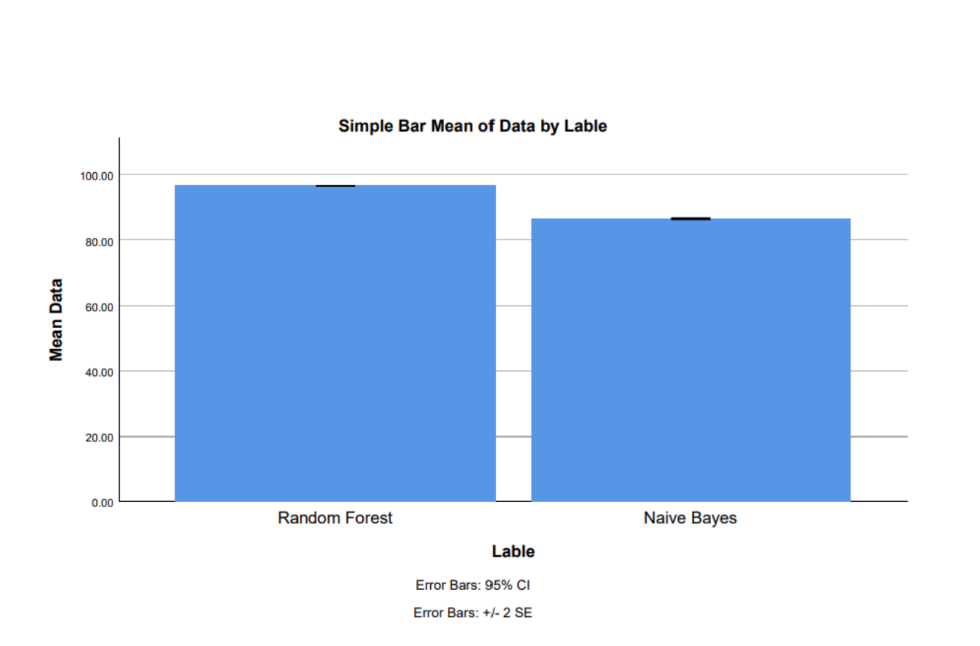
Ms. Poorani.S
Guided by Dr. Mary Valantina. G
Students Name K. Varshini
Registration number:19211556
Guided By-Dr.K.Sashi Rekha
Predicting Accuracy For Automated Aero Assist Recommendation Using Random Forest And Compared With Naive Bayes With Improved Accuracy
INTRODUCTION
The study evaluates the predictive accuracy of Random Forest versus Naive Bayes algorithms for automated aero assist recommendation, aiming for improved accuracy
The research's application lies in enhancing the accuracy and reliability of automated assistance systems in aviation, optimizing flight trajectories, minimizing risks.
Random Forest utilizes ensemble learning to construct multiple decision trees, offering robustness against overfitting and efficient handling of high-dimensional data. Naive Bayes classifier, based on Bayes' theorem, assumes independence between features, making it computationally efficient and suitable for classification tasks with datasets.
Despite previous studies exploring machine learning algorithms for automated aero assist recommendation, a gap exists in understanding the comparative performance of Random Forest and Naive Bayes in this context.
Fig 1:Predicting Accuracy For Automated Aero Assist Recommendation
MATERIALS AND METHODS
Random Forest shows higher accuracy in predicting automated aero assist recommendations compared to Naive Bayes.
The study aims to enhance prediction accuracy for automated aero assist recommendations through comparative analysis with Naive Bayes.
Flight data
Services Database
User Account
Database about AreoAssist Recommendations.
Booking
Reservation Details
Classification
Accuracy Prediction
Input
Customer information
Reservation Database
IBM SPSS is used for statical analysis of mean square error
Fig 2. Automated Aero Assist Recommendation using machine learning algorithms
RESULTS
Table 1.Mean table for Random forest and Naïve Bayes
Algorithms.
Table 2. The accuracy of Random Forest and Naïve Bayes.
Group statistics of accuracy for the Novel Random Forest and AdaBoost Classification Algorithms . The above Novel Random Forest has 96.57% accuracy the Naïve Bayes has 86.52%.
.
S.NO | Random Forest | Naïve Bayes
1 | 96.16 | 86.94
2 | 96.61 | 86.50
3 | 96.02 | 86.03
4 | 96.99 | 86.52
5 | 96.34 | 86.75
6 | 96.76 | 86.95
7 | 96.93 | 86.30
8 | 96.97 | 86.81
9 | 96.83 | 86.01
10 | 96.66 | 86.34
Accuracy | 96.57 | 86.52
 | Algorithm | N | Mean | Std.Deviation | Std . Error Mean
Accuracy | Novel Random Forest | 10 | 96.57 | 0.145 | 0.046
 | Naïve Bayes | 10 | 86.52 | 0.346 | 0.109
Fig 2.Comparison of Random forest and Naïve Bayes Algorithm.
DISCUSSION AND CONCLUSION
By independent sample test, there is a significant difference in accuracy attained by the algorithm is 0.0016(p<0.05).
The research with the help of machine learning methods revealed that the Random Forest algorithm perform 96.57% better that the Naïve bayes 86.52%.93.43%, Which had an accuracy of 92.37%.
Implementing study findings could revolutionize aviation by enhancing safety and efficiency in flight planning and assistance.
Limitations may arise from increased computational complexity with Random Forest compared to Naive Bayes, potentially affecting real-time implementation.
Random Forest's feature importance ranking facilitates the identification of influential variables in aero assist recommendations.
Overall, the study underscores the potential for Random Forest to improve the accuracy and reliability of automated assistance systems in aviation, potentially transforming safety measures and operational efficiency in the aerospace industry.
BIBLIOGRAPHY
National Research Council, Division of Behavioral and Social Sciences and Education, Board on Behavioral, Cognitive, and Sensory Sciences, and Committee on Behavioral and Social Science Research to Improve Intelligence Analysis for National Security. 2011. Intelligence Analysis: Behavioral and Social Scientific Foundations. National Academies Press.
Rana, Nripendra P., Emma L. Slade, Ganesh P. Sahu, Hatice Kizgin, Nitish Singh, Bidit Dey, Anabel Gutierrez, and Yogesh K. Dwivedi. 2019. Digital and Social Media Marketing: Emerging Applications and Theoretical Development. Springer Nature.
Ren, Dazhou. 2000. An Online Airline Reservation System with XML.
Smit, Chloé C. H., Maarten Lambert, Kris Rogers, Steven P. Djordjevic, Antoine M. Van Oijen, Caitlin Keighley, Katja Taxis, Hamish Robertson, and Lisa G. Pont. 2023. “One Health Determinants of Antimicrobial Resistance in Humans in the Community: An Umbrella Review.” International Journal of Molecular Sciences 24 (24). https://doi.org/10.3390/ijms242417204.

