Slide 1



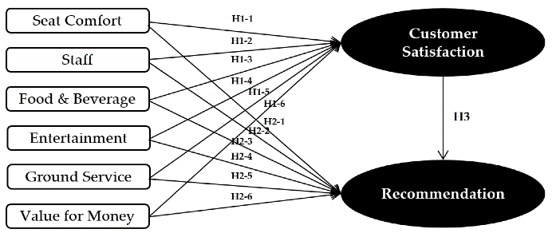
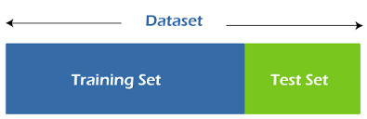
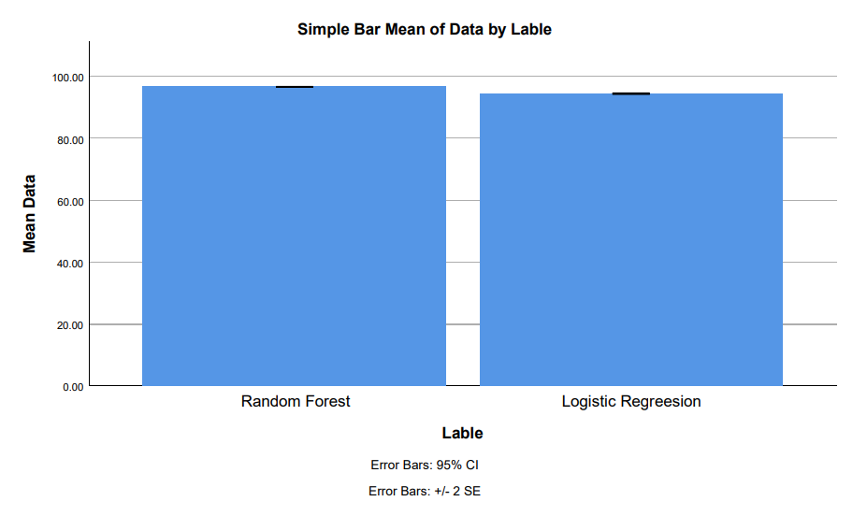
Ms. Poorani.S
Guided by Dr. Mary Valantina. G
Students Name K. Varshini
Registration number:1911556
Guided By-Dr.K.Sashi Rekha
Automated Aero Assist Recommendation using Random Forest and Compared with Logistic Regression with Improved Accuracy
INTRODUCTION
An automated AreoAssist recommendation system is a computional model design to suggest optimal flight options to users based on their parameters and historical data.
The aim of the study is to improve the accruacy of an automated AreoAssist recommendation system by comparing the performance of RF and LG.
Enhancing the accuracy of the AreoAssist recommendation system is crucial for improving user experience, increasing customer satisfaction, and optimizing airline.
Random forest employs multiple decision trees to predict classes, while logistic regression analyzes datasets with independent variables to determine outcomes.
Pervious research might focuses soley on the one algorithm or lacked a direct comparison between random forest and logistic regression in context of AreoAssist system
Fig 1. Automated Aero Assist Recommendation
MATERIALS AND METHODS
Random Forest outperforms Logistic Regression in accuracy for automated aero assist recommendations.
The study demonstrates improved accuracy in automated aero assist recommendation through Random Forest compared to Logistic Regression.
Preprocessing
Feature Extraction
Model Evaluation
Classification
Input
Split Train, Test
IBM SPSS is used for statical analysis of mean square error
Flight data
Accuracy Prediction
Fig 2. Automated Aero Assist Recommendation using machine learning algorithms
RESULTS
Table 1.Mean table for Random forest and Logistic Regression
Table 2. The accuracy of Random Forest and Logistic Regression.
Group statistics of accuracy for the Novel Random Forest and Logistic Regression Algorithms . The above Novel Random Forest has 96.57% accuracy and the Logistic Regression has 96.42% of accuracy.
S.NO | Random Forest | Logistic Regression
1 | 96.16 | 94.72
2 | 96.61 | 94.93
3 | 96.02 | 94.95
4 | 96.99 | 94.04
5 | 96.34 | 94.79
6 | 96.76 | 94.03
7 | 96.93 | 94.71
8 | 96.97 | 94.18
9 | 96.83 | 94.93
10 | 96.66 | 94.35
Accuracy | 96.57 | 94.72
 | Algorithm | N | Mean | Std.Deviation | Std . Error Mean
Accuracy | Novel Random Forest | 10 | 96.57 | 0.145 | 0.046
 | Logistic Regression | 10 | 94.39 | 0.275 | 0.087
Fig 3. Comparison between Random Forest and Logistic Regression
DISCUSSION AND CONCLUSION
By independent sample test, there is a significant difference in accuracy attained by the algorithm is 0.0016(p<0.05).
The research with the help of machine learning methods revealed that the Random Forest algorithm perform 96.57% better that the Logistic regression, Which had an accuracy of 94.39%.
Prioritizing user experience enhancement and addressing regulatory and ethical considerations will ensure responsible deployment and widespread adoption.
Incorporating potential dependencies on data quality and availability, addressing challenges in interpretability, especially with random forest, may impact users' understanding and trust in the recommendations..
From the work, it is concluded that the Random forest attains the high accuracy when comparing with other machine learning algorithms in Automated Aero Assist Recommendation.
BIBLIOGRAPHY
Cheverton, Peter. 2008. Global Account Management: A Complete Action Kit of Tools and Techniques for Managing Key Global Customers. Kogan Page Publishers.
Christou, Anastasia. 2006. Narratives of Place, Culture and Identity: Second-Generation Greek-Americans Return “Home.” Amsterdam University Press.
Davison, Michelle, Jason Chan, Meg Clarke, Caroline Mitchell, Alan Yan, and Elwyn Henaway. 2023. “Yarning to Reduce Take Own Leave Events in First Nations Patients Presenting to the Emergency Department-Presenting the Qualitative Themes and Co-Design of the Deadly RED Project.” Health Promotion Journal of Australia: Official Journal of Australian Association of Health Promotion Professionals, December. https://doi.org/10.1002/hpja.835.
Davison, Michelle, Jason Chan, Meg Clarke, Caroline Mitchell, Alan Yan, and Elwyn Henaway.

