Slide 1
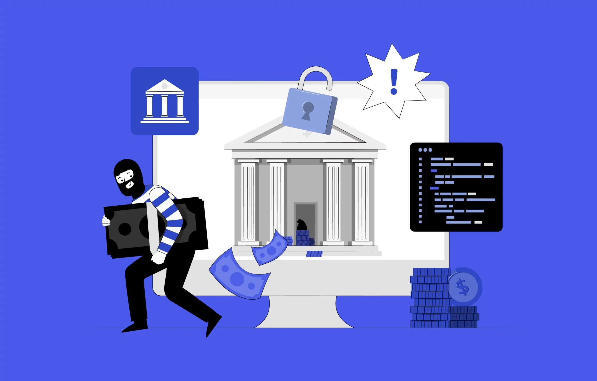

FRAUD DETECTION IN BANKING
ZENBANKER
K . Manvitha
P . Varshita
S . Harshitha

Slide 2

Problem statement –
Fraud Detection in Banking:
.Fraud detection is crucial for financial institutions in the digital banking era.
.The evolving landscape of financial transactions requires advanced methods to combat unauthorized activities.
.This guide focuses on the threat of ATM skimming and proposes a system to enhance security and build customer trust.

Slide 3
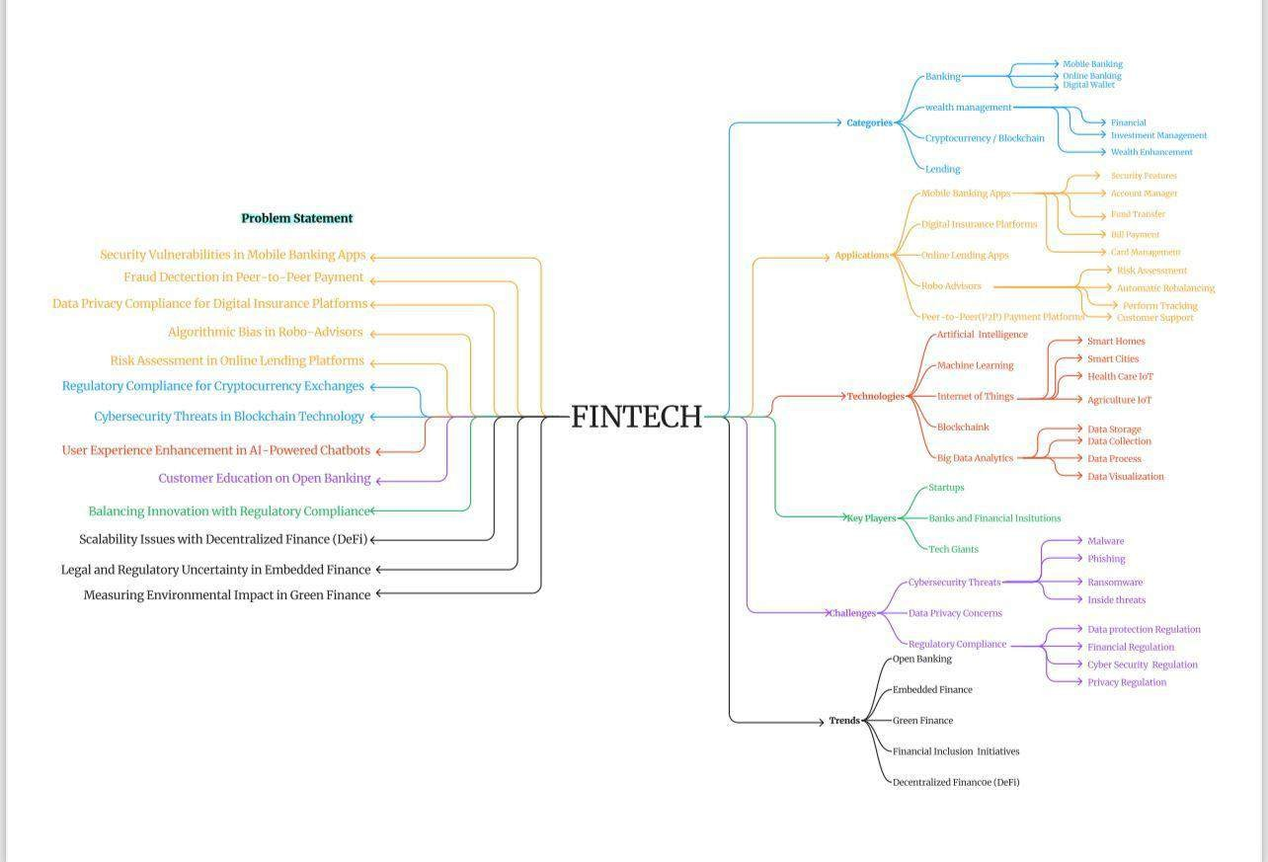
MIND MAP

Slide 4
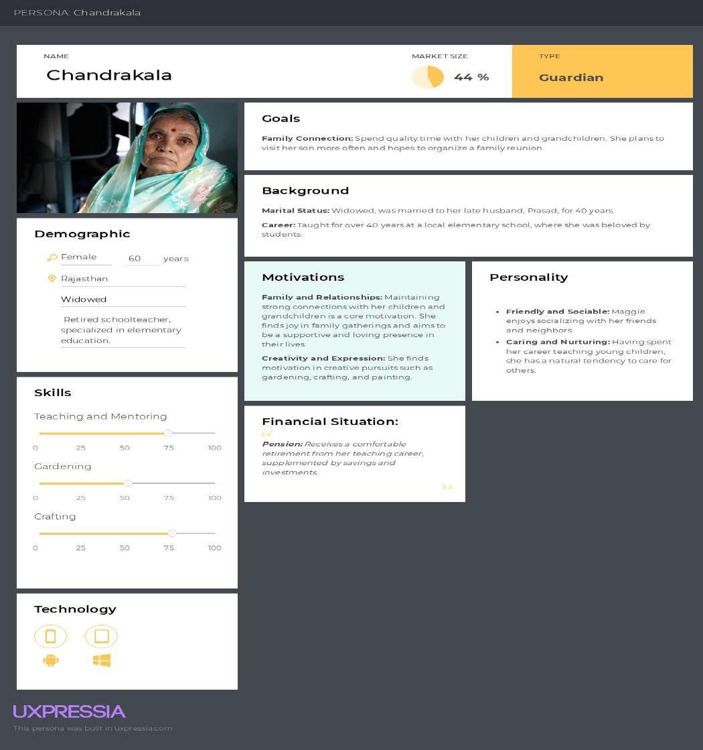
PERSONAS

Slide 5
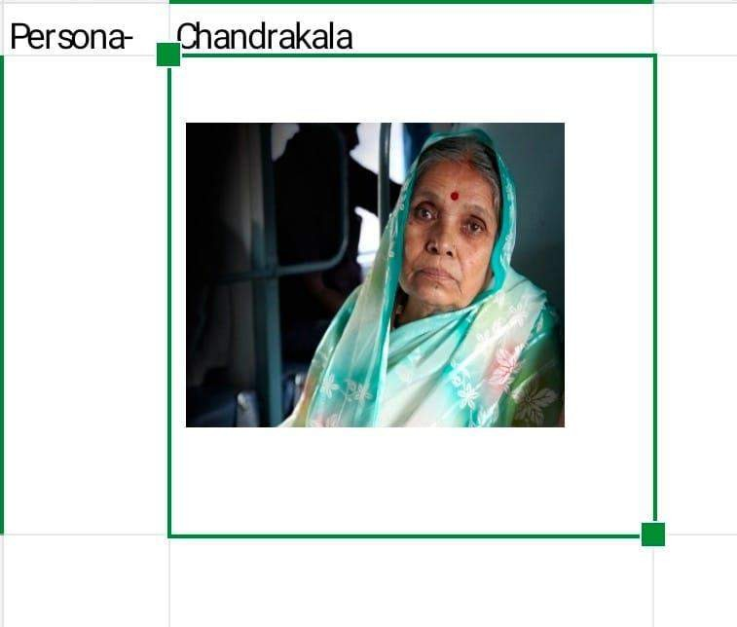
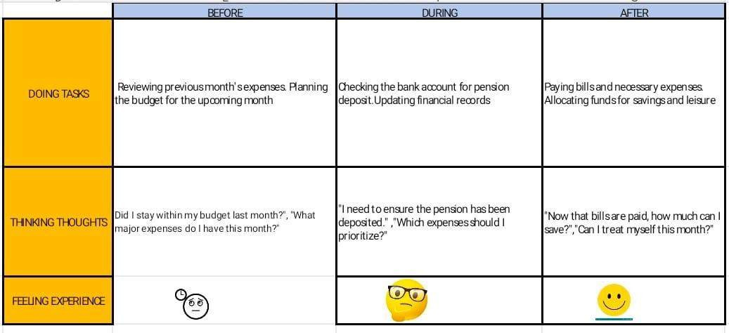
USER JOURNEY

Slide 6
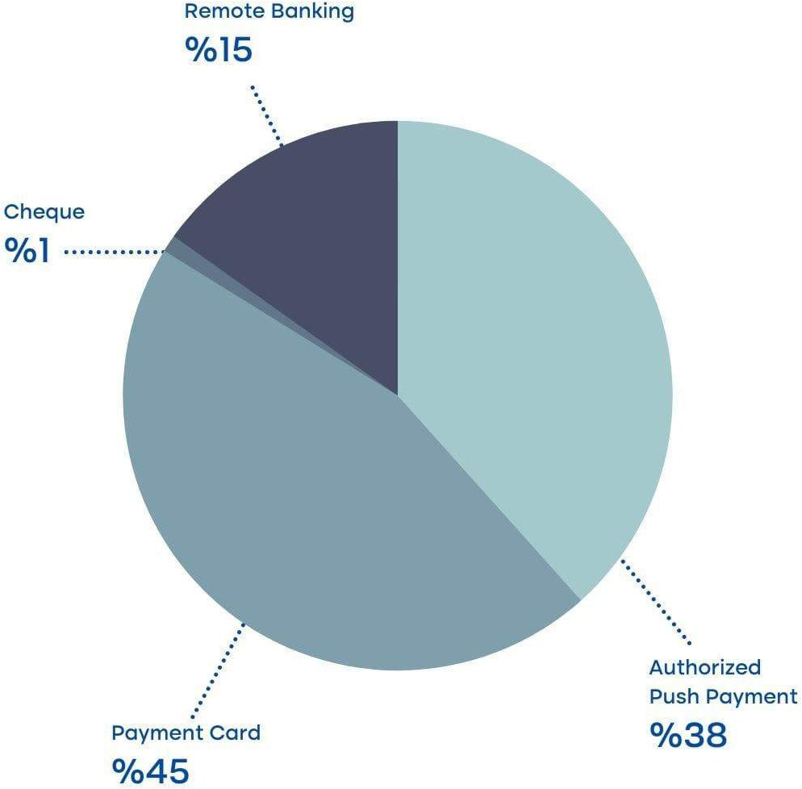
STATISTICS
The chart highlights the prevalence of payment cards and authorized push payments, with these two methods together comprising 83% of all transactions. Remote banking also has a notable share, while cheques are rarely used.

Slide 7


Proposed System for Enhanced ATM Security
Card Insertion
When a customer inserts their card into the ATM, a unique QR code is
generated by the bank's system and displayed on the ATM screen.
1
Mobile App Verification
The customer, who has the bank's mobile app installed on their device, scans
the QR code and verifies the transaction details displayed on their phone.
2
One-Time Password
After verifying the transaction, the customer is prompted to enter a one-time password (OTP) generated by the app, which must be entered within a 60- second time frame to complete the withdrawal.
3

Slide 8





Implementing the Proposed ATM Security System
Bank Integration
Mobile App Development
Development and deployment of a secure mobile app that can generate and validate the QR code and one- time password.
Customer Education
Comprehensive customer education and communication to ensure widespread adoption and understanding of the new security measures.
Regulatory Compliance
Ensuring the proposed system adheres to relevant banking regulations and industry standards for data security and privacy.
Seamless integration of the proposed system into the bank's existing ATM infrastructure and mobile banking platform.

Slide 9
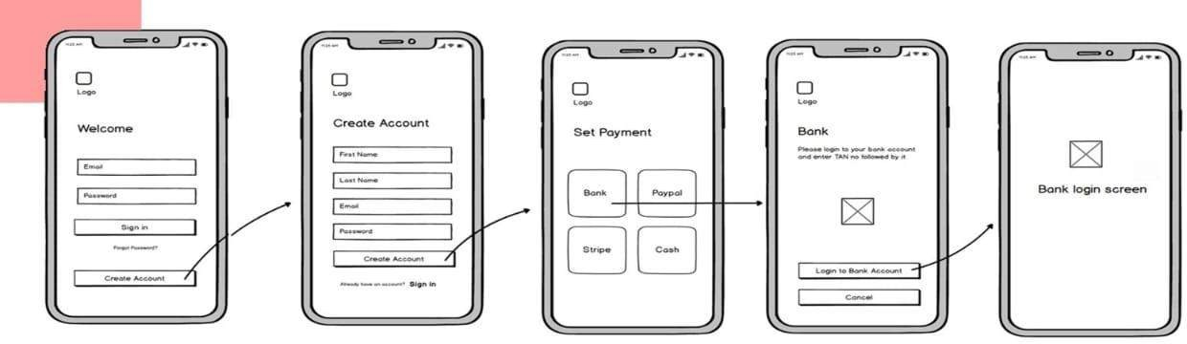
Wireframes

Slide 10
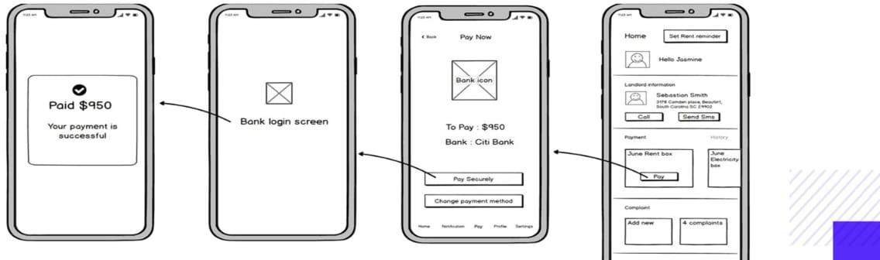

Slide 11
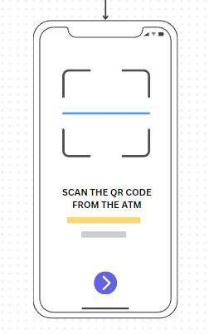
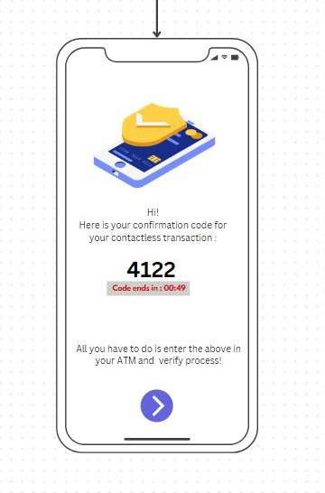
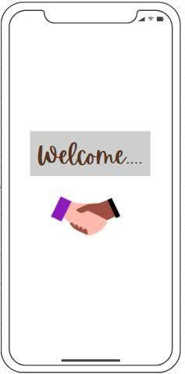
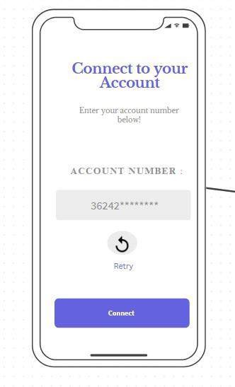

Slide 12


ZENBANKER

