Slide 1
Secure Data Hiding in image using steganography
CAPSTONE PROJECT
Presented By: Varshith Cherukupally
Student Name : Varshith Cherukupally
College Name & Department : Siddhartha Degree College –BSC (MSCs)

Slide 2
OUTLINE
Problem Statement
Technology used
Wow factor
End users
Result
Conclusion
Git-hub Link
Future scope

Slide 3
Problem Statement
Problem:
Traditional encryption methods can be detected and targeted by attackers.
Sensitive data needs a hidden communication channel.
Solution:
Use image steganography to hide messages within images securely.
Only authorized users with the correct passcode can decrypt it.

Slide 4
Technology used
💻 Platform:
Windows 11 (Compatible with Linux & macOS)
Python 3.x
📦 Libraries Used:
OpenCV – For image processing and modification

Slide 5
Wow factors
Invisible Encryption: The message is hidden inside an image, making it undetectable.
Passcode Protection: Only users with the correct passcode can retrieve the message.
Lightweight & Fast: Works without a heavy cryptographic setup.
Secure Communication: Prevents third parties from detecting hidden data.

Slide 6
End users
Journalists & Activists – Send secure messages in restricted regions.
Government & Military – Hide confidential data in images.
Cybersecurity Experts – Use for ethical hacking and secure data transmission.
Regular Users – Protect personal information from unauthorized access.

Slide 7
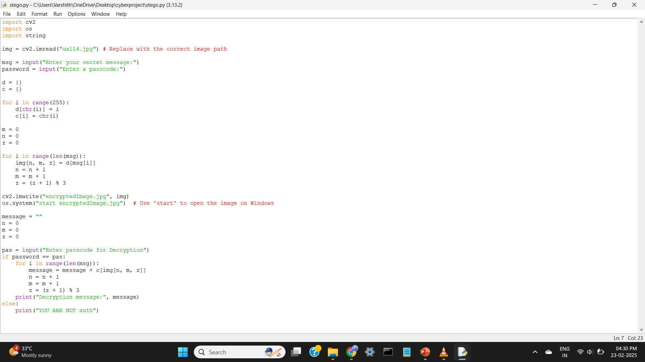
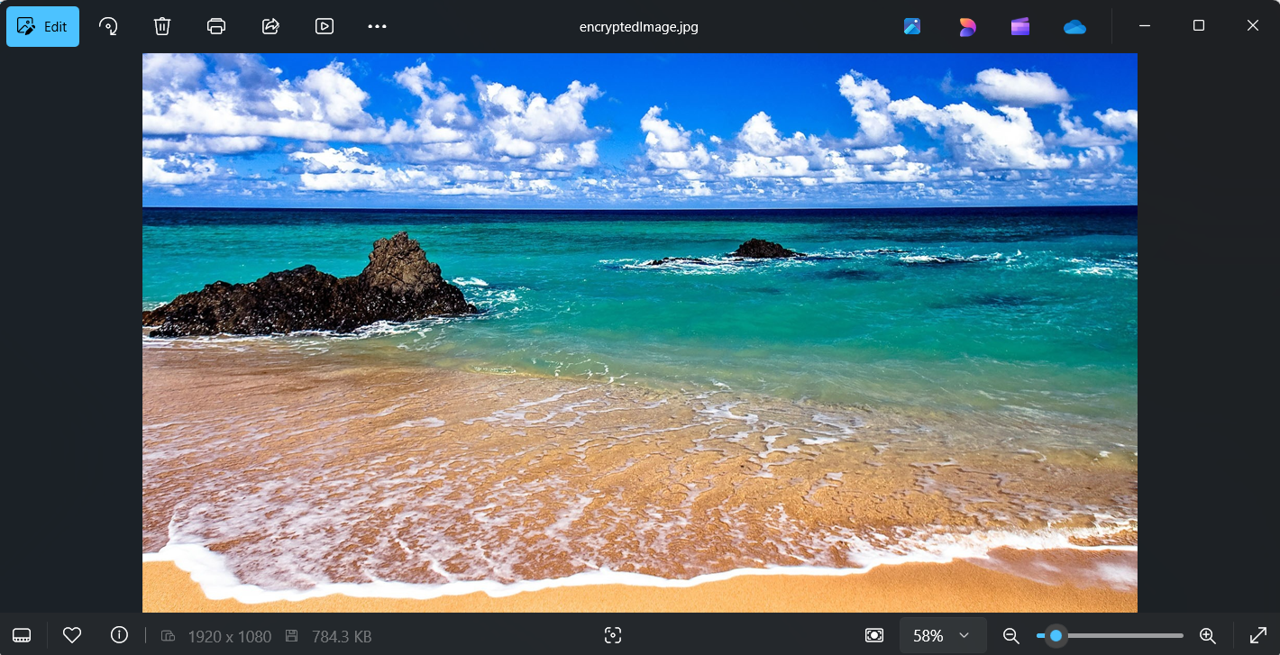
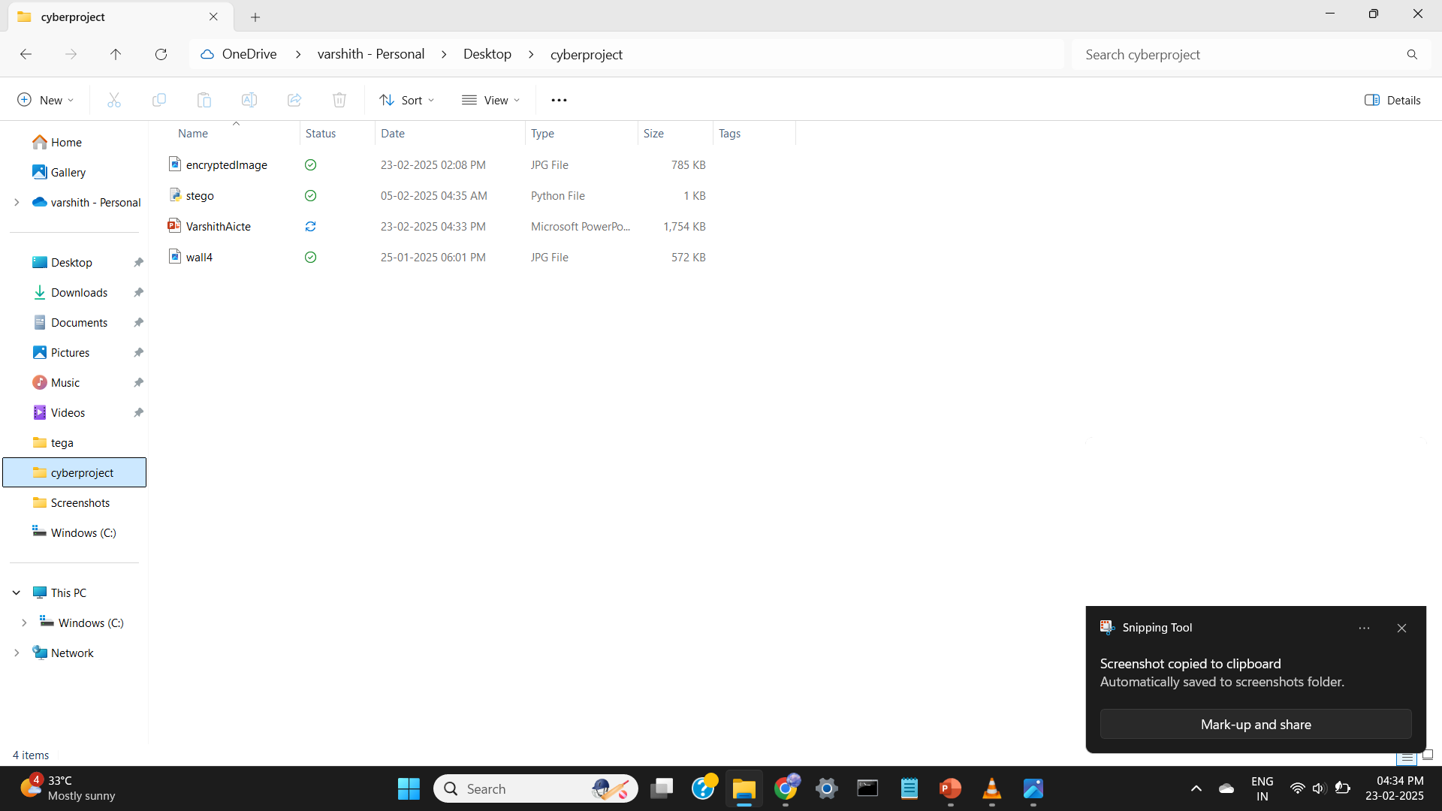
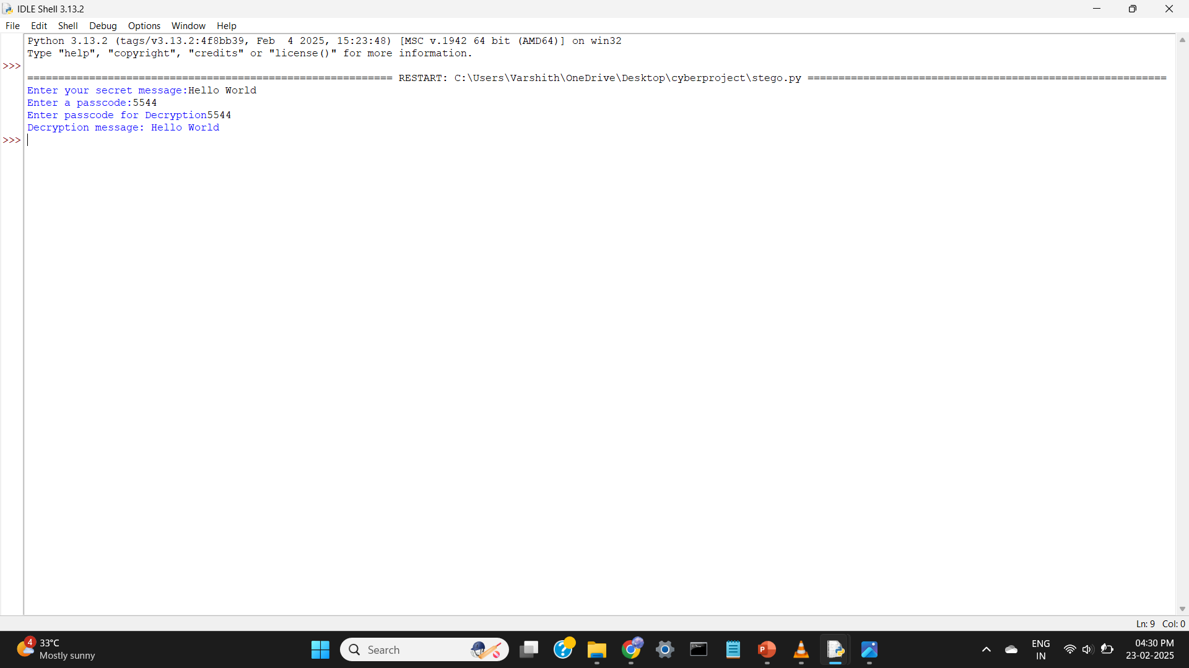
Results

Slide 8
Conclusion
✅ Achieved: Secure and invisible data hiding using images
✅ Advantages: Hard to detect, simple implementation, and effective security

Slide 9
GitHub Link
https://github.com/Varshith-108/Cyber

Slide 10
Future scope(optional)
Enhancements for the Future:
AES Encryption before embedding in the image.
Video Steganography (hide text in video frames).
Cloud Integration for secure message transfer.
Mobile App Development for easier usability.

Slide 11
THANK YOU

