Slide 1
An Efficient Deep Learning Model for Accurate Recognition and Classification of Crop Pests by using DeepPestNet
Supervisor Name: M. Harshini
Designation: Assistant Professor
Department: IT
By
Roll Number
22R21A1201
22R21A1254
22R21A1242
22R21A1237
Name
A. Pavani
T. Katyayini
P. Soumith Reddy
M. Varshith kumar

Slide 2
Index
Abstract
Problem Statement
Objectives
Scope
Literature review
Research Gaps
System Architecture
Methodology
Modules
Algorithms
Implementation
Results
Outputs
Conclusion and Future Enhancements
References

Slide 3


Abstract
Agricultural productivity is greatly affected by crop pests, causing economic losses and food security threats. Traditional pest identification through manual inspection is slow, labor-intensive, and error-prone, especially due to pest variations, complex backgrounds, and environmental conditions. To address this, we propose DeepPestNet, a deep learning–based CNN architecture for accurate and efficient crop pest detection and classification. on a large, diverse pest dataset, DeepPestNet uses specialized convolutional layers, data augmentation, and fine-tuning to improve robustness against noise, lighting, and intraclass similarities. This system enables early detection, reduces pesticide overuse, and supports sustainable farming.

Slide 4


Problem Statement
Crop pests are a major cause of yield loss in agriculture, significantly affecting food
production and farmers’ livelihoods. Traditional pest identification methods rely on expert
observation, which is slow, costly, and susceptible to inaccuracies due to pest similarity
and environmental variations. With the growing demand for precision agriculture, there is
a pressing need for an automated, accurate, and computationally efficient pest detection
and classification system capable of operating in real-world agricultural conditions to
support timely and effective pest management.

Slide 5
Objectives
To design and implement DeepPestNet with optimized convolutional layers for recognizing
fine-grained pest features in agricultural images.
To use specialized image preprocessing and data augmentation (rotation, scaling, brightness
adjustment) for robustness against backgrounds, lighting, and orientations.
To integrate lightweight yet high-performance CNN modules for balancing accuracy and
computational efficiency, enabling use on low-resource devices.
To apply transfer learning and fine-tuning for better feature extraction, especially with
limited pest samples.
To evaluate performance on a large-scale pest dataset using accuracy, precision, recall, and
F1-score, and compare with other deep learning models.

Slide 6
Scope
Early Pest Detection: Enables farmers to take preventive actions, reducing crop loss.
Precision Agriculture: Supports targeted pesticide application, lowering chemical use and environmental impact.
Accessibility: Potential to run on mobile devices or drones for field-level pest monitoring.
Scalability: Suitable for small farms and large-scale agricultural operations
Sustainability: Promotes eco-friendly farming by reducing reliance on broad-spectrum pesticides.

Slide 7
Literature Review
Paper Title | Authors | Journal | Year | Methods/Approaches | Key Findings | Limitations
Deep Learning Based Pest Classification Using Transfer Learning | Thenmozhi K., Srinivasulu Reddy R. | Computers and Electronics in Agriculture | 2019 | Applied transfer learning on CNN models (AlexNet, VGG16) for pest image classification. | Achieved high accuracy with limited data using pretrained models. | Dataset limited to controlled lab images; lacks real-field diversity.
Deep Learning-Based Pest Detection in Natural Agricultural Scenes | Li Y., Jiang H., Yin Y., Zhang J. | Computers and Electronics in Agriculture | 2020 | Used CNN models trained on field-captured images with variable lighting/backgrounds. | Robust detection in complex real-world agricultural scenes. | Accuracy drops with extremely small pests and high occlusion.
Smart Mobile Application for Crop Pest Identification Using Deep Learning | Karim Karar A., Abuelmaatti A., Alharbi M. | Alexandria Engineering Journal | 2021 | Developed mobile app using lightweight CNNs for on-device pest identification. | Enabled real-time pest recognition on smartphones. | Dependent on camera quality and lighting conditions.

Slide 8
Literature Review
Paper Title | Authors | Journal | Year | Methods/Approaches | Key Findings | Limitations
AgriPest-YOLO: Real-Time Pest Detection for Smart Traps | Zhang W., Li X., Ma J., Wang T. | Frontiers in Plant Science | 2022 | Integrated YOLOv4 with IoT-based light traps for automated pest monitoring. | Provided continuous real-time pest detection with high accuracy. | Limited to trap-based detection; may not capture all field pests.
TSCNNA: Three-Scale CNN with Attention Mechanism for Tiny Pest Detection | Wang X., Liu Q., Zhou F. | PLOS ONE | 2023 | Designed a multi-scale CNN with attention mechanism for tiny-object detection. | Enhanced accuracy for small and overlapping pests. | Slightly higher computational cost than standard CNNs.
Automatic Whitefly Counting in Sticky Trap Images Using Deep Learning | Ciampi L., De Luca R., Venturini G. | Ecological Informatics | 2023 | Used CNN-based detection and regression models for whitefly counting on traps. | Automated pest counting replacing manual monitoring. | Limited to sticky-trap images; not applicable to field plants.

Slide 9
Literature Review
Paper Title | Authors | Journal | Year | Methods/Approaches | Key Findings | Limitations
Systematic Review of Automatic Insect Detection Using Deep Learning | Teixeira A.C., Barbosa J., Silva A. | Agriculture (MDPI) | 2023 | Reviewed and compared DL models (YOLO, Faster R-CNN, MobileNet) for insect detection. | Summarized trade-offs between accuracy, speed, and device feasibility. | Review only; no new model implementation.
Improved Pest-YOLO: Enhanced YOLO Model for Small Insect Detection | Tang J., He Y., Li P., Zhao Z. | Ecological Informatics | 2023 | Enhanced YOLOv5 with feature-pyramid and anchor optimization. | Improved detection for tiny and overlapping pests in greenhouses. | Focused on greenhouse data; not tested in open-field settings.
GBiDC-PEST: Lightweight Model for Real-Time Multiclass Pest Detection | Xu W., Zhang L., Yang C. | Journal of Integrative Agriculture | 2024 | Developed compact deep network optimized for mobile and edge devices. | Achieved fast and efficient pest detection on smartphones. | Slightly lower accuracy than heavier CNNs.

Slide 10
Research Gaps
Current models are computationally heavy, unsuitable for mobile or drone deployment.
Many models fail under real-world conditions such as variable lighting, crop backgrounds, or pest camouflage.
Limited datasets restrict the recognition of multiple pest species across different environments.
Very few models are optimized for real-time applications in actual farming fields.
DeepPestNet bridges these challenges by using a lightweight design, data augmentation, and transfer learning to improve accuracy and efficiency.

Slide 11
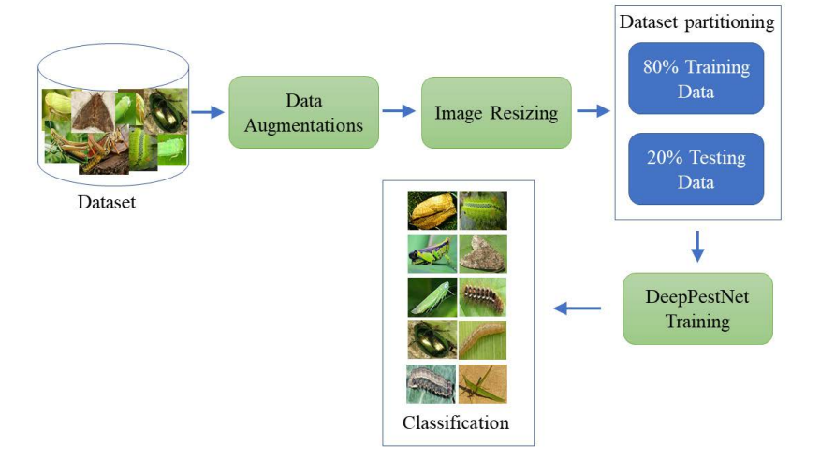
System Architecture

Slide 12
Methodology
The architecture of DeepPestNet is organized into five core stages:
Input Layer
  Pest images are resized and normalized for consistency.
  Basic filters remove noise and enhance image clarity.
Convolutional Feature Extractor
  Extracts visual features like color, texture, and shape.
  Uses small filters and residual blocks for better accuracy.
Feature Pyramid Network (FPN)
  Handles pests of different sizes using multi-scale feature maps.
Attention Mechanism
  Focuses on important regions (like pest bodies) while ignoring background.
Classification & Detection Head
  Classifies pest type using Softmax. Predicts bounding boxes for accurate pest location.

Slide 13
Modules
Data Acquisition:
  Collects and stores pest images from real-world agricultural fields.
  Uses benchmark datasets like AgriPest and IP102 containing thousands of annotated pest images.
  Images are captured under varied lighting, crop types, and environmental conditions.
  Ensures a diverse and high-quality dataset for training and evaluation.
Preprocessing:
  Cleans and standardizes input images before training.
  Performs resizing, normalization, and denoising to maintain uniform image quality.
  Applies data augmentation (rotation, brightness, flipping, cropping) to increase dataset diversity.
  Enhances the model’s ability to handle field-level variations like background clutter and lighting differences.

Slide 14
Modules
Training :
  Core module responsible for building and optimizing the DeepPestNet model.
  Uses Convolutional Neural Networks (CNNs) with residual blocks, feature pyramids, and attention layers for efficient learning.
  Employs transfer learning to improve accuracy with limited data.
  Fine-tunes hyperparameters (batch size, learning rate, epochs) to achieve optimal model performance.
Classification:
  Classifies pest images into their respective categories using the trained model.
  Implements fully connected layers and Softmax activation for multi-class prediction.
  Provides pest name (e.g., aphid, bollworm, locust) with a confidence score.
  Enables real-time pest identification in field applications.

Slide 15
Modules
Evaluation :
  Assesses model performance using metrics such as accuracy, precision, recall, and F1-score.
  Generates confusion matrices to identify correct and incorrect classifications.
  Compares DeepPestNet results with other existing models.
  Ensures the model is robust and reliable before deployment.
Deployment:
  Converts the trained model into a lightweight format (TensorFlow Lite / ONNX).
  Deploys the system on mobile devices, drones, or IoT platforms for real-time use.
  Supports offline functionality for remote agricultural areas.
  Enables farmers and field workers to detect pests instantly using portable devices.

Slide 16
Algorithms
DeepPestNet Algorithms:
EfficientNet-B0 (CNN Backbone / Transfer Learning): This pre-trained convolutional neural network automatically extracts rich visual features from pest images, reducing the need for large datasets and accelerating training.
CBAM (Convolutional Block Attention Module): Combines Channel Attention and Spatial Attention to help the model focus on the most informative parts of the image, improving pest recognition accuracy.
Fully Connected Layers (MLP Classifier): After feature extraction and attention, these layers perform the final classification of pest species based on the processed features.
AdamW Optimizer: An optimization algorithm that updates network weights efficiently while controlling overfitting through weight decay.
Cross-Entropy Loss: Calculates the difference between predicted and actual pest classes, guiding the network to minimize classification errors during training

Slide 17
Implementation
Pest images are gathered from agricultural datasets capturing real-world field conditions.
The images are resized and normalized to ensure uniform input for the model.
Data augmentation techniques, including rotation, flipping, scaling, and brightness adjustment, are applied to enhance the model’s robustness.
The dataset is divided into training and validation sets for proper learning and evaluation.
DeepPestNet (EfficientNet-B0 combined with CBAM) is trained to automatically extract and learn hierarchical features from the images.
Transfer learning is utilized to improve classification accuracy when data is limited.
Model performance is assessed using metrics such as accuracy, precision, recall, F1-score, and the confusion matrix.
The best-performing model is saved for future inference or testing on new, unseen pest images.

Slide 18
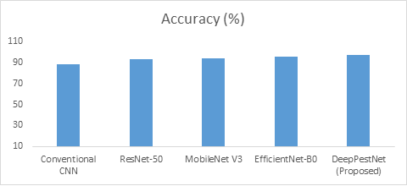
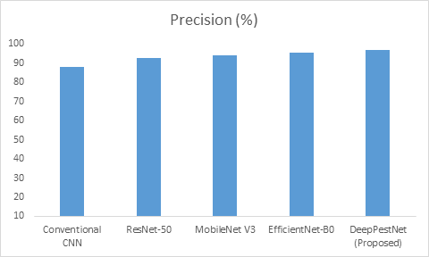
Results
Accuracy and Precision comparisons with different models

Slide 19
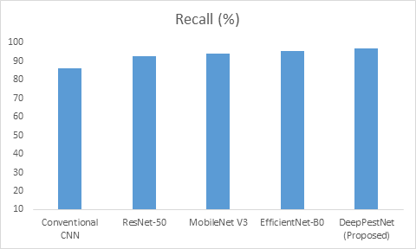

Results
Recall and F1-Score comparisons with different models

Slide 20
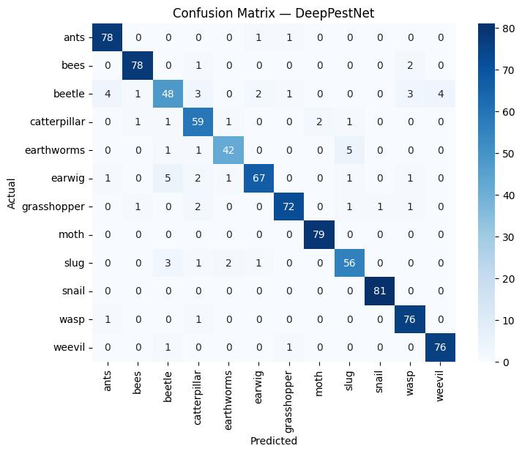
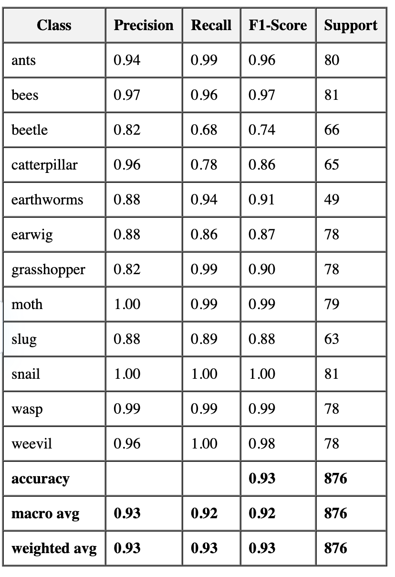
Results
Confusion Matrix and Classification Report of DeepPestNet

Slide 21
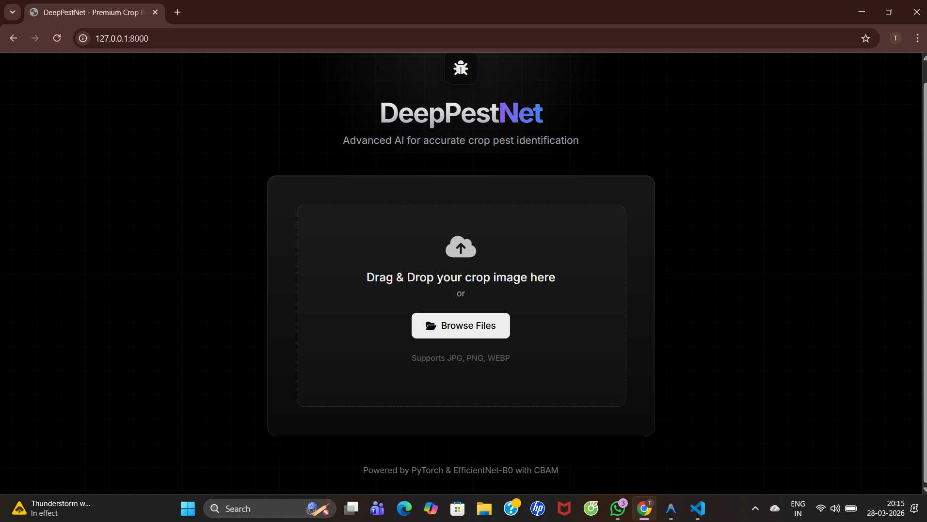
Outputs

Slide 22
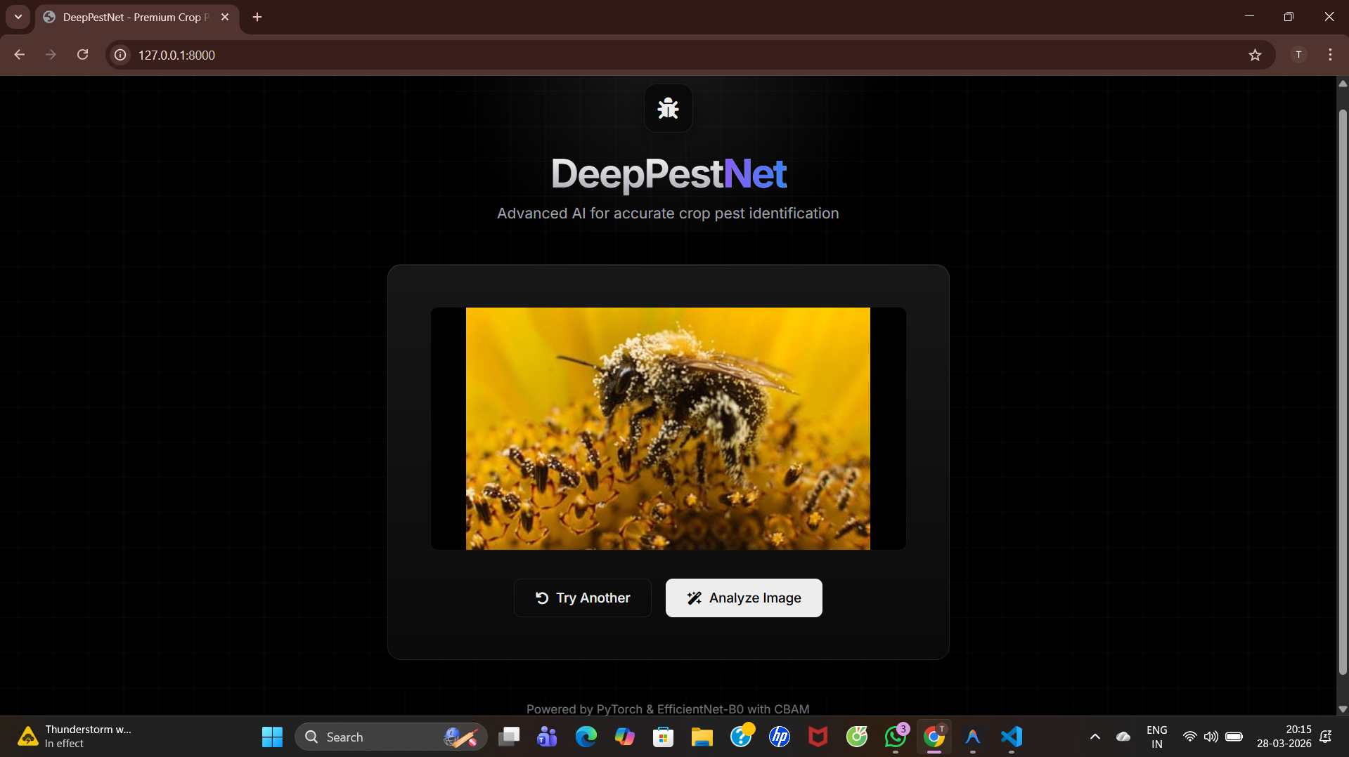
Outputs

Slide 23
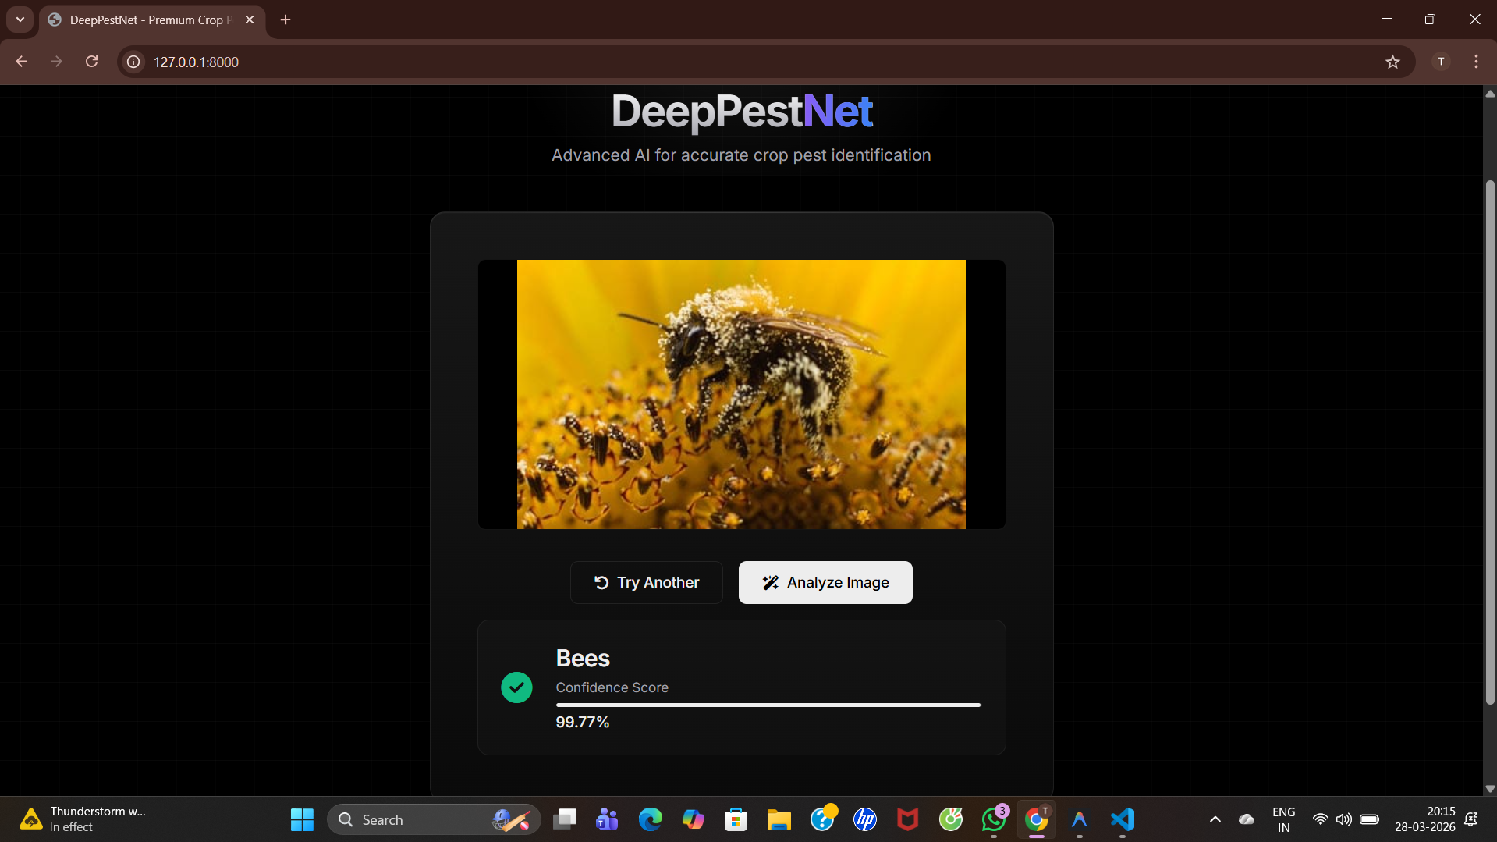
Outputs

Slide 24
Conclusion and Future Enhancements
This project highlights that DeepPestNet provides an efficient, accurate, and deployable solution for pest recognition in agriculture. By ensuring early detection, it safeguards crop yield and farmer income while reducing excessive pesticide usage. The model supports precision agriculture and promotes sustainable practices by minimizing environmental damage. With its adaptability to mobiles, drones, and IoT systems,
DeepPestNet has the potential to transform pest management.
Future directions include expanding datasets, enhancing IoT integration, and scaling to nationwide agricultural monitoring platforms, creating a smarter and more resilient farming ecosystem

Slide 25
References
[1] K. Thenmozhi and U. Srinivasulu Reddy, “Crop pest classification based on deep convolutional neural network and transfer learning,” Computers and Electronics in Agriculture, vol. 164, pp. 104906, 2019.
[2] Y. Li, et al., “Crop pest recognition in natural scenes using deep convolutional neural networks,” Computers and Electronics in Agriculture, vol. 169, pp. 105174, 2020.
[3] A. K. Karim Karar, et al., “A new mobile application of agricultural pests' recognition,” Alexandria Engineering Journal, vol. 60, no. 6, pp. 5171–5182, 2021.
[4] W. Li, et al., “Classification and detection of insects from field images using deep learning for smart pest management: A systematic review,” Ecological Informatics, vol. 63, pp. 101289, 2021.
[5] W. Zhang, et al., “AgriPest-YOLO: A rapid light-trap agricultural pest detection model,” Frontiers in Plant Science, vol. 13, pp. 1002847, 2022.

Slide 26
References
[6] R. Xu, et al., “Farmland pest recognition based on Cascade R-CNN,” PLOS ONE, vol. 19, no. 4, e0284120, 2024.
[7] L. Ciampi, et al., “A deep learning-based pipeline for whitefly pest abundance estimation on chromotropic sticky traps,” Ecological Informatics, vol. 74, pp. 102067, 2023.
[8] A. C. Teixeira, et al., “A systematic review on automatic insect detection using deep learning,” Agriculture, vol. 13, no. 1, pp. 58, 2023.
[9] X. Wang, et al., “Crop pest detection by three-scale convolutional neural network with attention (TSCNNA),” PLOS ONE, vol. 18, no. 3, e0282769, 2023.
[10] C. Zhang, et al., “Automatic pest identification system in the greenhouse based on deep learning and machine vision (improved YOLOv5),” PLOS ONE, vol. 18, no. 8, e0289081, 2023.

Slide 27


Slide 28
Paper Details
Conference Name : 6th International Conference on Image Processing and Capsule Networks - ICIPCN 2026
Presentation Date : 29th January , 2026
Paper Title : DeepPestNet: High-Accuracy Deep Learning for Crop Pest Detection and Classification in Precision Agriculture
Paper Id : ICIPCN-1049

