Slide 1
Microscopic Breast image classification Using Convolutional Neural Network (CNN)
PROJECT GUIDE : Mr. D.MADHU BABU M.Tech,(P.hD)
TEAM MEMBERS:
D.V.R.SANJAY VARMA : 18KD1A0542
CH.VARSHITH : 18KD1A0533
B.SANDEEP : 18KD1A0519
B.SRILEKHA : 18KD1A0516

Slide 2
CONTENTS
Introduction
Literature Survey
Existing System and Proposed System
System Architecture
Procedure
Software and Hardware Requirements
Execution Screens
Conclusion

Slide 3
Introduction
Thousands of females fall victim to breast cancer every year. The human body comprises millions of cells each with its unique function. When there is the unregulated growth of the cells it is termed cancer. In this, cells divide and grow uncontrollably, forming an abnormal swelling tissue part called a tumor. Tumor cells grow and invade digestive, nervous, and circulatory systems disrupting the body’s normal functioning. Though every single tumor is not cancerous. Cancer is classified by the type of cell that is affected and more than 200 types of cancers are known. This paper is focused on Breast cancer. Breast cancer is the most common type of cancer among females across the world. As per the National Breast Cancer Foundation, “Breast cancer is the most commonly diagnosed cancer in women”. Breast cancer is the second largest cause of cancer death among women.

Slide 4
LITERATURE SURVEY
Various papers contributed to the study of the sentimental classification of citations. Based on the study of these papers, this project was proposed.
Jyotismita Talukdar, Dr. Sanjib Kr. Kalita: Detection of Breast Cancer using Data Mining (WEKA) November 2015.
Breast cancer has become the primary reason for death in women in developed countries. Breast cancer is the second most common cause of cancer death in women worldwide. The high incidence of breast cancer in women has increased significantly during the last few decades. In this paper, we have discussed various data mining approaches that have been utilized for the early detection of breast cancer. Breast Cancer Diagnosis is the distinguishing of benign from malignant breast lumps. We have approached the diagnosis of this disease by using the Data mining technique. Data mining is an essential step in the process of knowledge discovery in databases in which intelligent methods are applied to extract patterns. The most effective way to reduce breast cancer deaths is to detect it earlier. This paper discusses the early detection of breast cancer in three major steps of determining breast cancer. They include (i) collection of data set, (ii) preprocess of the data set, and (iii) classification. Data mining and machine learning depend on classification which is the most essential task. Many experiments are performed on medical datasets using multiple classifiers and feature selection techniques. A good amount of research on breast cancer datasets is found in the literature. Many of them show good classification accuracy. For classification, we have chosen J48. All experiments are conducted in the WEKA data mining tool. Data-Sets are collected from online repositories which are of actual cancer patients. This paper primarily discusses the possibility to identify the breast cancer condition whether it is benign or malignant even at a very early stage. The prediction condition is based on the attributes related to breast cancer. There are 10 attributes in the data set used in this paper. Three major steps have been used in this paper i.e. collection of datasets, data preprocessing, and classification. This paper explains the various phases of data mining that are performed on the dataset. This journal has used WEKA as a data mining tool.

Slide 5
“Early Detection of Lung Cancer Risk Using Data Mining”- Article in Asian Pacific journal of cancer prevention: January 2013.
Lung cancer is the leading cause of cancer death worldwide Therefore, identification of genetic as well as environmental factors is very important in developing novel methods of lung cancer prevention. However, this is a multi-layered problem. Therefore, a lung cancer risk prediction system is here proposed which is easy, cost-effective, and time-saving. Materials and methods: Initially 400 cancer and non-cancer patients' data were collected from different diagnostic centers, pre-processed, and clustered using a K-means clustering algorithm for identifying relevant and non-relevant data. Next significant frequent patterns are discovered using AprioriTid and a decision tree algorithm. Results: Finally using the significant pattern prediction tools for a lung cancer prediction system was developed. This lung cancer risk prediction system should prove helpful in the detection of a person's predisposition for lung cancer. In this project, the data mining algorithm used is k-means and decision tree where the collected lung cancer dataset is passed through k-means clustering to separate the significant data into groups of relevant and non-relevant data and it also group the unique by their attributes connected records into groups, which helps to build a training machine and also used for recognizing cancer to non-cancerous data for predicting the results of lung cancer. They also used the decision tree algorithm to develop significant patterns to obtain an accurate lung cancer predictor.

Slide 6
EXISTING SYSTEM
An Ad Hoc Random Initialization Deep Neural Network Architecture for Discriminating Malignant Breast Cancer Lesions in Mammographic Images
In this project, they have designed and validated an ad hoc CNN architecture specialized in breast lesion classification from imaging data only. We explore a total of 260 model architectures in a train-validation-test split in order to propose a model selection criterion that can pose the emphasis reducing false negatives while still retaining acceptable accuracy. We achieve an area under the receiver operatic characteristics curve of 0.785 (accuracy 71.19%) on the test set, demonstrating how an ad hoc random initialization architecture can and should be fine-tuned to a specific problem, especially in biomedical applications.
LIMITATIONS:
Classes May Become imbalance and the model might lean toward favoring one class only
Which in turn leads to False-negative results that can lead to delays in treatment.
False-positive results would let the patient go through unwanted painful and expensive procedures.

Slide 7
PROPOSED SYSTEM
To overcome the drawbacks of the existing method we are proceeding with a Convolutional Neural Network.
CNN is one of the most widely used techniques for the processing of images with the atmost accuracy.
The goal is to assess whether a lump in a breast could be malignant (cancerous) or benign (non-cancerous). For instance, cancer cells tend to vary in size and shape.
So uniformity of cell size/shape, bare nuclei, bland chromatin, and normal nucleoli are signs of benignity. The analysis is probably part of a triple test.
If one or both of the other tests suggest malignancy, a biopsy for histological analysis will be necessary. It might be done as a frozen section analysis during the surgical procedure.
In this project, the main aim is to detect whether the patient is having benign cells or malignant tissue cells.
From this detection, It helps both patients, and radiologists save time and predict the disease at an early stage.

Slide 8
ADVANTAGES OF PROPOSED SYSTEM
The cost of the learning process is zero. The model can be modified with a new dataset without having to rebuild the model.
If datasets are huge, with the help of pandas the entire datasets can be made into one directory and perform on the entire directory without any issues.
The most important advantage of convolutional neural network is it helps by transferring all the dataset into one single directory. This will further helps the model in understanding the difference between the benign tissue cells and malignant cancer tissue cells.
With the help of ROI image retrieval becomes easy and with the help of pooling the image is can be extracted from the low pixels to the highest pixels which in turn helps the model to understand the image with a much more accuracy.

Slide 9
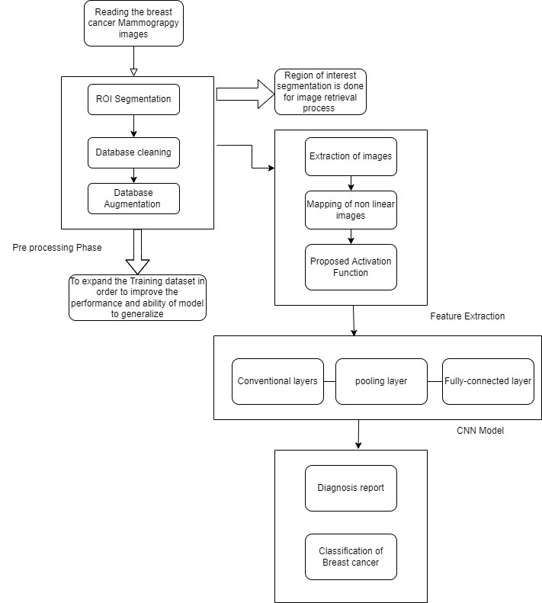
SYSTEM ARCHITETURE

Slide 10
Procedure
Step-1: First, we need to import the necessary libraries.
Step-2: In this stage, we need to identify the total number of images that are present for training the data and organize them into a Pandas data frame.
Step-3: After identifying the total number of images and organizing them into a data frame, we will look into the data and find out the percentage of IDC patches on the tissue images, as the IDC patches are the ones that determine whether the tissues are affected by cancer virus or not and come to the notion that the classes of IDC and non-IDC are imbalanced.

Slide 11
Procedure (cont…)
Step-4: check cancer and non-cancerous tissue images by displaying the sample tissue. We are provided with the notion that cancer-affected tissues are more violet in color than healthy tissues.
Step-5: Prepare a dataset so that the entire images in different datasets are transferred to a single data set separated by the directories ‘0’ and ‘1’, where 0 represents the directory for benign tissue samples and 1 represents the directory for malignant tissue samples.
Step-6: In this step, balance the class distribution so that the neural network does not lean on favouring only one class.
Step-7: Create new directories for training datasets and validation datasets.

Slide 12
Procedure(cont…)
Step-8: Now, we will set up the image generators and build the model.
Step-9: Train the model, with the help of the training dataset and evaluate for loss and accuracy metrics and plot the training curves based on the loss and accuracy.
Step-10: Now, after the model is trained validation of the data is performed with the help of the validation directory and make predictions to calculate the AUC score, print the confusion matrix, and the F1 score.
Step-11: Finally, calculate the AUC score and create a confusion matrix and provide the classification report result.

Slide 13
SOFTWARE requirements
Software Requirements deal with defining software resource requirements and pre – requisites that need to be installed on a computer to provide optimal functioning of an application. These requirements or pre – requisites are generally not included in the software installation package and need to be installed separately before the software is installed.
Operating System: Windows 10.
Coding Language: PYTHON Programming.
Dataset: Mammogram images.
Tool: Jupyter notebook.

Slide 14
HARDWARE REQUIREMENTS
The most common set of requirements defined by any operating system or software application is the physical computer resources, also known as hardware, a hardware requirements list is often accompanied by a hardware compatibility list (HCL), especially in case of operating systems. An HCL lists tested, compatible, and sometimes incompatible hardware devices for a particular operating system or applications. The following sub-sections discuss the various aspects of hardware requirements for our proposed system are:
System Processor: Intel Core i5 or RYZEN 5.
Hard Disk:1 TB.
Input Devices: Keyboard, and Mouse.
RAM: 8 GB.

Slide 15
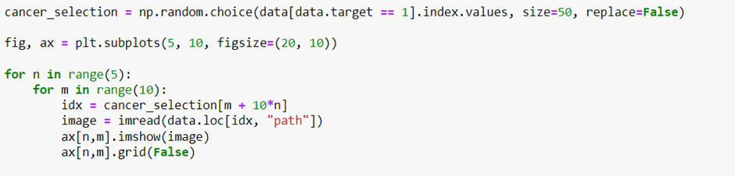
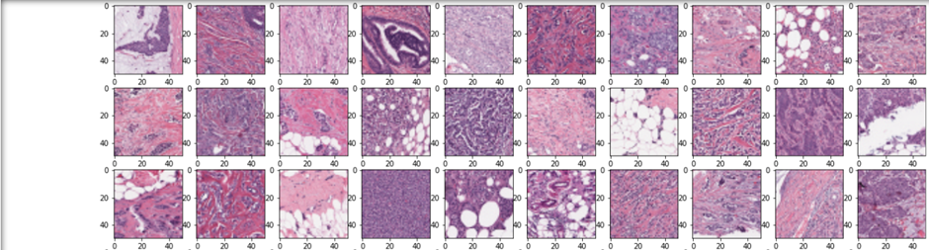
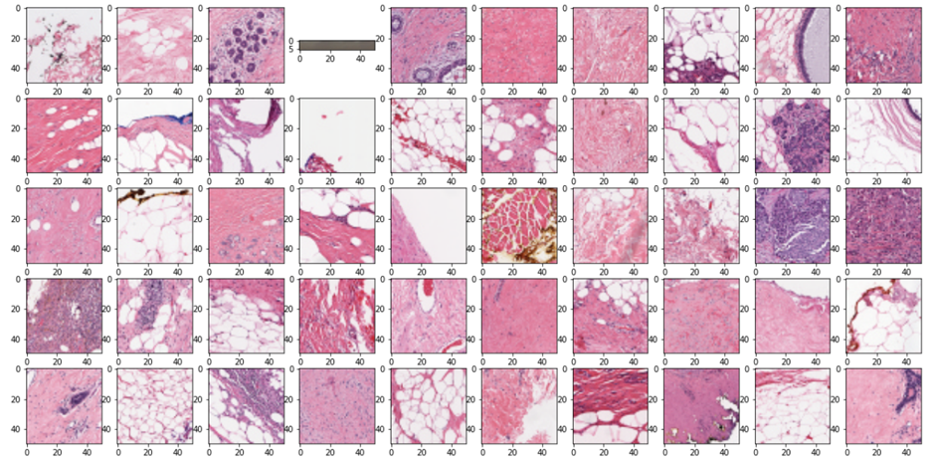
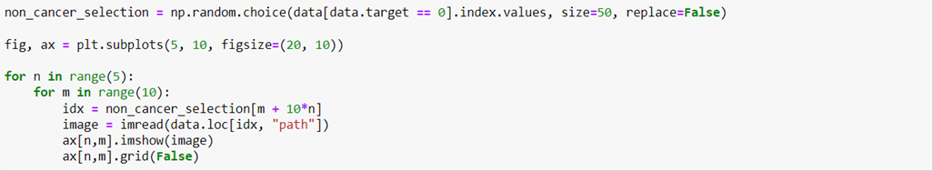
EXECUTION SCREENS
a) Displaying Cancer Tissue Samples:
b) Displaying Non-Cancer Tissue Samples:

Slide 16
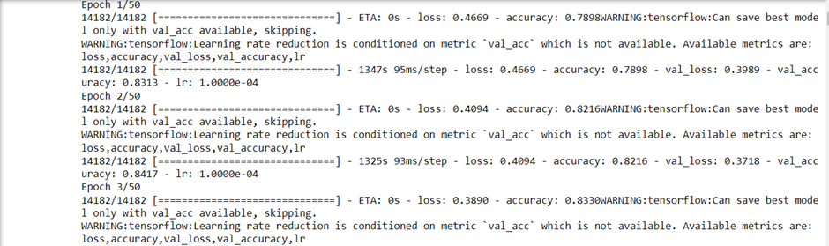
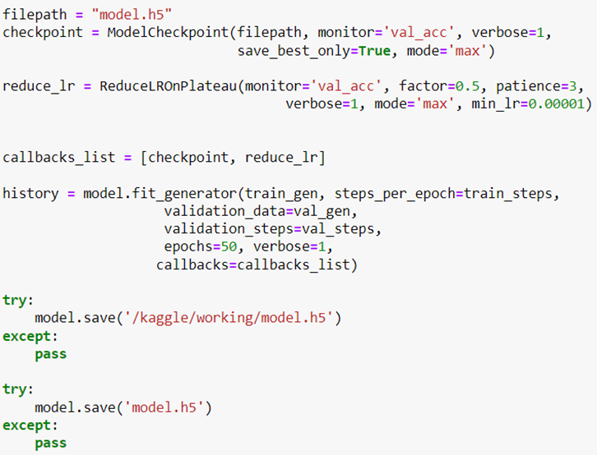
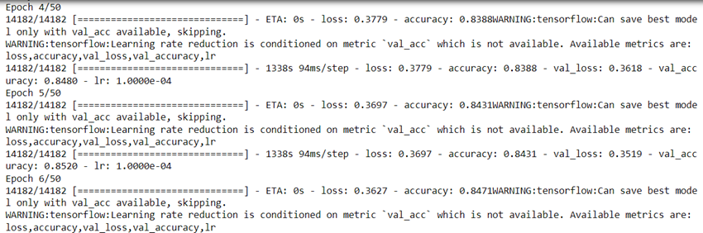
c) Training the model:

Slide 17
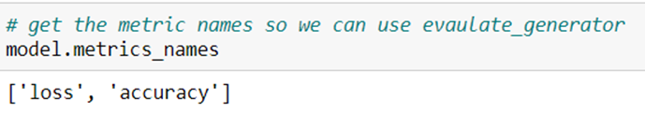
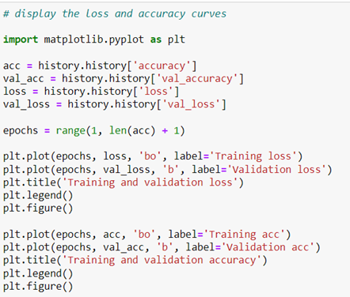
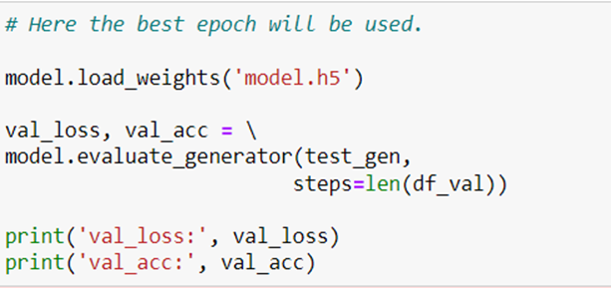
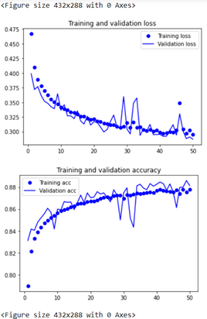

d) Evaluating the model for loss and accuracy: e) Plotting the training curves:
Output:

Slide 18
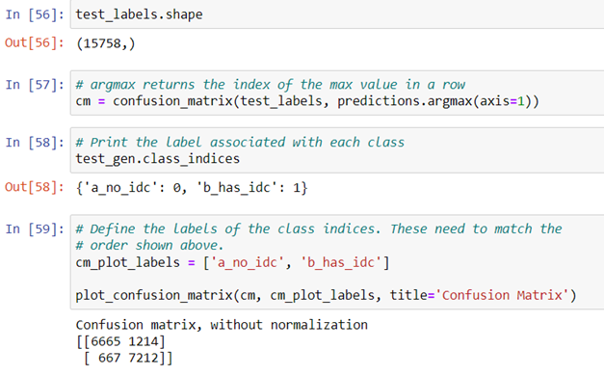
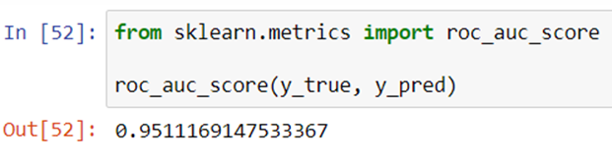
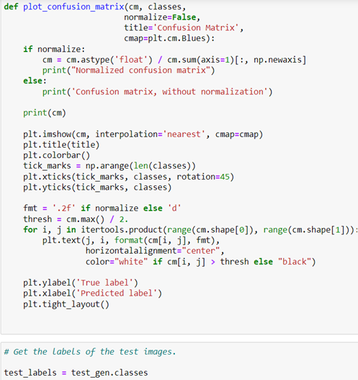
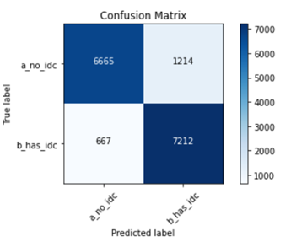
f) Calculating the AUC score:
g) Creating a Confusion Matrix:

Slide 19
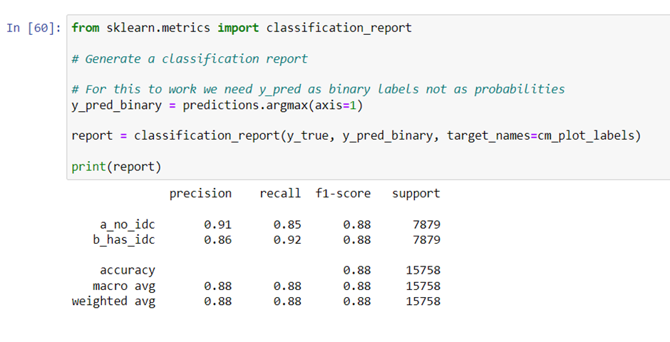
h) Creating a classification report:

Slide 20
CONCLUSION
In our project, we have presented the capability of classifying the malignant and benign cancer tissues using the detection techniques with the help of the microscopic image datasets. Convolutional Neural Network is one of the most emerging disruptive technologies that is used in many sectors like e-commerce, the agricultural sector, the health sector, the industrial sector, etc. The main aim of this model is to provide the earlier warning to the users and is also cost and time saving benefit to all users. The mortality rate of breast cancer is highest among all other types of cancer, it can be detected early by detecting the breast nodules. In this system, image preprocessing and image segmentation are implemented to obtain the diagnosis result. By using these steps, the nodules are detected and some features are extracted. The extracted features can be used for classification of disease stages. Determining the nodule features can provide to know more information of the condition of breast cancer at the early stages. In our project we have focused on this issue, we have developed a machine with improved accuracy which could assist radiologists in reviewing each mammogram, flagging potentially cancerous results that may have otherwise been missed for human review and take correct decision for breast cancer patient in short time with accuracy. Therefore, this method is less costly, less time consuming and easy to implement.

Slide 21
Any queries...?

