Slide 1
Line Following Robot
Transportation Robot

Slide 2
What Actually is this Robot
The line follower robot is a simple robot that is based on automation that follows a specific direction based on a particular line, usually a dark line on a light surface. The robot consists of two sensors that are installed at the front end of the robot body and two wheels that are driven by DC motors. The circuit board present in the robot controls the wheel speed based on the input signal from the sensors. The controlling of the robot is done like that when the robot sees a black line it stops.
A line follower robot is a type of robot that follows a particular direction or path and maintains its own working nature based on the situation it faces.
Line follower robot actually follows a feedback mechanism where the path is basically a black line or a dark line on the white or light surface.
Line follower robot has lots of usage in present-day applications including carrying small babies to shopping malls, home, entertainment areas, and many more.
In industrial areas, line follower robot plays a major role as it is mainly used for carrying various industrial goods and transporting the same from one location to another.
The line follower robot follows the same path that has been set for use to go. It follows the same track, never got deviated and for making products in the industries, the robot plays the role.
There are two types of line follower robots in the market. The first is the mobile-based line following robot and the next one is RF based line following robot.

Slide 3
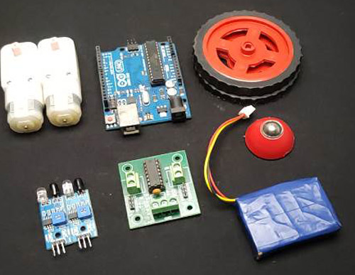
Components
Used
Arduino Uno - 1Nos
L293D motor driver- 1Nos
IR sensor module -2 Nos
7.4 or 9V battery -1 Nos
BO motor - 2 Nos
Motor wheel - 2 Nos
Castor wheel - 1 Nos
Hobby robot chassis - 1 Nos
Wires
Screw

Slide 4
Motion of Robot
1
3
2
4
Moving Forward
Turning Left
Turning Right
Stopping

Slide 5
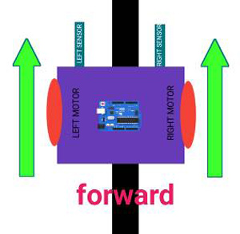
Moving Forward
In this case, when both the sensors are on a white surface and the line is between the two sensors, the robot should move forward, i.e., both the motors should rotate such that the robot moves in forward direction (actually both the motors should rotate in the opposite direction due to the placement of motors in our setup. But for the sake of simplicity, we will call the motors rotating forward.)

Slide 6
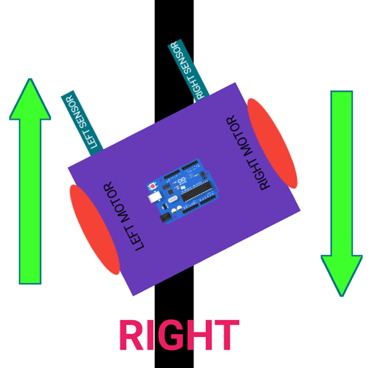
Turning
Right
This case is similar to the left case, but in this situation only the right sensor detects the line which means that the robot should turn in the right direction. To turn the robot towards the right direction, the left motor rotates forward and the right motor rotates backwards and as a result, the robot turns towards the right direction.

Slide 7
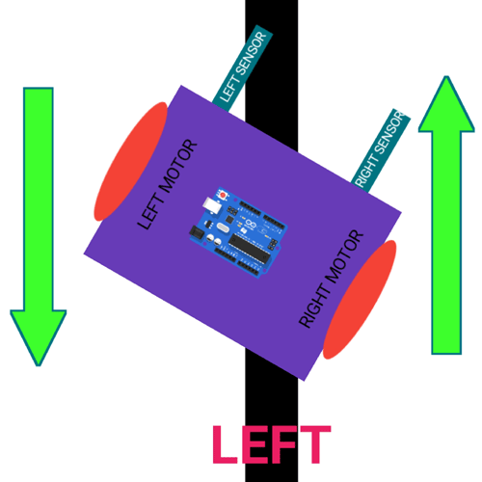
Turning
Left
In this case, the left sensor is on top of the dark line, whereas the right sensor is on the white part, hence the left sensor detects the black line and gives a signal, to the microcontroller. Since, signal comes from the left sensor, the robot should turn to the left direction. Therefore, the left motor rotates backwards and the right motor rotates in forward direction. Thus, the robot turns towards left side.

Slide 8
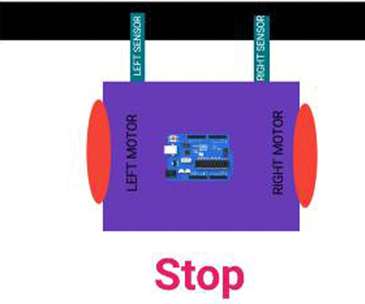
Stopping
In this case, both the sensors are on top of the line and they can detect the black line simultaneously, the microcontroller is fed to consider this situation as a process for halt. Hence, both the motors are stopped, which causes the robot to stop moving.

Slide 9
Applications
It is used in industrial areas for moving obstacles and goods.
It is used in automobile applications such as automatic cars seen on roads.
It is used for home purposes like cleaning floors.
It is also used in public places like malls and entertainment areas for showing and guiding paths to travelers.

Slide 10
Thanks!
Do you have any questions?
youremail@freepik.com
+91 620 421 838
yourcompany.com
Please keep this slide for attribution

