Slide 1
CS230: Digital Logic Design and Computer Architecture
Lecture 10: ISA/Microarch.
https://www.cse.iitb.ac.in/~biswa/courses/CS230/autumn23/main.html

Slide 2
ISA and Microarchitecture

Slide 3
Microarchitecture (Not exposed to us)
Implementation of an ISA
Programmer cannot see/access it
ISA:
add instruction
Microarch:
Implementation of an adder (ripple carry)

Slide 4
ISA: What does it provide?
Opcodes,
Addressing Modes,
Instruction Types and Formats,
Registers
Access control: user/OS
Address space,
Addressability,
Alignment

Slide 5
ISA: What does it provide?
Instructions:
Opcodes,
Addressing Modes,
Instruction Types and Formats,
Registers
Access control: user/OS
Memory: Address space,
Addressability,
Alignment
ISA must satisfy the needs of the software: - assembler, compiler, OS,

Slide 6
Microarchitecture
Rest of C230 after ISA ☺
Caches
Memory Controllers
Branch Predictors, Prefetchers, …

Slide 7
Microarchitecture
Processor is in state S
Processor moves to state SS
Instruction

Slide 8
State
The information held in the processor at the end of an instruction to provide the processing context for the next instruction.

Slide 9
Computer Architecture
ISA + Microarchitecture

Slide 10
Based on lectures so far
#registers
#cycles to access a register
#Width of the register (32/64 bit)
#Instruction that uses register to access memory
#cycles to access memory

Slide 11
Based on lectures so far
#registers: ISA
#cycles to access a register: Microarch.
#Width of the register (32/64 bit) : ISA
#Instruction that uses register to access memory: ISA
#cycles to access memory: Microarch.
x86: It has 128/256-bit registers and one-bit too ☺

Slide 12
Where to place it?
Closer to high-level language → Small semantic gap, complex instructions
(CISC kinda? e.g. quicksort an instruction ☺)
Closer to hardware? → Large semantic gap, simple instructions (RISC kinda?)
Remember: Compiler+ISA defines app’s instruction count

Slide 13
And then the Debate of RISC vs CISC
RISC: Reduced Instruction Set of Computers
Very few simple instructions
Example: MIPS
CISC: Complex Instruction Set of Computers
Lots of complicated instructions
Example: x86 kind of ☺ [x86 is CISC with RISC mysteries]

Slide 14
Mystery
Intel converts CISC ones into RISC ones, and generate microoperations.
Intelligent CISC-RISC decoder
Consumes around 2% of the chip area. Good or bad?

Slide 15
How Easy?
A billion-dollar idea ☺
requires changes to microarchitecture.
requires changes to ISA.
both (i) and (ii)
Think about the trade-offs ☺
Does it affect the system stack?

Slide 16
The Other ISAs

Slide 17

World of ISAs
x86: Intel, AMD: Laptops, Desktops, Servers
ARM: Arm, Qualcomm, Apple, Samsung: Mobiles
btw ARM: Advanced RISC Machines ☺
RISC-V: Open-source ISA, what does it mean?

Slide 18
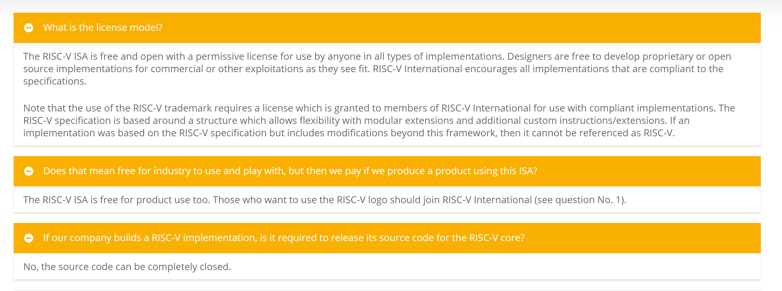
RISC-V, opensource

Slide 19
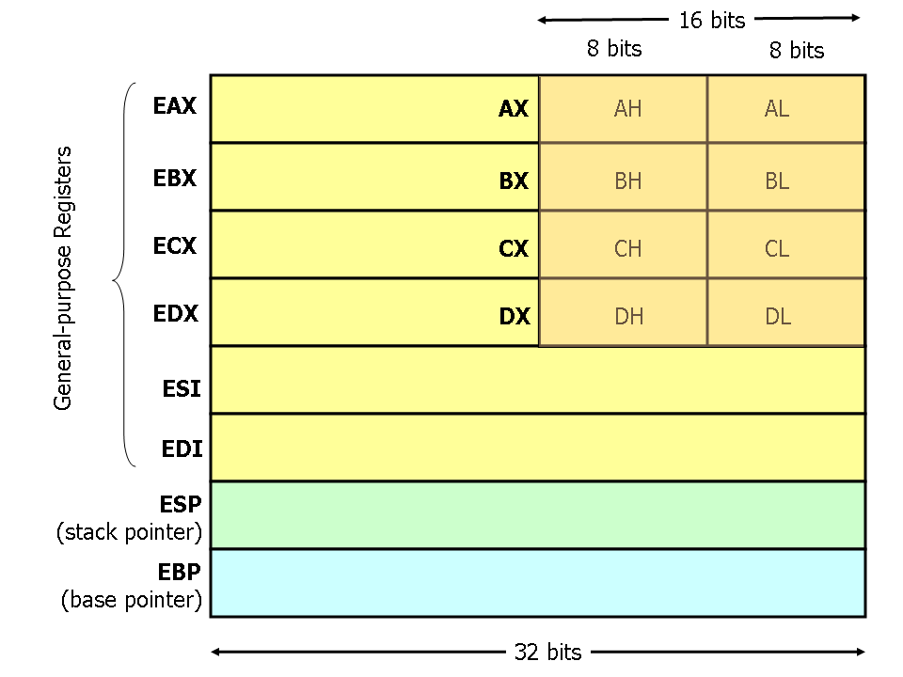
x86 Registers: 80386 For 64-bits, rax, rbx

Slide 20
Subtle Differences
x86 arithmetic/logic instructions: one operand should act as both source and destination
add $s0, $s1 // Add $s0 and $s1 and put it in $s0 ☺
One of the operands can be in memory:
wow (programmer) or oh no (instruction size ☹) !!
add $s0, Mem[$s1] ☺
No more fixed-length instructions ☹ can be 4/8/X bytes
Why?

Slide 21
Fixed Width or Variable Width
Variable: No fixed size
6 bytes for add, 2 bytes for load
Smaller code footprint (compact)
Fixed:
4 bytes for all, Larger code footprint, simple decoding

Slide 22

Fallacies
CISC instructions provide higher performance
Assembly language codes provide higher performance

Slide 23
Instruction Alignment: Why we need it?
0 1 2 3
Aligned
Not
Aligned
Aligned:
x-byte access starting from an address y: y % x must be zero.

Slide 24
MIPS vs X86
MIPS does not allow unaligned accesses
x86 does not enforce alignment ☺
Whose job is to generate aligned/unaligned accesses?

Slide 25
MIPS vs X86
MIPS does not allow unaligned accesses
x86 does not enforce alignment ☺
Whose job is to generate aligned/unaligned accesses?
Compiler

Slide 26
Let’s go a bit deeper
Object of size s bytes at byte add. A is aligned if A mod s = 0
Alignment for faster transfer of data ?
Why fast ??
Think about memory (caches if you know).

Slide 27
Memory operations and alignment network
lb R1, 1($s3)
4-byte chunk
Register R1
LOADs and STOREs need an alignment network that makes sure data loaded/written are aligned.

Slide 28
For the Curious ones
https://lemire.me/blog/2012/05/31/data-alignment-for-speed-myth-or-reality/

