Slide 1
CS230: Digital Logic Design and Computer Architecture
Lecture 11: Intro. to Single cycle CPU https://www.cse.iitb.ac.in/~biswa/courses/CS230/autumn23/main.html

Slide 2

Phones (smart/non-smart) on silence plz, Thanks

Slide 3
Single Cycle Processor
All operations – single cycle ☺
Clock cycle (unit of time) will be defined based on the longest instruction.
Two paths of interest: datapath and control. Control tells datapath what to do.
Do not forget the stored program concept.

Slide 4
Clock Cycle
Tick, clock tick, clock period, clock, clock cycle, or cycle
Discrete time intervals
Based on processor frequency (clock rate)
1GHz processor, clock cycle = 1ns
4GHz processor, clock cycle = 0.25ns

Slide 5

Let’s start with the datapath
Anything that stores data or operates on data, within a processor

Slide 6
Instruction Memory
Instr.
Mem
Remember: No writes to instruction memory ☺
32
Instruction
Not concerned about how programs are loaded into this memory.
Addr.
32

Slide 7
Program Counter
Remember: No writes to instruction memory ☺
32
32
PC

Slide 8
Register File
rs1 and rs2: Read register 1 and 2
RegFile
ws: Write register
5
rs1
32
wd: Write data
5
rd1
rs2
5
ws
32
rd2
wd
32
Write Enable (a.k.a. register write)

Slide 9
The ALU
op
32
ALU
32
32

Slide 10
Data Memory
Memory Read/Write
Data
Mem
Why data and instruction memory and not one memory?
Later in the course ☺
32
32
data
data
Addr.
32

Slide 11
Address and Data Bus (Instruction Fetch)
Instr
Mem
Fetching straight-line MIPS instructions requires a machine that generates this timing diagram:
32
Inst.
Addr
32
CLK
Addr
PC
PC + 4
PC + 8
Data
IMem[PC]
IMem[PC + 4]
IMem[PC + 8]
PC == Program Counter, points to next instruction.

Slide 12
Decode and Execute
opcode
rs
rt
rd
shamt
funct
Logic
Decode fields to get : ADD $8 $9 $10
op
RegFile
32
Remember the opcode field
is the input to the control unit
5
rs1
32
5
rd1
ALU
32
rs2
5
ws
32
rd2
32
wd
32
WE

Slide 13
All in one go
32
Instr
Mem
PC
To rs1,
rs2, ws, op decode
logic ...
32
32
32
+
D
Q
Addr
Data
32
32
0x4
op
RegFile
32
5
rs1
32
5
rd1
ALU
32
rs2
5
ws
32
rd2
32
wd
32
WE

Slide 14
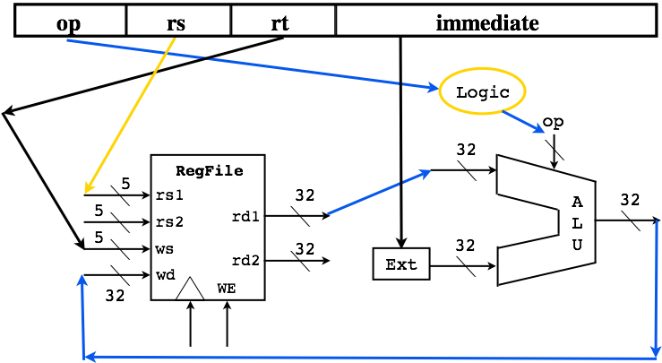
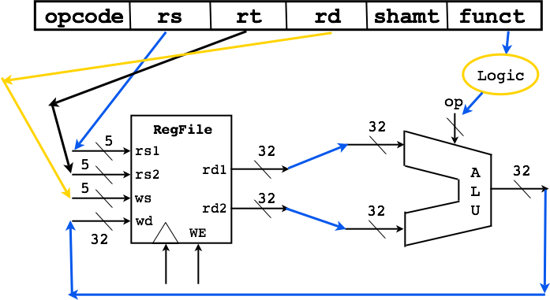
What about I format?

Slide 15
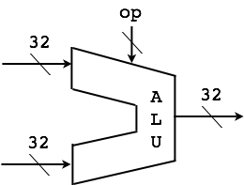

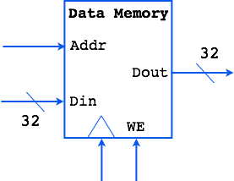
Loads from Memory
RegFile
ALUctr
5
rs1
32
5
rd1
rs2
5
ws
32
rd2
wd
32
WE
RegDest
Ext
RegWr
ExtOp
ALUsrc
MemToReg
MemWr
Syntax: LW $1, 32($2)
Action: $1 = M[$2 + 32]

Slide 16
Branch Instructions
Syntax: BEQ $1, $2, 12
Action: If ($1 != $2), PC = PC + 4 Action: If ($1 == $2), PC = PC + 4 + 48
32
Instr Mem
Addr Data
PC
32
32
32
+
D
Q
32
32
0x4
32
PCSrc
Clk
Ex te nd
+
32

Slide 17
Control Signals So far
MemRead
MemWrite
RegWrite
MemtoReg
RegDst
ALUop, ALUSrc
PCSrc (we have not discussed about the branch)
RegDst
RegWrite
Read
address
Instruction
[31-0]
I [31 - 26]
ALUSrc
ALUOp
I [5 - 0]
Control
MemWrite
Instruction
memory
MemRead
MemToReg
PCSrc
Zero

Slide 18
In detail
MemRead: Read from memory when assert
MemWrite: Write into the memory when assert
RegWrite: Reg. on Write register updated with the input, on assert
MemtoReg: On assert, memory to register, on deassert, ALU to register
RegDst: On assert, use rd field, on deassert use rt field
ALUSrc: On assert, lower 16 bits of an inst., on deassert from the second register
PCSrc: On assert, branch target, deassert, PC+4

Slide 19
Control Signal Table
Operation | RegDst | RegWrite | ALUSrc | ALUOp | MemWrite | MemRead | MemToReg
add | 1 | 1 | 0 | 010 | 0 | 0 | 0
sub | 1 | 1 | 0 | 110 | 0 | 0 | 0
and | 1 | 1 | 0 | 000 | 0 | 0 | 0
or | 1 | 1 | 0 | 001 | 0 | 0 | 0
slt | 1 | 1 | 0 | 111 | 0 | 0 | 0
lw | 0 | 1 | 1 | 010 | 0 | 1 | 1
sw | X | 0 | 1 | 010 | 1 | 0 | X
beq | X | 0 | 0 | 110 | 0 | 0 | X

Slide 20
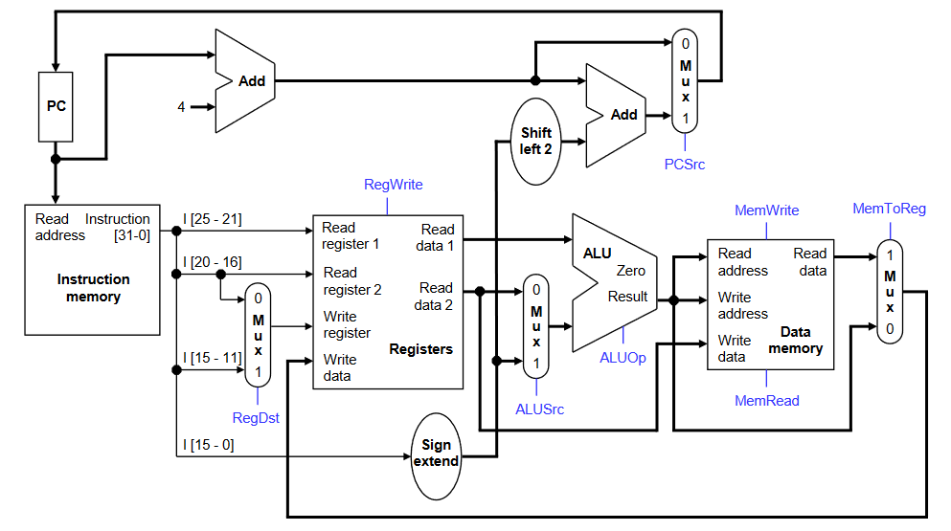
The Complete Picture
I[31-26]: Control unit

Slide 21
Why not single cycle?
The longest possible datapath is the clock cycle time.
What does it mean?

Slide 22
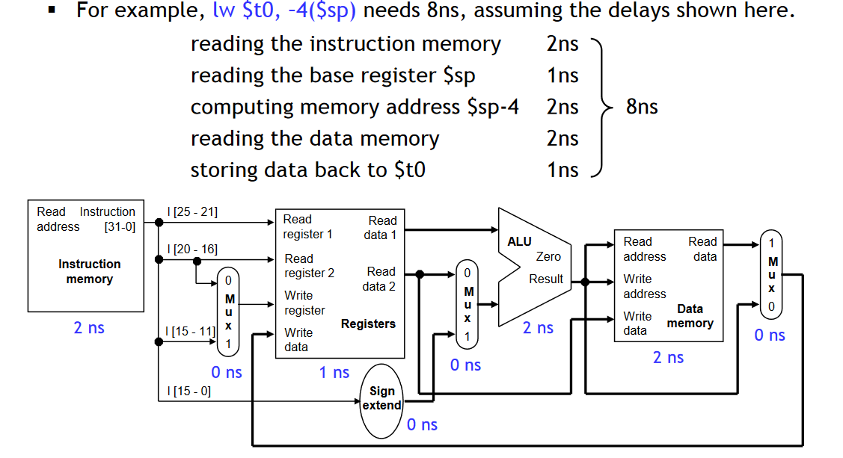
Why not single cycle?
one clock cycle: 8ns
Processor frequency: 125MHz
Cycle per Instruction (CPI): 1
An add instruction: no need of 8ns

Slide 23
Why not single cycle?
The longest possible datapath is the clock cycle time.
Violating common case fast (Confucius says)

Slide 24
Oh No! Such a bad design

Slide 25
Single to Multi Cycle

