Slide 1
CS230: Digital Logic Design and Computer Architecture
Lecture 12: Instruction Pipelining
https://www.cse.iitb.ac.in/~biswa/courses/CS230/autumn23/main.html

Slide 2

Phones (smart/non-smart) on silence plz, Thanks

Slide 3
Single to Multi Cycle

Slide 4
Single/multi-cycle (COVID19 vaccine schedule)
Single cycle (Worst case)
One shot will take 60 minutes one slot = 60 minutes
Multi cycle (average case kinda)
One shot: five to 60 minutes one slot = 15 minutes

Slide 5

Can We Have Both?
Faster clock rate and also CPI=1?

Slide 6
COVID19 Vaccination Schedule
Single cycle: one hour per person
verification: 25 minutes
5 minutes for vaccination
20 minutes post-vaccination
10 minutes, certificate ☺

Slide 7
COVID19 Vaccination Schedule
Single cycle: Three hour, three persons
verification: 25 minutes
5 minutes for vaccination
20 minutes post-vaccination
10 minutes, certificate ☺

Slide 8
COVID19 Vaccination Pipelined Schedule
Single cycle: one hour per person
Stage 1 verification: 15 minutes
Stage 2 verification: 10 minutes
Stage 3: 5 minutes for vaccination
Stage 4: 20 minutes post-vaccination
Stage 5: 10 minutes, certificate ☺

Slide 9
COVID19 Vaccination Pipelined Schedule
Single cycle: one hour per person
Stage 1 verification: 15 minutes
Stage 2 verification: 10 minutes
Stage 3: 5 minutes for vaccination
Stage 4: 20 minutes post-vaccination
Stage 5: 10 minutes, certificate ☺

Slide 10
COVID19 Vaccination Pipelined Schedule
Single cycle: one hour per person
Stage 1 verification: 15 minutes
Stage 2 verification: 10 minutes
Stage 3: 5 minutes for vaccination
Stage 4: 20 minutes post-vaccination
Stage 5: 10 minutes, certificate ☺

Slide 11
COVID19 Vaccination Pipelined Schedule
Single cycle: one hour per person
Stage 1 verification: 15 minutes
Stage 2 verification: 10 minutes
Stage 3: 5 minutes for vaccination
Stage 4: 20 minutes post-vaccination
Stage 5: 10 minutes, certificate ☺

Slide 12
COVID19 Vaccination Pipelined Schedule
Single cycle: one hour per person
Stage 1 verification: 15 minutes
Stage 2 verification: 10 minutes
Stage 3: 5 minutes for vaccination
Stage 4: 20 minutes post-vaccination
Stage 5: 10 minutes, certificate ☺

Slide 13
COVID19 Vaccination Pipelined Schedule
Pipelined: One hour: Three persons
Stage 1 verification: 15 minutes
Stage 2 verification: 10 minutes
Stage 3: 5 minutes for vaccination
Stage 4: 20 minutes post-vaccination
Stage 5: 10 minutes, certificate ☺

Slide 14
COVID19 Vaccination Pipelined Schedule
Pipelined: One hour: ? Persons, first person: 100 minutes ☹, after a while throughput= 3 persons/hr
Stage 1 (20 mins): verification
Stage 2 (20 mins): verification
Stage 3 (20 mins): 5 minutes for vaccination
Stage 4 (20 mins): 20 minutes post-vaccination
Stage 5 (20 mins):10 minutes, certificate ☺
Think about variable stages, does it improve latency and throughput?

Slide 15
Let’s pause a bit
Single cycle: CPI: 1 , Cycle time: long
Multi cycle: CPI: >1, Cycle time: short
Pipelined: CPI: 1, Cycle time: short (improves throughput but not latency)

Slide 16
Latency and Bandwidth (throughput)
Latency
time it takes to complete one instance
Throughput
number of computations done per unit time

Slide 17
Pipelining and Richard Feynman
https://www.youtube.com/watch?v=9miKIWIYi4w
Jump to 1:25

Slide 18











Multi-cycle vs Pipelined
Multi-cycle
ins0.fetch ins0.(dec,ex) ins0.(mem,wb)
ins0.fetch ins0.(dec,ex) ins0.(mem,wb)
ins1.fetch ins1.(dec,ex) ins1.(mem,wb)
Pipelined
ins1.fetch ins1.(dec,ex) ins1.(mem,wb)
ins2.fetch ins2.(dec,ex) ins2.(mem,wb)
time

Slide 19

Real World

Slide 20
Vanilla 5-stage pipeline
Instruction
Fetch
Instr. Decode
Reg. Fetch
Execute
Addr. Calc
Memory
Access
Write
Back
Next PC
IF/ID
ID/EX
EX/MEM
MUX
MEM/WB
Next SEQ PC
Next SEQ PC
Adder
4
Zero?
Address
RS1
Reg File
Memory
RS2
MUX
ALU
Data
Memory
MUX
MUX
Sign
Extend
Imm
WB Data
RD
RD
RD
The right place to put the MUX that selects PC+4 and the target is the fetch stage.
The slide shows a vanilla 5-stage pipeline if we just take a single cycle datapath and divide it into five stages.

Slide 21
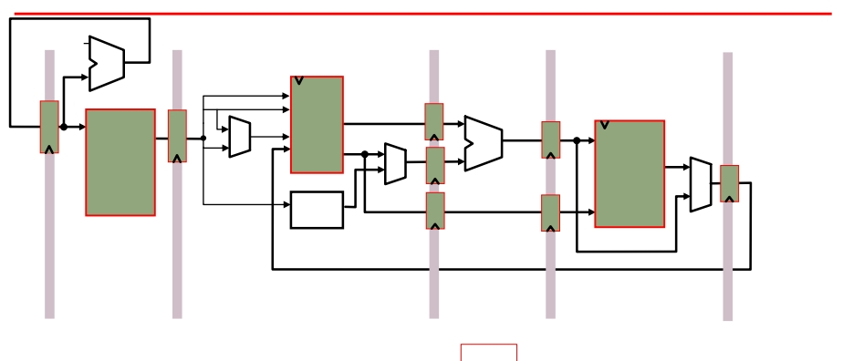
Resource Utilization
0x4
Add
we
rs1
addr
rdata
Inst.
IR
rs2
rd1
PC
ws
we
addr
rdata
Data
wdata
wd rd2
ALU
GPRs
Memory
Imm
Ext
Memory
Write
I-Fetch
Decode, Reg. Fetch Execute
Memory
-
(IF)
(ID)
(EX)
(MA)
Back
t4
I5
I4
I3
I2
I1
(WB)
time t0 t1 t2 t3
t5 t6 t7 . . . .
IF
I1
I2
I3
I4
ID
I1
I2
I3
I5
Resources
EX
I1
I2
I4
I5
MA
I1
I3
I4
I5
WB
I2
I3
I4
I5

Slide 22
Visualizing Pipeline
Clock cycle 5
1
2
3
4
6
7
8
9
lw $t0, 4($sp)
sub $v0, $a0, $a1 and $t1, $t2, $t3 or $s0, $s1, $s2 add $sp, $sp, -4
filling full emptying
IF | ID | EX | MEM | WB
 | IF | ID | EX | MEM | WB
 |  | IF | ID | EX | MEM | WB
 |  |  | IF | ID | EX | MEM | WB
 |  |  |  | IF | ID | EX | MEM | WB

Slide 23
Visualizing Pipeline: Execution time
Clock cycle 5
1
2
3
4
6
7
8
9
lw $t0, 4($sp)
sub $v0, $a0, $a1 and $t1, $t2, $t3 or $s0, $s1, $s2 add $sp, $sp, -4
filling full emptying
IF | ID | EX | MEM | WB
 | IF | ID | EX | MEM | WB
 |  | IF | ID | EX | MEM | WB
 |  |  | IF | ID | EX | MEM | WB
 |  |  |  | IF | ID | EX | MEM | WB
For a k-stage pipeline executing N instructions
first instruction: K cycles
Next N-1 instructions: N-1 cycles, total = K + (N-1) cycles

Slide 24
Pipelined versus Single cycle CPU design
Instruction | Ifetch | Decode | Execute | Memory | Writeback | Total time
LOAD | 200ns | 100 | 200 | 200 | 100 | 800ns
STORE | 200 | 100 | 200 | 200 |  | 700ns
ADD | 200 | 100 | 200 |  | 100 | 600ns
BRANCH | 200 | 100 | 200 |  |  | 500ns
Total latency in single cycle CPU: 3200 ns
Total latency in pipelined CPU (200ns clock cycle):
1000ns (1st instruction) + 3 X 200 ns (for next three) = 1600 ns

Slide 25
What’s the big deal
Speedup = 3200ns/1600ns = 2X
What if we have a billion instructions?
Single cycle = 1 billion X 800ns = 800 seconds
Pipelined = 1000ns + (1 billion -1) X 200ns ~ 200 seconds
Speedup = 4X ☺

Slide 26
Let’s include latch latency too
Inter-stage latch = 10ns
New clock cycle time in the pipelined design = 210ns
First instruction will get completed by 1040ns (five stages X 200 ns + four inter-stage latches X 10ns)
New Speedup = 800s/210s ~ 3.8X

Slide 27
How to Divide the Datapath?
Suppose memory is significantly slower than other stages. For example, suppose
t
= 10 units
IM
t
= 10 units
DM
t
= 5 units
ALU
t
= 1 unit
RF
t
= 1 unit
RW
Since the slowest stage determines the clock, it may be possible to combine some stages without any loss of performance

Slide 28
#Stages and Speedup
Assumptions
Unpipelined
t_{C}
Pipelined Speedup
t_{C}
1. t = t = 10,
IM DM
t_{ALU} = 5,
t_{RF} = t_{RW}= 1
27
10
2.7
4-stage pipeline
2. t_{IM} =t_{DM} = t_{ALU} = t_{RF} = t_{RW} = 5
4-stage pipeline
25
10
2.5
3. t_{IM} =t_{DM} = t_{ALU} = t_{RF} = t_{RW} = 5
5-stage pipeline
25
5
5.0

Slide 29
Devil is in the details

Slide 30









Stage-1: Fetch
target
M
U X
4
PC + 4
+
Decode
PC
en
Instruction bits
Instruction Memory
en
IF / ID
Pipeline register

Slide 31










Stage 2: Decode
target
PC + 4
PC + 4
regA regB
regA contents
Fetch
Execute
destReg
Register File
Signals contents
regB
Instruction bits
data
en
Control
IF / ID
Pipeline register
ID / EX
Pipeline register

Slide 32












Stage 3: Execute
PC + 4
PC+4
+offset
+
regA contents
ALU
result
A L U
Memory
Decode
regB contents
M U X
regB contents
Control Signals
Control Signals
destReg
data
ID / EX
Pipeline register
EX/Mem
Pipeline register

Slide 33







Stage 4: Memory Stage
PC+4
+offset
target
ALU
result
ALU
result
in_addr
in_data
Data Memory
en R/W
destReg
data
Write-back
Execute
regB contents
Loaded
data
Control signals
Control
signals
EX/Mem
Pipeline register
Mem/WB Pipeline register

Slide 34






Stage 5: Write-back
ALU
result
Memory
Loaded data
M U X
data
Control signals
M U X
destReg
Mem/WB Pipeline register

Slide 35





























The Complete Picture
M U X
4
+
+ target
PC+4
PC+4
regA
regB
eq?
ALU
M
instruction
valA
result _{U}
PC
Inst
Register
File
A L
U
ALU
data dest
mdata
X
Mem
valB
result
Data
Memory
M
U X
data
dest
offset
valB
M U X
dest op ID/EX
dest
op
dest
op
IF/ID
EX/Mem
Mem/WB

Slide 36
Coffee Credits
Aditya Agarwal

