Slide 1
CS230: Digital Logic Design and Computer Architecture
Lecture 13: Data/Control Hazards
https://www.cse.iitb.ac.in/~biswa/courses/CS230/autumn23/main.html

Slide 2
The ideal world
Uniform Sub-operations
Operation (op) can be partitioned into uniform-latency sub-ops
Repetition of Identical Operations
Same ops performed on many different inputs
Independent Operations
All ops are mutually independent

Slide 3
The real world
Uniform Sub-operations NO
Operation can be partitioned into uniform-latency sub-ops
Repetition of Identical Operations NO
Same ops performed on many different inputs
Independent Operations NO
All ops are mutually independent

Slide 4
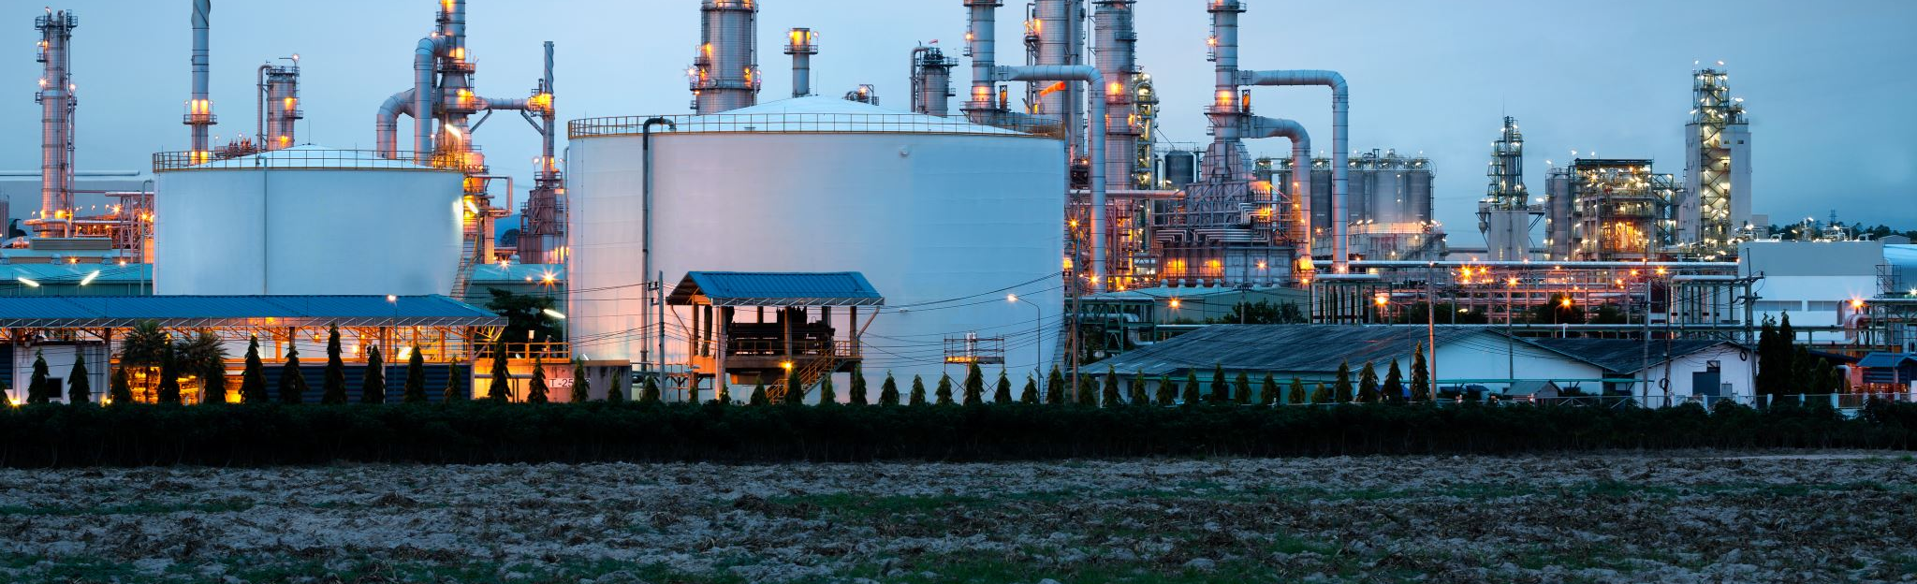
Structural/Data/Control Hazards
What is a hazard ? Anything that prevents an instruction to move ahead in the pipeline.
Structural: Resource conflicts, two instructions want to access the same structure on the same clock cycle.

Slide 5
An Example with unified (single) memory
Load
M
Reg
ALU
M
Reg
Can’t read same memory twice in same clock cycle
Instr 1
M
Reg
ALU
M
Reg
Instr 2
M
Reg
ALU
M
Reg
Instr 3
M
Reg
ALU
M
Reg
Instr 4
M
Reg
ALU
M
Reg

Slide 6
What about registers?
Can read/write the register file (same register) in same clock cycle ☺ but.. Real picture is different
Remember: Edge-triggered
Load
M
Reg
ALU
M
Reg
Instr 1
M
Reg
ALU
M
Reg
Instr 2
M
Reg
ALU
M
Reg
Instr 3
M
Reg
ALU
M
Reg
Instr 4
M
Reg
ALU
M
Reg
Structural hazards are highly infrequent

Slide 7
Data Hazards
Instruction depends on the result (data) of previous instruction(s).
Hazards happen because of data dependences.

Slide 8
Data dependences (hazards)
add R1, R2, R3
sub R2, R4, R1
or R1, R6, R3
read-after-write
(RAW)
True dependence

Slide 9
Data dependences (hazards)
add R1, R2, R3
sub R2, R4, R1
or R1, R6, R3
add R1, R2, R3
sub R2, R4, R1
or R1, R6, R3
read-after-write
(RAW)
write-after-read
(WAR)
True dependence
anti dependence

Slide 10
Data dependences (hazards)
add R1, R2, R3
sub R2, R4, R1
or R1, R6, R3
add R1, R2, R3
sub R2, R4, R1
or R1, R6, R3
add R1, R2, R3
sub R2, R4, R1
or R1, R6, R3
read-after-write
(RAW)
write-after-read
(WAR)
write-after-write
(WAW)
True dependence
anti dependence
output dependence

Slide 11
Data Hazards
Read-After-Write (RAW)
Read must wait until earlier write finishes
Anti-Dependence (WAR)
Write must wait until earlier read finishes
Output Dependence (WAW)
Earlier write can’t overwrite later write
(WAW hazard: not possible with vanilla 5-stage pipeline)

Slide 12
Data Hazards (Examples)
Time (clock cycles)
I
n
s
t
r.
O
r
d
e
r
add r1,r2,r3
Ifetch
Reg
ALU
DMem
Reg
sub r4,r1,r3
Ifetch
Reg
ALU
DMem
Reg
and r6,r1,r7
Ifetch
Reg
ALU
DMem
Reg
or r8,r1,r9
Ifetch
Reg
ALU
DMem
Reg
xor r10,r1,r11
Ifetch
Reg
ALU
DMem
Reg

Slide 13

Control Hazards
Hazards that arise from branch/jump instructions and any instructions that change the PC.

Slide 14
An Example
10: beq r1,r3,36
Ifetch
Reg
ALU
DMem
Reg
14: and r2,r3,r5 ☹
Ifetch
Reg
ALU
DMem
Reg
18: or r6,r1,r7 ☹
Ifetch
Reg
ALU
DMem
Reg
22: add r8,r1,r9 ☹
Ifetch
Reg
ALU
DMem
Reg
50: xor r10,r1,r11
Ifetch
Reg
ALU
DMem
Reg
What do you do with the 3 instructions in between?
How do you do it?

Slide 15

What happens on a hazard?
Instruction cannot move forward
Instruction must wait to get the hazard resolved.
The pipeline must stall ☹
It is like air bubbles in pipelines

Slide 16
Stall/Bubble
De-assert all control signals
Time (clock cycles)
Cycle 1
Cycle 2
Cycle 3
Cycle 4
Cycle 5
Cycle 6
Cycle 7
I
n
s
t
r.
O
r
d
e
r
Load
Ifetch
Reg
ALU
DMem
Reg
Instr 1
Ifetch
Reg
DMem
Reg
ALU
Instr 2
Ifetch
Reg
ALU
DMem
Reg
Stall
Bubble
Bubble
Bubble
Bubble
Bubble
Instr 3
Ifetch
Reg
ALU
DMem
Reg

Slide 17
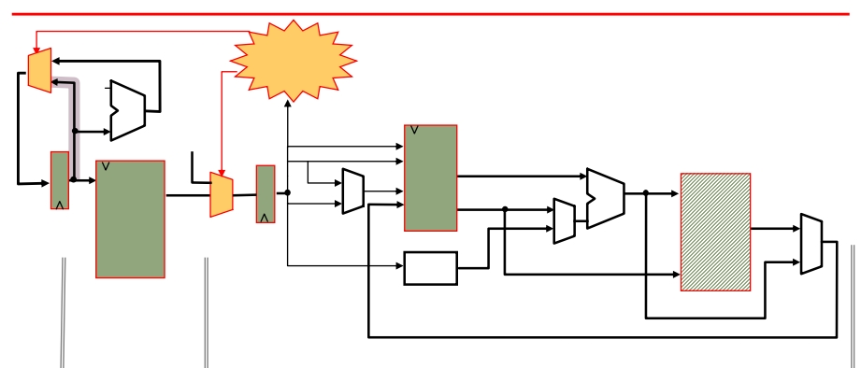
How to implement a stall?
stall?
0x4
Add
nop
we
PC
rs1
we
addr
rdata
wdata
IR
rs2
rd1
ws
we
wd rd2
ALU
addr
Memory
GPRs
rdata
Ext
Memory
Imm
wdata
fetch
phase
execute phase
Don’t fetch a new instruction and don’t change the PC
insert a nop (compiler way)

Slide 18
An example of an NOP
sll $0 $0 (in MIPS)

Slide 19
Simple Example (no bubbles)
add r3, r2, r1
add r6, r5, r4
C1 C2 C3 C4 C5 C6 C7 C8
IF1 ID1 IE1 IM1 IWB1
IF2 ID2 IE2 IM2 IWB2

Slide 20
Simple Example (2 bubbles)
add r3, r2, r1
add r6, r5, r3
C1 C2 C3 C4 C5 C6 C7 C8
IF1 ID1 IE1 IM1 IWB1
IF2 ID2 ID2 ID2 IE2 IM2 IWB2

Slide 21

Control Hazard and NOPs
time
t0 t1
IF₁ ID₁ IF₂
t2 t3 t4 t5 t6 EX₁ MA₁ WB₁
ID₂ EX₂ MA₂ WB₂
IF₃ nop nop nop nop
IF₄ ID₄ EX₄ MA₄ WB₄
t7 . . . .
(I₁) 096: ADD
(I₂) 100: J 200
(I₃) 104: ADD
(I₄) 304: ADD
 |  | time
 |  | t0 | t1 | t2 | t3 | t4 | t5 t6 | t7 . . . .
Resource Usage | IF ID EX MA WB | I₁ | I₂ I₁ | I₃ I₂ I₁ | I₄ nop I₂ I₁ | I₅ I₄ nop I₂ I₁ | I₅ nop I₄ I₂ nop nop ⇒ | I₅ I₄ I₅ pipeline bubble
I₄ I₅

Slide 22
What happens to the speedup?
Speedup = CPI unpipelined = CPI unpipelined
---------------------- -------------------------------------
CPI pipelined ideal CPI + stalls/instructions
Ideal CPI=1, assume stages are perfectly balanced

Slide 23
Data Hazard Detector and stalls
Execute to decode:
EX/MEM.RegisterRd = ID/EX.RegisterRs
EX/MEM.RegisterRd = ID/EX.RegisterRt
Memory to decode:
MEM/WB.RegisterRd = ID/EX.RegisterRs
MEM/WB.RegisterRd = ID/EX.RegisterRt
what about instructions that do not write into the registers?

Slide 24
Bypassing
Route data as soon as possible after it is calculated to the earlier pipeline stage

Slide 25
Bypassing/forwarding: Updated Datapath
NextPC
ID/EX
EX/MEM
MEM/WR
mux
Registers
ALU
Data
Memory
mux
mux
Immediate

Slide 26
How does it help?
Time (clock cycles)
I
n
s
t
r.
O
r
d
e
r
add r1,r2,r3
Ifetch
Reg
ALU
DMem
Reg
lw r4, 0(r1)
Ifetch
Reg
ALU
DMem
Reg
sw r4,12(r1)
Ifetch
Reg
ALU
DMem
Reg
or r8,r6,r9
Ifetch
Reg
ALU
DMem
Reg
xor r10,r9,r11
Ifetch
Reg
ALU
DMem
Reg

Slide 27
Does it help always?
Time (clock cycles)
I
n
s
t
r.
O
r
d
e
r
lw r1, 0(r2)
Ifetch
Reg
DMem
Reg
ALU
sub r4,r1,r6
Ifetch
Reg
ALU
DMem
Reg
and r6,r1,r7
Ifetch
Reg
ALU
DMem
Reg
or r8,r1,r9
Ifetch
Reg
ALU
DMem
Reg

