Slide 1
CS230: Digital Logic Design and Computer Architecture
Lecture 14: Mitigating Control Hazards
https://www.cse.iitb.ac.in/~biswa/courses/CS230/autumn23/main.html

Slide 2
What and Where? Control Hazard
What do we need to calculate next PC?
For Jumps
Opcode, offset, and PC
For Jump Register
Opcode and register value
For Conditional Branches
Opcode, offset, PC, and register (for condition)
For all others
Opcode and PC
In what stage do we know these?
PC - Fetch
Opcode, offset - Decode (or Fetch?)
Register value - Decode
Branch condition ((rs)==0) - Execute (or Decode?)

Slide 3
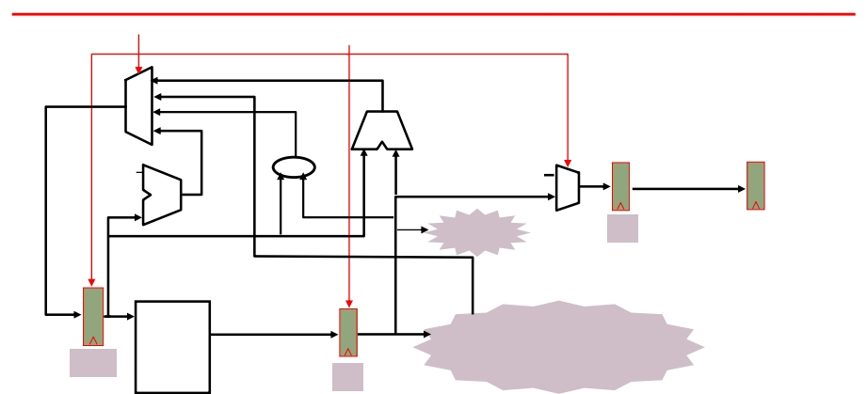
Speculate, PC=PC+4
PCSrc (pc+4 / target)
stall
Add
E M
0x4
nop
IR IR
Add
Jump?
I1
PC
addr
inst
Inst
Memory
IR
104
I
2
I1
096 ADD
What happens on mis-speculation, i.e., when next instruction is not PC+4?
I2
100 J304
I3
104 ADD
kill
How? Insert NOPs
I4
304 ADD

Slide 4
Conditional branches
I1
096 ADD
Branch condition is not known
until the execute stage
I2
100 BEQZ r1 200
I3
104 ADD
I4
304 ADD
Instructions between a branch instruction and the target are
in the wrong-path if the branch is not taken

Slide 5

Again (stalls/NOPs)
time
t0 t1 t2 t3 t4 t5 t6 t7 . . . .
(I1) 096: ADD IF1 ID1
EX1
MA1 WB1
(I2) 100: BEQZ 200 IF2
ID
2
EX2 MA2
WB2
(I3) 104: ADD IF3
ID3 nop nop nop
(I4)
108:
IF4 nop nop nop nop
(I5)
304: ADD
IF5
ID5 EX5 MA5 WB5
time
t0 t1 t2 t3 t4 t5 t6 t7 . . . .
IF I1 I2 ID I1
I3
I4
I5
I2
I3
nop I5
Resource
EX
I1
I2
nop nop I5
Usage
MA
I1
I2 nop nop I5
WB
I1
I2 nop nop I5

Slide 6
Branches: Taken/Not Taken and Target
Instruction Taken known? Target known?
After Inst. Decode After Inst. Decode
J
After Inst. Execute After Inst. Execute
BEQZ/BNEZ
what action should be taken in the decode stage?
Can we add an ALU in the decode stage?

Slide 7
What else can be done? Compiler?
Delayed branch: Define branch to take place AFTER a following instruction(used to be in early RISC processors)
branch instruction
sequential successor₁
sequential successor₂
........
sequential successor_{n}
branch target if taken
Branch delay of length n

Slide 8
Scheduling Branch Delay Slots
A. From before branch
add $1,$2,$3 if $2=0 then
delay slot
becomes
if $2=0 then
add $1,$2,$3
A is the best choice, fills delay slot & reduces instruction count (IC)

Slide 9
Scheduling Branch Delay Slots
A. From before branch B. From branch target
add $1,$2,$3 if $2=0 then
sub $4,$5,$6
delay slot
add $1,$2,$3 if $1=0 then
delay slot
becomes
becomes
if $2=0 then
add $1,$2,$3
add $1,$2,$3 if $1=0 then
sub $4,$5,$6
A is the best choice, fills delay slot & reduces instruction count (IC)

Slide 10
Scheduling Branch Delay Slots
A. From before branch B. From branch target
C. From fall through
add $1,$2,$3 if $1=0 then
add $1,$2,$3 if $2=0 then
sub $4,$5,$6
delay slot
delay slot
add $1,$2,$3 if $1=0 then
delay slot
sub $4,$5,$6
becomes
becomes
becomes
add $1,$2,$3 if $1=0 then
if $2=0 then
add $1,$2,$3
sub $4,$5,$6
add $1,$2,$3 if $1=0 then
sub $4,$5,$6
A is the best choice

Slide 11
Word of Caution!
Do not put a branch
in the branch delay slot ☹

Slide 12
Stalls and Performance
For a program with N instructions and S stall cycles,
Average CPI = N
---------
N

Slide 13
Stalls and Performance
For a program with N instructions and S stall cycles,
Average CPI = N+S
---------
N

Slide 14
New Pipeline Speedup
Pipeline Speedup = Pipeline Depth
----------------------------------------------------
1+pipeline stalls because of branches
Pipeline stalls (branches) = Branch frequency X penalty

Slide 15
Summary
Data Hazards
Bypassing/forwarding
Stalls (NOPs) – if no scope for bypassing
Control hazards
Speculate, PC=PC+4, kill the wrong path
Delayed branch with the help of branch delay slots, new pipeline speedup

Slide 16
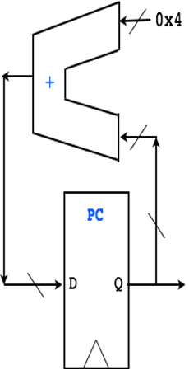




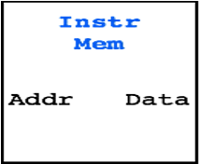
Branch instructions
IF (Fetch)
ID (Decode)
EX (ALU)
MEM
WB
I-Mem
Time:
t1
t2
t3
t4
t5
t6
t7
t8
Inst
EX stage computes if branch is taken
I1:
IF
ID
EX
MEM
WB
I2:
IF
ID
I3:
IF
I4:
If branch is taken, these instructions MUST NOT complete!
I5:
I6:

Slide 17
Branch Predictors
IF (Fetch)
ID (Decode)
EX (ALU)
MEM
WB
I-Mem
Branch Predictor
Time:
t1
t2
t3
t4
t5
t6
t7
t8
Inst
EX stage computes if branch is taken
Predictions
I1:
IF
ID
EX
MEM
WB
I2:
IF
ID
A control instr?
I3:
IF
I4:
Taken or Not Taken?
If taken, where to? What PC?
If branch is taken, these instructions MUST NOT complete!
I5:
I6:

Slide 18
A quick recap
What if PC=PC+4? Not TRUE
Flush/kill all the instructions in the wrong path.

Slide 19
Branch Prediction: 10K Feet View
Predict whether the next PC is a branch PC, at the fetch stage?

Slide 20
Branch Prediction: 10K Feet View
Predict whether the next PC is a branch PC, at the fetch stage?
If branch, will it be taken?

Slide 21
Branch Prediction: 10K Feet View
Predict whether the next PC is a branch PC, at the fetch stage?
If branch, will it be taken?
If taken, what is the target address?

Slide 22
Branch Prediction: 10K Feet View
Predict whether the next PC is a branch PC, at the fetch stage?
If branch, will it be taken?
If taken, what is the target address?
How?

Slide 23
Branch Prediction: 10K Feet View
Predict whether the next PC is a branch PC, at the fetch stage?
If branch, will it be taken?
If taken, what is the target address?
How?
We know whether it is a branch PC or not in the decode stage. Oh no ☹

Slide 24
Branch Predictor: A bit deeper
Three tasks
Is the PC a branch/jump? YES/NO
If Yes, can we predict the direction? Taken or not-taken
If taken, can we predict the target address?

Slide 25
Let’s see
Program
Counter
Address of the
current branch

Slide 26
Let’s see
Direction predictor
taken?
PC + 4
Next Fetch
Address
Program
Counter
Address of the
current branch

Slide 27
Let’s see
Direction predictor
taken?
PC + 4
Next Fetch
Address
Program
Counter
hit?
Address of the
current branch
target address
Repository of Target Addresses (BTB: Branch Target Buffer)

Slide 28
Static (compiler) Direction Prediction Techniques
Always not-taken: Simple to implement: no need for BTB,
no direction prediction
Low accuracy: ~30-40%
Always taken: No direction prediction, we need BTB though
Better accuracy: ~60-70%
Backward branches (i.e., loop branches) are usually taken

Slide 29
Dynamic Predictors
Microarchitectural way of predicting it.
Simple one: Last time predictor

Slide 30
Last-time predictor
predict
not
taken
predict
taken
actually
not taken
actually
taken

Slide 31
Last-time predictor
actually
taken
predict
not
taken
predict
taken
actually
not taken
actually
taken
actually
not taken

Slide 32
Implementation
K bits of branch instruction address
Index

Slide 33
Implementation
Branch history table of 2^{K} entries, 1 bit per entry
K bits of branch instruction address
Index

Slide 34
Implementation
Branch history table of 2^{K} entries, 1 bit per entry
K bits of branch instruction address
Index
Use this entry to predict this branch:
0: predict not taken
1: predict taken

Slide 35
Performance of Last-time predictor
TTTTTTTTTTNNNNNNNNNN - 90% accuracy
Always mispredicts the last iteration and the first iteration of a loop branch
Accuracy for a loop with N iterations = (N-2)/N
+ Loop branches for loops with large number of iterations
-- Loop branches for loops will small number of iterations

Slide 36
Performance contd.
TNTNTNTNTNTNTNTNTNTN → 0% accuracy
20% of all instructions are branches, 85% accuracy
Last-time predictor CPI =
[ 1 + (0.20*0.15) * 2 ] =
1.06 (minimum two stalls to resolve a branch)

