Slide 1
CS230: Digital Logic Design and Computer Architecture
Lecture 15: Branch Prediction and Interrupts/Exceptions
https://www.cse.iitb.ac.in/~biswa/courses/CS230/autumn23/main.html

Slide 2
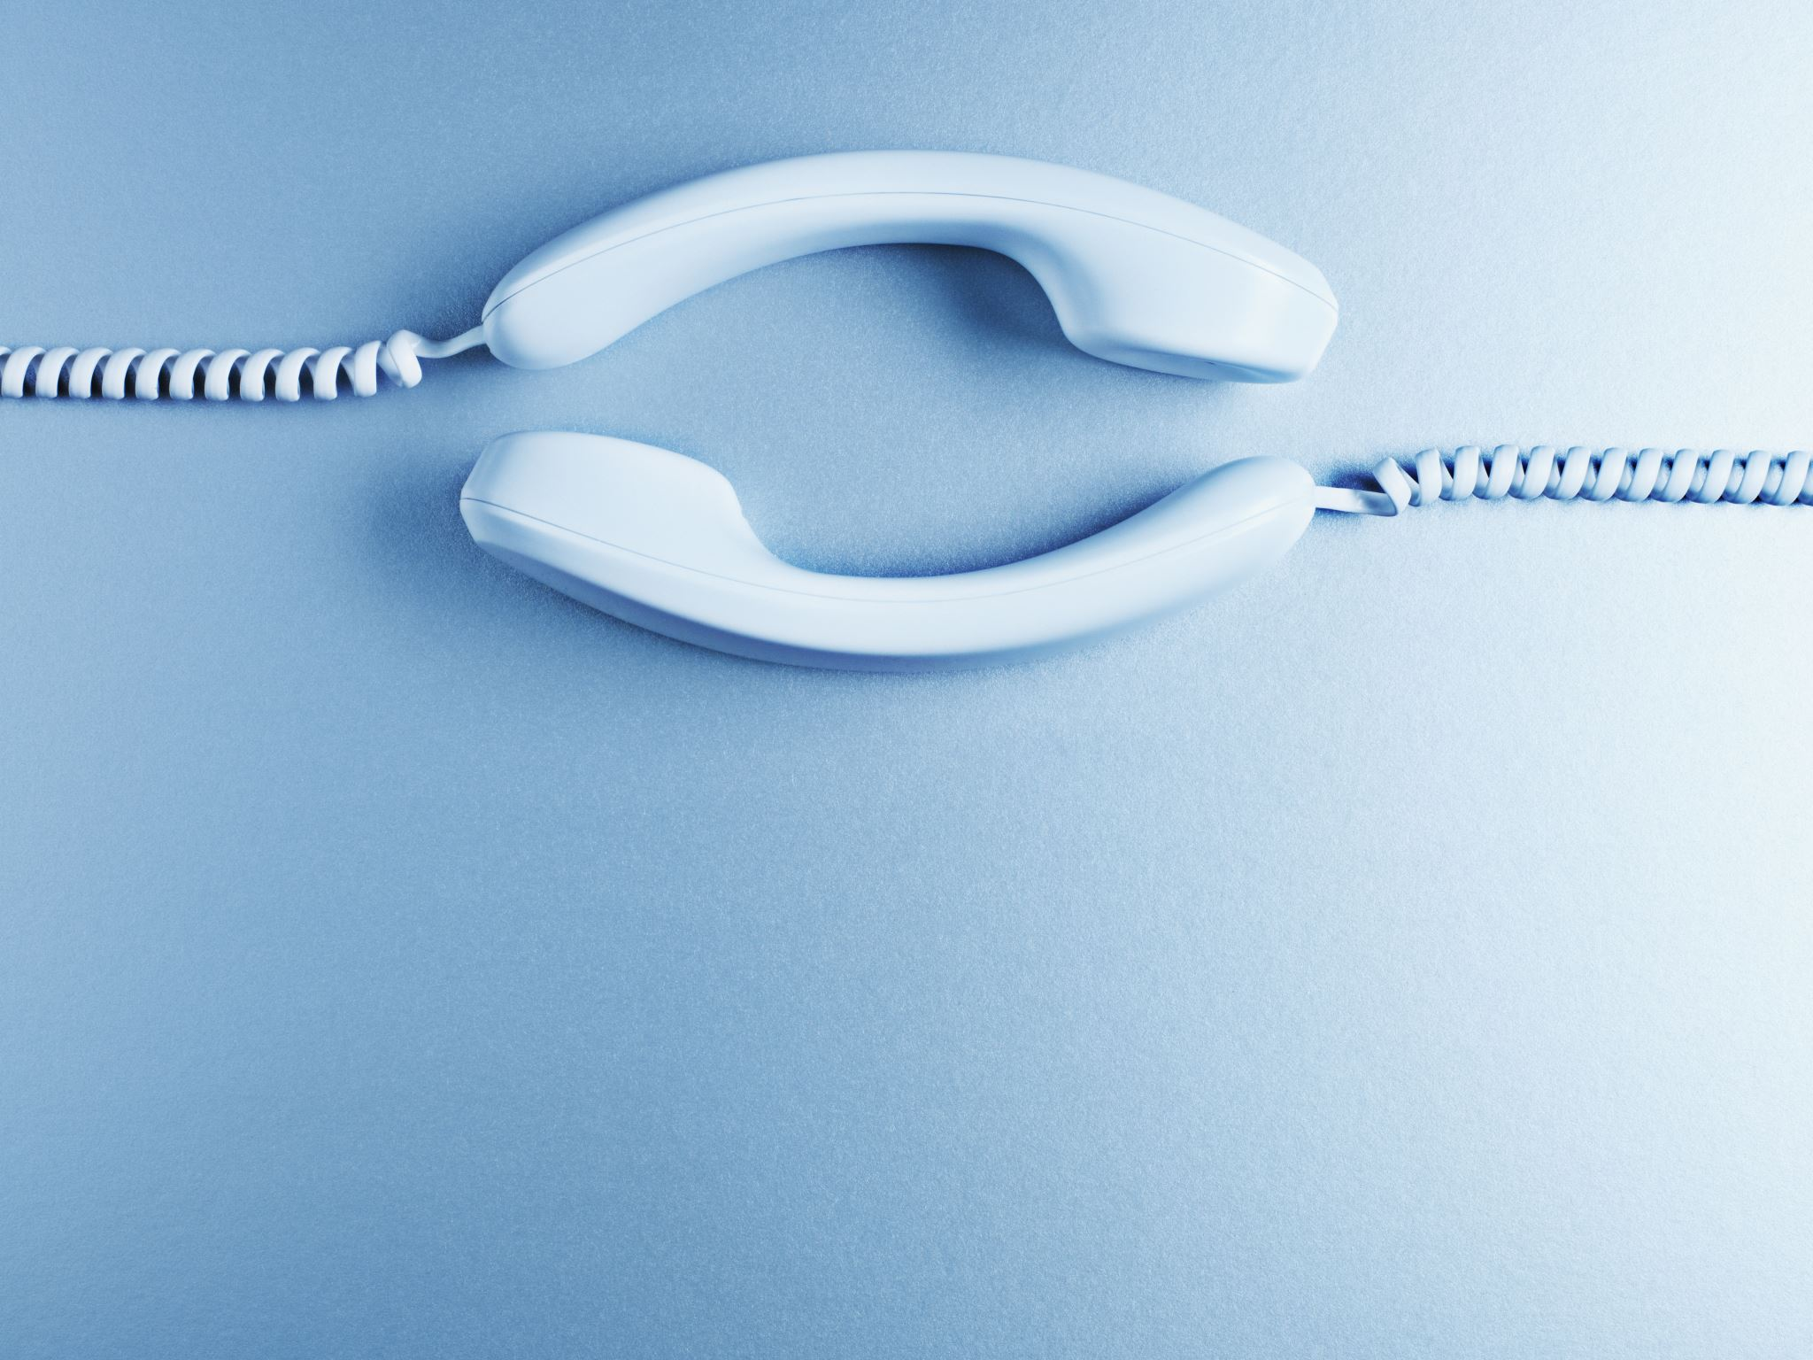
Phones (smart/non-smart) on silence plz, Thanks

Slide 3
2-bit Bimodal Predictors: A bit better
actually
taken
actually
!taken
2-bit saturating counter:
Values from 00 to 11
pred
Taken
11
pred
Taken
10
actually
taken
actually
taken
actually
!taken
actually
!taken
pred
!taken
01
pred
!taken
00
actually
!taken
Counter greater than
equal to 10,
prediction: taken
actually
taken

Slide 4
No history predictor: 2 bit predictor
k bit
(PC >> 2) &
(2^{p} -1)
2^{p}
Bimodal predictor: Good for biased branches

Slide 5
Local and global history
Local Behavior
What is the predicted direction of Branch A given the outcomes of previous instances of Branch A ?
Global Behavior
What is the predicted direction of Branch Z given the outcomes of all* previous branches A, B, …, X and Y?
Number of previous branches tracked limited by the history length

Slide 6
Two Level Branch Predictors
First level: Global branch history register (N bits)
The direction of last N branches
Second level: Table of saturating counters for each history entry
The direction the branch took the last time the same history was seen
1 1 ….. 1 0
GHR
(global history register)

Slide 7
Two Level Branch Predictors
First level: Global branch history register (N bits)
The direction of last N branches
Second level: Table of saturating counters for each history entry
The direction the branch took the last time the same history was seen
00 …. 00
1 1 ….. 1 0
00 …. 01
previous one
00 …. 10
GHR
(global history register)
index
11 …. 11
Pattern History Table (PHT)

Slide 8
Two Level Branch Predictors
First level: Global branch history register (N bits)
The direction of last N branches
Second level: Table of saturating counters for each history entry
The direction the branch took the last time the same history was seen
00 …. 00
1 1 ….. 1 0
00 …. 01
2
3
previous one
00 …. 10
GHR
(global history register)
index
0
1
11 …. 11
Pattern History Table (PHT)

Slide 9
GHR per branch
m bit
k bit
00 …. 00
00 …. 01
00 …. 10
2^{p}
1 1 ….. 1 0
2^{m}
11 …. 11
BHT
PHT
(PC >> 2) &
(2^{p} -1)
BHT: Branch history table
Mostly K=2, m =12 for example

Slide 10
Set of branches: One register for correlated ones
m bit
k bit
00 …. 00
00 …. 01
00 …. 10
2^{p}
2^{m}
1 1 ….. 1 0
B1: if (aa == 2) aa = 0;
B2: if (bb == 2); bb=0;
B3: if (aa != bb) { … }
11 …. 11
BHT
PHT
(PC %
2^{p} )
Can lead to positive/negative/neutral interference

Slide 11
Gshare is the answer
k bit
m bit
00 …. 00
1 1 ….. 1 0
00 …. 01
00 …. 10
2^{m}
PC >>2 & 2^{m} -1
11 …. 11
For a given history and for a given branch (PC) counters are trained

Slide 12
Few Important Points
Branch prediction happens at the IF stage.
We know the target outcome at the end of EX stage.
So BHT and PHT will be updated after EX stage for the corresponding PC. Any issues here?

Slide 13
Issue
I1 F D E
I2 F D E
I3 F D E
Lets assume I1 and I3 are branch instructions. I1 will update BHT and PHT in E stage, and I3 will probe BHT and PHT in F stage. To make sure PHT is updated correctly with the correct BHT entry, BHT entry is communicated till the E stage.

Slide 14
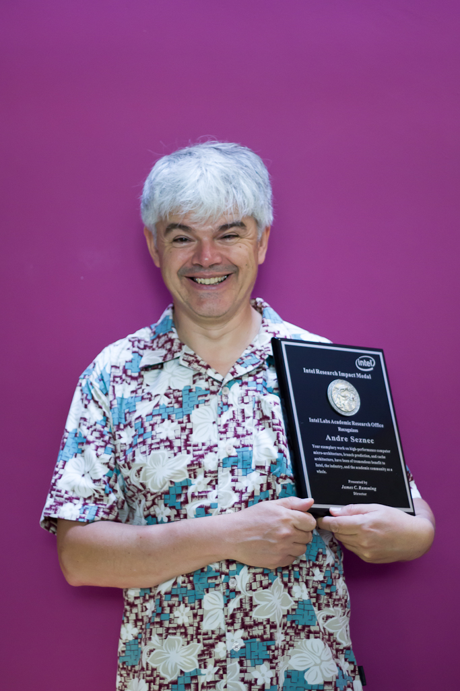
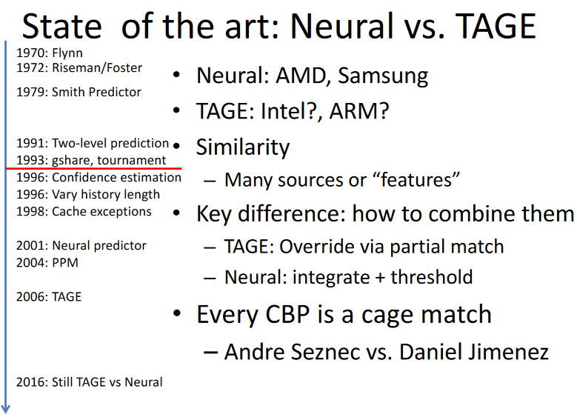
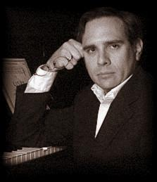
State-of-the-art

Slide 15
BTB (Target Address Predictor)
Address of branch instruction
Branch instruction
0b0110[...]01001000
BNEZ R1 Loop
BTB is probed in the fetch stage along with the direction predictor.
A hit in the BTB means the PC is a branch PC.
Branch
History Table
(BHT)
Branch Target Buffer (BTB)
30-bit address tag
target address
2 state bits
0b0110[...]0010
PC + 4 + Loop

Slide 16
Exception/Interrupt
An unscheduled event that disrupts program (instructions) in action.

Slide 17
Interrupt Handling
I_{i-1}
HI₁
interrupt
handler
program
I_{i}
HI₂
I_{i+1}
HI_{n}
An external or internal event that needs to be processed. The event is usually unexpected or rare from program’s point of view.

Slide 18
Causes
Asynchronous: an external event
input/output device service-request
timer expiration
power disruptions, hardware failure
Synchronous: an internal event (a.k.a. traps or exceptions)
undefined opcode, privileged instruction
arithmetic overflow, FPU exception, misaligned memory access
virtual memory exceptions: page faults, TLB misses, protection violations
system calls, e.g., jumps into kernel

Slide 19
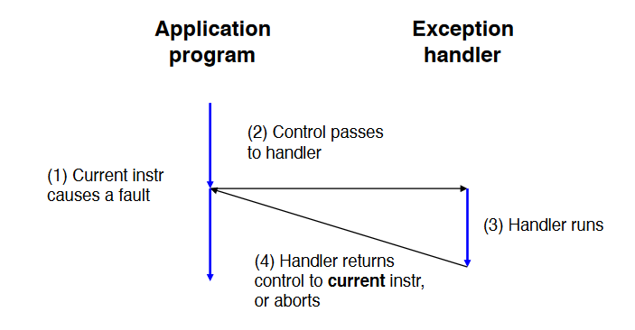
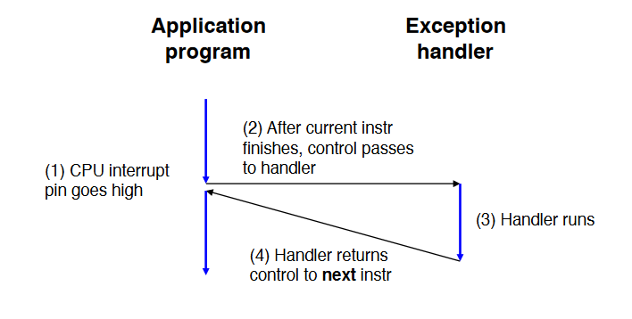
Interrupt and Exception

Slide 20
Interrupt Handler
Exception program counter (EPC): address of the offending instruction,
Saves EPC before enabling interrupts to allow nested interrupts
Need to mask further interrupts at least until EPC can be saved
Need to read a status register that indicates the cause of the interrupt

Slide 21
Handshake between processor and the OS
Processor:
stops the offending instruction,
makes sure all prior instructions complete,
flushes all the future instructions (in the pipeline)
Sets a register to show the cause
Saves EPC
Jumps to pre-decided address (cause register or vectored)
Disables further interrupts

Slide 22
Handshake between processor and the OS
OS:
Looks at the cause of the exception
Handles the interrupt/exception
Interrupt handler saves the GPRs
Calls RFE

Slide 23
Contd.
Uses a special indirect jump instruction RFE (return-from-exception) which
enables interrupts
restores the processor to the user mode

