Slide 1
CS230: Digital Logic Design and Computer Architecture
Lecture 17: Empirical evaluation and Memory Hierarchy
https://www.cse.iitb.ac.in/~biswa/courses/CS230/autumn23/main.html

Slide 2
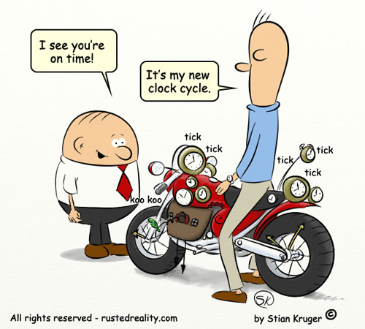
Empirical Evaluation
Benchmarks
Metrics
Simulators
Latency and bandwidth

Slide 3
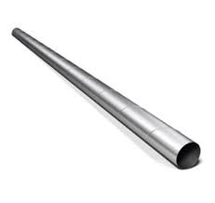
Performance
• Latency (execution/response time): time to finish one task. It is additive (Performance = 1/latency)
• Throughput (bandwidth): number of tasks/unit time. It is not additive
• Latency lags bandwidth, Bandwidth hurts latency,
Read: https://cacm.acm.org/magazines/2004/10/6401-latency-lags-bandwith/fulltext
3

Slide 4
Latency vs bandwidth
Latency vs Bandwidth, How they affect each other?
Latency helps bandwidth but not vice versa.
DRAM latency
More # Accesses ~DRAM Bandwidth
Bandwidth usually hurts latency
Queues - Bandwidth
Increases latency

Slide 5
For the curious ones
Bandwidth problems can be cured with money.
Latency problems are harder because the speed of light is fixed – you can’t bribe God
https://www.youtube.com/watch?list=PL2LuePcZTMh_MzNHqZWNdvWdAnAThHCKK&v=lfqgpuH10uc&feature=emb_logo
https://www.youtube.com/watch?v=GNK-67JUH7M&list=PL2LuePcZTMh_MzNHqZWNdvWdAnAThHCKK&index=2
https://www.youtube.com/watch?v=5CxpoGwCxKU&list=PL2LuePcZTMh_MzNHqZWNdvWdAnAThHCKK&index=3
Some of the major bottlenecks: latency and bandwidth bottlenecks

Slide 6
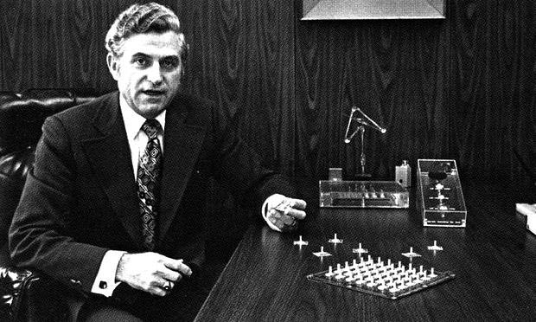
Amdahl’s Law (common case fast)
Execution Time _{old}
-------------------------------------------
Execution Time _{new}
Speedup _{overall}
=
1
---------------------------------------------------------------------------------------
(1 – Fraction _{enhanced}) + Fraction _{enhanced}
------------------------------------
Speedup
^{enhanced}
=

Slide 7
Amdahl’s Law
Which one will provide better overall speedup?
Small speedup on the large fraction of execution time.
Large speedup on the small fraction of execution time.
Does not matter.
Depends on the difference between small and large. Mostly it is A.

Slide 8


Evaluation
To compare Processor A with Processor B by running programs
How many programs?
The programs that you care.
What if I want to build a new one (processor, caches, DRAM) ?

Slide 9
World of Benchmarks
SPEC CPU 2017 (https://www.spec.org/cpu2017/)
The SPEC CPU® 2017 benchmark package contains SPEC's next-generation, industry-standardized, CPU intensive suites for measuring and comparing compute intensive performance, stressing a system's processor, memory subsystem and compiler.
SPECspeed: used for comparing time for a computer to complete single tasks
SPECrate: measure the throughput or work per unit of time.

Slide 10
World of Benchmarks
CloudSuite (https://www.cloudsuite.ch/)
CloudSuite is a benchmark suite for cloud services. The benchmarks are based on real-world software stacks and represent real-world setups.
PARSEC (https://parsec.cs.princeton.edu/)
Benchmark suite composed of multithreaded programs. The suite focuses on emerging workloads and was designed to be representative of next-generation shared-memory programs for chip-multiprocessors.

Slide 11
World of Benchmarks
MobileBench (https://mobilebench.engineering.asu.edu/)
comprising a selection of representative smart phone applications.
Many more application domain specific: Graph processing, ML perf,

Slide 12
Pitfalls of Benchmarks
Benchmark not representative of all
Your workload is I/O bound → SPECCPU is useless
Benchmark is too old
Need to be periodically refreshed

Slide 13
Non-benchmarks
Application kernels: A small code fragment or part of the program
Synthetic benchmark : Not part of any real program!!
Micro-benchmark
OK! So, I will create a chip and then evaluate these benchmarks

Slide 14
World of Simulators
Functional Simulator: Used to verify the correct execution of the program. Can not be used for performance evaluation.
Performance simulators:
Trace-driven: ChampSim (https://github.com/ChampSim/ChampSim)
Execution-driven: gem5, Multi2sim
Functional simulator is part of the performance simulators.

Slide 15
Evaluation Continued
Pick a relevant benchmark suite
Measure IPC of each program
Summarize the performance using:
Arithmetic Mean (AM)
Geometric Mean (GM)
Which one to choose?
Harmonic Mean (HM)

Slide 16
Example
IMTEL
ABM
AND
App. one
10
20
30
App. two
20
30
40
App. three
30
40
10
Which machine performs better over IMTEL and why?

Slide 17

Contd.
ABM
AND
App. one
2
3
App. two
1.5
2
App. three
1.3
0.3
A.M.
1.60
1.76
G.M.
1.57
1.21
H.M.
1.54
0.72

Slide 18

AM on ratios (use always GM on ratios)
 | X | Y
App. 1 | 1 | 100
App. 2 | 1000 | 10
Normalized to X | X | Y
App. 1 | 1 | 100
App. 2 | 1 | 0.01
AM | 1 | 50.005
Y is 50 times faster than X
Normalized to Y | X | Y
App. 1 | 0.01 | 1
App. 2 | 100 | 1
AM | 50.005 | 1
X is 50 times faster than Y

Slide 19

Time for Memory Hierarchy

Slide 20
The Ideal World
Pipeline
(Instruction
execution)
Instruction
Supply
(Fetch stage)
Data
Supply
(Memory stage)
- Zero-cycle latency
- Infinite capacity
- Perfect control flow
Zero-cycle latency
Infinite capacity
- Infinite bandwidth

Slide 21
World of Memory Hierarchy: Why?
Before that What is memory?

Slide 22
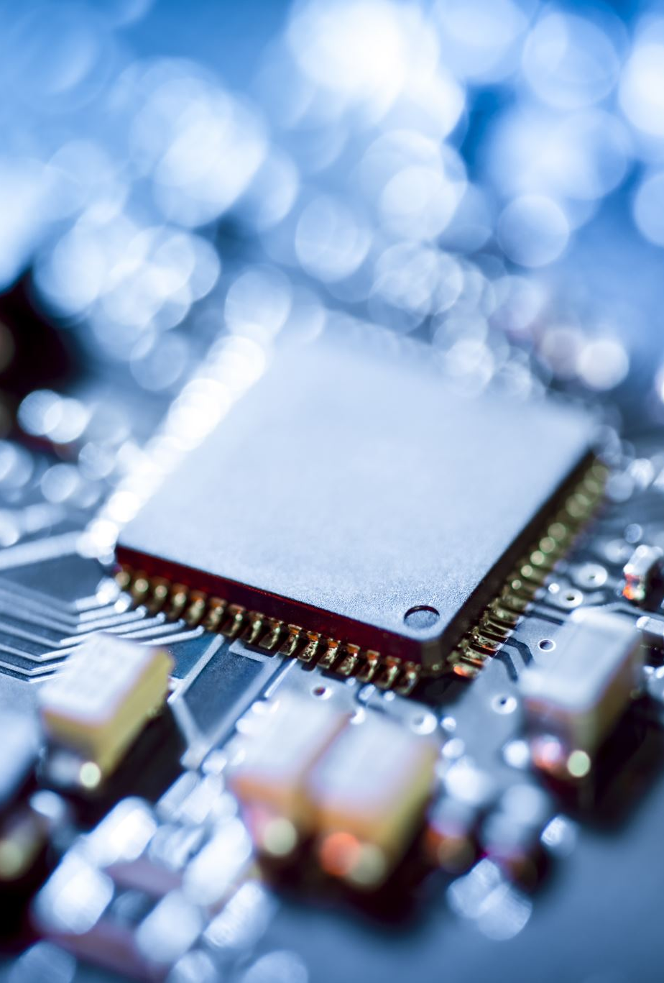
Semiconductor Memory
Semiconductor memory began to be competitive in early 1970s
Intel formed to exploit market for semiconductor memory
Early semiconductor memory was Static RAM (SRAM). SRAM cell internals similar to a latch (cross-coupled inverters).
First commercial Dynamic RAM (DRAM) was Intel 1103
1Kbit of storage on single chip
charge on a capacitor used to hold value

Slide 23
One transistor DRAM
1-T DRAM Cell
Denser
word
access transistor
Value kept in one cell is as
per the charge in the capacitor
V_{REF}
bit
Storage
capacitor
Need to be refreshed periodically to maintain the charge
So dynamic RAM (DRAM)

Slide 24
DRAM
Dynamic random-access memory
Capacitor charge state indicates stored value
Whether the capacitor is charged or discharged indicates storage of 1 or 0
1 capacitor
1 access transistor
Capacitor leaks
DRAM cell loses charge over time
DRAM cell needs to be refreshed

Slide 25
SRAMs (6T to 8T)
Static RAMs. No need of refresh as no capacitor.
Faster access (no capacitor)
Density low as 6T: 1 bit compared to 1T: 1bit in DRAM
Costly than DRAM

Slide 26
The Problem
Bigger is slower
SRAM, 512 Bytes, sub-nanosec
SRAM, KByte~MByte, ~nanosec
DRAM, Gigabyte, ~50 nanosec
Hard Disk, Terabyte, ~10 millisec
Faster is more expensive (dollars and chip area)
SRAM, < 1000$ per GB
DRAM, < 20$ per GB
Hard Disk < 0.01$ per GB
These sample values scale with time
Other technologies have their place as well
Flash memory, NVRAM, MRAM etc

Slide 27
Size affects latency
CPU
Big Memory
CPU
Small Memory
Signals have further to travel
Fan out to more locations

Slide 28
Why Memory Hierarchy
We want both fast and large
But we cannot achieve both with a single level of memory
Idea: Have multiple levels of storage (progressively bigger and slower as the levels are farther from the processor) and ensure most of the data the processor needs is kept in the fast(er) level(s)

Slide 29
Welcome to Memory Hierarchy
Big, Slow Memory
(DRAM)
A
Small,
Fast Memory
(RF, SRAM)
B
CPU
holds frequently used data
capacity: Register << SRAM (Cache) << DRAM
latency: Register << SRAM (Cache) << DRAM
bandwidth: on-chip >> off-chip
On a data access:
if data ∈ fast memory ⇒ low latency access Cache
if data ∉ fast memory ⇒ high latency access DRAM

Slide 30
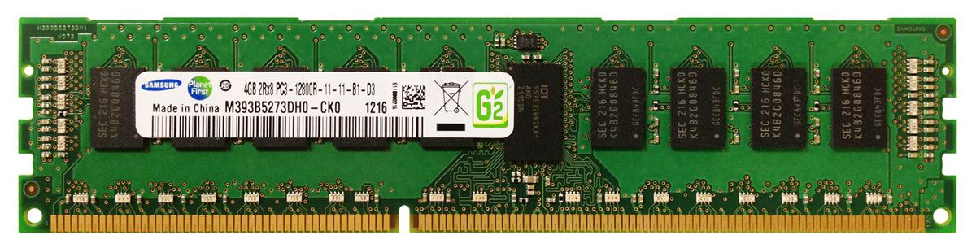
World with no caches
North pole ☹
32-bit Address
Core
Data
200 to 300 cycles
Costly DRAM accesses☹
Minimizing costly DRAM accesses is critical for performance
4 GB DRAM
South pole ☹

