Slide 1
CS230: Digital Logic Design and Computer Architecture
Lecture 18: Cash, no; Caches
https://www.cse.iitb.ac.in/~biswa/courses/CS230/autumn23/main.html

Slide 2
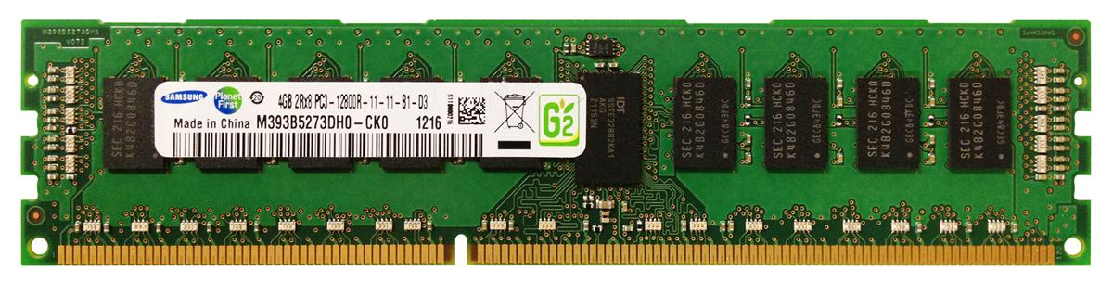
World with no caches
North pole ☹
32-bit Address
Core
Data
200 to 300 cycles
Costly DRAM accesses☹
Minimizing costly DRAM accesses is critical for performance
4 GB DRAM
South pole ☹

Slide 3
Remember Latency and Bandwidth
Core
Latency
Bandwidth

Slide 4
Latency ☹
Bandwidth problems can be cured with money.
Latency problems are harder because the speed of light is fixed – you can’t bribe God

Slide 5
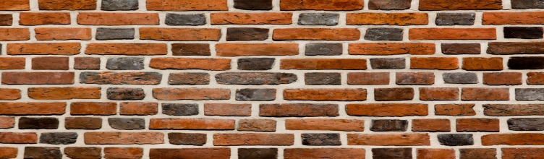
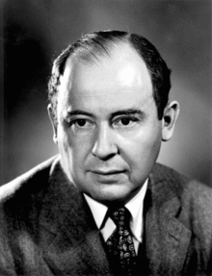
Why access memory?
Core
DRAM Contr.
200 Cycles
CPU
Memory stores CODE and DATA
Processor accesses for LOADs (reads) and STOREs(writes)
Memory Wall: Grandmother of all the walls ☺

Slide 6


Do not ignore the common case mantra
Reduction in DRAM accesses ~ Improvement in execution time
WRONG!
First Law of Performance:
Make the common case fast
What if your program is not memory intensive

Slide 7
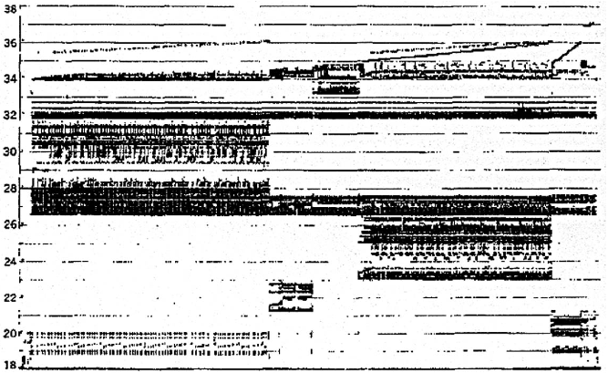
Let’s look at the Applications (benchmarks)
Memory Address (one dot per access)
Donald J. Hatfield, Jeanette Gerald: Program Restructuring for Virtual Memory. IBM Systems Journal 10(3): 168-192 (1971)
Time

Slide 8
Oh Yes locality
Temporal
Locality
Memory Address (one dot per access)
Spatial
Locality
Donald J. Hatfield, Jeanette Gerald: Program Restructuring for Virtual Memory. IBM Systems Journal 10(3): 168-192 (1971)
Time

Slide 9
Few Examples
Address
n loop iterations
Instruction
fetches
subroutine call
subroutine return
Stack
accesses
argument access
vector access
Data
accesses
scalar accesses
Time

Slide 10
Caching: 10K Feet View
North pole ☺
Address
Address
Core
$
Data
Data
200 to 300 cycles
Costly DRAM accesses☹
Caching is a speculation technique ☺
Works – if locality

Slide 11
Caching: 10K Feet View
North pole ☺
Address
Address
Core
$
Data
Data
200 to 300 cycles
Costly DRAM accesses☹
Caching is a speculation technique ☺
Works – if locality

Slide 12
How big/small?
$
Core
$
Latency: low
Area: low
Capacity: low
Latency: high
Area: high
Capacity: high

Slide 13
1K Feet View of an O3 core: A bit Deeper
Bottleneck
DRAM: 300 cycles
1. LOAD
1. LOAD ☹
1 cycle ☺
2. SUB
2. SUB ☹
3. LOAD
300 cycles
3. LOAD ☹
4. LOAD
300 cycles
4. LOAD ☹
5. MUL
2 cycles ☺
5. MUL☹
In-order Instruction Fetch
(Multiple fetch in one cycle)
Processor core says all LOADs should take one cycle. Ehh!

Slide 14
Impact of one DRAM access
DRAM: 100ns (16 instructions per ns)
1. LOAD
2. SUB
4-fetch and issue processor running at 4GHz (0.25ns)
3. LOAD
4. LOAD
.
.
.

Slide 15
Impact of one DRAM access
DRAM: 100ns (16 instructions per ns)
1. LOAD
2. SUB
4-fetch and issue processor running at 4GHz (0.25ns)
3. LOAD
4. LOAD
#instructions can get executed during one DRAM access: 1600 ☹ ☹
.
.
.

Slide 16
Cache with latency
North pole ☺
Address
Address
Core
$
Data: 1 cycle
Data
200 to 300 cycles
Costly DRAM accesses☹
32 to 64KB $ will be available in one to four cycles ☹
South pole ☺

Slide 17
Cache hierarchy with latency
North pole ☺
$
$
Core
Address
$
Address
Address
Data: 1 cycle
10 cycles
30 cycles
10s of KBs
100s of KBs
1000s of KBs
Multi-level cache hierarchy
South pole ☺

Slide 18
Cache hierarchy with latency
North pole ☺
$
$
Core
Address
$
Address
Address
Data: 1 cycle
10 cycles
30 cycles
10s of KBs
100s of KBs
1000s of KBs
Multi-level cache hierarchy
How many levels ?
Total latency < DRAM latency
South pole ☺

Slide 19
Takeaway
L1 $
Latency and bandwidth (multiple ports)
L2 $
L3 $

Slide 20
Takeaway
L1 $
Latency and bandwidth (multiple ports)
L2 $
Latency
L3 $

Slide 21
Takeaway
L1 $
Latency and bandwidth (multiple ports)
L2 $
Latency
L3 $
Capacity

Slide 22
Accessing a cache
One byte
Core

Slide 23
Bytes to blocks (lines)
One byte
One line
Core
Typical line size: 64 to 128 Bytes

Slide 24
A bit deeper: 1024 lines each of 32B
4 GB DRAM
One byte
Line 0
Address (32-bit)
One line
Core
Line 1023

Slide 25
A bit deeper: 1024 lines each of 32B
4 GB DRAM
One byte
Line 0
Address (32-bit)
One line
Core
Line 1023
Line number (index): 10 bits
Byte offset (offset): 5 bits

Slide 26
Direct Mapped Cache
Tag
Index
Offset
Line 0
Line 512
byte
.
.
.
Line 1023

Slide 27
Direct Mapped in Action
31
14
5
0
Cache Tag
Cache Index
Byte Select
Ex: 0x50
Ex: 0x01
Ex: 0x00
Valid Bit
Cache Tag
Cache Data
Byte 31
:
Byte 1
Byte 0
0
0x50
Byte 63
:
Byte 33
Byte 32
1
2
3
:
:
:
Byte 1023
:
Byte 992
1023

Slide 28
What if we have multiple ways?
Tag
Index
Offset
One byte
Tag
Line 0
Set 0
Tag
Tag
Set 511
byte
Tag
Line 1023

Slide 29
2-way associative in action
31
14
5
0
Cache Tag
Cache Index
Byte Select
Valid
Cache Tag
Cache Data
Cache Data
Cache Tag
Valid
Cache Block 0
Cache Block 0
:
:
:
:
:
:
Compare
Sel1
1
Mux
0
Sel0
Compare
OR
Hit
Cache Block

Slide 30
4-way associative: Just a better picture
Tag
Index
V
Tag
Data
V
Tag
Data
V
Tag
Data
V
Tag
Data
0
1
2
.
.
.
255
0
1
2
.
.
.
255
0
1
2
.
.
.
255
0
1
2
.
.
.
255
4x1 select
Hit
Data

Slide 31
Extreme: One cache, one set, fully associative
Tag
Offset
One byte
Tag
Line 0
Tag
byte
Tag
Tag
Line 1023

Slide 32
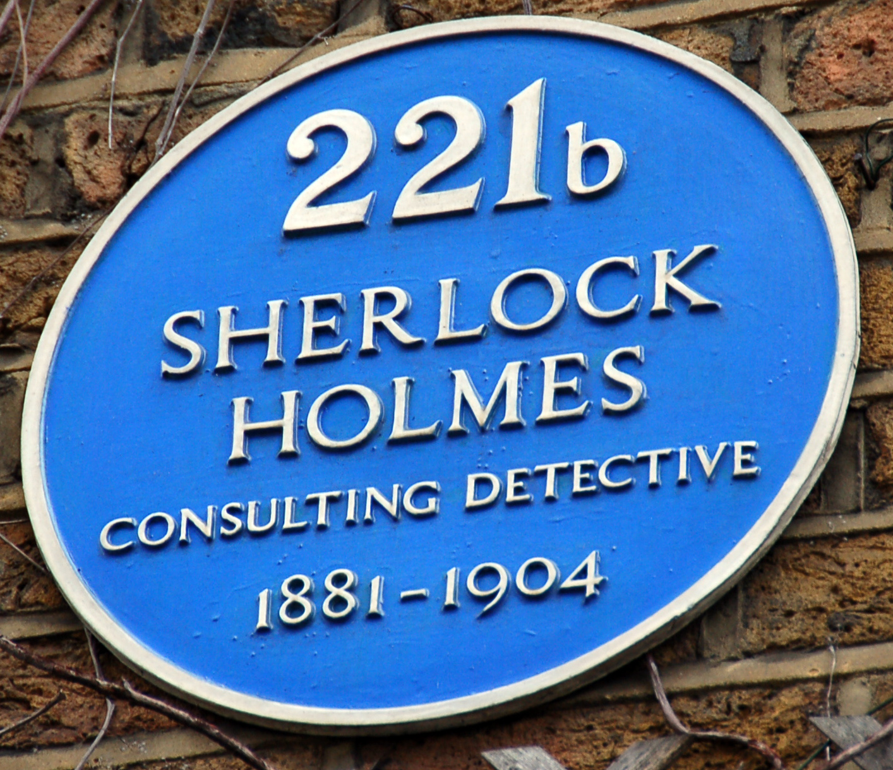
A bit different way
Baker Street: Cache Index ☺
221b: Tag bits ☺
Sherlock Holmes: Byte offset ☺ ☺

