Slide 1
CS230: Digital Logic Design and Computer Architecture
Lecture 20: Caches-III
https://www.cse.iitb.ac.in/~biswa/courses/CS230/autumn23/main.html

Slide 2
Cache Performance
How good is the cache for a given application?
Hit rate
Miss rate
Misses per kilo instructions (MPKI)
But Why?

Slide 3
Average Access Time
On average, how much time it takes for a LOAD to complete
Average memory access time (AMAT) =
Hit time + Miss rate x Miss penalty
Hit time-L1 + Miss rate-L1 x Miss penalty-L1
Miss penalty-L1 = Hit time-L2 + Miss rate-L2 x Miss penalty-L2
Hit time: Low, Miss rate: Low , Miss penalty: Low
Ideally, miss rate = 0.00% and hit time should be one cycle, so all LOADs will take just one cycle ☺

Slide 4
The Implications of L1-D Hit rate of 100%
Bottleneck
DRAM: 300 cycles
1. LOAD
1. LOAD
1 cycle ☺
2. SUB
2. SUB ☹
3. LOAD
L3 Cache: 30 cycles
3. LOAD ☹
4. LOAD
L1 Cache: 5 cycles ☺
4. LOAD ☹
5. MUL
2 cycles ☺
5. MUL☹

Slide 5
A Dreamy World
Yippee
L1 Cache: 5 cycles ☺
1. LOAD
1. LOAD ☺
1 cycle ☺
2. SUB
2. SUB ☺
3. LOAD
L1 Cache: 5 cycles ☺
3. LOAD ☺
4. LOAD
L1 Cache: 5 cycles ☺
4. LOAD ☺
5. MUL
2 cycles ☺
5. MUL☺

Slide 6
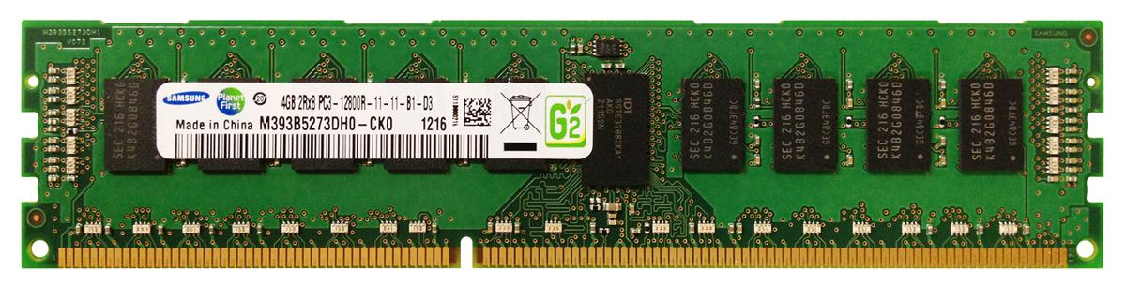
Core, cache, DRAM interaction
L1-I
L1-D
$$❶$$
…
$$❷$$
Core
Back-end
data
Front-end
(code)
❸
Unified
L2/LLC
❹

Slide 7
Core, cache, DRAM interaction
Core
LOAD X
$

Slide 8
Core, cache, DRAM interaction
Hit
Core
LOAD X
$
Data
Few cycles

Slide 9
On a miss: Critical Word first
Miss
Core
LOAD X
$
Data
On a miss, respond with the word/byte requested to the core so that core can continue while fetching the rest of the block

Slide 10
On a miss: Early Restart
Miss
Core
LOAD X
$
Data
On a miss, fetch the words/bytes in normal order, but as soon as the requested word/byte of the block arrives, send it to the core.

Slide 11

Core, cache, DRAM interaction
Miss
Core
LOAD X
$
Data
100s of cycles
One cache miss and can’t handle anymore misses
I am an out-of-order core

Slide 12
MSHRS (Miss-status holding registers)
X
Miss
Core
LOAD X
$
Data
Non-blocking cache

Slide 13
MSHRS (Miss-status holding registers)
X
Y
Miss
Core
LOAD Y
$
Data

Slide 14

MSHRS (Miss-status holding registers)
X
Y
Z
Miss
Core
LOAD Z
$
Data
K-entry MSHR allows K outstanding misses: provides memory-level parallelism

Slide 15
MSHRS (Miss-status holding registers)
X
Y
Z
Miss
Core
LOAD Z
$
Data
DRAM response time is not constant: can take from 60 cycles to 1000s of cycles (on a multi-core system).

Slide 16
MSHRS (Miss-status holding registers)
X
Y
Z
Miss
Core
LOAD Z
$
Data
DRAM response time is not constant: can take from 60 cycles to 1000s of cycles (on a multi-core system).

Slide 17
MSHRS (Miss-status holding registers)
X
Z
Miss
Core
LOAD Z
$
Data
DRAM response time is not constant: can take from 60 cycles to 1000s of cycles (on a multi-core system).

Slide 18
What about writes (stores)
On a hit: Update the cache block. We need an additional bit in tag-store, named dirty bit along with the valid bit and replacement priority bits.
Write-through cache: On a hit, write into a cache block and also into the next-level in the memory hierarchy
Write-back cache: On a hit, write into a cache block only, and during replacement update the next-level

Slide 19
What about writes: Writeback cache
Core
STORE Z
$
data
Z

Slide 20
What about writes: On replacement
Core
STORE Z
$
data
Write-back Buffer

Slide 21
Write-back cache
Core
STORE Z
$
data
Write-back Buffer
Write-back cache
In general, STOREs are not critical for performance. But why?

Slide 22
What about a write miss?
Z
Miss
Core
STORE Z
$
LOAD Z
STORE gets converted to a LOAD,
and data is allocated into the cache (write-allocate policy).
Usually write-allocate is used with the write-back caches.

Slide 23
The Bigger Picture
CPU time = CPU execution cycles + Memory-stall cycles
Clock cycle time may be different
Memory-stall cycles = Read-stalls + Write-stalls
Read/Write stalls =
#Reads/writes X Read/Write miss-rate X Read/write miss-penalty

Slide 24

Latency Hiding Technique

Slide 25
Hardware Prefetching
HIT
❺
Core
X+3
❸
$
X+2
❹
X+1
X+3
X
❷
❶
Prefetcher

Slide 26
10K Feet View
What?
Latency-hiding technique - Fetches data before the core demands.
Why?
Off-chip DRAM latency has grown up to 400 to 800 cycles.
How?
By observing/predicting the demand access (LOAD/STORE) patterns.

Slide 27
Prefetch Degree
Prefetch Degree: Number of prefetch requests to issue at a given time.
Demand
Access
L2
X
Prefetcher
L3/DRAM
X+1
X+1
X+2
X+1
X+2
X+3
X+4

Slide 28
Prefetch Distance
Prefetch Distance: How far ahead of the demand access stream are the prefetch requests issued?
demand access
prefetch
X
Y
Prefetch-distance
Y
= X + 4
Y
= X + 8
Y
= X + 16

Slide 29
Next-line prefetcher
Next Line: Miss to cache block X , prefetch X+1. Degree=1, Distance=1
Works well for L1 Icache and L1 Dcache.

Slide 30
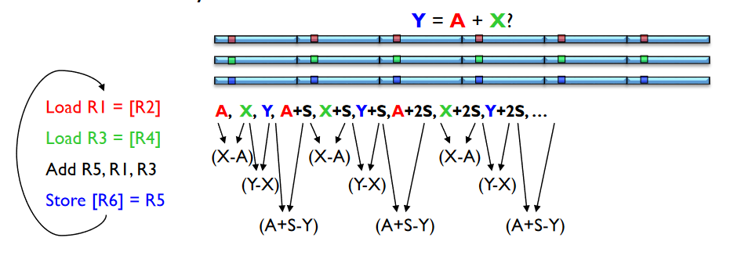
What About this?

Slide 31
Example
for (i = 0; i < N; i=i+16)
sum +=c[i];
IP_{X}: LOAD
Cache line size of 64B
L0
L1
L2
L3
L4
L5
L6
...
c[0]
c[16]
c[32]
c[48]

Slide 32
IP-stride prefetcher
PC
effective address
-
instruction tag
previous address
stride
state
+
prefetch address

Slide 33
Metrics of interest
Accuracy
Coverage
Timeliness

