Slide 1
CS230: Digital Logic Design and Computer Architecture
Lecture 21: Multicore-Caches
https://www.cse.iitb.ac.in/~biswa/courses/CS230/autumn23/main.html

Slide 2
IP-stride prefetcher
PC
effective address
-
instruction tag
previous address
stride
state
+
prefetch address

Slide 3
Metrics of interest
Accuracy
Coverage
Timeliness

Slide 4
Memory Mountain
L1
L2
Think about it, before you
write your program
L3
Mem

Slide 5
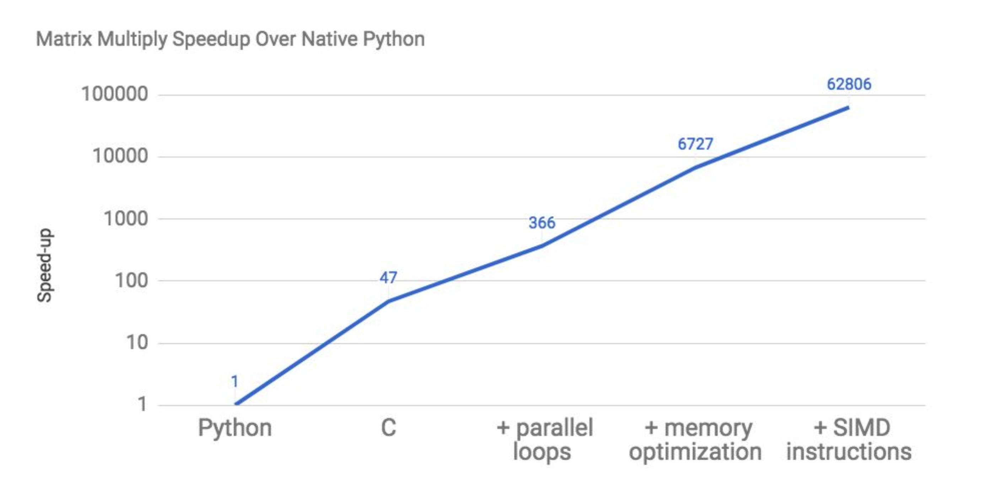
Does programming languages matter?
Computer Architecture

Slide 6
Seriously?
Computer Architecture

Slide 7
What?
Computer Architecture

Slide 8
Insane
Computer Architecture

Slide 9
Still?
Computer Architecture

Slide 10

62,806X

Slide 11
Ohhhhh!!
Computer Architecture

Slide 12

Can Compilers/programmers exploit locality?

Slide 13
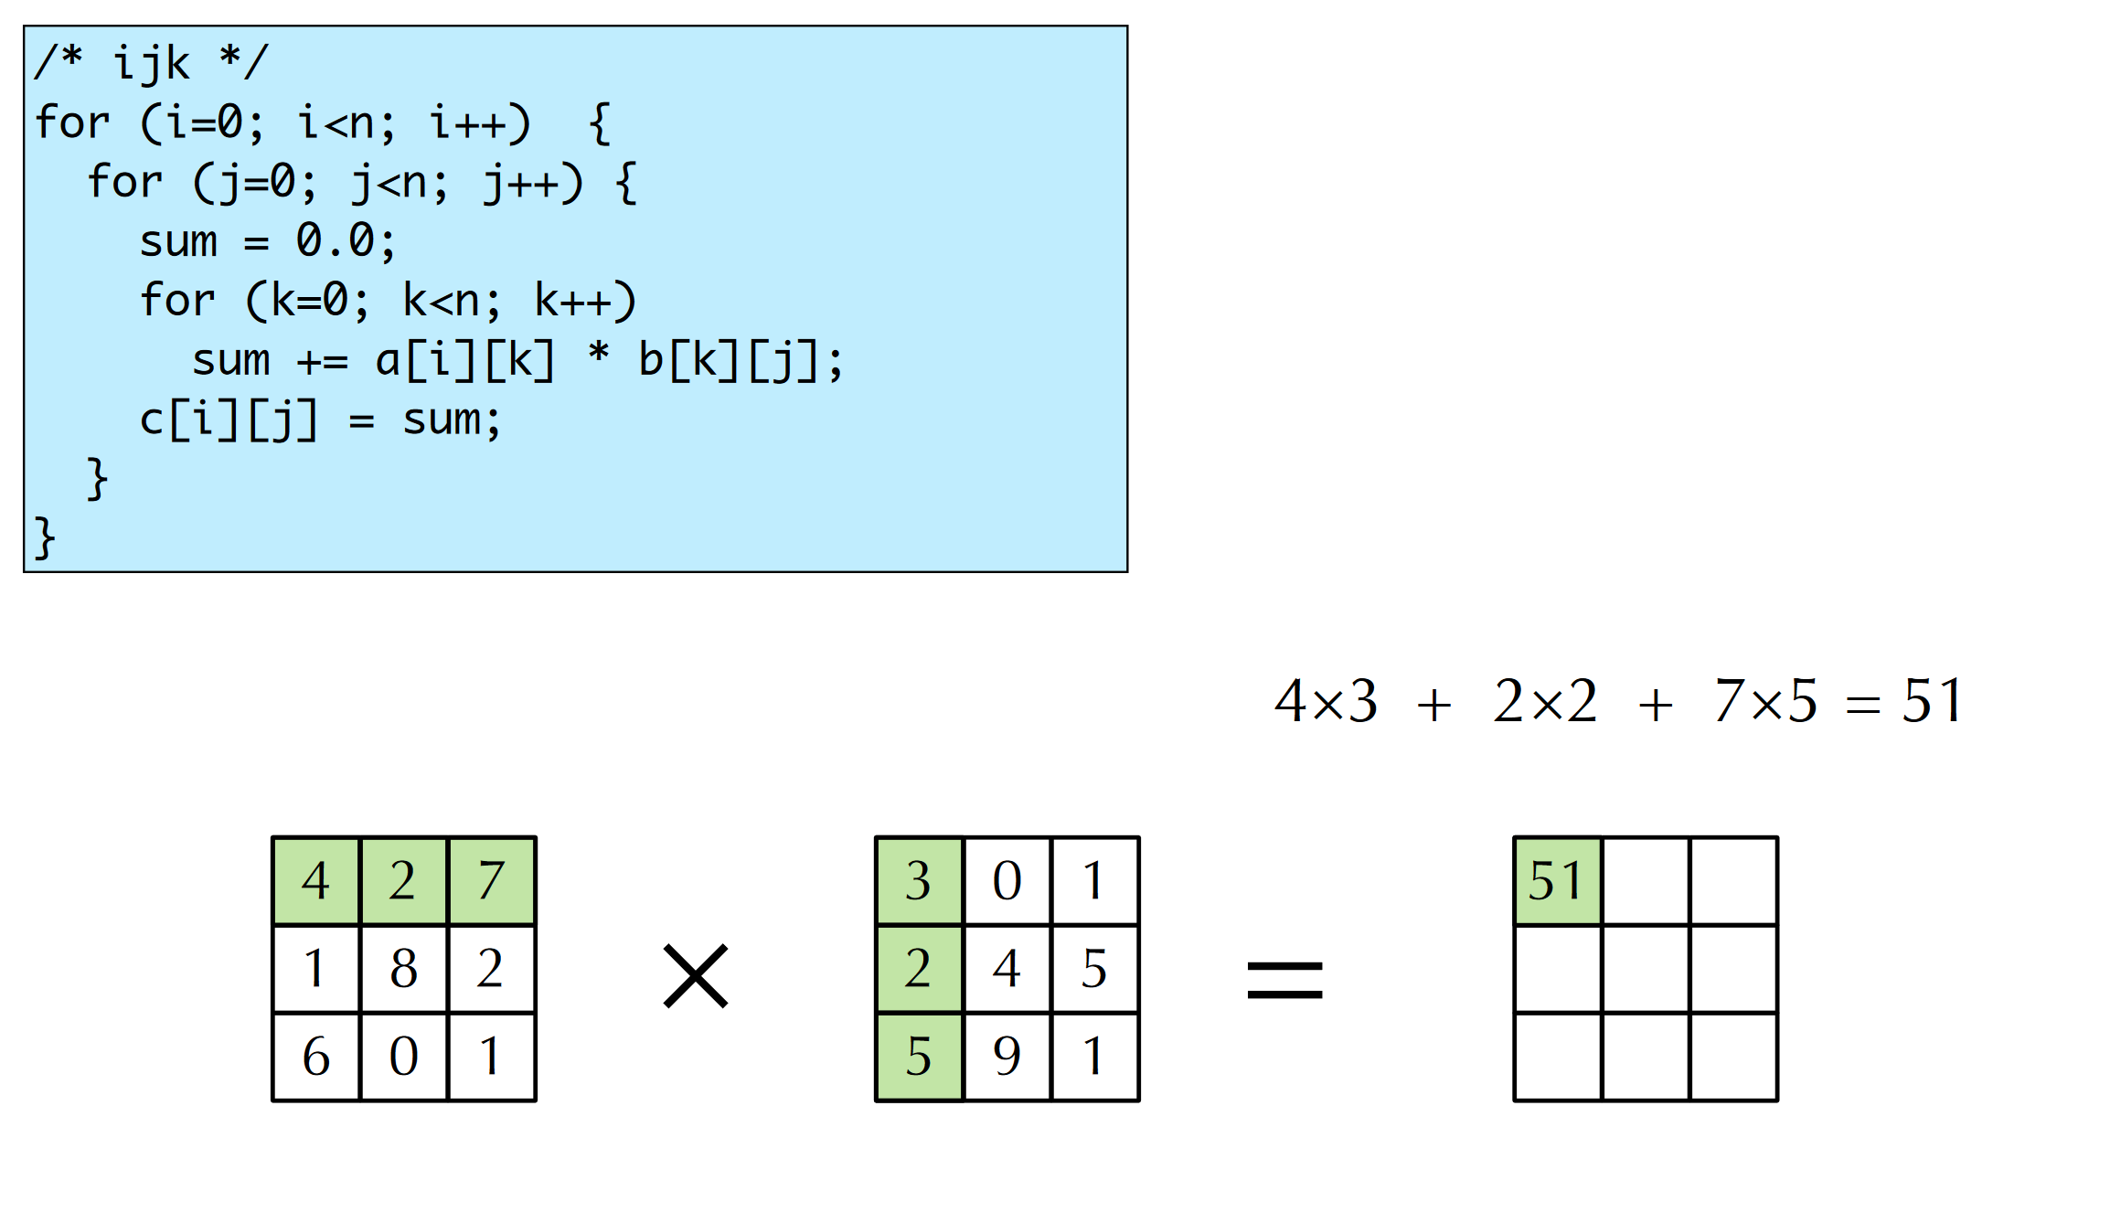
Matrix Multiplication: 101

Slide 14
Miss Rate analysis
Assume:
Block size = 32B (big enough for four doubles)
Matrix dimension (N) is very large
Approximate 1/N as 0.0
Cache is not even big enough to hold multiple rows
Analysis Method:
Look at access pattern of inner loop
j
k
j
=
x
i
i
k
C
A
B

Slide 15
Effect of Cache Layout
C arrays allocated in row-major order
each row in contiguous memory locations
Stepping through columns in one row:
for (i = 0; i < N; i++) sum += a[0][i];
accesses successive elements
if block size (B) > sizeof(a_{ij}) bytes, exploit spatial locality
miss rate = sizeof(a_{ij}) / B
Stepping through rows in one column:
for (i = 0; i < N; i++) sum += a[i][0];
accesses distant elements
no spatial locality!
miss rate = 1 (i.e. 100%)

Slide 16
Effect of loop order (ijk)
Inner loop:
/* ijk */
for (i=0; i<n; i++) {
for (j=0; j<n; j++) {
sum = 0.0;
for (k=0; k<n; k++)
sum += a[i][k] * b[k][j];
c[i][j] = sum;
}
}
(*,j)
(i,j)
(i,*)
A
B
C
Row-wise
Column-
wise
Fixed
Miss rate for inner loop iterations:
A B C
0.25 1.0 0.0
16

Slide 17
Effect of loops (kij)
/* kij */
for (k=0; k<n; k++) {
for (i=0; i<n; i++) {
r = a[i][k];
for (j=0; j<n; j++)
c[i][j] += r * b[k][j];
}
}
Inner loop:
(i,k)
(k,*)
(i,*)
A
B
C
Fixed
Row-wise
Row-wise
Miss rate for inner loop iterations:
A B C
0.0 0.25 0.25

Slide 18
Effect of loops (jki)
/* jki */
for (j=0; j<n; j++) {
for (k=0; k<n; k++) {
r = b[k][j];
for (i=0; i<n; i++)
c[i][j] += a[i][k] * r;
}
}
Inner loop:
(*,k)
(*,j)
(k,j)
A
B
C
Column-
wise
Fixed
Column-
wise
Miss rate for inner loop iterations:
A B C
1.0 0.0 1.0
18

Slide 19
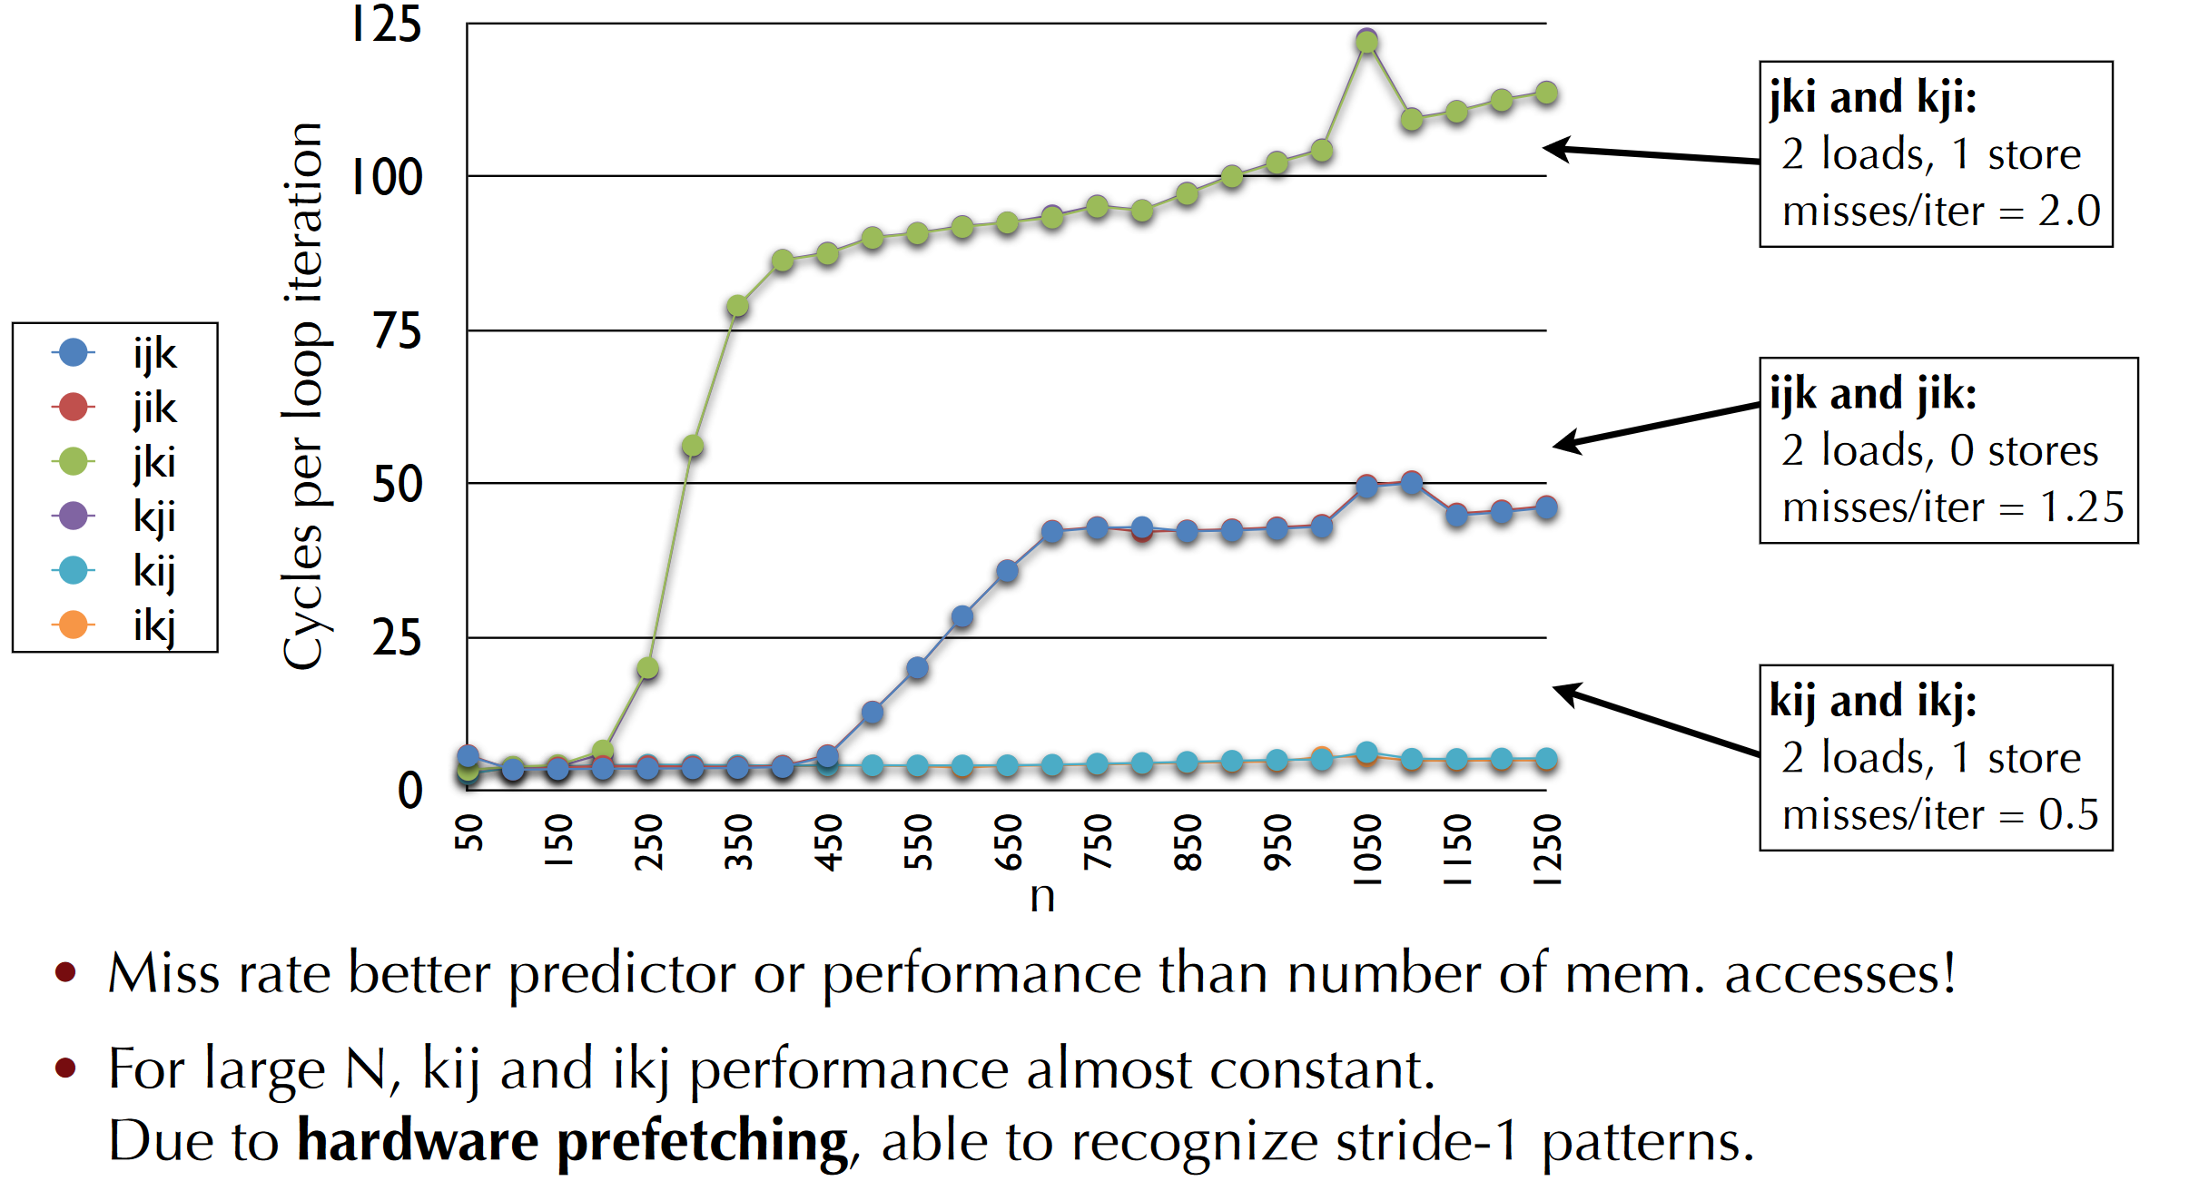
Effect of loops

Slide 20
Few Linux commands of interest
perf: https://perf.wiki.kernel.org/index.php/Tutorial#Counting_with_perf_stat
dmidecode
/proc/cpuinfo

Slide 21




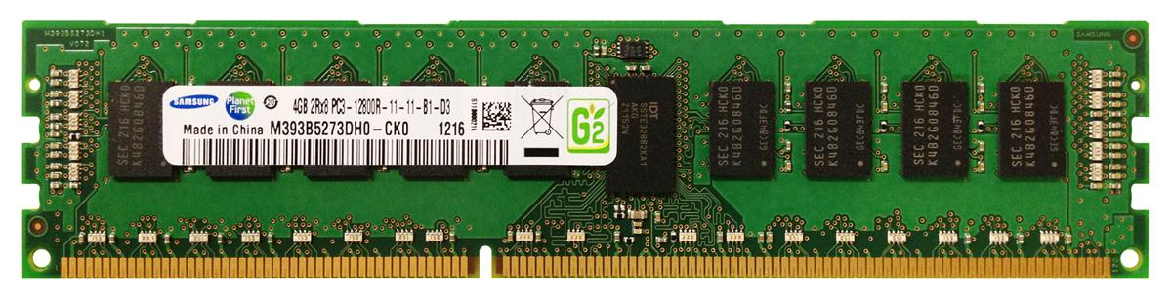
Multicore
Core 0
Core 1
Core 2
Core 3
L1
L1
L1
L1
L2
L2
L2
L2
Interconnect
L3

Slide 22
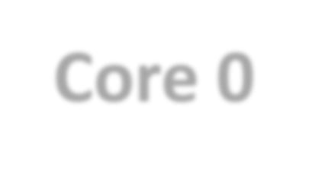
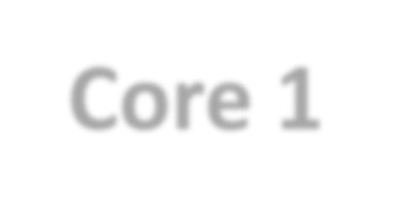
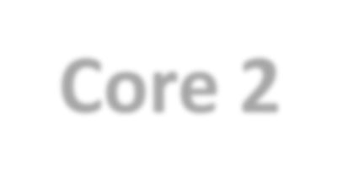
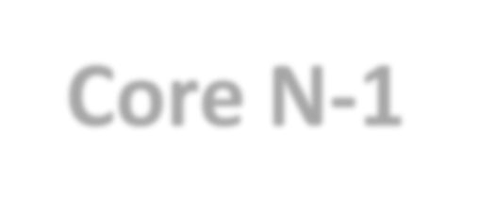










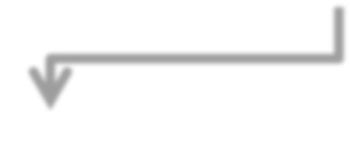
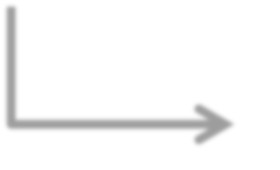
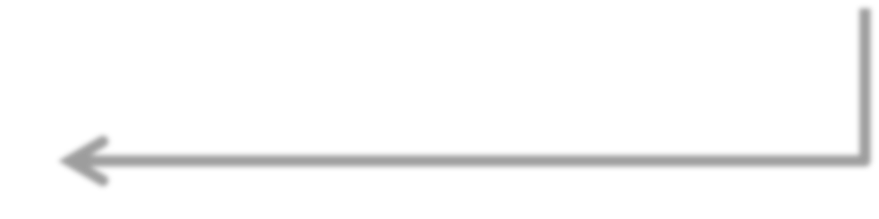


Caches: Private/Shared
Core 0
Core 1 Core 2 Core 3
Core N-1
…
Interconnect
Cache (Private/Shared)

Slide 23


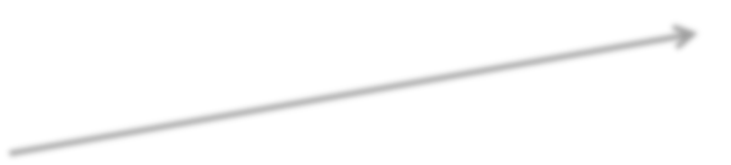


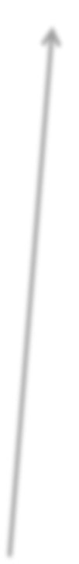


Application behavior
Core 0
Core 1
Core-Cache Fitting
LLC Fitting/thrashing
L1/L2
L1/L2
Interconnect
LLC
LLC

Slide 24
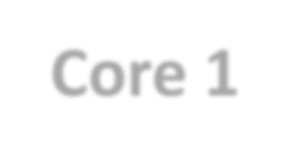





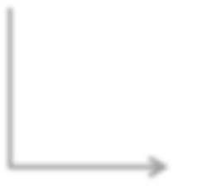
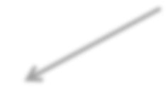

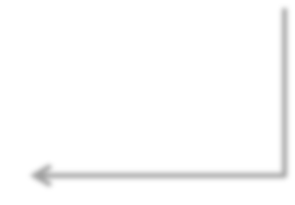

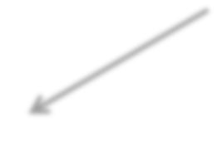
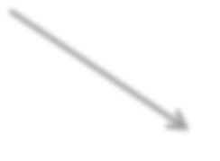

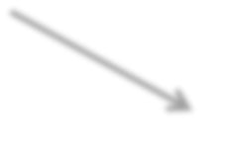






Sliced/Banked LLC
Core 0 L1 L2
Core 1 L1 L2
Core 2 L1 L2
Core 3
L1
L2
All caches are
pipelined
In commercial
machines
Ring(s)
S0
S1
S2
S3

Slide 25
Inclusive Cache Hierarchy
Core request
L1/L2
evict
BackInval
fill
LLC
fill
memory
victim

Slide 26
Non-inclusive (many commercial machines)
Core request
L1/L2
fill
LLC
fill
victim
memory

Slide 27
Exclusive hierarchy
Core request
victim
L1/L2
fill
LLC
fill
victim
memory

