Slide 1
CS230: Digital Logic Design and Computer Architecture
Lecture-3: Combinational Circuits
https://www.cse.iitb.ac.in/~biswa/courses/CS230/main.html

Slide 2

Phones (smart/non-smart) on silence plz, Thanks

Slide 3


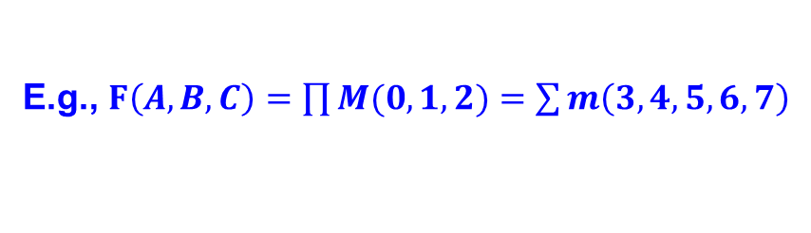


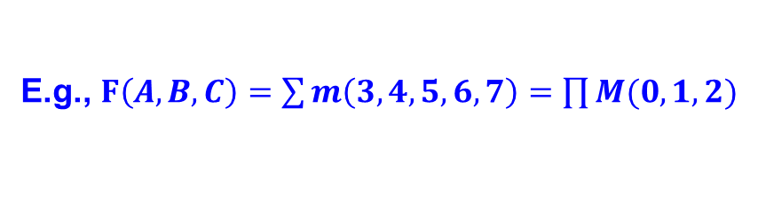

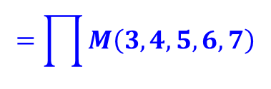

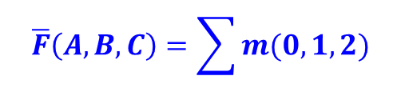

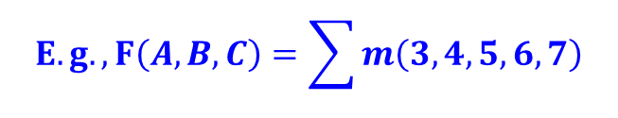
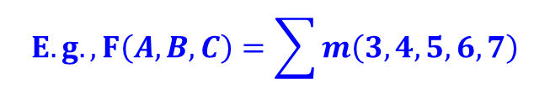


Contd.
1.
Minterm to Maxterm conversion:
rewrite minterm shorthand using maxterm shorthand
replace minterm indices with the indices not already used
E.g., $F\left(A,B,C\right)=\sum{m\left(3,4,5,6,7\right)=\prod{M(0,1,2)}}$
2.
Maxterm to Minterm conversion:
rewrite maxterm shorthand using minterm shorthand
replace maxterm indices with the indices not already used
E.g., $F\left(A,B,C\right)=\prod{M(0,1,2)}=\sum{m\left(3,4,5,6,7\right)}$
3.
$$F$$
$$\overline{F}$$
Expansion of to expansion of :
$$E.g., F\left(A,B,C\right)=\sum{m\left(3,4,5,6,7\right)}$$
$$\overline{F}\left(A,B,C\right)=\sum{m(0,1,2)}$$
$$=\prod{M(0,1,2)}$$
$$=\prod{M\left(3,4,5,6,7\right)}$$
4.
$$F$$
$$\overline{F}$$
Minterm expansion of to Maxterm expansion of :
$$F$$
rewrite in Maxterm form, using the same indices as
$$E.g., F\left(A,B,C\right)=\sum{m\left(3,4,5,6,7\right)}$$
$\overline{F}\left(A,B,C\right)$ $=\prod{M\left(3,4,5,6,7\right)}$
$$=\prod{M(0,1,2)}$$
$$=\sum{m(0,1,2)}$$

Slide 4






K-Maps
Karnaugh Map (K-map) method
K-map is an alternative method of representing the truth table that helps visualize adjacencies in up to 6 dimensions
Physical adjacency ↔ Logical adjacency
 |  | 0 | 1
0 |  | 00 | 01
1 |  | 10 | 11
 |  | 00 | 01 | 11 | 10
0 |  | 000 | 001 | 011 | 010
1 |  | 100 | 101 | 111 | 110
 |  | 00 | 01 | 11 | 10
00 |  | 0000 | 0001 | 0011 | 0010
01 |  | 0100 | 0101 | 0111 | 0110
11 |  | 1100 | 1101 | 1111 | 1110
10 |  | 1000 | 1001 | 1011 | 1010
2-variable K-map
3-variable K-map
4-variable K-map
$$B$$
$$BC$$
$$CD$$
$$A$$
$$A$$
$$AB$$

Slide 5

Coffee points
Why 11 before 10 ?

Slide 6
Coffee points
Why 11 before 10 ?
Numbering Scheme: 00, 01, 11, 10 is called a
“Gray Code” — only a single bit (variable) changes
from one code word and the next code word

Slide 7


How? To minimize the Function
Adjacent
 |  | 00 | 01 | 11 | 10
0 |  | 000 | 001 | 011 | 010
1 |  | 100 | 101 | 111 | 110
$$BC$$
$$A$$
000
010
110
100
001
011
111
101
000
010
110
100
001
011
111
101
Adjacent
K-map adjacencies go “around the edges”
Wrap around from first to last column
Wrap around from top row to bottom row

Slide 8






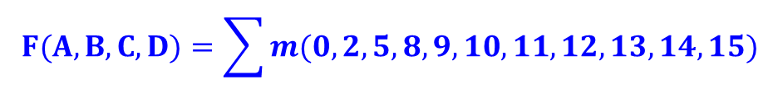
How?
 |  | 00 | 01 | 11 | 10
00 |  | 1 | 0 | 0 | 1
01 |  | 0 | 1 | 0 | 0
11 |  | 1 | 1 | 1 | 1
10 |  | 1 | 1 | 1 | 1
$$F(A,B,C,D)=\sum{m(0,2,5,8,9,10,11,12,13,14,15)}$$
$$CD$$
$$AB$$
$$A+\overline{B}\overline{D}+B\overline{C}D$$
$$F=$$
$$A$$
$$A+\overline{B}\overline{D}$$
Strategy for “circling” rectangles on Kmap:
As big as possible
Biggest “oops!” that people forget:
Wrap-arounds

Slide 9
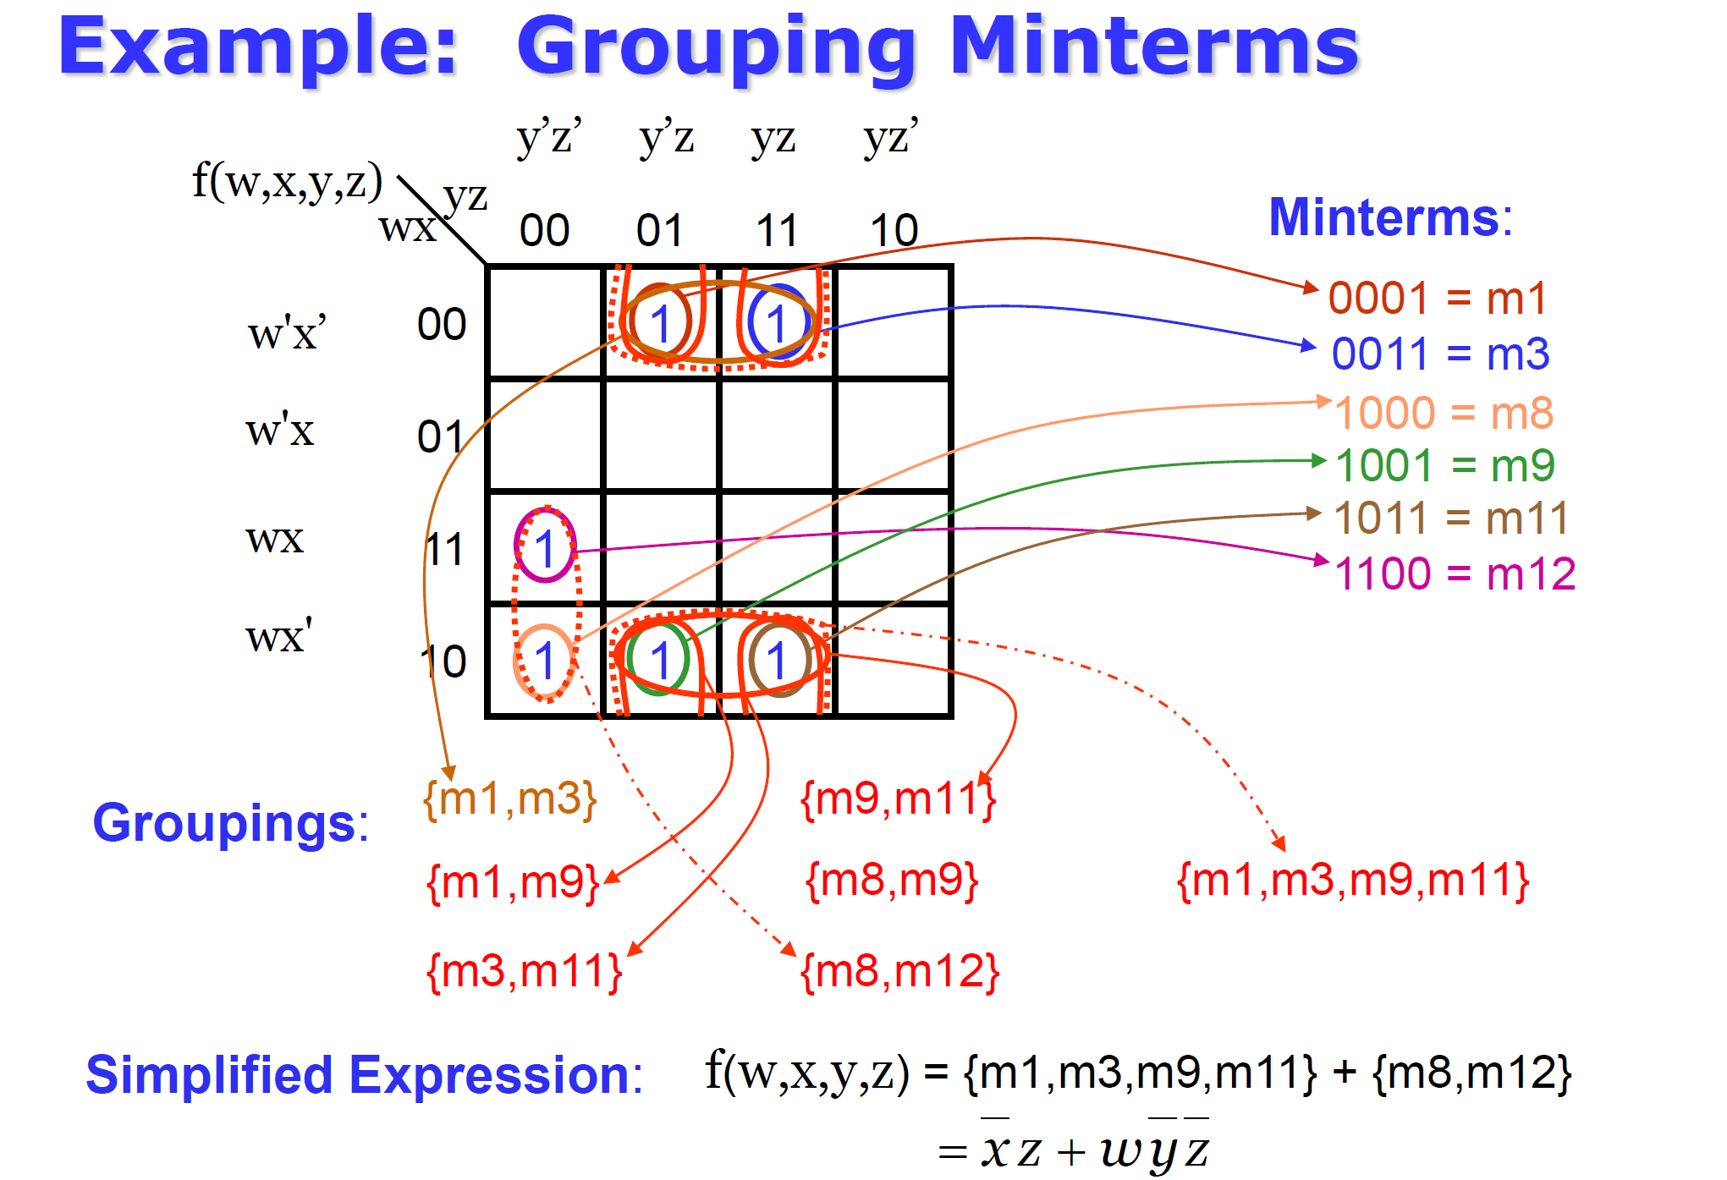
Some more examples

Slide 10
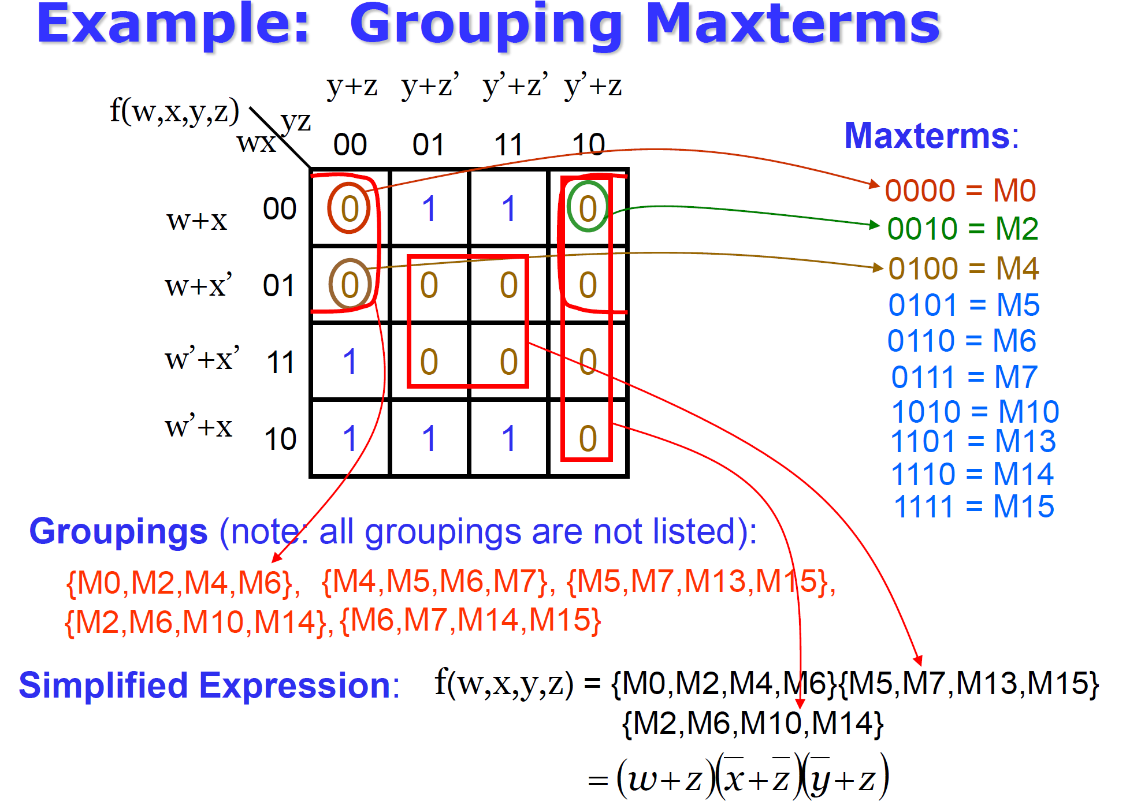
Some more examples

Slide 11

Why minimize?
Efficient resource usage
Resource scarcity

Slide 12
Summary
Very simple guideline:
Circle all the rectangular blocks of 1’s in the map, using the fewest possible number of circles
Each circle should be as large as possible
Read off the implicants that were circled
Some of them may be “don’t care” (X) Try it yourself

Slide 13

PAUSE

Slide 14
Combinational Circuits
Combinational logic is often grouped into larger building blocks to build more complex systems
Hides the unnecessary gate-level details to emphasize the function of the building block
Output is only dependent on the input
We now examine:
Decoder
Multiplexer
Full adder

Slide 15
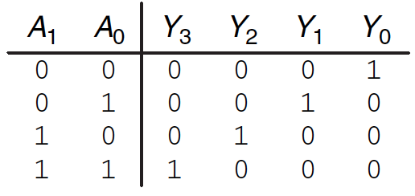
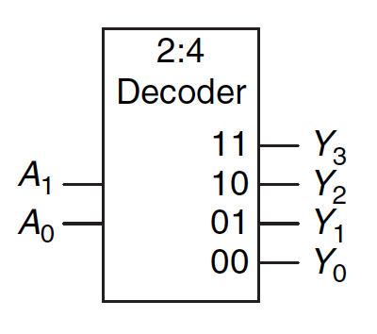
Decoder
“Input pattern detector”
n inputs and 2^{n} outputs
Exactly one of the outputs is 1 and all the rest are 0s
The output that is logically 1 is the output corresponding to the input pattern that the logic circuit is expected to detect
Example: 2-to-4 decoder
The complement of a decoder is encoder

Slide 16
Contd.
n inputs and 2^{n} outputs
Exactly one of the outputs is 1 and all the rest are 0s
The output that is logically 1 is the output corresponding to the input pattern that the logic circuit is expected to detect
Mostly decoders have an enable signal. Output is only generated if the enable is high.

Slide 17
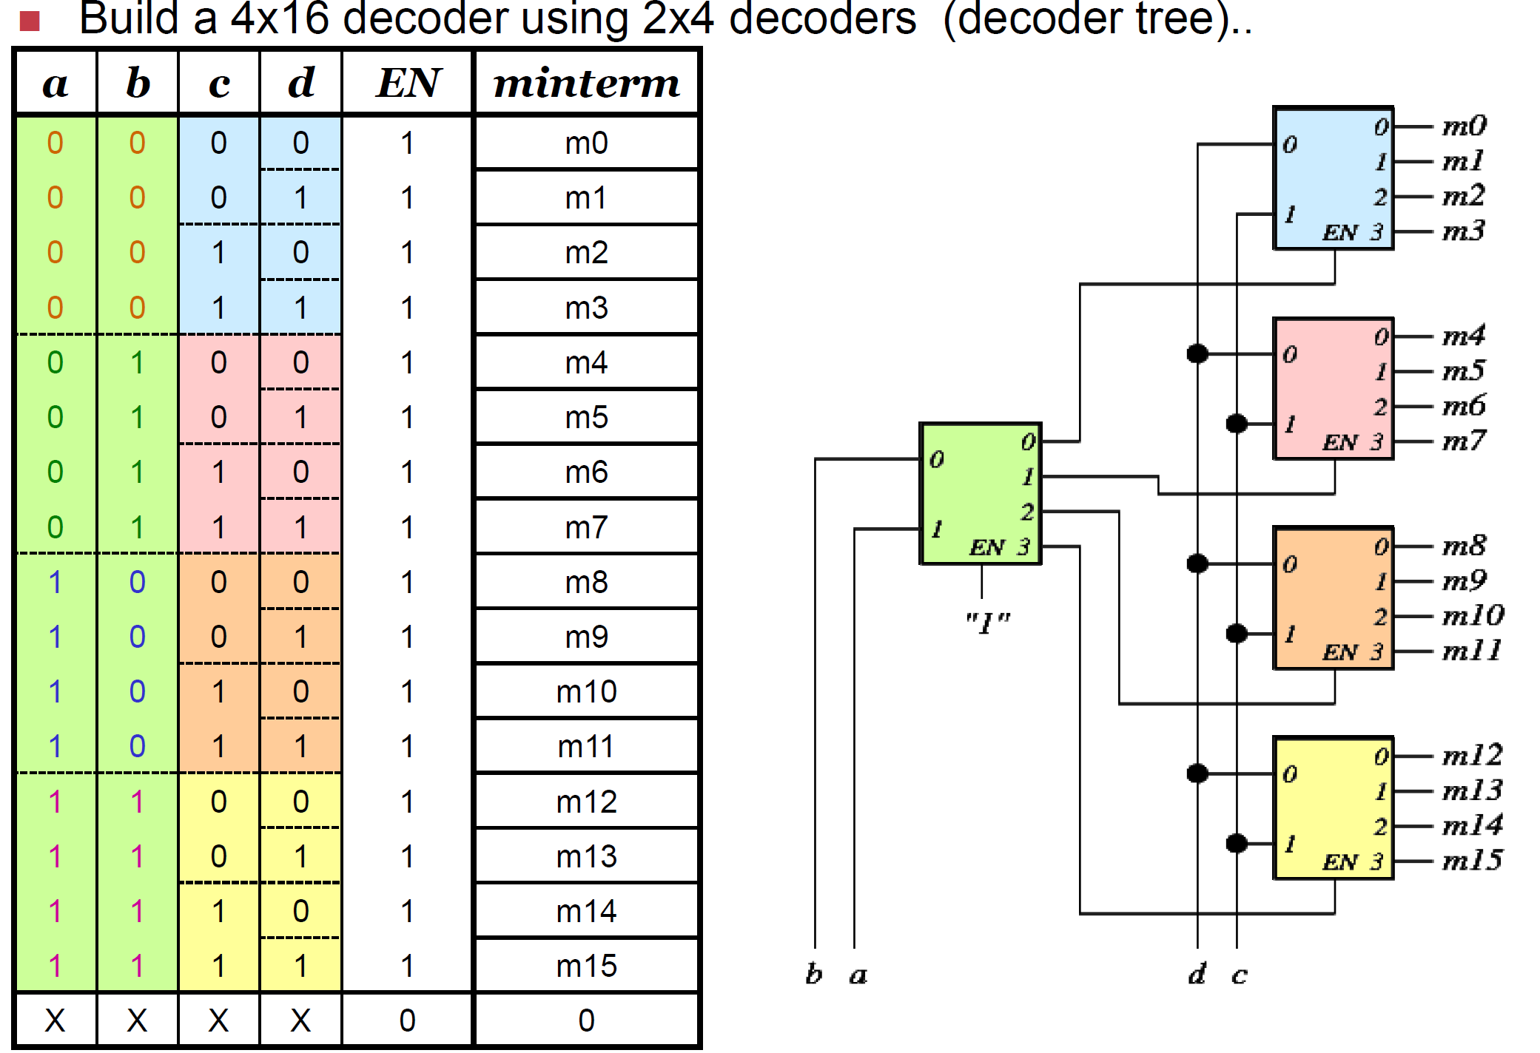

Slide 18
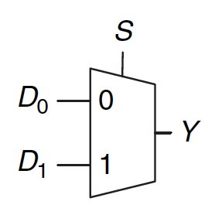
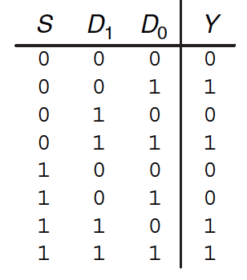
Multiplexer
Selects one of the N inputs to connect it to the output
based on the value of a log₂N-bit control input called select
Example: 2-to-1 MUX
When S is 0, Y is D₀ and when S is 1, Y is D₁

Slide 19
Contd.
Selects one of the N inputs to connect it to the output
based on the value of a log₂N-bit control input called select
Example: 2-to-1 MUX

Slide 20
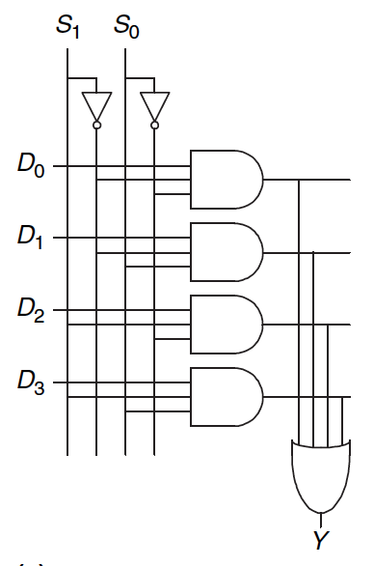
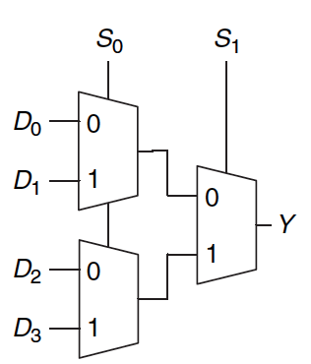
From 2 to 4:1 MUX

Slide 21
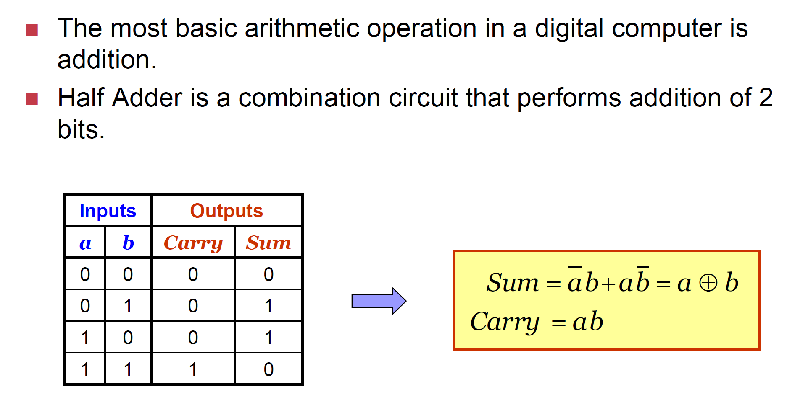
Adder

Slide 22
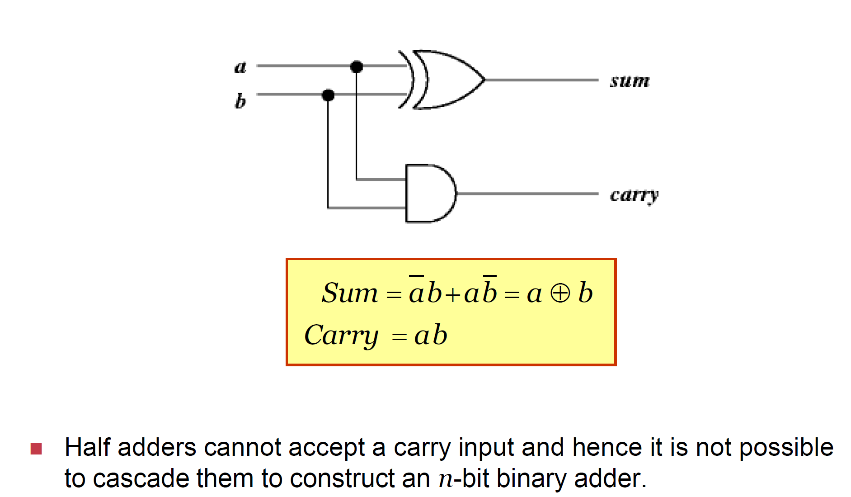
Half adder

Slide 23
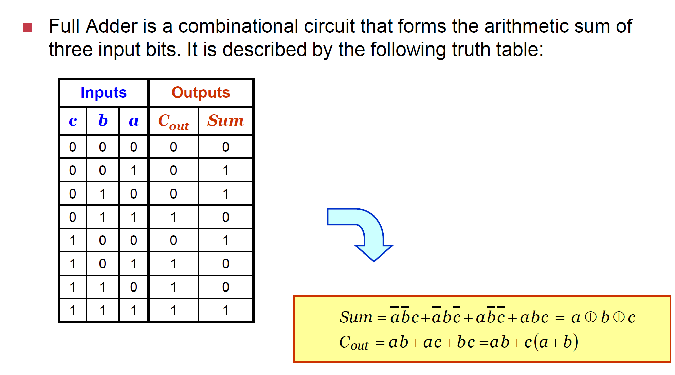
Full adder

Slide 24
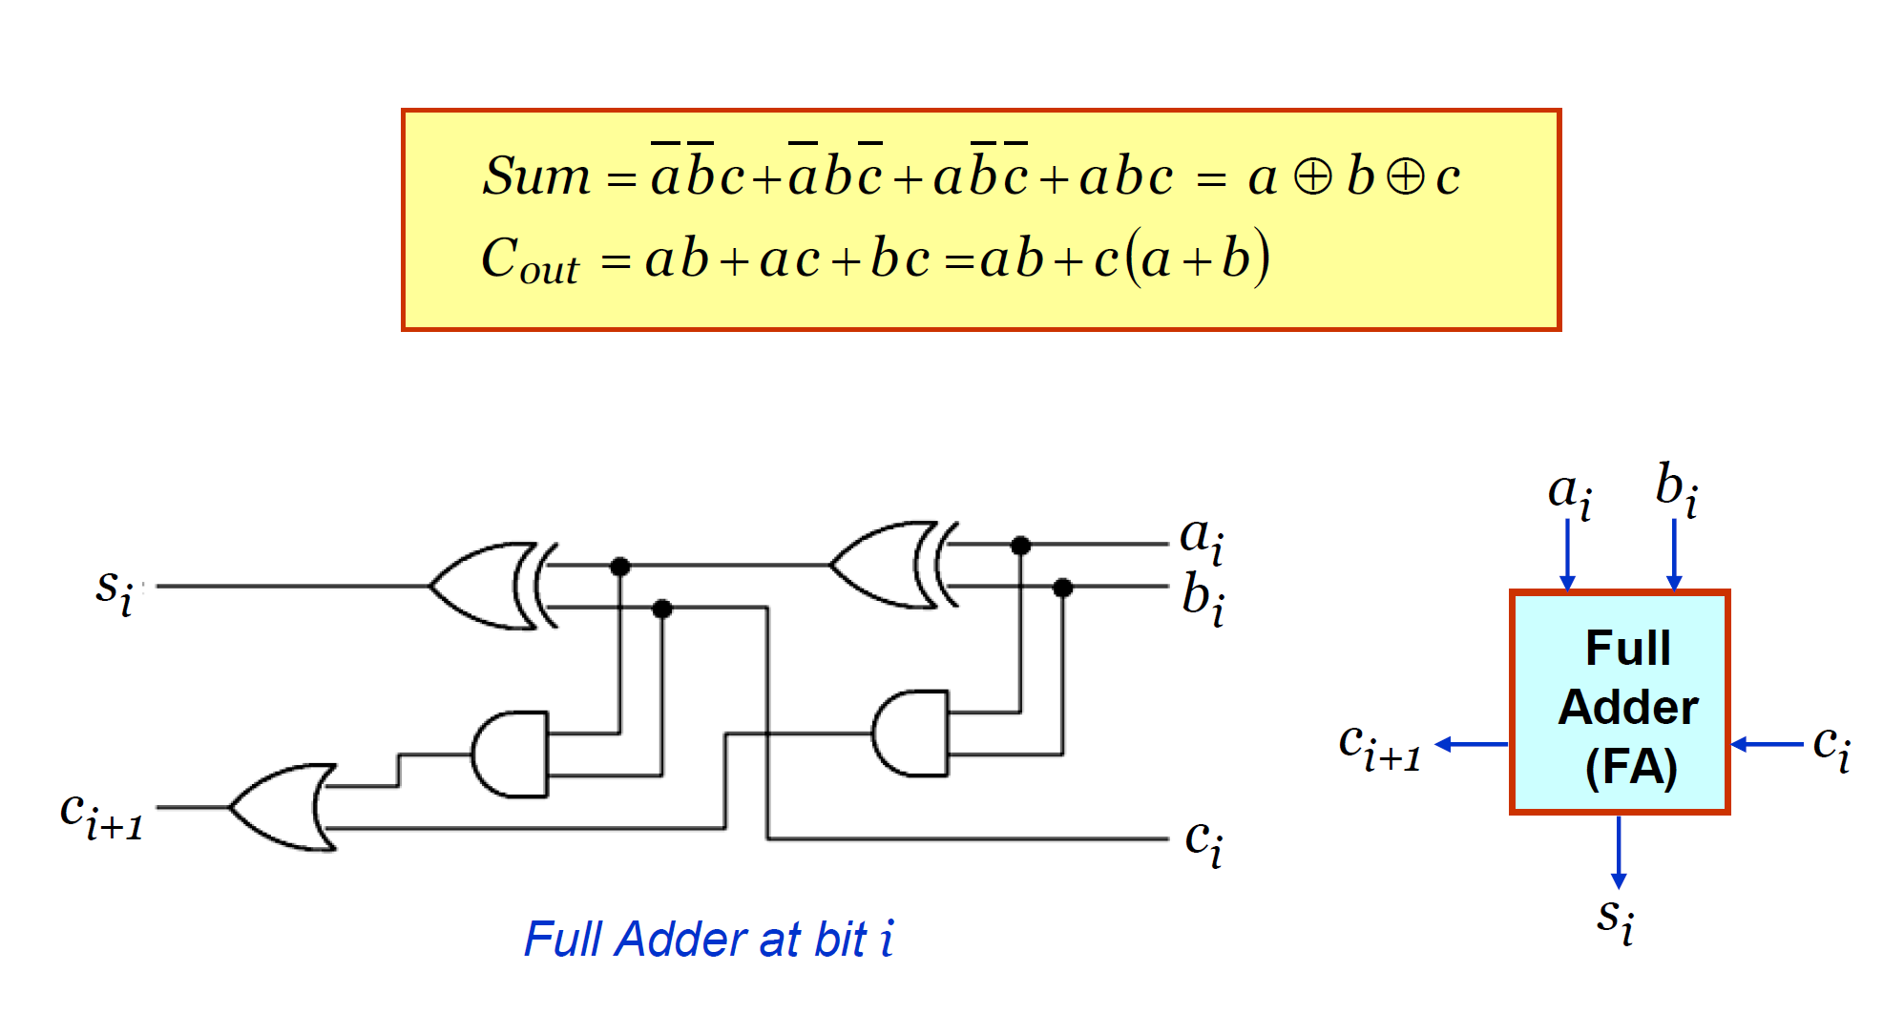
Implementation

Slide 25
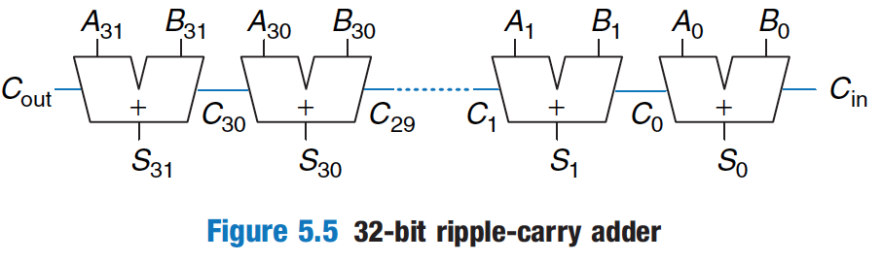
Ripple Carry Adder

Slide 26
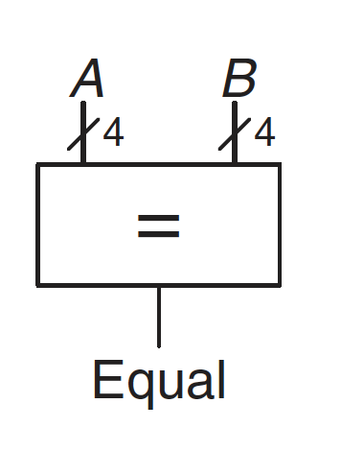
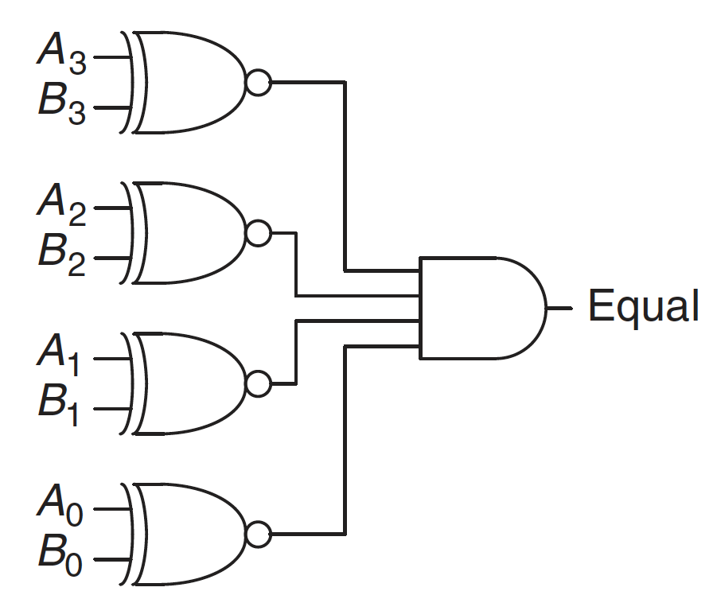
Comparator (Equality Checker)

Slide 27
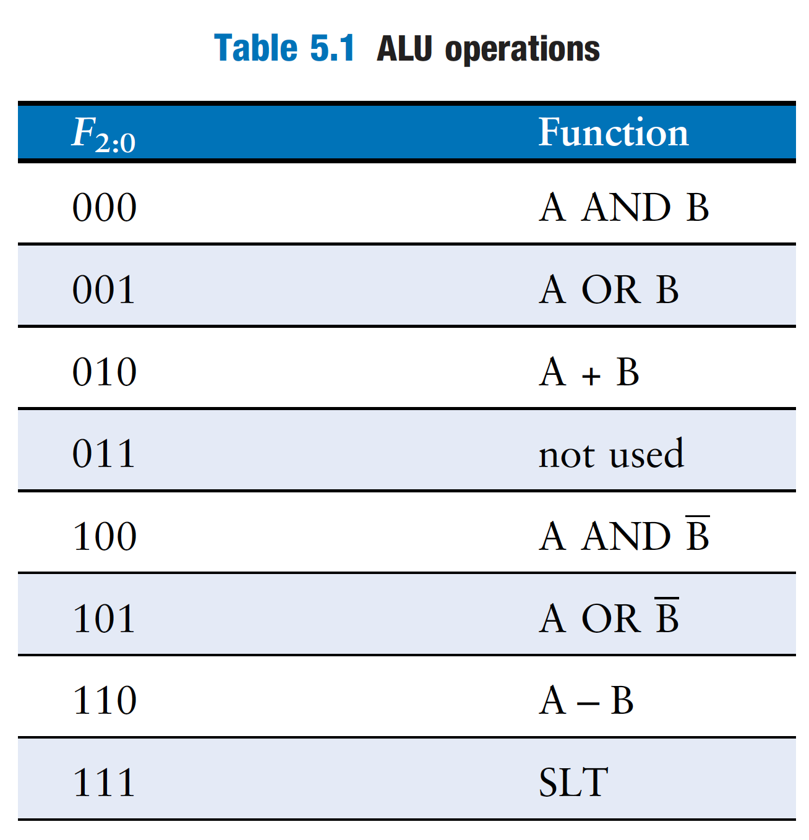
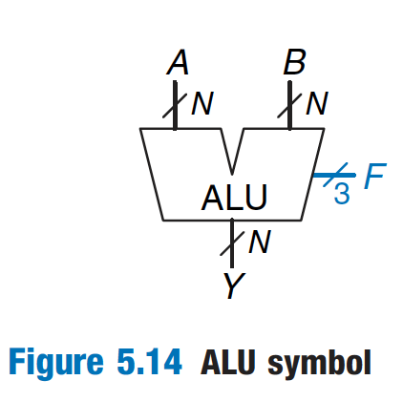
ALU (Arithmetic Logic Unit)

