Slide 1
CS230: Digital Logic Design and Computer Architecture
Lecture 4: Sequential Circuits
https://www.cse.iitb.ac.in/~biswa/courses/CS230/autumn23/main.html

Slide 2

Phones (smart/non-smart) on silence plz, Thanks

Slide 3
Sequential Circuit
Combinational circuit output depends only on current input
We want circuits that produce output depending on current and past input values – circuits with memory
How can we design a circuit that stores information?
Sequential Circuit
inputs
Combinational
Circuit
outputs
Storage
Element

Slide 4
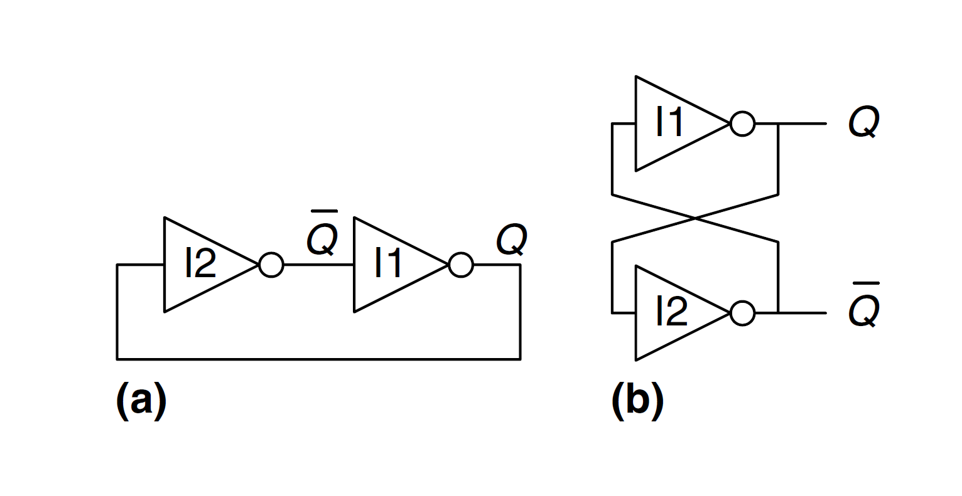
The base for any storage
If Q is zero then Q complement is 1. Note that the circuit has no inputs ☺

Slide 5
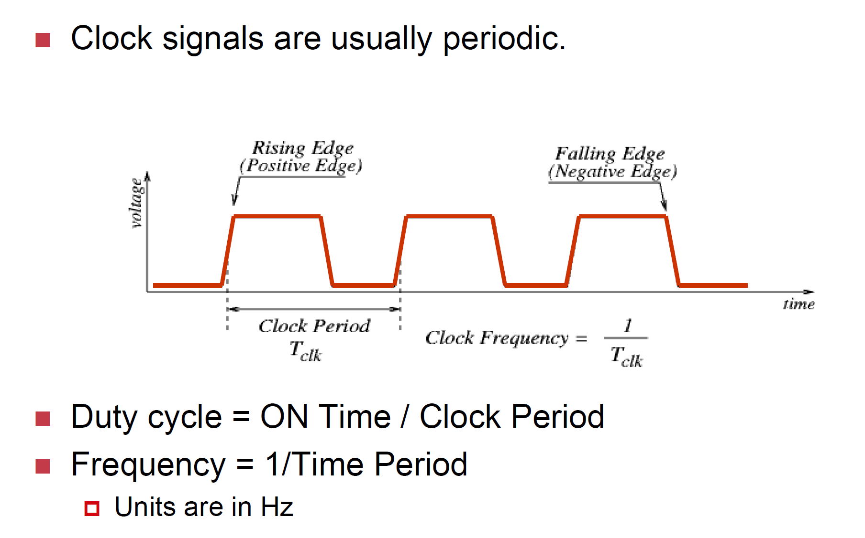
The Clock as some need it
Clock is driven by the slowest combinational circuit/path.
Clock is responsible for triggering a state change

Slide 6

Clock
Logic beat (like heart beat) oscillates between high and low voltage but at a constant frequency

Slide 7



Clock and Storage Elements
Storage elements are affected only at the arrival of a clock pulse.
Storage elements are usually called as a latch/flip-flop.
They maintain a binary state until directed by a clock pulse.

Slide 8

S-R Latch
Cross-coupled NOR/NAND gates
Data is stored at Q (inverse at Q’)
S and R are control inputs
S = Set, Q=1 -> S=1, Q=0; S=0
R = Reset

Slide 9
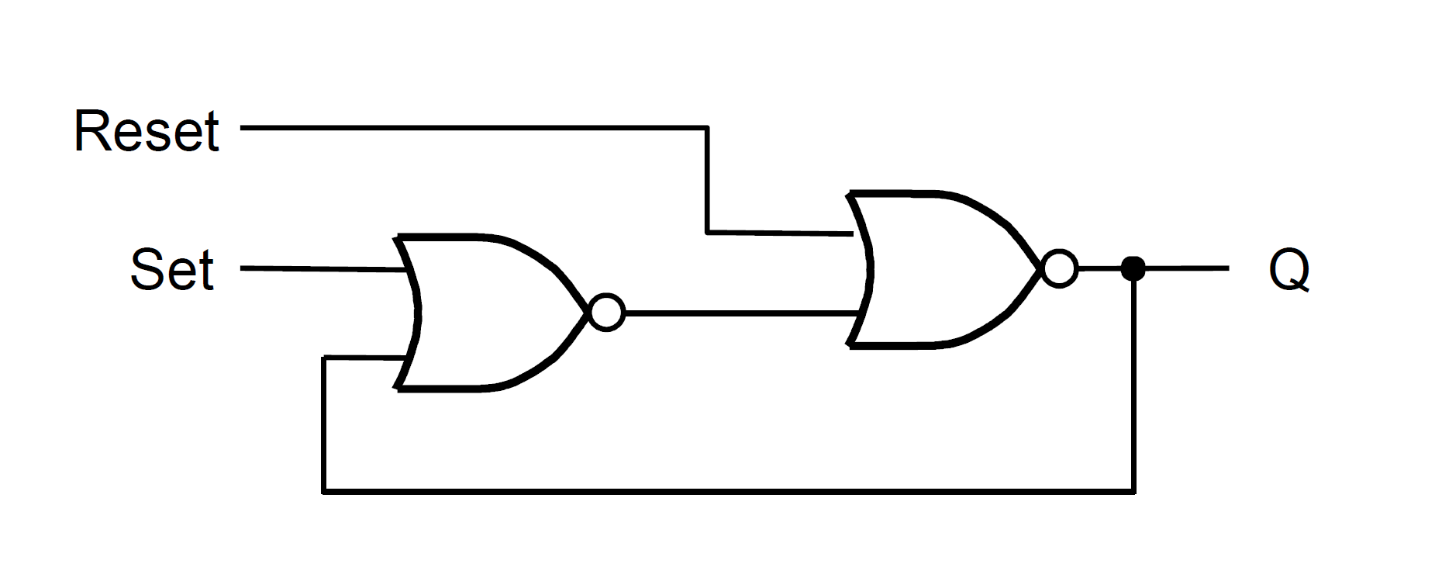
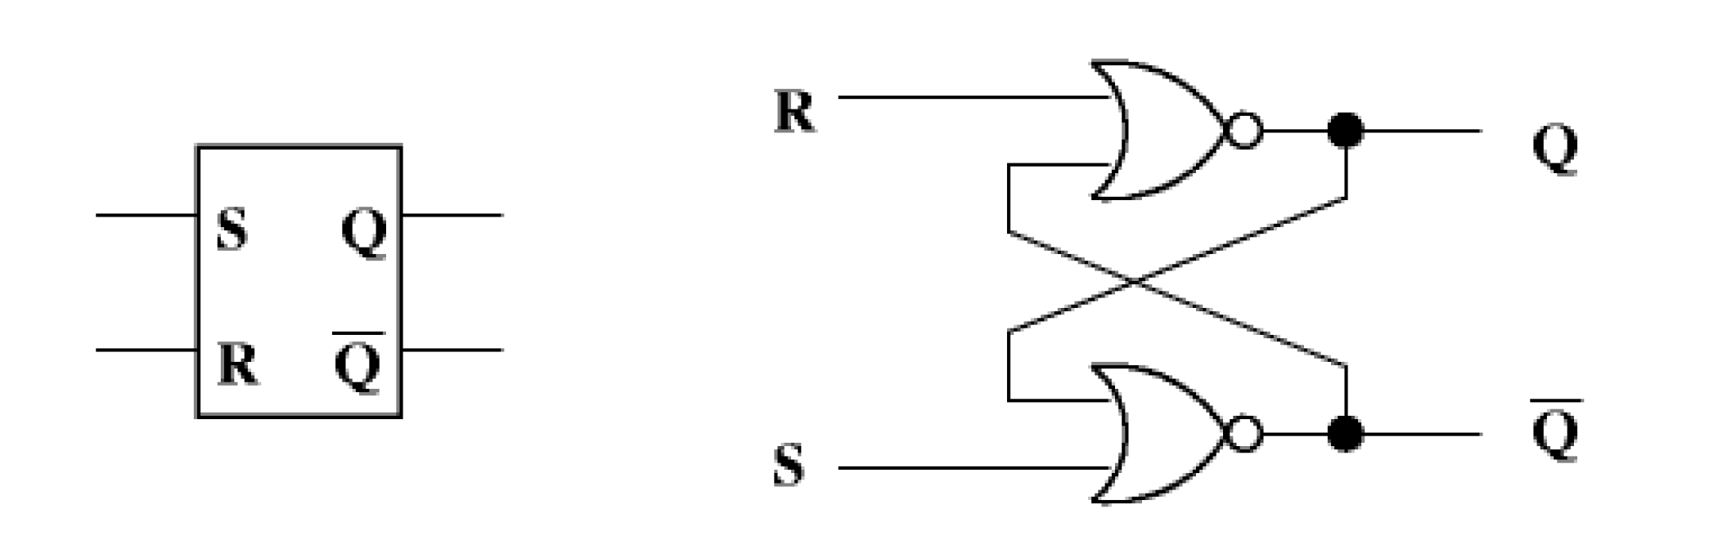
S-R Latch
Three inputs: Set, Reset, and a proxy clock
Circuit works only when the proxy clock is ON S=Set R=Reset

Slide 10
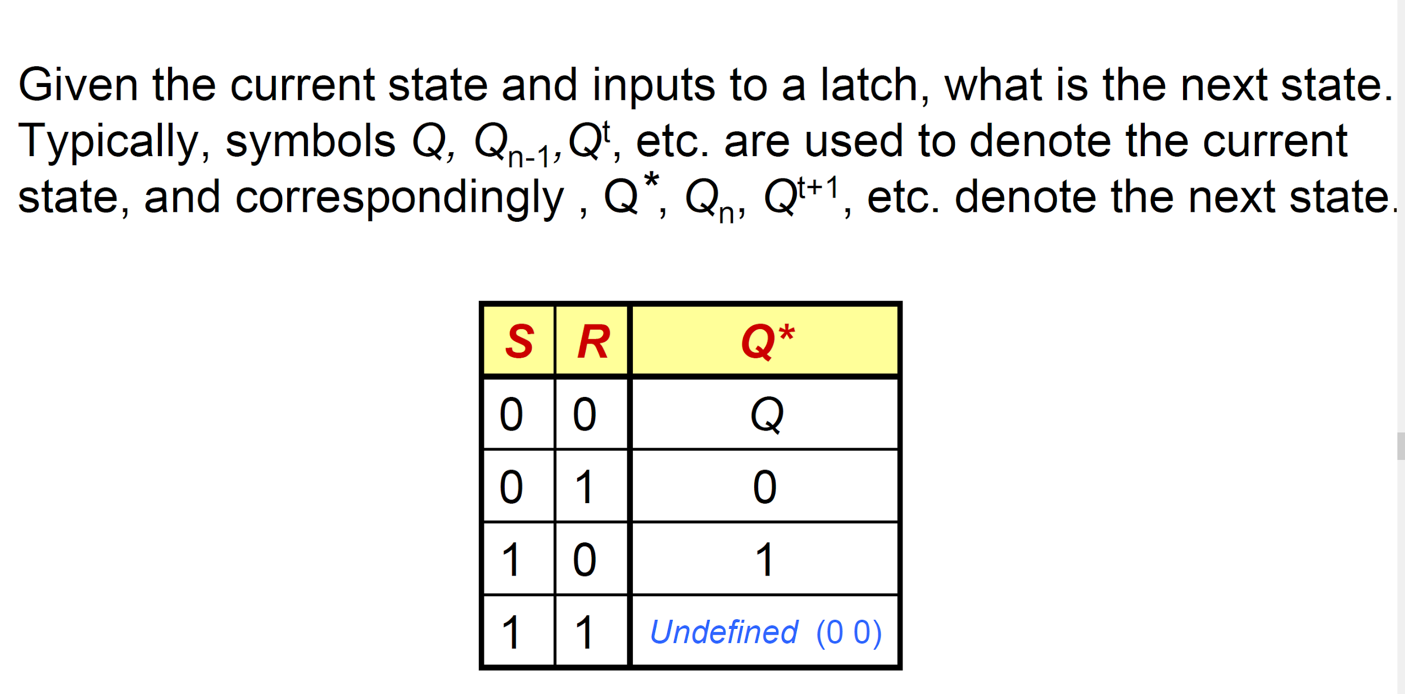
Contd.

Slide 11
NAND gates
S
Q
Cross-coupled NAND gates
Data is stored at Q (inverse at Q’)
S and R are control inputs
In quiescent (idle) state, both S and R are held at 1
S (set): drive S to 0 (keeping R at 1) to change Q to 1
R (reset): drive R to 0 (keeping S at 1) to change Q to 0
S and R should never both be 0 at the same time
R
Q’
Input |  | Output
R | S | Q
1 | 1 | Q_{prev}
1 | 0 | 1
0 | 1 | 0
0 | 0 | Forbidden

Slide 12
Why not R=S=0?
1
0
S
Q
Input |  | Output
R | S | Q
1 | 1 | Q_{prev}
1 | 0 | 1
0 | 1 | 0
0 | 0 | Forbidden
1
0
1
0
R
0
Q’
1
If R=S=0, Q and Q’ will both settle to 1, which breaks our invariant that Q = !Q’
If S and R transition back to 1 at the same time, Q and Q’ begin to oscillate between 1 and 0 because their final values depend on each other (metastability)
This eventually settles depending on variation in the circuits

Slide 13
Gated D-latch
How do we guarantee correct operation of an S-R Latch?
Add two more NAND gates!
Q takes the value of D, when write enable (WE) is set to 1
S and R can never be 0 at the same time!
D
S
Q
Input |  | Output
WE | D | Q
0 | 0 | Q_{prev}
0 | 1 | Q_{prev}
1 | 0 | 0
1 | 1 | 1
Write
Enable
Q’
R

Slide 14

Why are latches not preferred? Coffee points++
The inputs should not change while the gate signal is asserted (otherwise there are multiple state changes which can lead to problems in a circuit).

Slide 15
One Solution
What if we change our states only on clock edge and call me edge-triggered

Slide 16
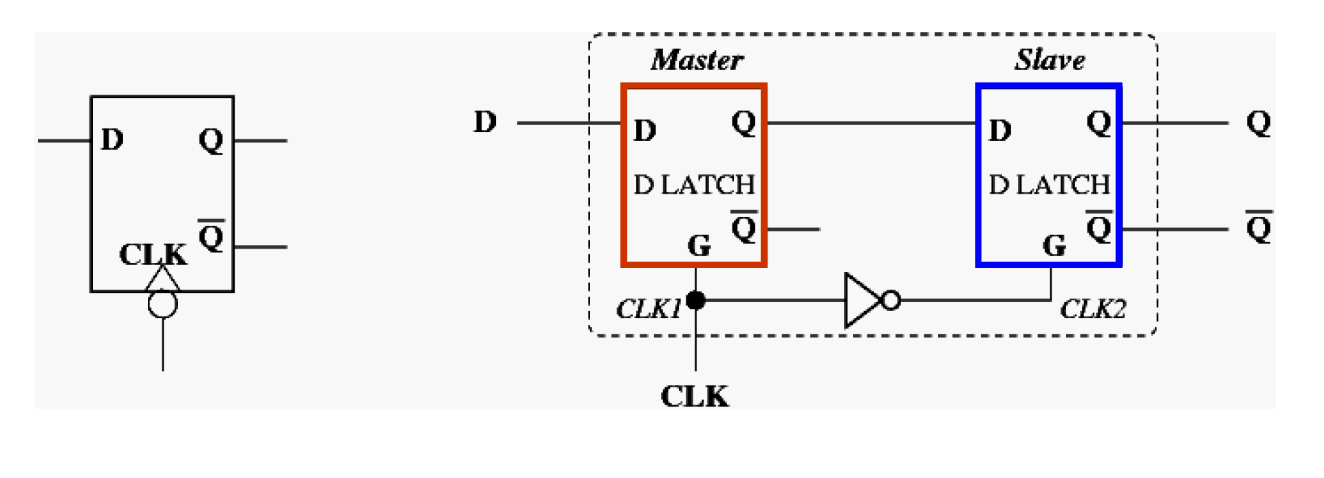
Edge Triggering Master-slave D Flip-flop with two latches
Negative edge triggered flipflop
At a given time, only one latch is alive (either master or slave)

Slide 17
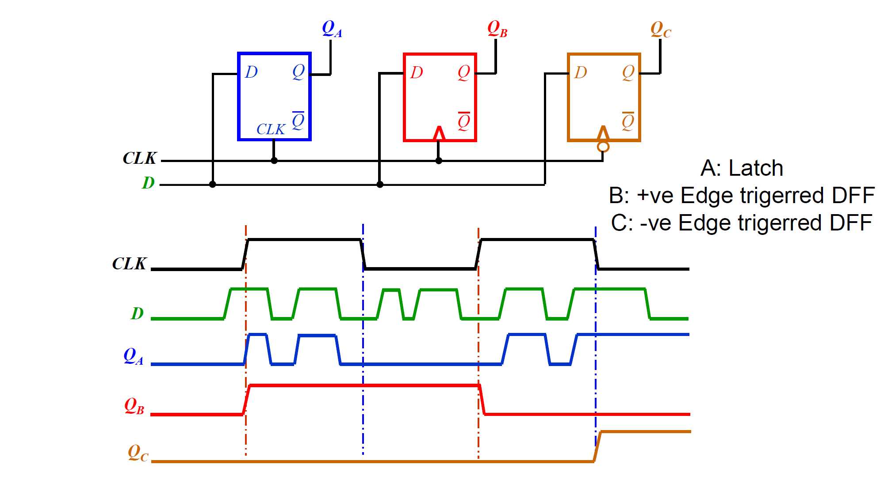
Level/Edge Triggered

Slide 18




Summary
Gates are building blocks of combinational circuits
Latches are ………………………....... sequential circuits
Latches are built from gates
Flip-flops are built from latches

Slide 19
Register
How can we use D latches to store more data?
Use more D latches!
A single WE signal for all latches for
simultaneous writes
Here we have a register, or a structure that stores more than one bit and can be read from and written to
This register holds 4 bits, and its data is referenced as Q[3:0]
D
D₂
D₁
D₀
₃
Write Enable
₃
Q
Q₂
Q₁
Q₀

Slide 20
Register
How can we use D latches to store more data?
Use more D latches!
A single WE signal for all latches for
simultaneous writes
Here we have a register, or a structure that stores more than one bit and can be read from and written to
This register holds 4 bits, and its data is referenced as Q[3:0]
D_{3:0}
4
Register x (Rx)
WE
4
Q_{3:0}

Slide 21

Sequential circuit 101 again
Combination of latches/flip-flops and combinational elements (gates).
Flip-flops need a clock

Slide 22
Coffee Credits
Shreyas: +1

Slide 23
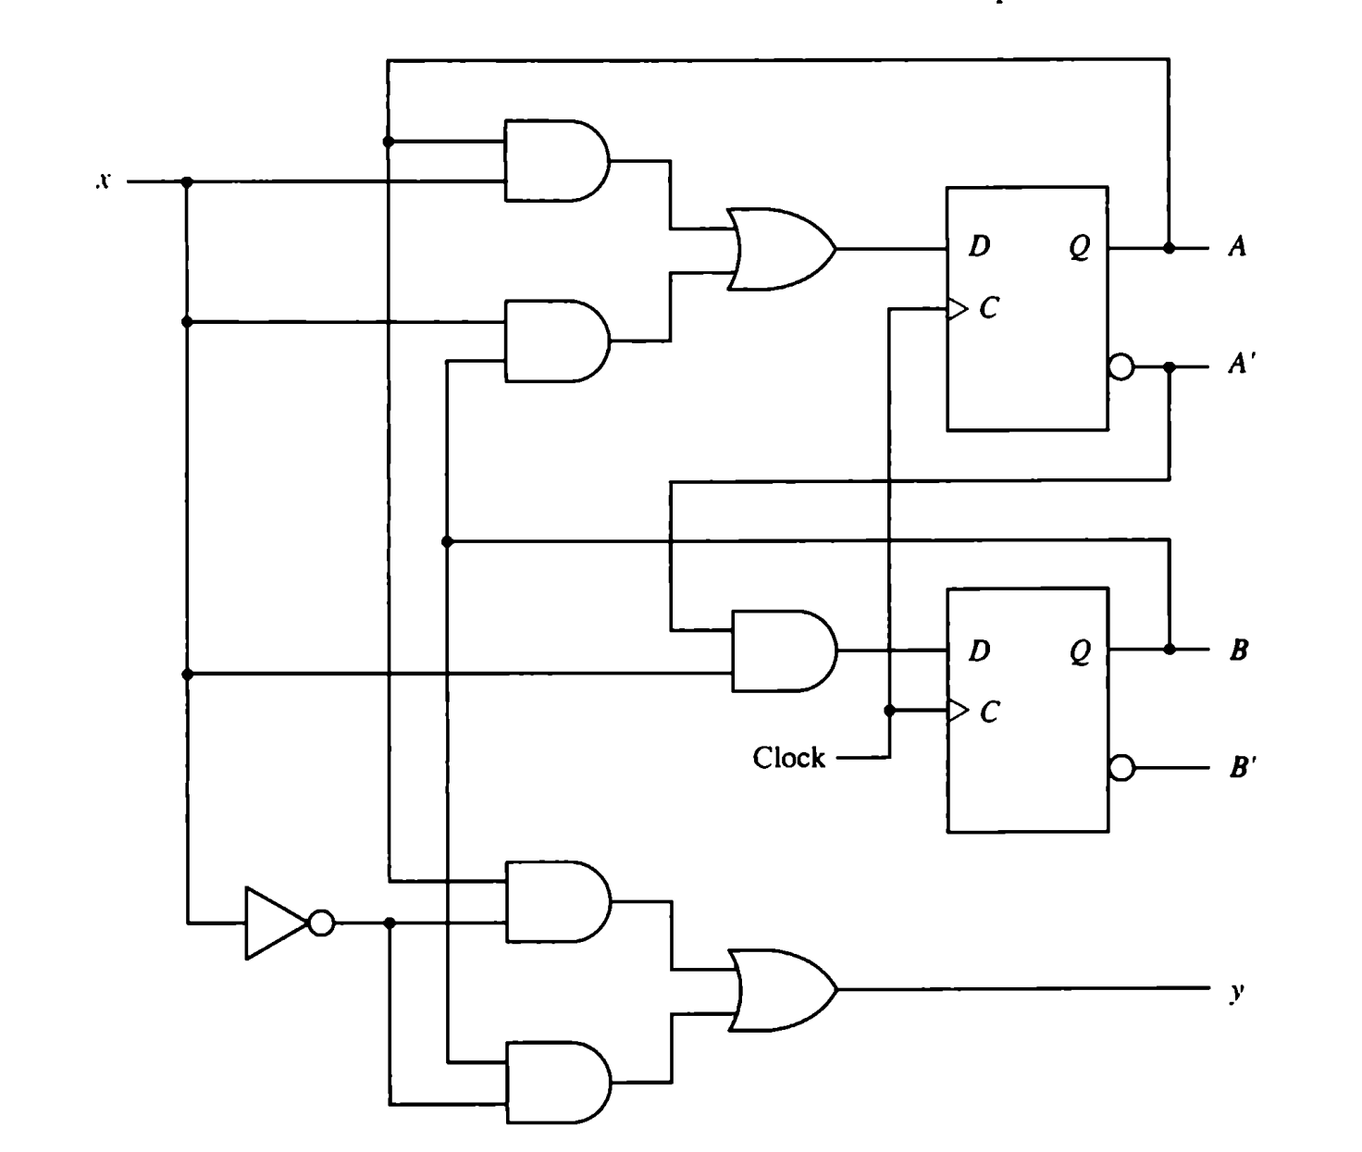
An Example (Let’s try it)

Slide 24
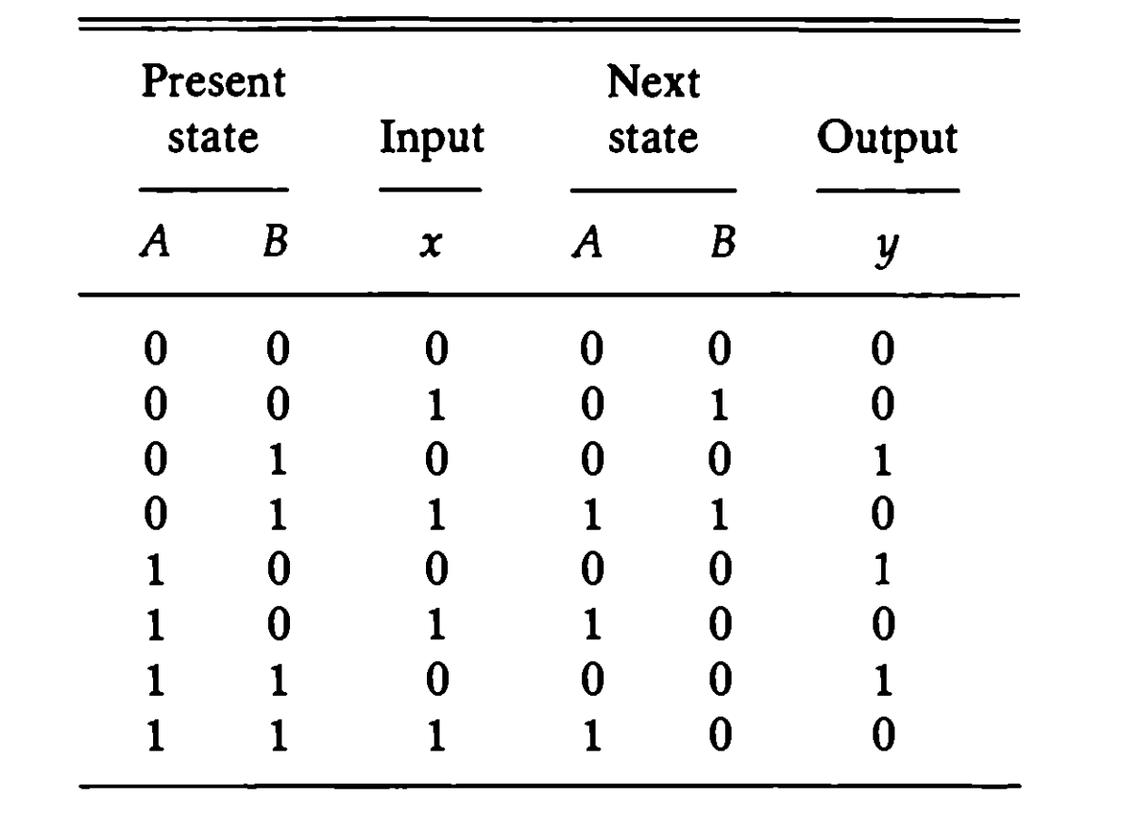
State Table
A (t+1) = Ax + Bx, B (t+1) = A`x , y = Ax` + Bx`

Slide 25
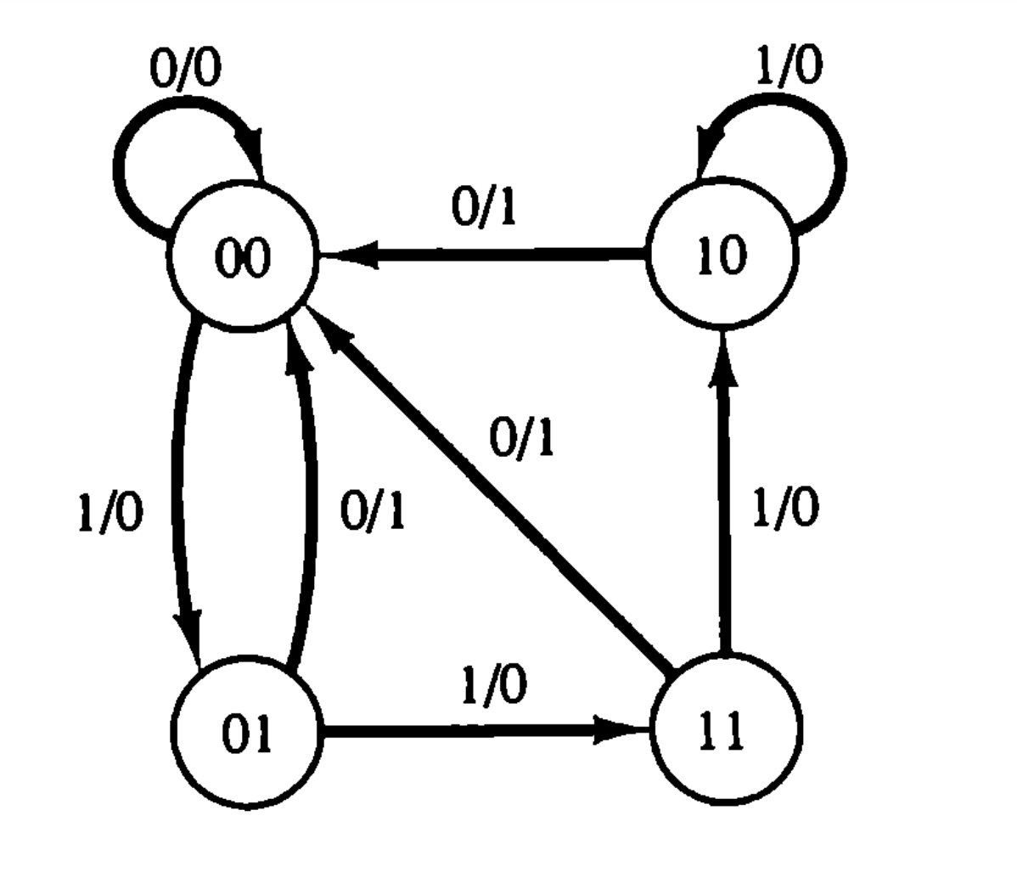
State Diagram x/y where x is input and y is output after the transition

Slide 26

Try it for a binary counter ☺
Lab-1

Slide 27
Textbook Reading
H&H, 3.2 and 3.4

