Slide 1
CS230: Digital Logic Design and Computer Architecture
Lecture 5: The D-Day@Digital logic
https://www.cse.iitb.ac.in/~biswa/courses/CS230/autumn23/main.html

Slide 2

Phones (smart/non-smart) on silence plz, Thanks

Slide 3
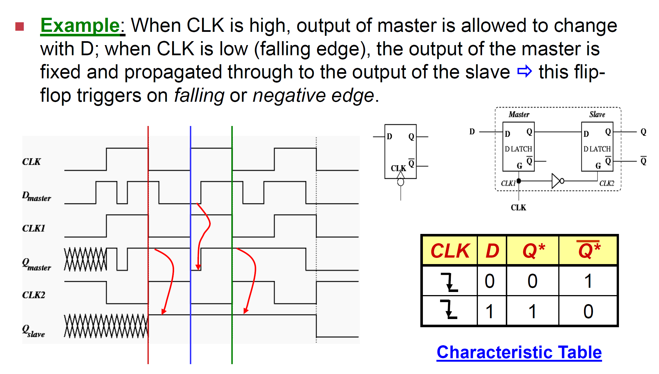
Recap of D Flip-flop

Slide 4
Recap of D Flip-flop

Slide 5
Recap of D Flip-flop

Slide 6
Recap of D Flip-flop

Slide 7
Recap of D Flip-flop

Slide 8
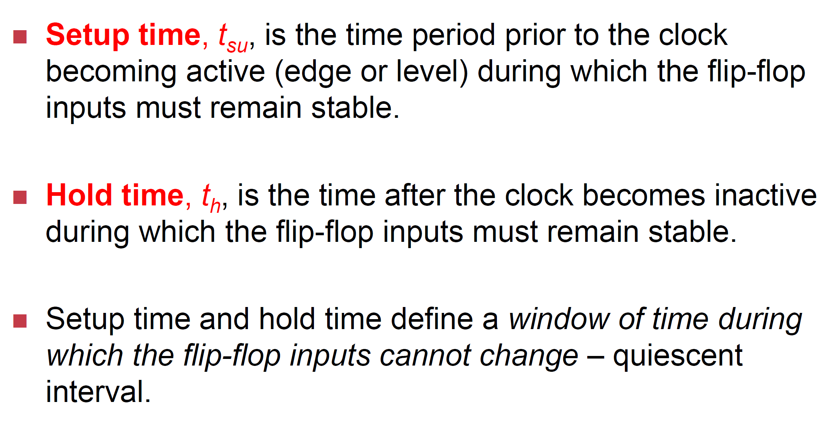
Delay to make sure all is well

Slide 9
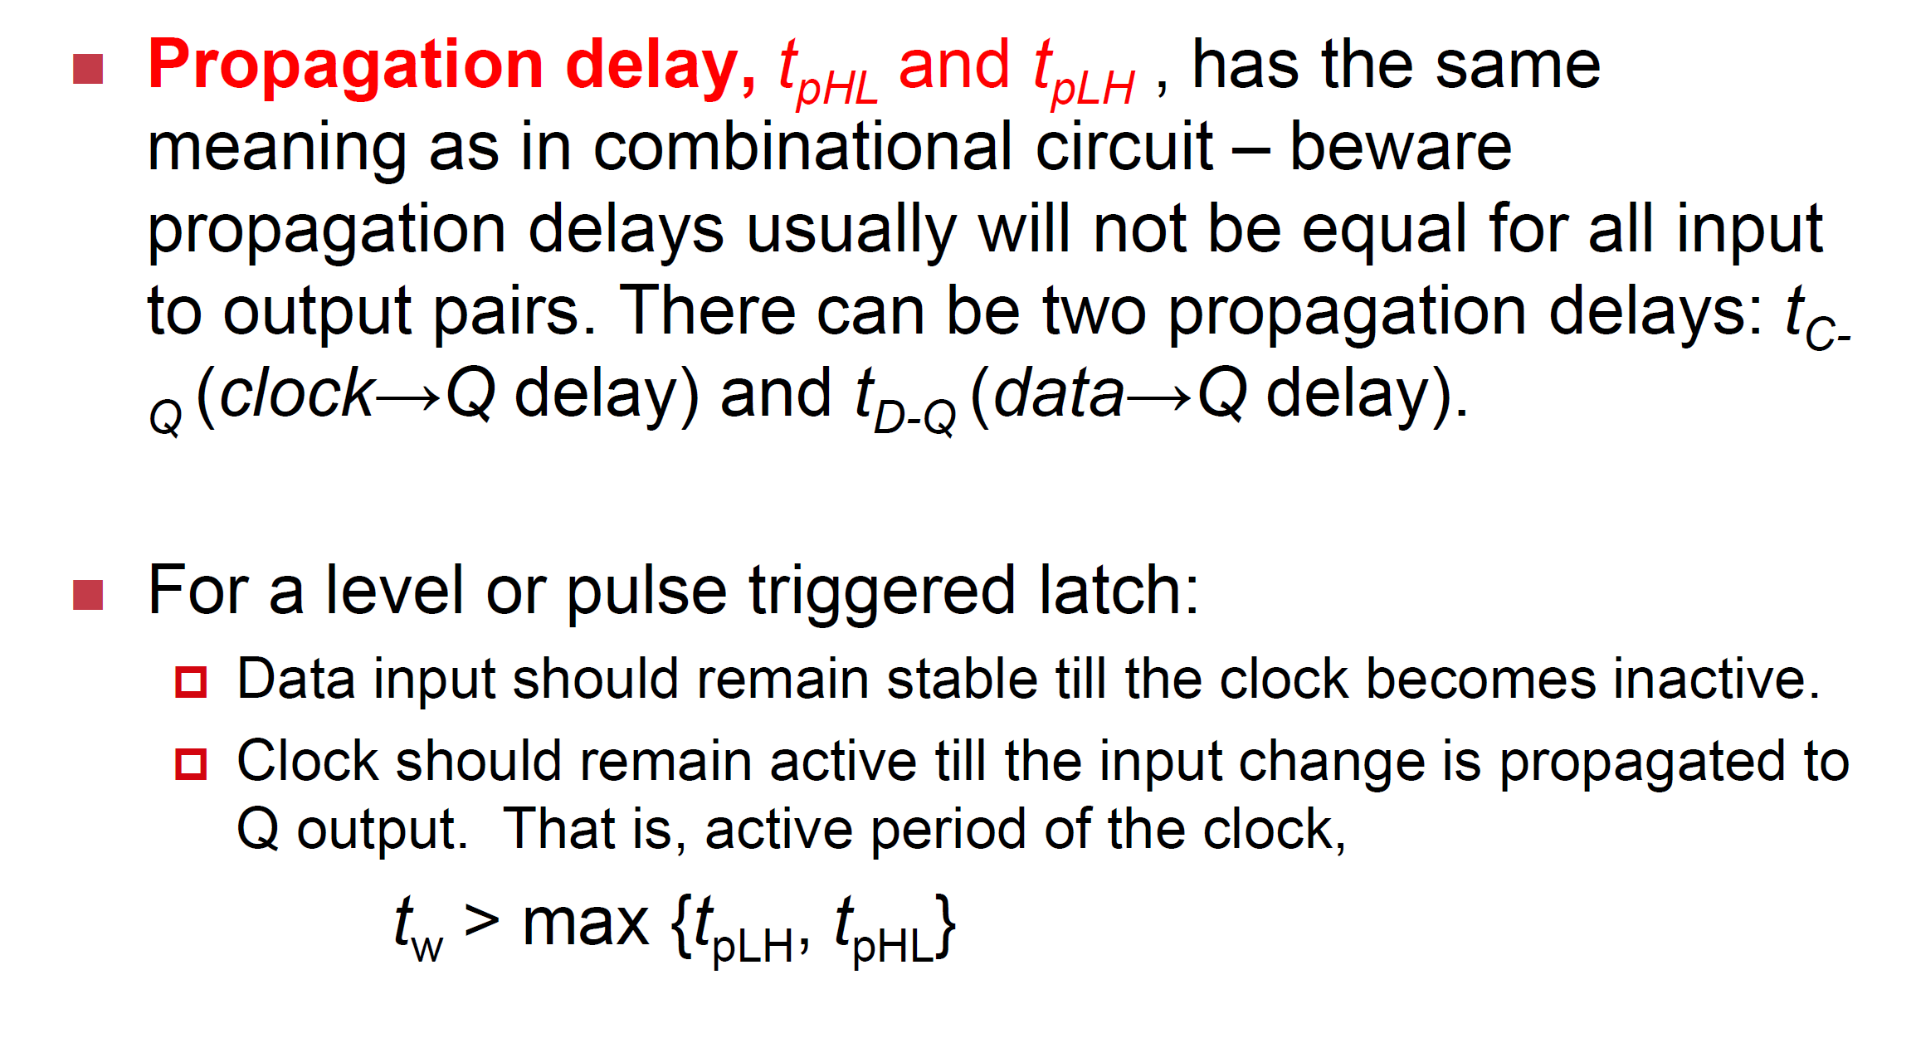
More Delay

Slide 10
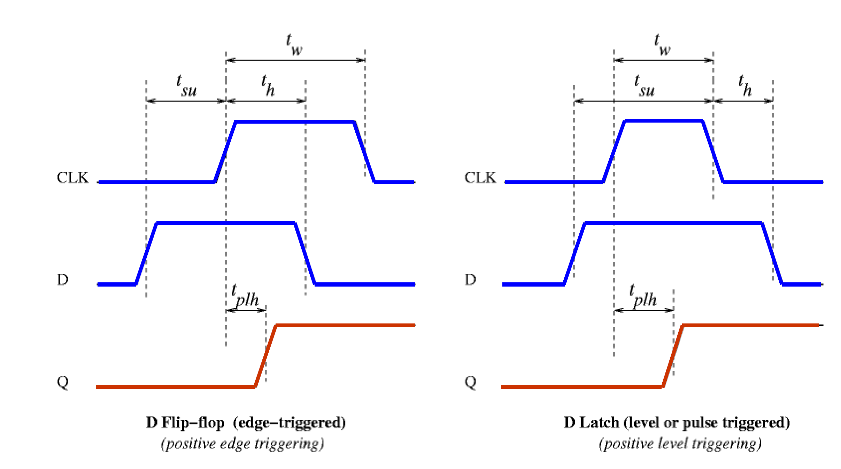
All in One

Slide 11
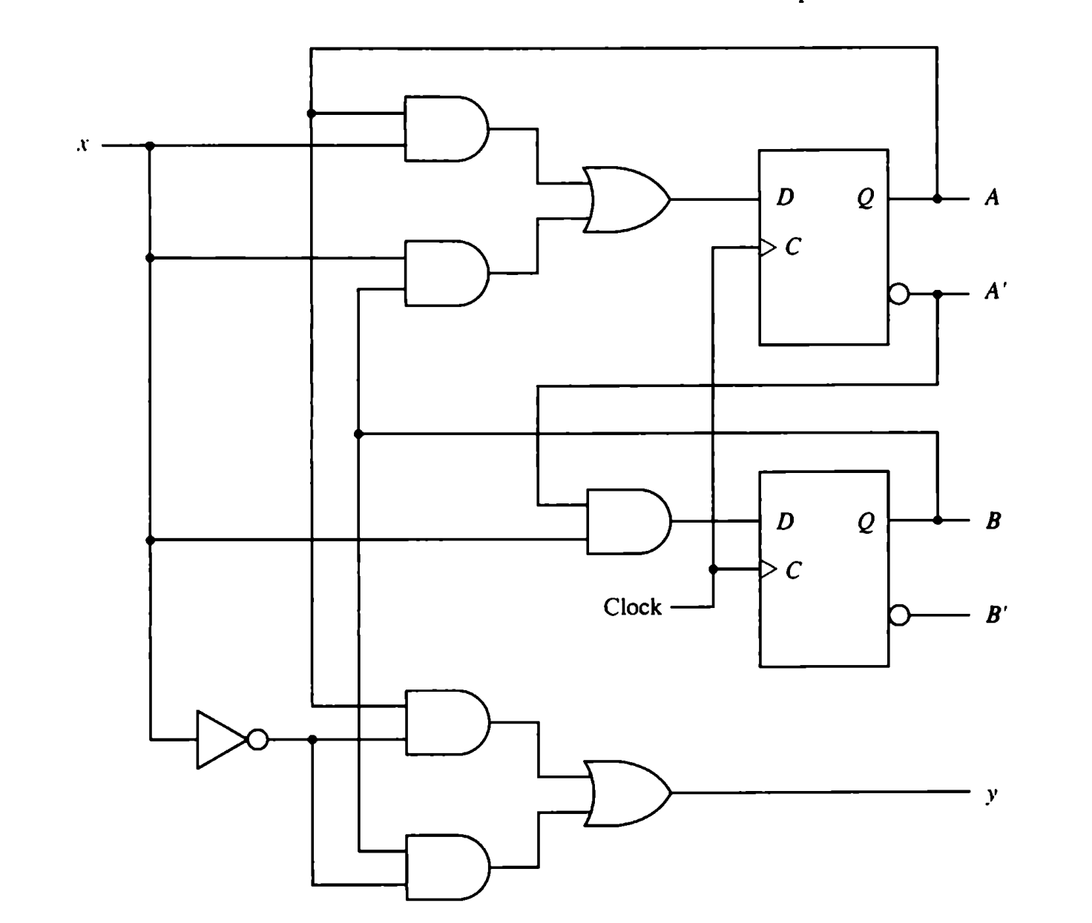
Revisiting sequential circuit: A complete picture

Slide 12
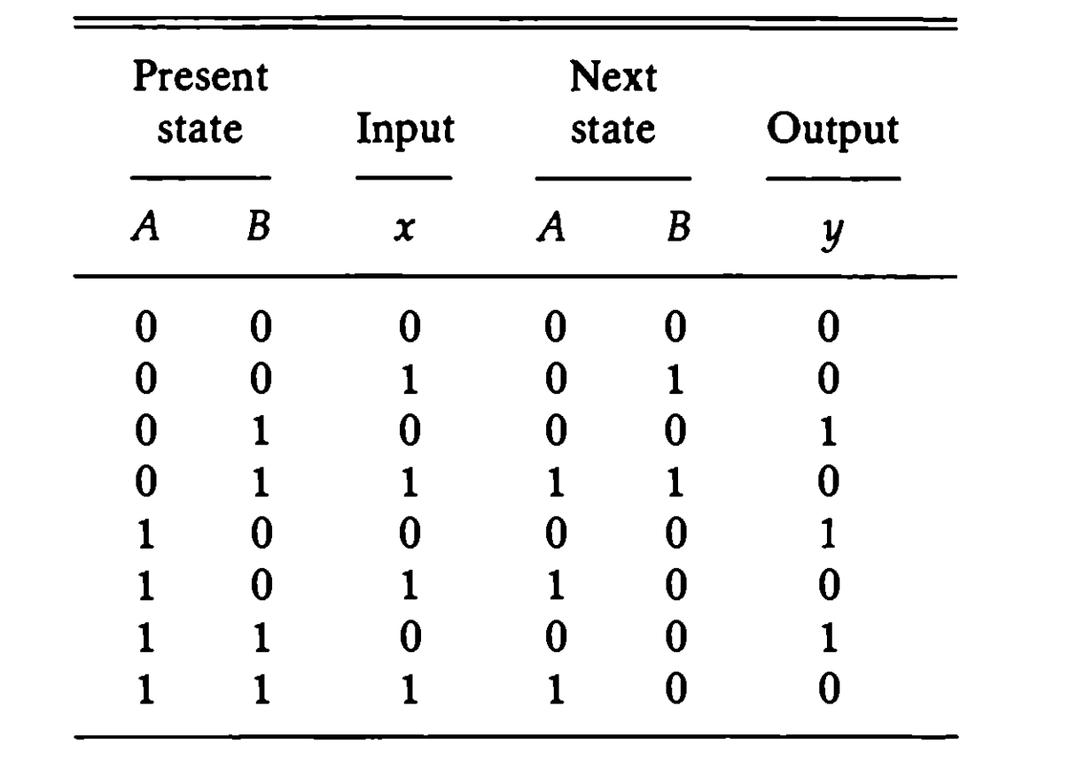
State Table
A (t+1) = Ax + Bx, B (t+1) = A`x , y = Ax` + Bx`

Slide 13
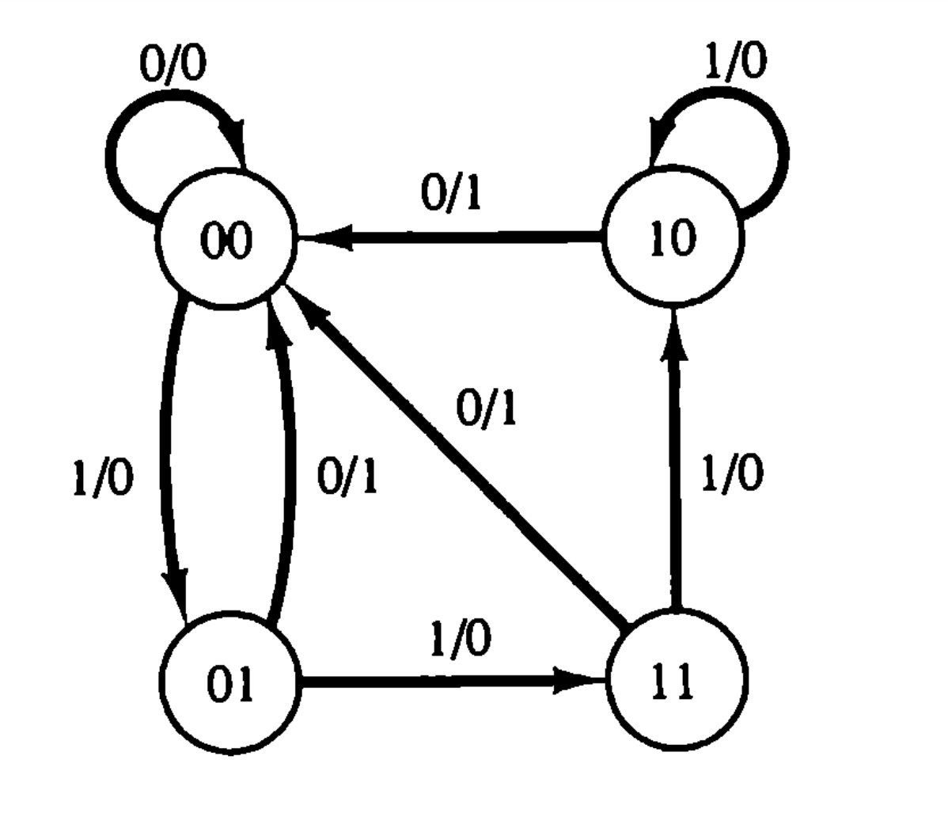
State Diagram x/y where x is input and y is output after the transition

Slide 14

Try it for a binary counter ☺
Lab-1

Slide 15
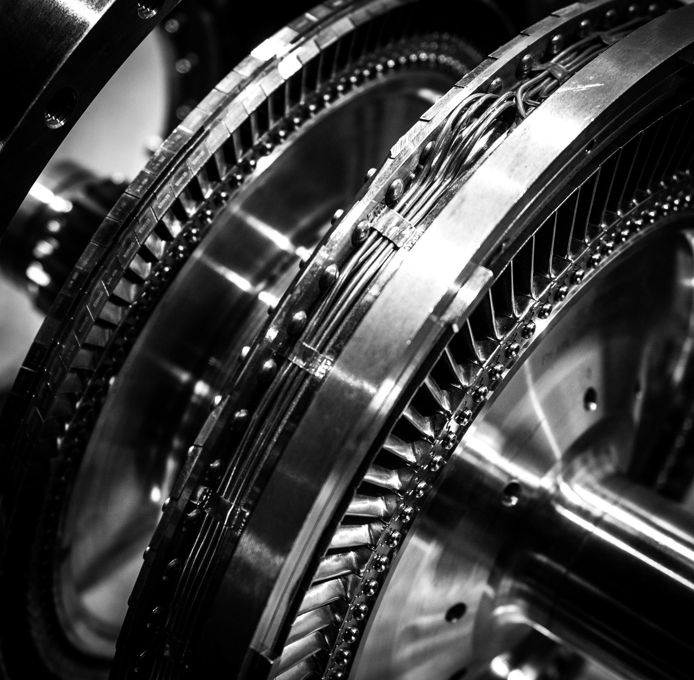
World of State machines (FSMs) Moore and Mealy Machines

Slide 16


Moore vs Mealy
Moore machine: Output depends on the current state
Mealy machine: Output depends on the current state and inputs

Slide 17
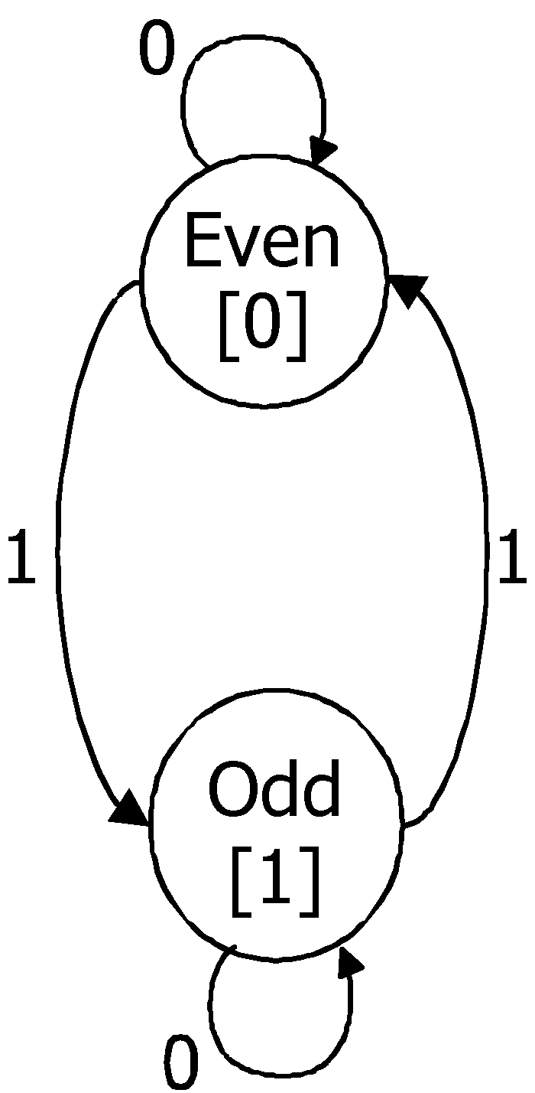
Odd Parity Checker
Serial input string
OUT=1 if odd # of 1s in input
OUT=0 if even # of 1s in input
Let’s do this for Moore and Mealy
Moore
Mealy
0/0
1/1
1/0
0/1

Slide 18

Try on your own

Slide 19
State Transitions
Output changes only when the state changes
Appears after the state transition takes place
outputs change at clock edge
Even = 0
Odd = 1
Moore
Output changes when the state and input changes
Appears before the state transition is completed
React faster to inputs — don't wait for clock
Present Input Next Present
State State Output
Even 0 Even 0
Even 1 Odd 0
Odd 0 Odd 1
Odd 1 Even 1
Mealy
Present Input Next Present
State State Output
Even 0 Even 0
Even 1 Odd 1
Odd 0 Odd 1
Odd 1 Even 0

Slide 20
01/10 detector: Moore Machine
current next current reset input state state output
0
1
1 – – A 0
0 0 A B 0
0 1 A C 0
0 0 B B 0
0 1 B D 0
0 0 C E 0
0 1 C C 0
0 0 D E 1
0 1 D C 1
0 0 E B 1
0 1 E D 1
B/0
D/1
0
reset
0
A/0
1
0
1
1
C/0
E/1
0
1

Slide 21
01/10 detector: Mealy Machine
0/0
current next current reset input state state output
B
0/0
1 – – A 0
0 0 A B 0
0 1 A C 0
0 0 B B 0
0 1 B C 1
0 0 C B 1
0 1 C C 0
reset/0
A
0/1
1/1
1/0
C
1/0

Slide 22
PAUSE

Slide 23

Architecture-101

Slide 24

Next Few Lectures
How can a programmer interact with the processor?
The language of computer: Instructions
Instructions have a vocabulary called instruction set
Driven by instruction set architecture (ISA)
ISA: x86, Arm, RISC-V, MIPS

Slide 25

Coffee Credits
Anirrudh + 1
Tejas +1

