Slide 1
CS230: Digital Logic Design and Computer Architecture
Lecture 6: Hola Computer Architecture
https://www.cse.iitb.ac.in/~biswa/courses/CS230/autumn23/main.html

Slide 2
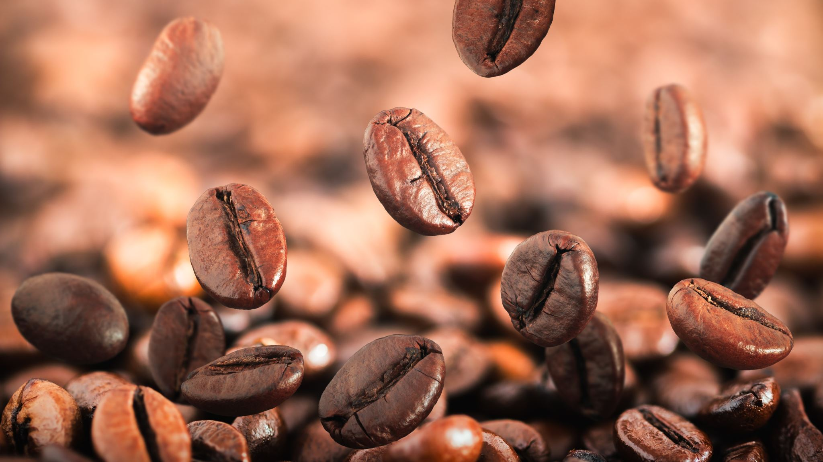
Coffee Points Café closed ☺

Slide 3
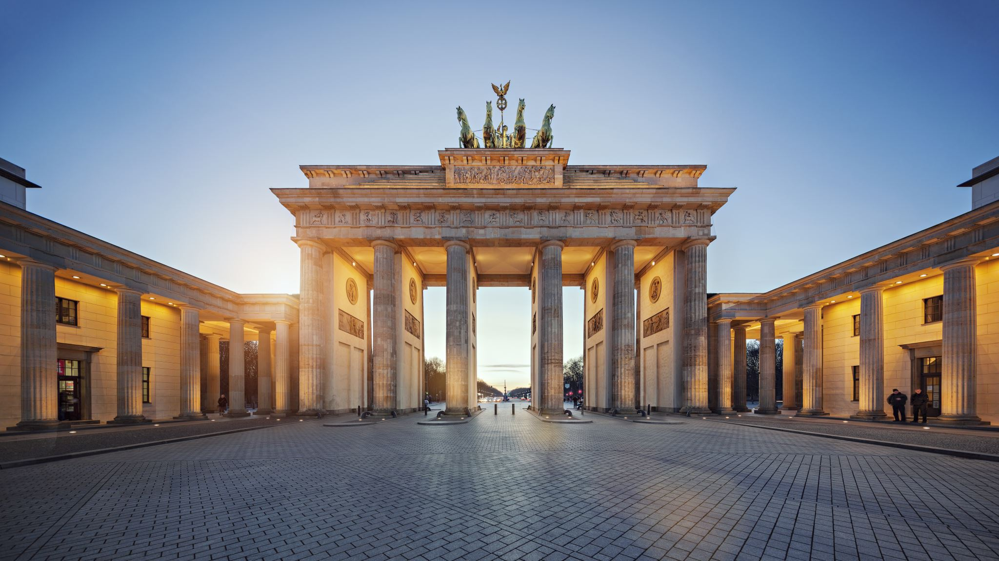
Architecture-101

Slide 4

Next Few Lectures
How can a programmer interact with the processor?
The language of computer: Instructions
Instructions have a vocabulary called instruction set
Driven by instruction set architecture (ISA)
ISA: x86, Arm, RISC-V, MIPS

Slide 5

Why MIPS?
Simple yet expressive
Basic principles are similar if not the same. e.g., ARM ISA
Still in use today: embedded devices, routers, modems etc.

Slide 6
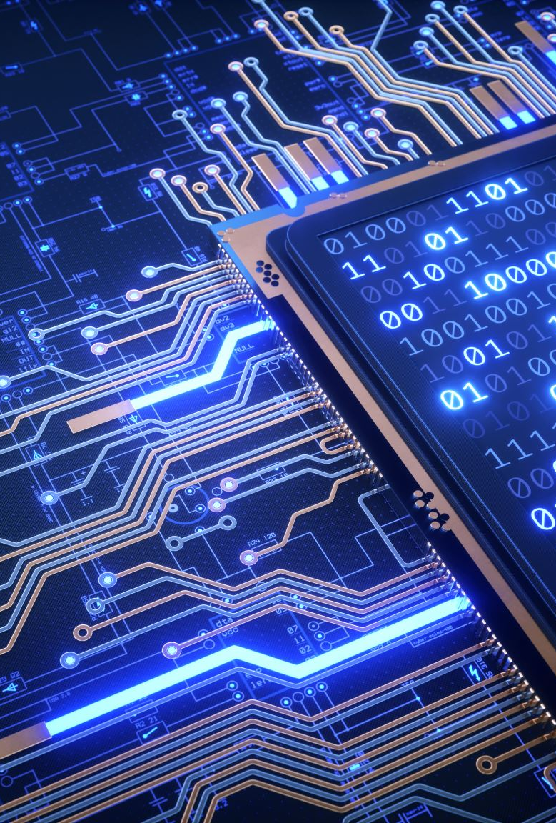
ISA: Abstraction layer
Interface between hardware and software
hides complexity from the software through a set of simple instructions

Slide 7

Abstraction Example: 101
a = b + c ; // C code
compiler
add $1, $2, $3 // assembly language as per the ISA
assembler
010101010101010 // machine language, 0s and 1s

Slide 8
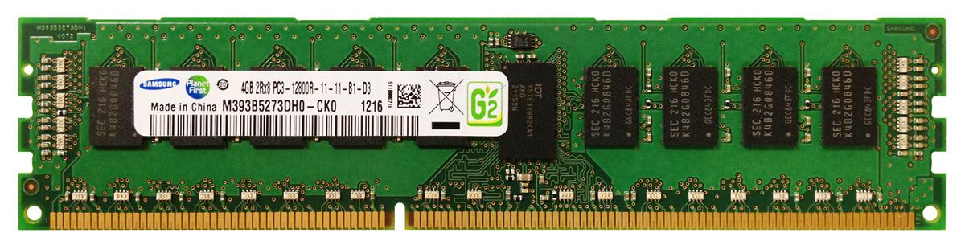
Abstraction Example: 101
Operands can be in registers or in memory
Core
Registers
operands

Slide 9
A bit detailed
Registers
32-bit Address
Core
Data
Costly: 100 times
Costly DRAM accesses☹
Registers are limited
GBs DRAM
South pole ☹

Slide 10

Instructions
Programmers’ order/command to the processor

Slide 11
Why Instructions?
Programmer knows what it can/cannot
Processor knows what it should
Power of abstraction:
World with no instructions:
Programmers – communicate a sequence of 0s and 1s

Slide 12

World with no instructions
000000 00000 00000 00010 00000 100101 000000 00000 00101 01000 00000 101010 000100 01000 00000 00000 00000 000011 000000 00010 00100 00010 00000 100000 001000 00101 00101 11111 11111 111111 000010 00000 10000 00000 00000 000001

Slide 13
Let’s Open the Processor Core
Register 0
Register 1
Register 2
Register 3

Slide 14
Let’s Open the Processor Core
Register 0
Arithmetic / Logic Unit
Register 1
Register 2
Register 3

Slide 15
Let’s put the Memory (not inside the core)
Register 0
Arithmetic / Logic Unit
Register 1
Bus
Register 2
Register 3

Slide 16
Let’s put the Memory (not inside the core)
Register 0
Arithmetic / Logic Unit
Address Bus
Register 1
Data Bus
Register 2
Register 3

Slide 17
MIPS Instructions: 101
add $0, $1, $2
add: operation, $0: Destination, $1 & $2: Source(s)
Most of the arithmetic/logical: two sources and one destination

Slide 18
What to do for “a=b+c-d”?

Slide 19
What to do for “a=b+c-d”?
add $t0, $s1, $s2 #$t = b+c
sub $s0, $t0, $s3 #$s = $t-d
Temporary register
Try out:
f=(g+h) – (i+j)

Slide 20
Constants and Immediate
x=x+10
addi $s0, $s0, 10
i: immediate, for constants, constant: 2s complement
No need of a register

Slide 21
Constants and Immediate
x=x+10
addi $s0, $s0, 10
i: immediate, for constants
constant: 16 bits, 2s complement form
No need of a register
Do we need a subi ? ☺

Slide 22
Constants and Immediate
x=x+10
addi $s0, $s0, 10
i: immediate, for constants, constant: 2s complement form
No need of a register
Do we need a subi ? ☺
NO

Slide 23
Special treatment for zero
$0 or $zero is a special register that contains ZERO
a=b becomes add $s1 $s2 $zero
Why add if we can move?

Slide 24
Pseudo Instruction 101
a=b
move $S0, $s1
Not an actual instruction.
It is used for programming convenience

Slide 25
Logical Operations
Bitwise operations and shifts (Refer Section 2.6 P&H)
sll, srl, and, or, nor, andi, ori etc
No not instruction ☺, well not is nor with one operand=0
32 raw bits instead of a 32-bit number.

Slide 26
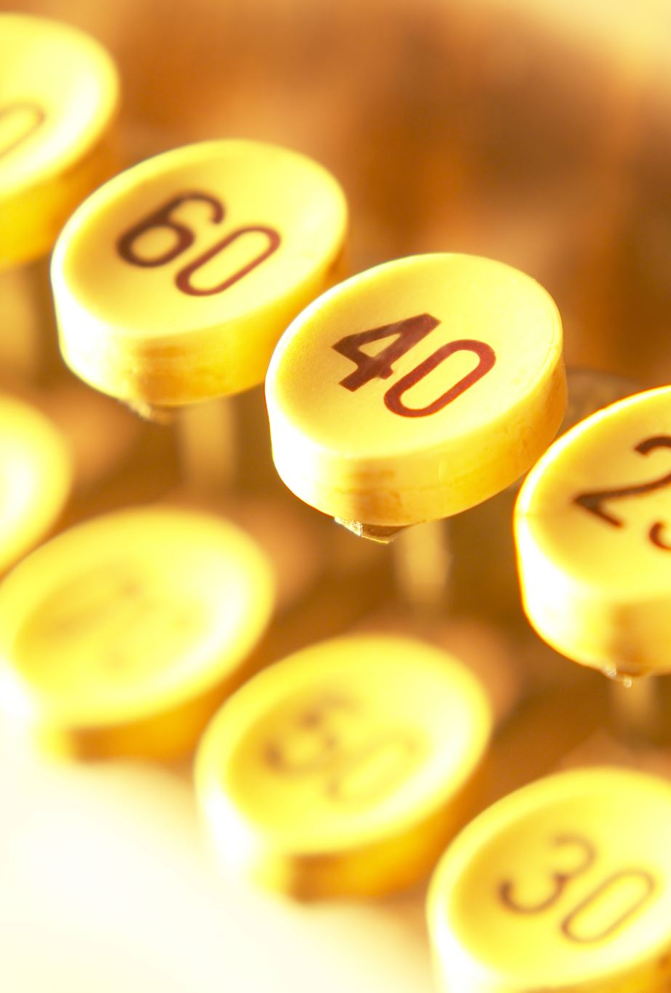
How to store a 32-bit constant into a 32-bit register? Remember 16-bit ☺
For example, 10101010 10101010 11110000 11110000

Slide 27
Trivia? How to store a 32-bit constant into a 32-bit register?
For example, 10101010 10101010 11110000 11110000
lui $t0, 0xAAAA #1010101010101010, lower bits all 0s.
ori $t0, $t0, 0xF0F0 #1111000011110000

Slide 28
Trivia? How to store a 32-bit constant into a 32-bit register?
For example, 10101010 10101010 11110000 11110000
lui $t0, 0xAAAA #1010101010101010, lower bits all 0s.
Basically it will be 0xAAAA0000 (in hexadecimal)
ori $t0, $t0, 0xF0F0 #1111000011110000
it will be 0xAAAAF0F0
lui: upper bits, ori/addi: lower bits

Slide 29

Coffee Credits
Navya +1
Satyankar +1

Slide 30
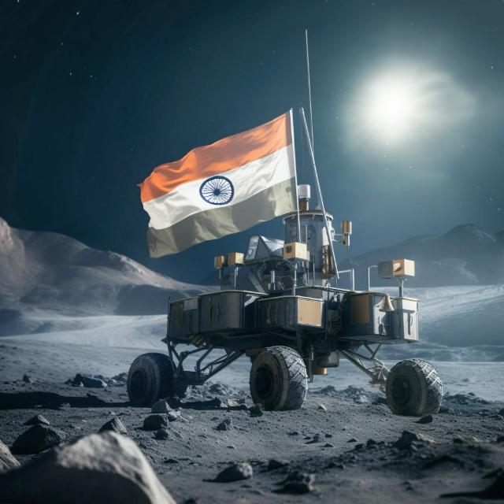
Congrats ISRO, Well Done India
Processor used: Vikram (some avatars of Vikram), 32-bit, 150 instructions
Photo credit: To the owner!

