Slide 1
CS230: Digital Logic Design and Computer Architecture
Lecture 7: MIPS instructions contd.
https://www.cse.iitb.ac.in/~biswa/courses/CS230/autumn23/main.html

Slide 2

Phones (smart/non-smart) on silence plz, Thanks

Slide 3
Recap
ISA
Assembly
Machine level
Instructions

Slide 4
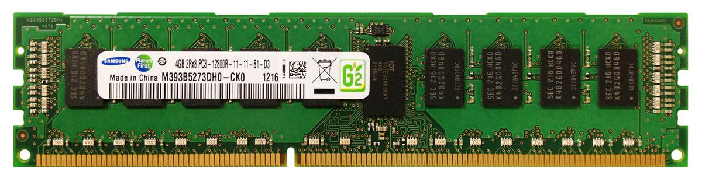
Memory Instructions
LOAD from memory
Core
STORE into the memory
lw $t0, 1($a0) # $t0 = Memory[$a0 + 1]
sw $t0, 1($a0) # Memory[$a0 + 1] = $t0

Slide 5
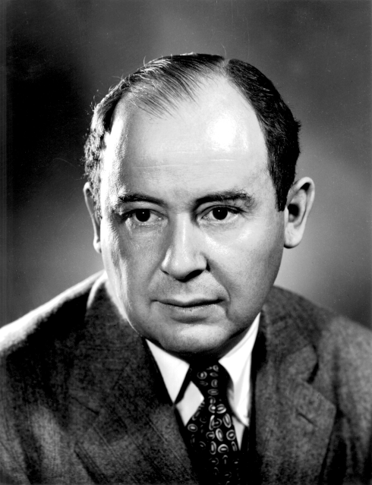
Stored Program
Stored Program
&
Von
Neumann

Slide 6
Memory
4GB of Memory (DRAM)
Say, a word: four bytes

Slide 7
How to access instructions: Program Counter (PC)
A register that stores the address of the instruction
32-bit processor: addresses are of width 32 bits (devil is in the details ☺ )
So the processor fetches PC, PC+4, PC+8, ….. in a sequential order

Slide 8
1946 onwards
Since 1946 all computers have had 5 components
Processor
Input
Registers,
ALU, PC
Memory
(instructions
+data)
Datapath
Output

Slide 9
Example (Remember PC for the time being)
PCX: lw
PCY: add
PCZ: lui
PCZ=PCY+4 and PCY = PCX+4

Slide 10

Why Memory? Why Not Registers?
Registers are limited. More #registers, higher access time.
How? we will see sooner than later.
Let’s focus on the data part now. How to access data for our instructions?

Slide 11
Memory Instructions
LOAD from memory
Core
STORE into the memory
lw $t0, 1($a0) # $t0 = Memory[$a0 + 1]
sw $t0, 1($a0) # Memory[$a0 + 1] = $t0

Slide 12
LOAD From the Memory (data-transfer insts)
Memory[$a0 + 1]
Address
Data
0
10
1
100
.
.
lw $t0, 1($a0)
.
.
Core
.
.
r1
.
.
.
Load immediate is not a load from memory ☺
r32

Slide 13
STORE
Memory[$a0 + 1]
Address
Data
0
10
1
100
.
.
sw $t0, 1($a0)
.
.
Core
.
.
r1
.
.
.
r32

Slide 14
Both instructions and data from memory
g = h + A [8];
PCX: lw $t0, 8($3) # A[8]
PCY: add $s1, $s2, $t0 # g = h + t0
PCY = PCX+4

Slide 15

A quick recap
Von Neumann (stored program) concept
As registers are limited, data can be there in the registers or in the memory
Register accesses are through register names/numbers
Memory accesses are through addresses stored in registers

Slide 16
Let’s move on: Decision Making Instructions
Decisions: if, else ….
Two instructions:
beq (branch equals to) and
bne (branch not equals to)
beq $t0, $t1, L1
bne $t0, $t1, L1

Slide 17
Branch Instructions: Conditional branches
beq $t0, $t1, L1
goto L1 (statements labeled as L1) if $t0 equals $t1
bne $t0, $t1, L1
goto L1 (statements labeled as L1) if $t0 does not equal to $t1

Slide 18
The slt instruction (Set on less than)
if (a < b) // beq and bne won’t work here
c=1
else
c=0
slt $t3, $t1, $t2 // t1 and t2 contain a and b
We can slti too; one of the operand will be a constant

Slide 19
Loops: How to deal with it?
while(CS230[i] == k)
i+=1;
say i and k are in $s3 and $s5, and the
base of CS230 in $s6

Slide 20
Loops continued
while(CS230[i] == k)
i+=1;
LOAD CS230[i], base address of CS230 is in $s6
We need to go to CS230[i]
Assuming CS230 is an integer array, each index is of 4 bytes. We need to go to CS230 [i*4 bytes]

Slide 21
Loops contd. ($s3=i, $s5=k, $s6=base address)
while(CS230[i] == k)
i+=1;
sll $t1, $s3, 2 // i*4
add $t1, $t1, $s6 // address of CS230[i]
lw $t0, 0($t1) // t0 = CS230[i]
bne $t0, $s5, Exit // go to Exit if CS230[i] not equals to k
addi $s3, $s3,1 // i=i+1
Exit: // do nothing
Where is the Loop?

Slide 22
Loops continued
while(CS230[i] == k)
i+=1;
Loop: sll $t1, $s3, 2 // i*4
add $t1, $t1, $s6 // address of CS230[i]
lw $t0, 0($t1) // t0 = CS230[i]
bne $t0, $s5, Exit // go to Exit if CS230[i] not equals to k
addi $s3, $s3,1 // i=i+1
Exit: // do nothing
How to jump to the Loop?

Slide 23
Loops continued
while(CS230[i] == k)
i+=1;
Loop: sll $t1, $s3, 2 // i*4
add $t1, $t1, $s6 // address of CS230[i]
lw $t0, 0($t1) // t0 = CS230[i]
bne $t0, $s5, Exit // go to Exit if CS230[i] not equals to k
addi $s3, $s3,1 // i=i+1
j Loop // go to loop. j here is jump
Exit: // do nothing

Slide 24

Textbook Chapter 2 P&H

Slide 25

Namaste

