Slide 1
CS230: Digital Logic Design and Computer Architecture
Lecture-8: MIPS Instructions-III
https://www.cse.iitb.ac.in/~biswa/courses/CS230/autumn23/main.html

Slide 2
Sequential execution and jumps
PC, PC+4, PC+8, …………….
PC, PC+4, {if condition here, TRUE} PC+32, ………
j instruction loads an immediate into the PC. It can be either specified as an offset or the label (assembler will convert this label into an offset).

Slide 3
Functions (Procedures)
int sum(int a, int b)
{
int c=a+b;
return c;
}
void main (void)
{
int i=1;
int j=2;
int k = sum(i,j);
// …..
}

Slide 4
Simple ☺
int sum(int a, int b)
{
int c=a+b;
return c;
}
void main (void)
{
int i=1;
int j=2;
int k = sum (i,j);
// …..
}
//jump to function

Slide 5
Simple ☺
int sum(int a, int b)
{
int c=a+b;
return c;
}
void main (void)
{
int i=1;
int j=2;
int k = sum(i,j);
// …..
}
How do you return? ☹
j sum

Slide 6
Awesome Instructions
jal: Jump and Link and jr $ra
jal L1:
go to L1, the instruction that has to be executed next is in L1.
and
save the address of the next instruction in $ra. ra is an awesome register that stores the return address.

Slide 7
Awesome Instructions
jal: Jump and Link and jr $ra
jal L1:
go to L1, the instruction that has to be executed next is in L1.
and
save the address of the next instruction in $ra. ra is an awesome register that stores the return address (ra).
Go to instruction whose address is stored in ra (PC+4)

Slide 8
Let’s Have a Complete Picture
PC+4 addi $R1, $R0, 2 // R0 = 0, R1=2
PC+8 jal sum // R31 (ra) = PC+12
PC+12 add $R0, $R3, $R3
sum:
PC+100 addi $R2, $R1, 4
PC+104 jr

Slide 9
Let’s Have a Complete Picture
PC+4 addi $R1, $R0, 2 // R0 = 0, R1=2
PC+8 jal sum // R31 = PC+12 (ra)
PC+12 add $R0, $R3, $R3
sum:
PC+100 addi $R2, $R1, 4 // R2 =6
PC+104 jr $R31

Slide 10
Let’s Have a Complete Picture
PC+4 addi $R1, $R0, 2 // R0 = R3 = 0, R1=2
PC+8 jal sum // R31 = PC+12 (ra)
PC+12 add $R0, $R3, $R3 // R0 = 0
sum:
PC+100 addi $R2, $R1, 4 // R2 =6
PC+104 jr $R31

Slide 11
Let’s Have a Complete Picture
PC+4 addi $R1, $R0, 2 // R0 = R3 = 0, R1=2
PC+8 jal sum // R31 = PC+12 (ra)
PC+12 add $R0, $R2, $R2 // R0 = 12
sum:
PC+100 addi $R2, $R1, 4 // R2 =6
PC+104 jr $R31

Slide 12
JAL: Jump and Link, What’s wrong?
PC+4 addi $R1, $R0, 2
PC+8 jal sum // R31 = PC+12 (ra)
PC+12 add $R0, $R2, $R2

Slide 13
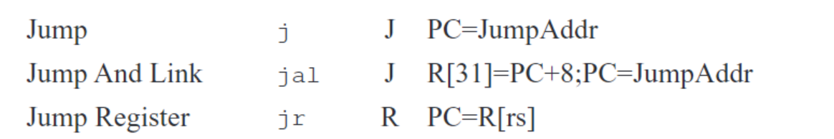

Well
As per MIPS specification, Check P&H MIPS sheet ☹
PC: jal label ra = PC + 8
PC+4:
PC+8:

Slide 14
PC+4 or PC+8? Why this
PC+4 at the moment
PC+8 after a month or so ☺

Slide 15
PAUSE: Quick recap
Usage of j, jr, jal, and $ra

Slide 16
MIPS provides
Upto four arguments can be passed from the caller to the callee while using jal. It uses registers $a0 to $a3
A callee can return upto two values to the caller. It uses registers $v0 and $v1

Slide 17
What if?
main(){
a = a + f1(a);
} f1:
f1(a) { f2’s argument in $a0 to $a3
a = a - f2(a); return a;} jal f2
f2(a) {
a = a + f3(a); return a;}
f3(a) {
a = a + 1; return a;}

Slide 18
What if?
f1:
f2’s argument in $a0 to $a3
jal f2
…
f2:
f3’s argument in $a0 to $a3
jal f3
…

Slide 19
What is the big deal?
f1:
f2’s argument in $a0 to $a3
jal f2
…
f2:
f3’s argument in $a0 to $a3
jal f3
...

Slide 20
What is the big deal? Oh no!
f1:
PC: f2’s argument in $a0 to $a3
PC+4: jal f2 // $ra = PC+8
…
f2:
PC+100: f3’s argument in $a0 to $a3
PC+104: jal f3 // $ra = PC+108
f3: …
... jr $ra

Slide 21
What is the big deal? Oh no!
f1:
PC: f2’s argument in $a0 to $a3
PC+4: jal f2 // $ra = PC+8
…
f2:
PC+100: f3’s argument in $a0 to $a3
PC+104: jal f3 // $ra = PC+108
jr $ra ☹ Oh no!! f3: …
... jr $ra

Slide 22
Saving and Restoring Registers (limited)
caller registers
callee registers
Why?
Callee does not know, registers used by callers, can be many callers too
Caller does not know the callee’s plan ☺

Slide 23

Do not forget 32 MIPS registers only Register spilling ☹

Slide 24
Quick recap
Register spilling, 32 MIPS registers, nested functions,
oh no!
Spilled registers: Where else can we store?

Slide 25
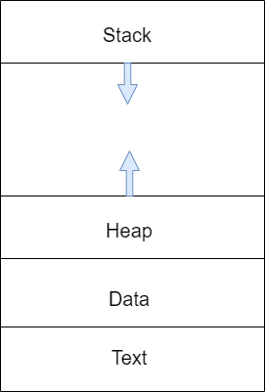
The loaded program
System program that loads the executable into the memory.
Every executable has a text, heap/stack data segments

Slide 26
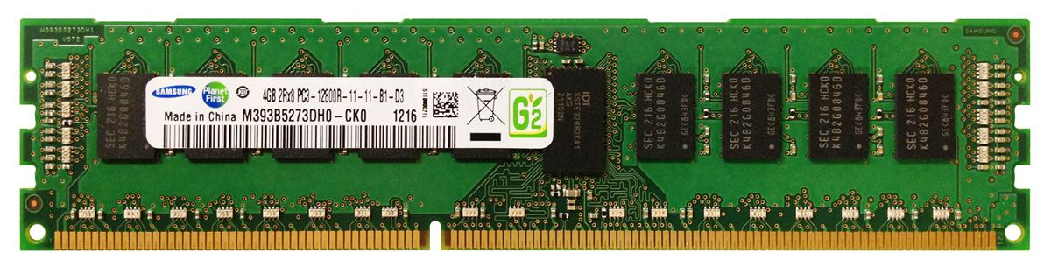
MIPS way of handling it: The Stack (part of DRAM, for each function call)
Stores caller data
Stack grows down
$sp (stack pointer) points to the address where stack ends
One per function, private memory area, else the same problem ☹

Slide 27
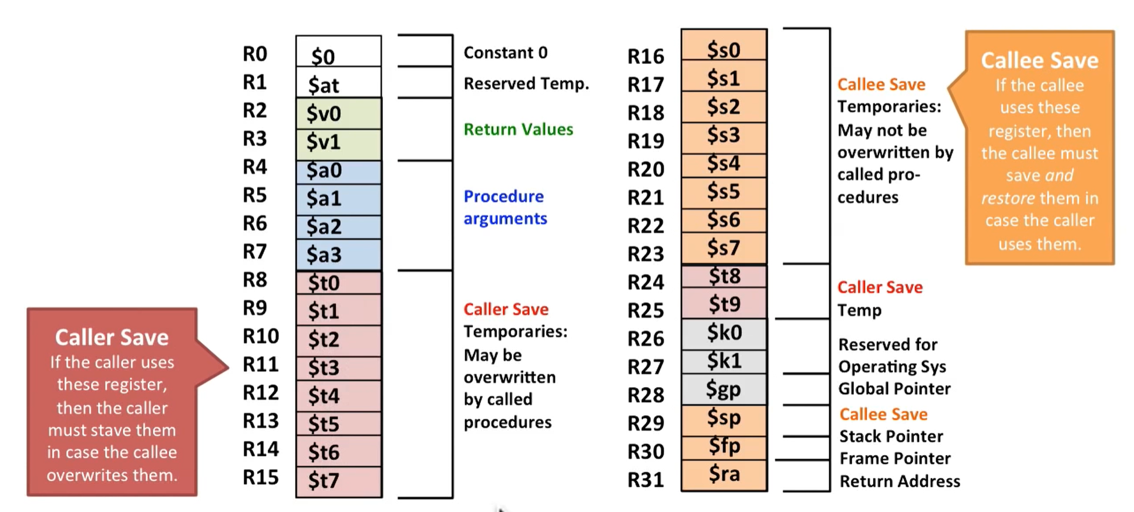

Slide 28
MIPS way of handling it: Before function call
sp
Caller

Slide 29
MIPS way of handling it: Function call is ON
Caller R1
Callee R2
sp
Callee R4
Saved

Slide 30
MIPS way of handling it: After the function call
sp
Caller R1

Slide 31
How to save and restore?
Caller R1
sp
Save:
addi $sp, $sp, -4
sw R4, ($sp)
Restore:
lw R4, ($sp)
addi $sp, $sp, 4
Callee R4
Saved
32 bit registers, 4 bytes, one word, remember
sp
Caller R1
Restored

Slide 32
Nested Functions (Remember main() is a function too ☺ )
CS230 // jal cs230
{
CS330 // jal cs330
{
CS430 // jal cs430
{
} //jr
} //jr
} // jr

Slide 33
The final one: Frame pointer
Stack also stores local variables and data structures (local arrays and structures) for a function along with the return address(es).
Frame pointer will get incremented and decremented based on the local arguments used.

Slide 34
The final one: Frame pointer
Frame pointer: Points to local variables and saved registers. Points to the highest address in the procedure frame. Stays there throughout the procedure. Stack pointer, moves around.
fp
fp
fp
returns
regs.
sp
sp
sp
local
Awesomeness: You can access any using fp/sp and an offset

Slide 35
Try This Out! Discuss on Piazza
Page no A-27 to A-29 P&H
Recursive function fact(n)
Look for sp, fp, ra, jal, and jr

Slide 36
For the Curious Ones (Beyond CS230)
Stack buffer overflow - 101: https://en.wikipedia.org/wiki/Stack_buffer_overflow

Slide 37

Coffee credits
Ankeet +5

Slide 38
ਸਤਿ ਸ੍ਰੀ ਅਕਾਲ

