Slide 1
CS661 · BIG DATA VISUAL ANALYTICS
Global Inequality in Diabetes
and Hypertension Care
A Visual Analytics Study
Group 5
Stuti Singh (251083)
Unnati Gangurde (231107)
Talakola Maha Lakshmi (241082)
Khasha Meganakshtra (240542)
Pyna Hema Lakshmi SatyaSree (240819)
Sruja BG (240289)
Annadevara Yashvanth Chary (240143)
Mavilla Bharadwaja (251110021)
Singampalli Sri Varshith (251110074)
Indian Institute of Technology Kanpur

Slide 2
Problem Statement
Managing diabetes and hypertension well requires a health system to do two things reliably:
REACH
put people on treatment
CONTROL
actually bring the condition under control
These are not the same achievement.
A country can put a large share of its population on medication and still fail to bring most of them under control. The gap between those two numbers is one of the most policy-relevant quantities in chronic disease care — and the WHO publishes both, for the same country, year and sex.
OUR QUESTION
Where in the world are people being treated for diabetes and hypertension but not having it effectively controlled — and how has that gap evolved and differed by sex, region, and income level?
2

Slide 3
Dataset
WHO Health Inequality Data Repository
Health Care System and Access module · WHO Global Health Observatory
• Full repository: 197 countries · 1980–2023 · 33 indicators · ~100k rows
• The problem: most indicators are sparse — few countries per year, or no national-level values at all. A dashboard built on them would be mostly empty.
• Our decision: we audited all 33 for completeness and scoped to the 6 that are verified complete.
72,420
country–year–sex estimates · 195 countries
zero missing values
Indicator | Years | Countries
Diabetes treatment coverage (age-std. / crude) | 1990–2022 | 195
Hypertension treatment coverage (age-std. / crude) | 1990–2019 | 195 / 194
Hypertension effective control (age-std. / crude) | 1990–2019 | 195 / 194
Derived metrics
ΔSex = Male − Female · ΔLeak = Treatment − Effective control · ΔAge = Crude − Age-standardized
3

Slide 4
Tech Stack
Dash 4.4 (Flask)
Web application framework. Provides the reactive callback graph that keeps all six views synchronised with one shared filter state, and serves the single-page interface.
Plotly 6.9
All six visualizations — choropleth, dumbbell, multi-line series, cascade, grouped bars, slope chart. Hover, zoom and click events arrive already wired to Dash.
pandas 3.0 · NumPy 2.5
Data aggregation, the derived metrics (ΔSex, ΔLeak, ΔAge), and all in-callback filtering over the eight prepared tables.
Render
Deployment. The dashboard is live and publicly accessible.
Deliberately not used: D3.js (every chart was expressible in Plotly) and SQLite (72k rows fit in memory; repeat views are served from an LRU cache).
4

Slide 5
Experiments
Six linked visual analytics tasks — each is demonstrated live.
1
Global Coverage Map
Choropleth Map
Where is coverage highest and lowest?
2
Sex Gap Analysis
Dumbbell Chart
How large is the male–female gap, and is it closing?
3
Temporal Trend Analysis
Multi-line Time Series
Has three decades of progress been equitably shared?
4
Treatment-to-Control Cascade
Horizontal Bar Cascade
Of the people a system treats, how many does it actually help?
5
Regional & Income-Group Comparison
Grouped Bar Chart + Error Bars
Is coverage explained by geography, or by income?
6
Age-Standardized vs. Crude
Paired Slope Chart
How much of a country's figure is just its age structure?
5

Slide 6
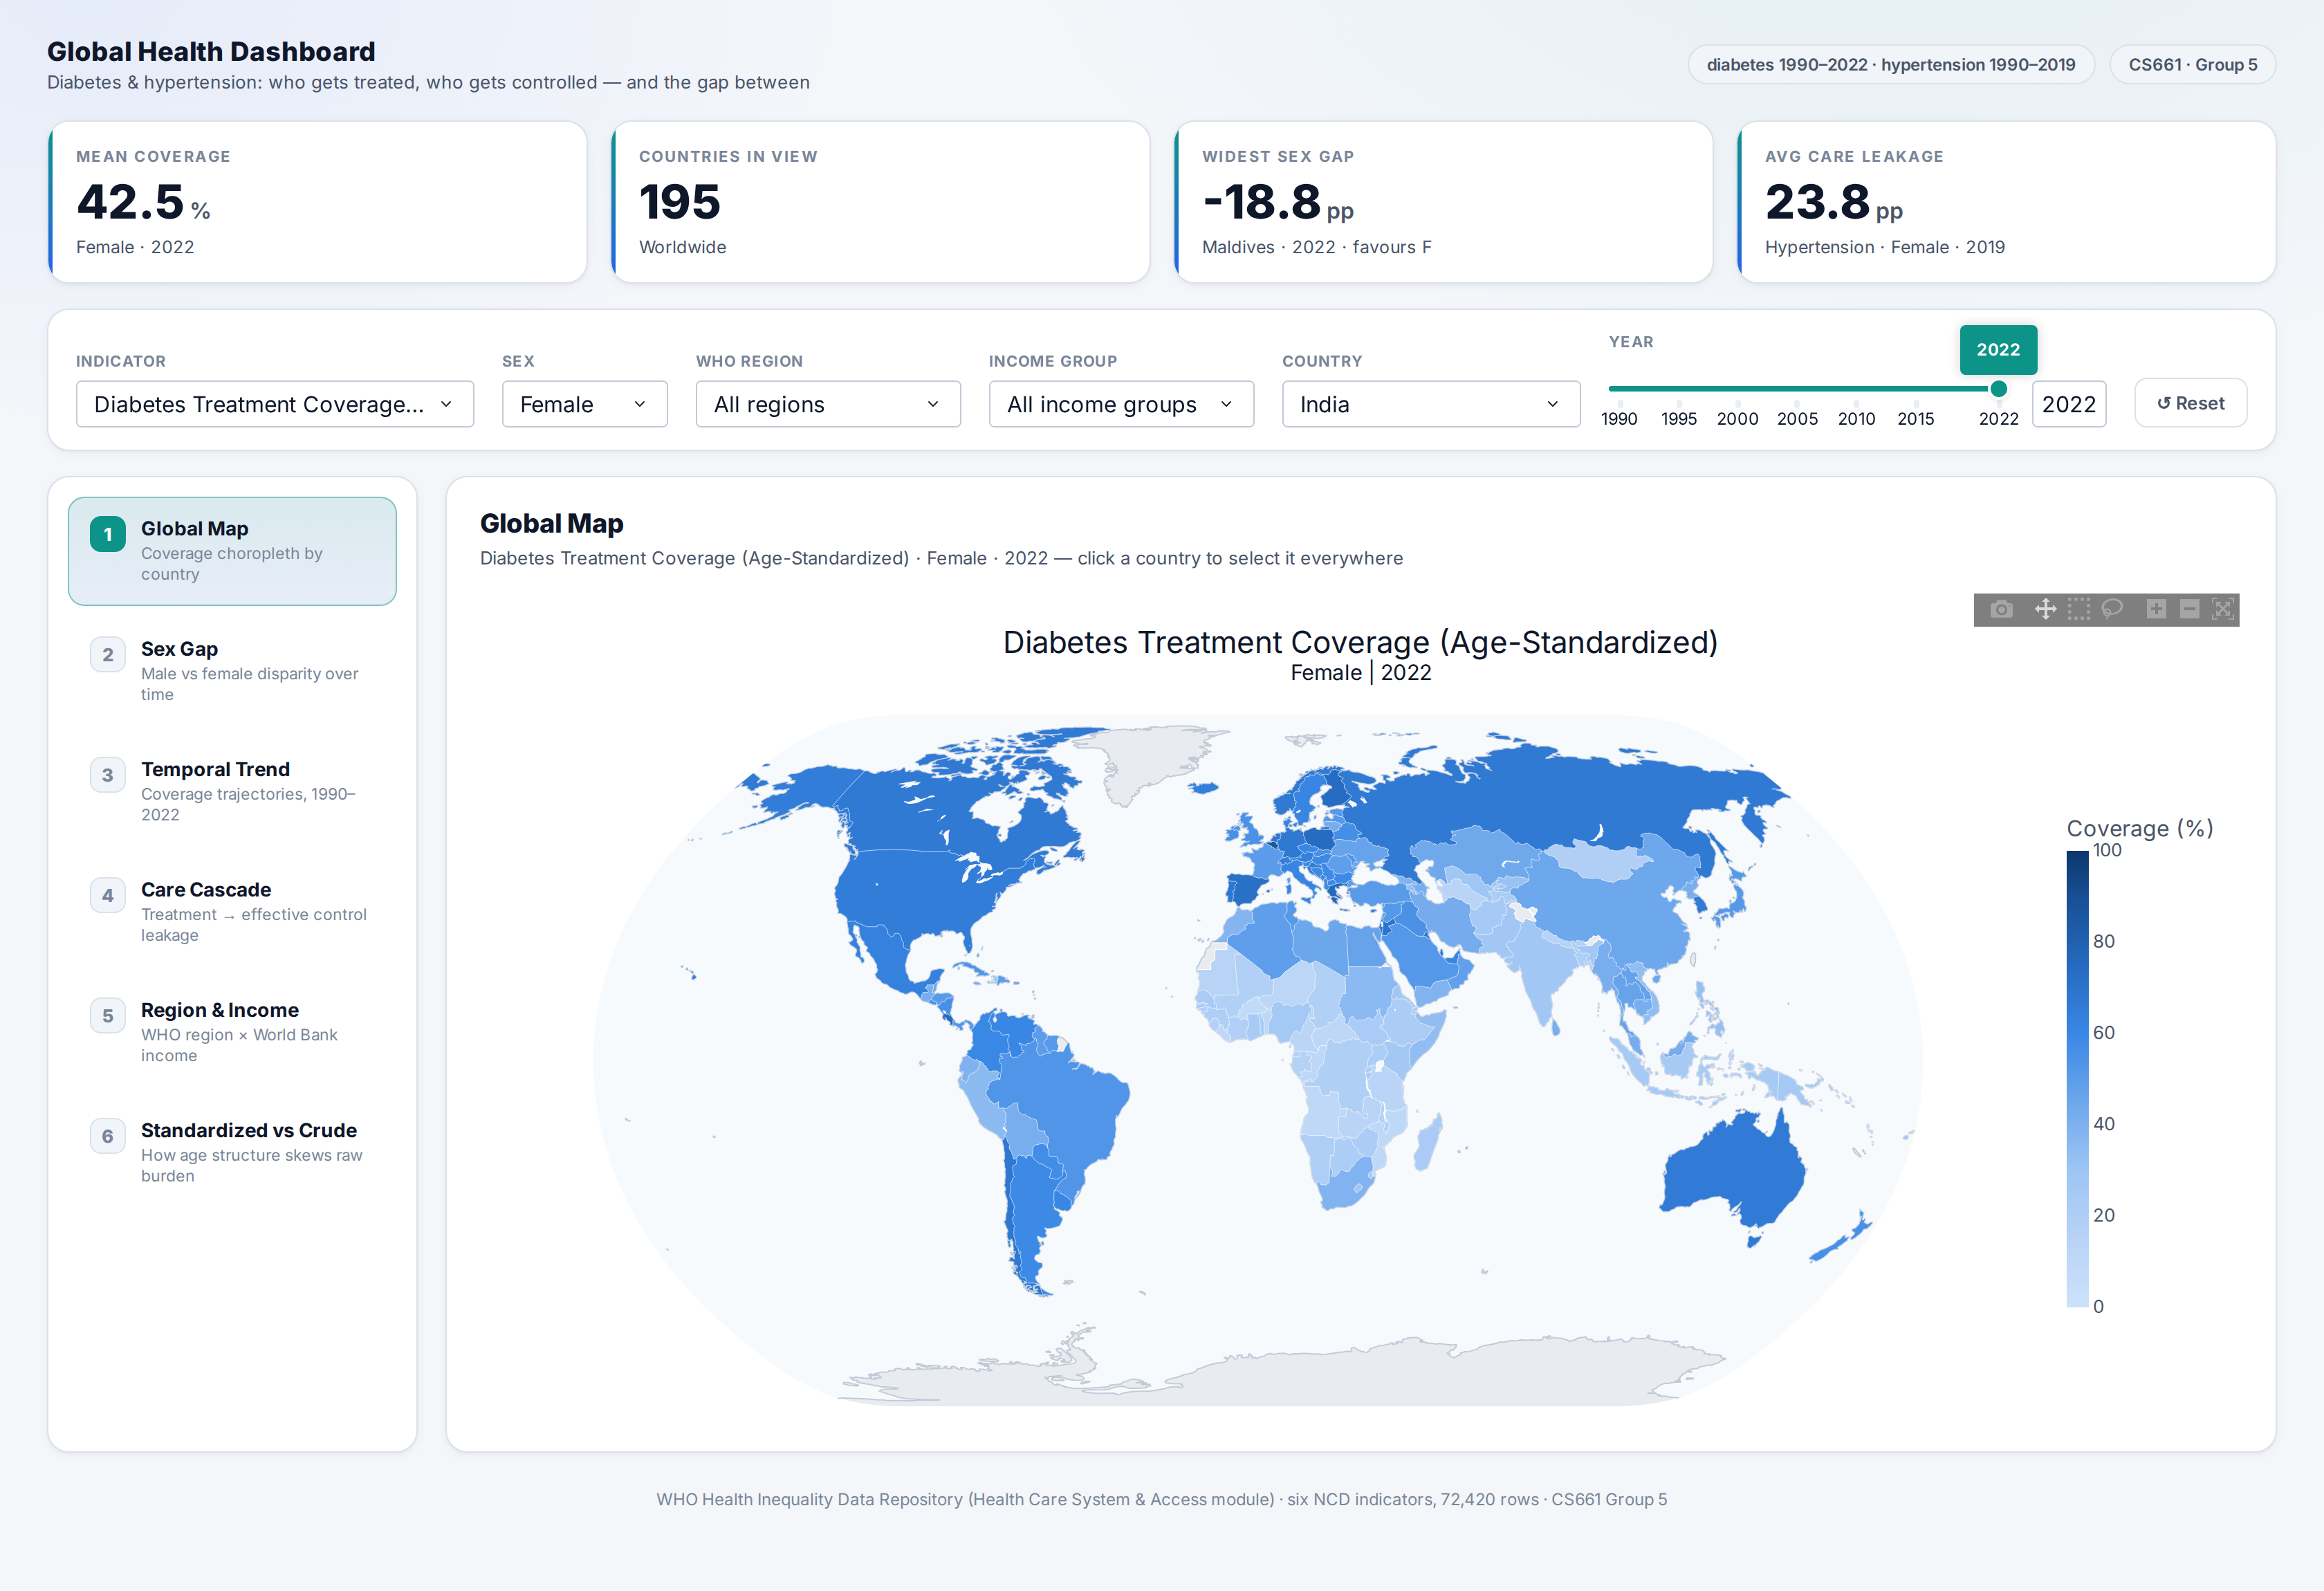
Dashboard Overview
A single-page linked dashboard — not six independent charts.
• One shared state. All six views read from a single filter store.
• Cross-filtering. Click a country on the map and it is selected everywhere.
• Scoping. Region and income narrow the country pool across every view.
• Live KPI strip. Four headline numbers, recomputed from the current scope.
• Nearest-year fallback. Switching indicators never blanks a view.
LIVE DEMO
https://global-health-dashboard-1.onrender.com/
6

Slide 7
Conclusion
• Care is stratified, not merely uneven. Diabetes treatment coverage runs from 8.5% in Burkina Faso to 86.0% in Belgium — a 10× ratio.
• Thirty years of progress widened every absolute gap. The high-to-low income gap in hypertension control grew from 4.4 pp (1990) to 18.5 pp (2019) — even though low-income countries improved by over 400% in relative terms. Growth converged; levels diverged.
• Treatment is the easy half. Fewer than half (47.5%) of treated hypertensive patients reach effective control. The worst conversion belongs to upper-middle-income countries (43.7%) — not the poorest ones.
• Men are systematically under-reached. Women have higher hypertension treatment coverage in 190 of 195 countries, and the gap has widened since 1990 — a diagnostic, not therapeutic, failure.
• Measurement is a policy choice. Choosing crude over age-standardized rates moves Qatar 54 places in a global ranking, purely because of population age structure.
Several of these are visible only because the views are linked and the metrics are paired — a chart-by-chart dashboard would not surface them.
7

Slide 8
Contributions
Component | Member | Roll No.
Data Preprocessing | Stuti Singh | 251083
Task 1: Global Coverage Map | Annadevara Yashvanth Chary | 240143
Task 2: Sex Gap Analysis | Singampalli Sri Varshith | 251110074
Task 3: Temporal Trend Analysis | Mavilla Bharadwaja | 251110021
Task 4: Treatment-to-Control Cascade | Talakola Maha Lakshmi Khasha Meganakshtra | 241082 240542
Task 5: Regional & Income-Group Comparison | Pyna Hema Lakshmi SatyaSree Sruja BG | 240819 240289
Task 6: Age-Standardized vs. Crude | Unnati Gangurde | 231107
8

Slide 9
Thank You
Group 5 · CS661 Big Data Visual Analytics
Live dashboard https://global-health-dashboard-1.onrender.com/
GitHub repository https://github.com/VarshithSS/global_health_dashboard

