Slide 1

PRE-IDEATHON TEMPLATE
GENESIS
IDEATHON
TEAM & DOMAIN
Introduce your team and the domain you have chosen
Team Name –Aviators
Team Members - 1.Varshith Vrindesh -CB.EN.U4AEE25053
2.Jatin Dinesh - CB.EN.U4AEE25020
3.Akshara Pulicherla - CB.EN.U4AEE25003
4.Gurucharan - CB.EN.U4AEE25037
Selected Domain –8
Problem Statement –Current flight ground operations rely on inefficient jet engines, causing massive fuel waste, expensive engine damage, and severe pollution that prevents sustainable aviation.

Slide 2


DOMAIN PROBLEM IN OUR WORDS
TEAM
Aviators
Explain the problem in your domain simply, in your own words
Q1) What exactly needs to be solved?
1.Fuel Waste and Congestion: These cause severe financial losses for airlines.
2.Inefficient Use: Jet engines operate efficiently at high altitudes, not at slower speeds on the ground
3.Breakaway Thrust: Heavy aircraft need high power just to start moving. Stop-and-go traffic on the taxiway causes huge fuel usage and waste of potential fuel that can be used in the cruise phase.
MagTaxi stops this waste by keeping the main engines off until the aircraft reaches the runway.
Q2) Why is it important right now?
1.Climate Mandates: Aviation must reach net-zero emissions by 2050. Stopping ground idling is the fastest way to eliminate massive carbon pollution today.
2.High Costs: Jet fuel is very expensive. Airlines urgently need to stop wasting millions of dollars driving planes on the ground to protect their profits.
3.Airport Congestion: Global air traffic is growing, but airports have no space to build new taxiways. Automated tracks prevent gridlock by routing aircraft perfectly.
4.Noise Restrictions: Cities are enforcing strict airport noise curfews. Silent magnetic tracks allow airports to safely operate more flights late at night without disturbing local communities.

Slide 3
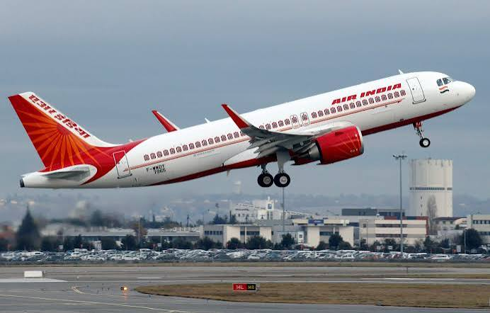

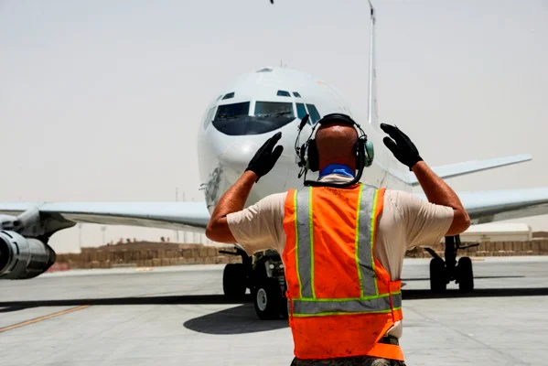
WHO IS AFFECTED?
TEAM
Aviators
Target users, stakeholders, beneficiaries
Primary users / target group:-
- Commercial airlines and flight crews
- Airport ground control and traffic control
Secondary stakeholders:-
- Aviation Safety & Regulatory Bodies
- Airport Infrastructure & Construction Developers
- Aircraft OEMs (Original Equipment Manufacturers)
Who benefits if the problem is solved:-
- Local communities
- Airport Ground Staff
- Global climate goals

Slide 4
CURRENT SITUATION & CONTEXT
TEAM
Aviators
Existing scenario, background and how things work today
Existing scenario and background
Jet engines are engineered for high-altitude cruise, making low-speed tarmac taxiing highly inefficient. The stop-and-go traffic of ground operations forces massive, unnecessary fuel burn. Minimizing this ground wastage directly preserves fuel to extend the aircraft's cruising range.
Relevant data or facts
The proposed magnetic receiver adds less than 50kg of total weight and it can be installed during a scheduled maintenance check.
The MagTaxi plans to reduce fuel consumption by 90% on all ground operation.
Current workflow, step by step
Main Engine start for gate-to-runway transit
Low speed taxi causes excessive fuel burn
Debris ingestion could risk engine damage
Stop and go traffic also causes fuel burn
Causes local pollution and inefficient use of fuel

Slide 5
KEY CHALLENGES
TEAM
Aviators
Main difficulties, bottlenecks, root causes and consequences
Main difficulties and bottlenecks:
(i) Fuel waste- Commercial jets consume massive amounts of aviation fuel by simply moving between the runway and gates.
(ii) Maintenance costs- Ground taxiing increases the overall operation hours raising the maintenance costs.
(iii) Air and noise pollution- Continuous usage generates toxic emissions (CO2,NOx) along with ground noise.
Root causes behind them:
(i) Sub-Optimal Operation: Jet engines are designed for high-altitude, high-speed flight. Operating them at low speeds causes
thermodynamic inefficiency.
(ii) Braking Wear: Relying on traditional friction-based disk brakes to slow heavy aircraft on taxiways causes excessive wear.
Consequences of leaving them unsolved:
(i) Failure to Meet Sustainability Goals: Airlines will fail to achieve their target carbon reduction goals.
(ii) Escalating Airline Costs: Increased fuel burn and shortened engine lifespans significantly drive-up operating costs.

Slide 6
EXISTING SOLUTIONS / APPROACHES
TEAM
Aviators
What is already being done, and where it falls short
Existing methods/systems | Limitations
Traditional Main Engine | Inefficient at low speeds, high aviation fuel waste, high risk of Foreign Object Debris (FOD) damage, severe air/noise pollution
Tow-Tractors (e.g., TaxiBot) | Increases vehicle traffic on the apron, requires manual labor for connection, slower turnaround times.
On-Board Motors (e.g., WheelTug) | Adds permanent heavy motors to the landing gear, increasing aircraft weight and reducing flight range/payload capacity.
The Gap They Leave Open (Key Challenges)
The "Cold Engine" Problem
2. The "Universal Plug" Problem (Interoperability)
3. Peak Electrical Grid Surges

Slide 7
PROBLEM INSIGHTS & OPPORTUNITY AREAS
TEAM
Aviators
Resources required to solve the problem
HARDWARE REQUIREMENTS | SOFTWARE REQUIREMENTS | OTHER RESOURCES
Concrete-embedded Linear Induction Motor (LIM) tracks across main taxiways. 50 kg magnetic receivers with emergency quick-release on the nose landing gear. Contactless KERS magnetic brakes, dual power feeds, and terminal battery units. | Centralized system managing real-time aircraft routing and taxiway traffic. Smart grid software routing KERS-recovered power to batteries or gate support. Real-time monitoring logic to initiate instant disconnect during power grid loss. | High initial CapEx for phased ground construction and track installation Engineering and maintenance teams Such as Civil crews for taxiway builds and avionics techs for 24-hour plane retrofits. Regulatory liaisons like aviation safety officers to certify non-interference with radio/nav systems.

Slide 8
INITIAL DIRECTION & EXPECTED OUTCOME
TEAM
Aviators
What Is Your Expected Outcome?
What your team intends to do
We intend to design and implement Project MagTaxi, a fully automated magnetic induction surface mobility system embedded directly into airport taxiways that seamlessly moves aircraft to and from the terminal gates without ever using their main jet engines.
What you want to improve
We want to eliminate the thermodynamic inefficiency, massive aviation fuel waste, and severe air and noise pollution caused by heavy jet engines idling and crawling in stop-and-go ground traffic, ultimately reducing overall airline operating and maintenance costs.
What successful improvement should you achieve
We aim to achieve a 90% reduction in ground taxi fuel consumption, zero localized engine emissions, and zero engine damage from ground debris (FOD), alongside capturing reusable deceleration energy via a Kinetic Energy Recovery System (KERS) to power airport infrastructure.

Slide 9
TEAM CONTRIBUTION
TEAM
Aviators
Who will handle which part of the execution
Team Member | Role | Responsibility in Execution
Varshith Vrindesh | Project Manager & Lead Systems Integrator | Directs execution by aligning cross-functional workflows and ensuring that all hardware and software subsystems function as a unified network.
Jatin Dinesh | Infrastructure & Master Planning Lead | Architect of the high-level physical track layout and network geometry, ensuring optimal spatial design and long-term expansion capabilities.
Guru Charan | Operations & Reliability Engineer | Ensures continuous network uptime and peak efficiency through system monitoring, stress testing, and predictive maintenance planning.
Akshara Pulicherla | Ground Systems Engineer | Overseas daily stationary track environment operations, quick-response hardware troubleshooting, and the execution of emergency safety protocols.

