Slide 1
Neural Network and Genetic Algorithms
UNIT-2

Slide 2
Introduction to Artificial Neural Networks
Neural networks, also known as artificial neural networks (ANNs) or simulated neural networks (SNNs), are a subset of machine learning and are at the heart of deep learning algorithms.
Their name and structure are inspired by the human brain, mimicking the way that biological neurons signal to one another.

Slide 3
What is Neuron?
Neurons in deep learning models are nodes through which data and computations flow.
Neurons work like this:
They receive one or more input signals. These input signals can come from either the raw data set or from neurons positioned at a previous layer of the neural net.
They perform some calculations.
They send some output signals to neurons deeper in the neural net through a synapse.

Slide 4
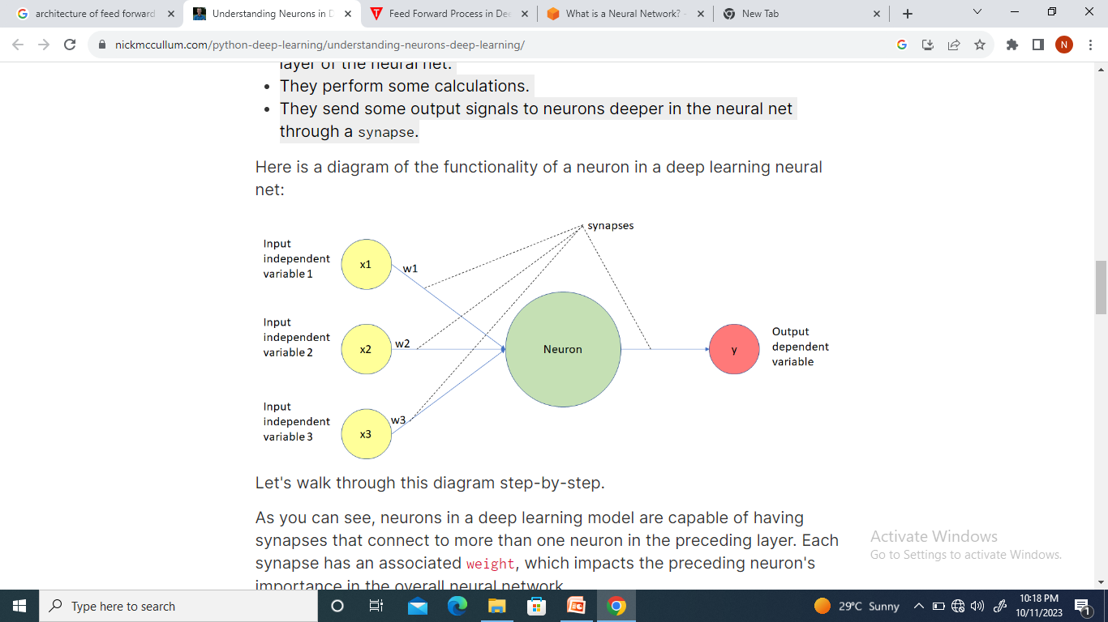
Functionality of a neuron in a deep learning neural net

Slide 5
Inspiration of neural networks
The human brain is the inspiration behind neural network architecture. Human brain cells, called neurons, form a complex, highly interconnected network and send electrical signals to each other to help humans process information.
Similarly, an artificial neural network is made of artificial neurons that work together to solve a problem. Artificial neurons are software modules, called nodes, and artificial neural networks are software programs or algorithms that, at their core, use computing systems to solve mathematical calculations.

Slide 6
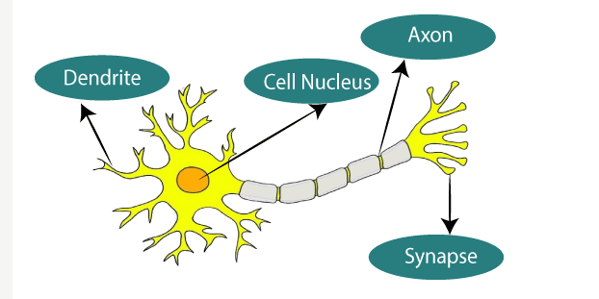
Typical diagram of biological neural network

Slide 7

NN comparison with ANN

Slide 8
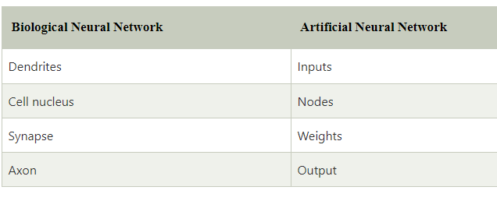
Dendrites from Biological Neural Network represent inputs in Artificial Neural Networks, cell nucleus represents Nodes, synapse represents Weights, and Axon represents Output.

Slide 9
Applications
Neural networks are widely used in a variety of applications, including image recognition, predictive modeling and natural language processing (NLP).
Examples of significant commercial applications since 2000 include handwriting recognition for check processing, speech-to-text transcription, oil exploration data analysis, weather prediction and facial recognition.

Slide 10
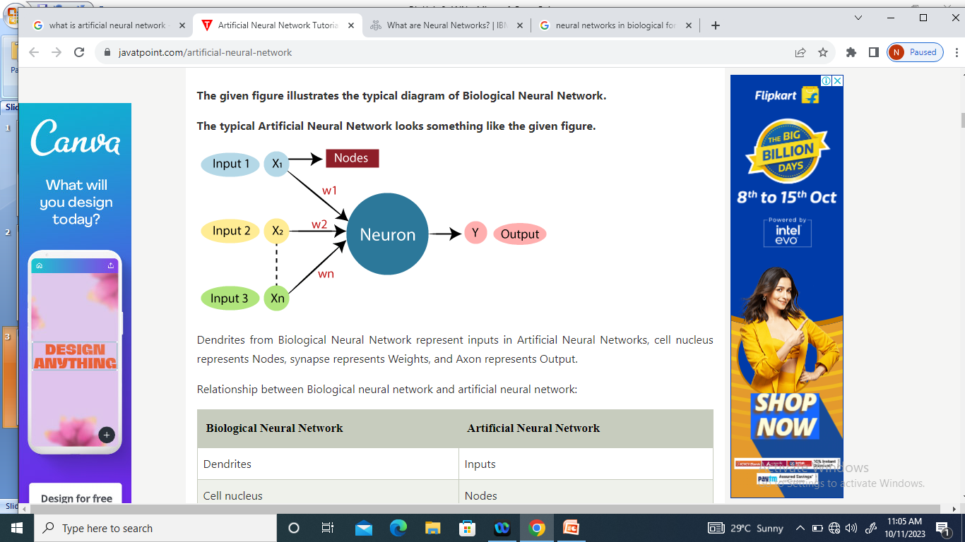
Typical Artificial Neural Network

Slide 11
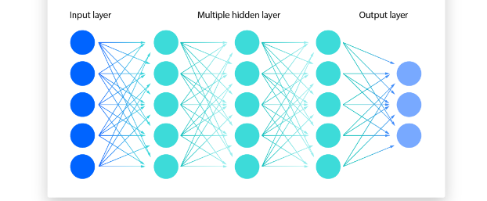
Architecture of Neural Network

Slide 12
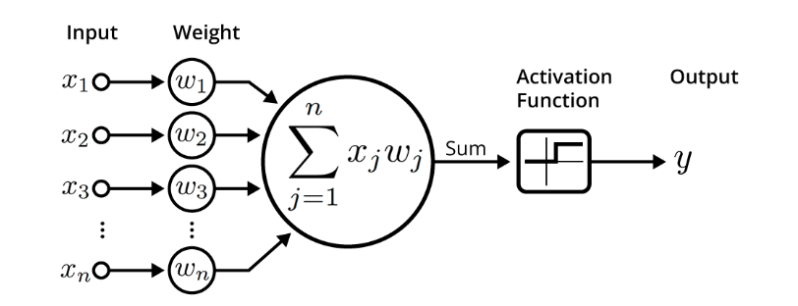
An illustration of neural network

Slide 13
Learning rule
Learning is the most important aspect of an ANN model. There are mainly two types of learning, viz., supervised and unsupervised learning.
The desired output of the ANN model is known in the case of supervised learning, but on the other hand, the desired output is unknown in unsupervised learning.
Learning rule is an algorithm that helps in improving the network performance. Various learning rules have been developed to train or update the weights

Slide 14
Types of learning rules
(a) Hebbian learning rule
(b)Perceptron learning rule
(c)Delta learning rule
(d)Outstar learning rule
(e)Correlation learning rule

Slide 15
Perceptron learning
Perceptron learning is introduced by Frank Rosenblatt in 1957
Perceptron is a linear Machine Learning algorithm used for supervised learning for various binary classifiers.
It is the simplest type of feedforward neural network, consisting of a single layer of input nodes that are fully connected to a layer of output nodes.

Slide 16
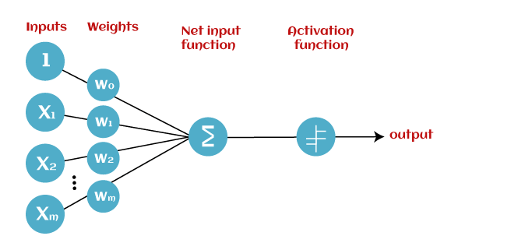
Architecture of Perceptron Learning

Slide 17
Types of Perceptron
Single-Layer Perceptron: This type of perceptron is limited to learning linearly separable patterns. effective for tasks where the data can be divided into distinct categories through a straight line.
Multilayer Perceptron: Multilayer perceptrons possess enhanced processing capabilities as they consist of two or more layers, adept at handling more complex patterns and relationships within the data.

Slide 18
Basic Components of Perceptron
The architecture of perceptron learning consists of four parameters.
1. Inputs: these are values which are given to perceptron neurons. If we are having 4 inputs then we also have four nodes.
2. Weights and Bias: Values between inputs and net inputs (output function). It takes the values of 0 and 1

Slide 19
3. Net input function: This will be calculated by multiplying inputs and weights with bias.
Yin= x1w1+x2w2+…+xnwn+b
4. Activation function: Activation function will tell whether neuron will fire (or) not fire. In this learning we are using Step activation function

Slide 20
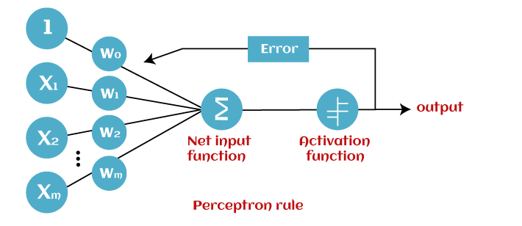
Perceptron Learning

Slide 21
Feed forward neural network
Feed forward neural network
Perceptron learning method
Weights and activation functions
Problem on feed forward(MP)
Test and training data

Slide 22
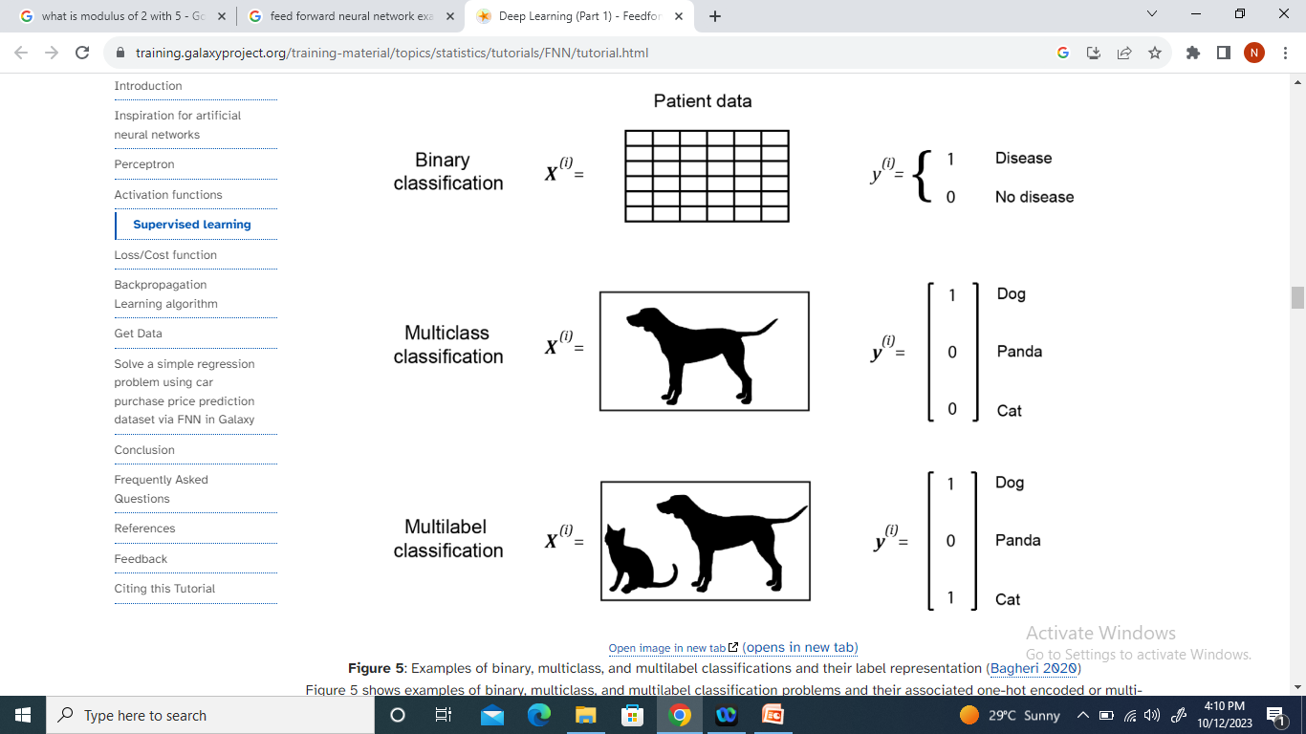
Classification of data

Slide 23
Back propagation
Back propagation is a widely used algorithm for training feed forward neural networks. It computes the gradient of the loss function with respect to the network weights.
It is very efficient, directly computing the gradient concerning each weight.
This efficiency makes it possible to use gradient methods to train multi-layer networks and update weights to minimize loss; variants such as gradient descent or stochastic gradient descent are often used.

Slide 24
Loss function
A loss function is a mathematical function that quantifies the difference between predicted and actual values in a machine learning model.

Slide 25
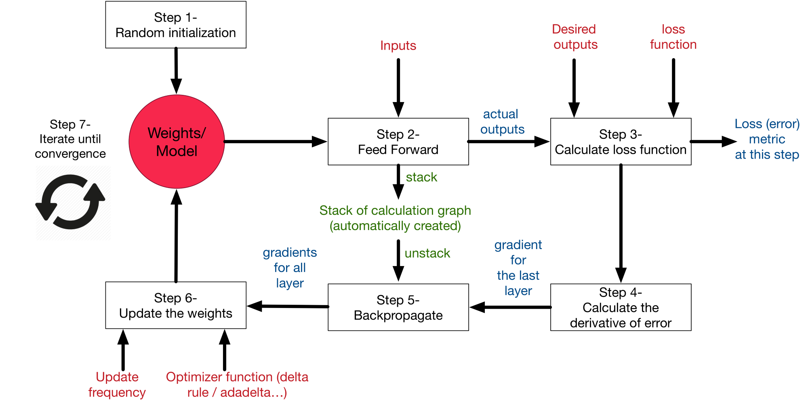
Back Propagation Flow chart

Slide 26
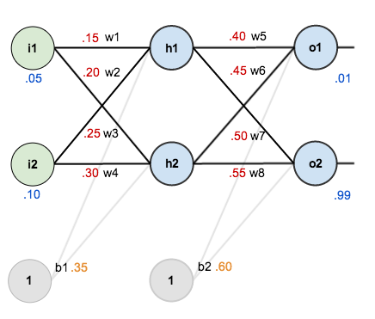
Example of back propagation with weights and activation function

Slide 27
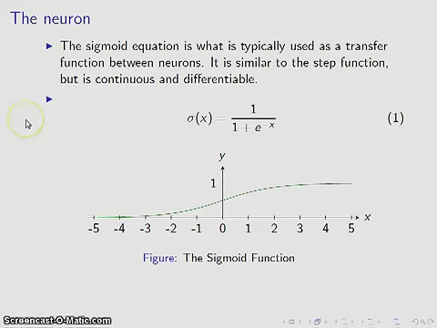

Slide 28
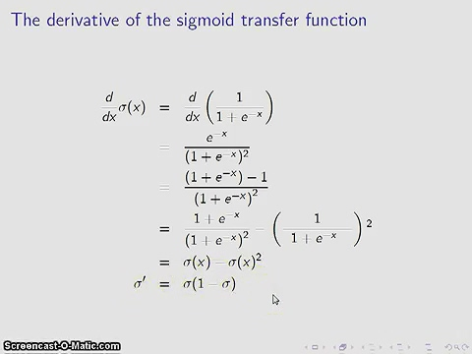

Slide 29
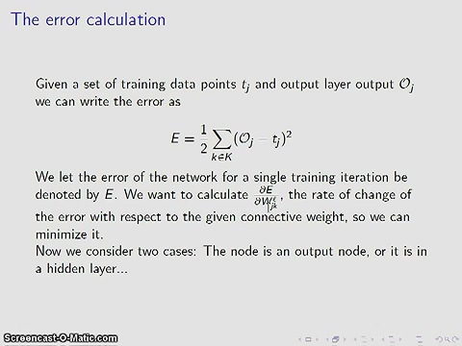

Slide 30
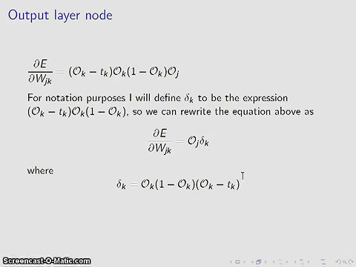

Slide 31
Features of Back Propagation:
It is the gradient descent method as used in the case of simple perceptron network with the differentiable unit.
It is different from other networks in respect to the process by which the weights are calculated during the learning period of the network.

Slide 32
Back propagation Algorithm:
Step 1: Inputs X, arrive through the pre connected path.
Step 2: The input is modeled using true weights W. Weights are usually chosen randomly.
Step 3: Calculate the output of each neuron from the input layer to the hidden layer to the output layer.
Step 4: Calculate the error in the outputs

Slide 33
Back propagation Error = Actual Output – Desired Output
Step 5: From the output layer, go back to the hidden layer to adjust the weights to reduce the error.
Step 6: Repeat the process until the desired output is achieved

Slide 34
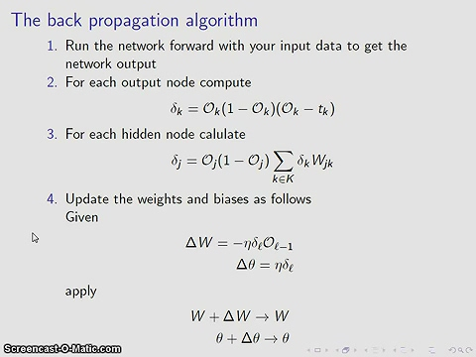

Slide 35
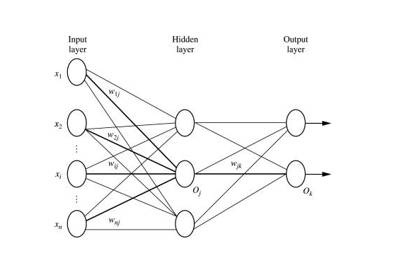
Back propagation with activation function

Slide 36
Parameters :
x = inputs training vector x=(x₁,x₂,…………x_{n}).
t = target vector t=(t₁,t_{2……………}t_{n).}
δ_{k} = error at output unit.
δ_{j} = error at hidden layer.
α = learning rate.
V_{0j} = bias of hidden unit j.

Slide 37
Training Algorithm :
Step 1: Initialize weight to small random values.
Step 2: While the steps stopping condition is to be false do step 3 and perform back propagation
Step 3: For each training pair do step (Feed-Forward).
Step 4: Each input unit receives the signal unit and transmits the signal x_{i} signal to all the units.
Step 5 : Each hidden unit Zj (z=1 to a) sums its weighted input signal to calculate its net input

Slide 38
Back propagation problem
Assume x1=0.05 and x2=0.10 with b1=0.35 and b2=0.6 and the target values t1=0.01, t2=0.99 with activation function as sigmoid function.

Slide 39
Pros
It is simple, fast, and easy to program.
Only numbers of the input are tuned, not any other parameter.
It is Flexible and efficient.
No need for users to learn any special functions.

Slide 40
Cons
It is sensitive to noisy data and irregularities. Noisy data can lead to inaccurate results.
Performance is highly dependent on input data.
Spending too much time training.
The matrix-based approach is preferred over a mini-batch.

Slide 41
Genetic algorithm
Genetic algorithm is a heuristic search algorithm that inspired by Charles Darwin’s theory of natural evolution.
This algorithm reflects the process of natural selection where the fittest individuals are selected for reproduction in order to produce offspring of the next generation.
Genetic algorithm are being widely used in different real-world applications, for example, Image processing, Designing electronic circuits, code-breaking and artificial creativity.

Slide 42

Genetic algorithm

Slide 43
There are five phases in Genetic algorithm
Initialization
Fitness Assignment
Selection
Crossover (Reproduction)
Termination

Slide 44
Initial population
The process begins with a set of individuals which is called a population.
Each individual is a solution to the problem you want to solve known as chromosome.
An individual is characterized by a set of parameters(variables) known as Genes.
Genes are joined into a string to form a chromosome(solution).

Slide 45
Fitness function
The fitness function determines how fit an individual is? (the ability of an individual to compete with other individuals)
It gives a fitness score to each individual.
The probability that an individual will be selected for reproduction is based on its fitness score.

Slide 46
Selection
The idea of selection phase is to select the fittest individual and let them pass their genes to the next generation.
Two pairs of individuals (parents) are selected based on their fitness scores.
Individuals with high fitness have more chance to be selected for reproduction.

Slide 47
There are 3 types of selection methods available , which are :
1. Roulette wheel selection
2. Tournament selection
3. Rank – based selection

Slide 48
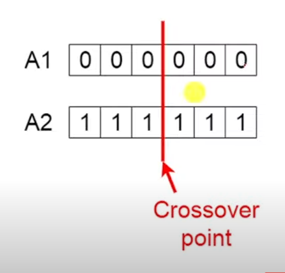
Crossover
Crossover is the most significant phase in a genetic algorithm.
For each pair of parents to be mated, a crossover point is chosen at random from within the genes.
For example, consider the crossover point to be 3 as shown.

Slide 49
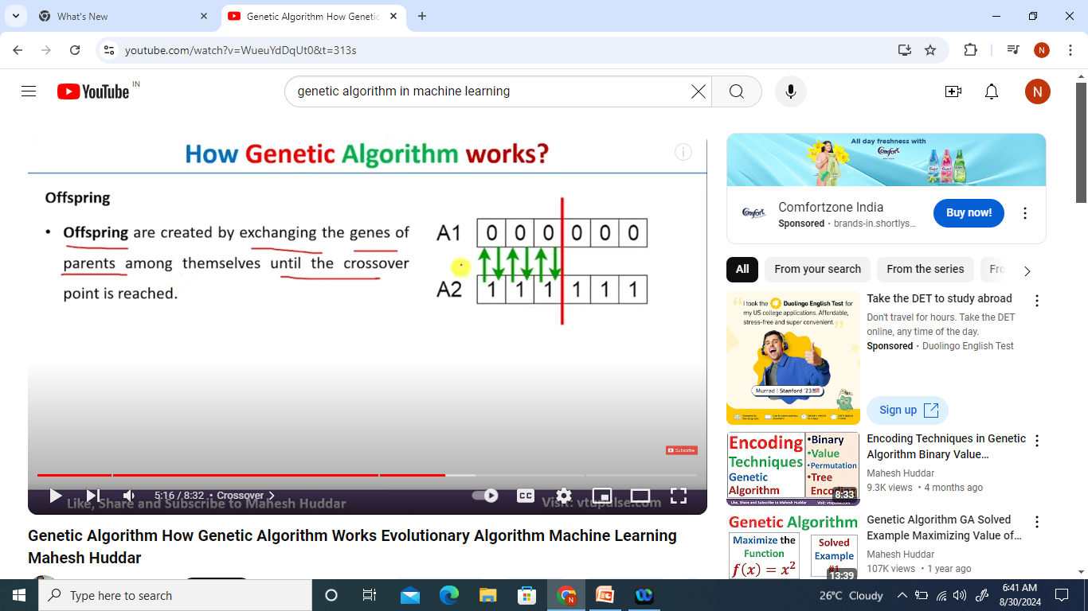

Offspring:
Offspring are created by exchanging the genes of parents among themselves until the crossover point is reached.
The new offspring is added to the population.

Slide 50
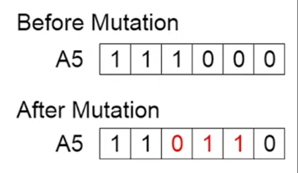
Mutation: In certain new offspring formed, some of their genes can be subjected to a mutation with a low random probability.
This implies that some of the bits in the bit string can be flipped.

Slide 51
Types of mutation:
Flip bit mutation
Gaussian mutation
Exchange/Swap mutation

Slide 52
Termination
The algorithm terminates if the population has converged (does not produce offspring which are significantly different from the previous generation).
Then it is said that the genetic algorithm has provided a set of solutions to our problem.

Slide 53
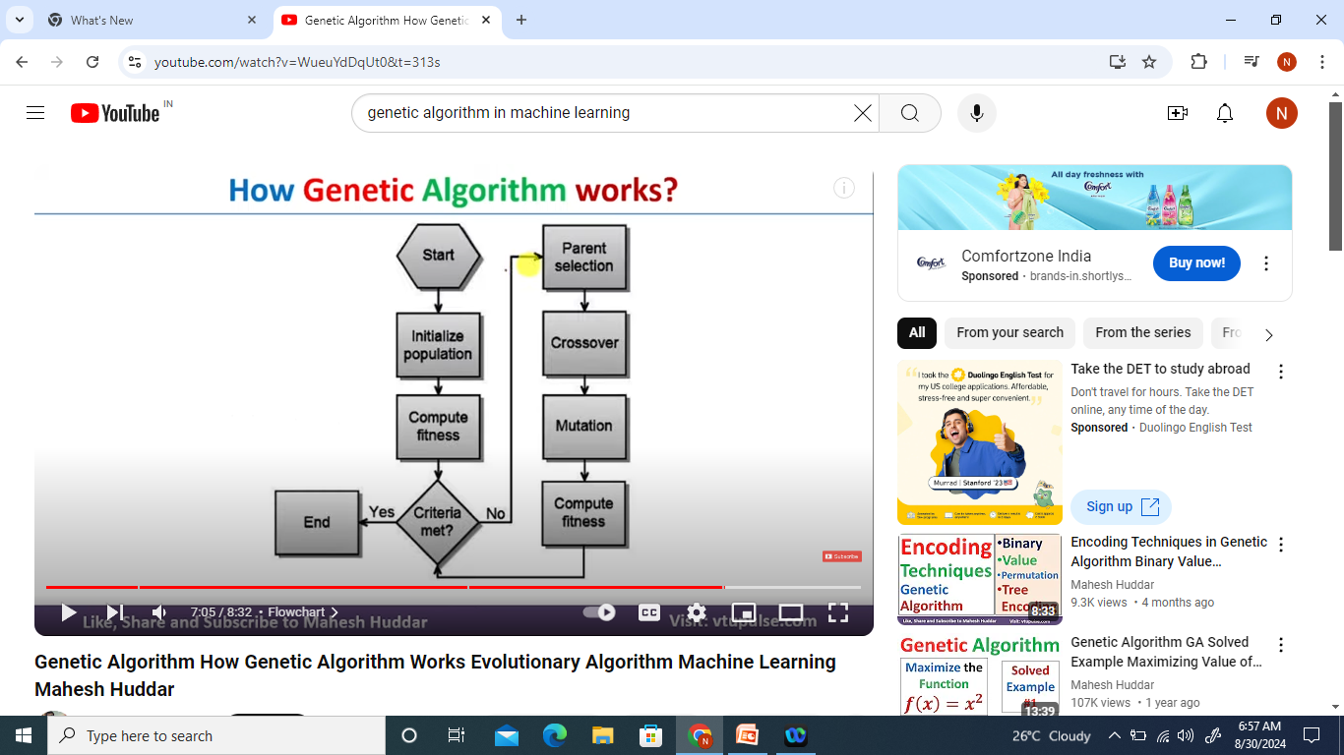
Flow chart

Slide 54
Problem
Maximize the function f(x)=x^2 with x as interval [0,31]

